Slide 1
Language Detection and Summarization for Multilingual Content
SPOORTHI JS 21BAI1064
NIMALAVARSHAN S 21BAI1039
RAKSHITH SRIDHAR 21BAI1017

Slide 2
Table of contents
01
02
03
04
05
06
Introduction
Importance
Literature review
Datasets
Conclusion
Flowchart

Slide 3
01
INTRODUCTION

Slide 4
IDEA
The increasing volume of multilingual content online, from social media posts to news articles, has created a demand for tools that can manage and process information across different languages efficiently. This project proposes the creation of a language detection and summarization system that automatically identifies the language of a given text and generates accurate summaries in that language. The system would utilize advanced NLP algorithms, such as deep learning models for language detection and transformer-based models like BERT or GPT for summarization. The goal is to support users in quickly understanding key information from multilingual sources, regardless of their linguistic background.

Slide 5
INTRODUCTION
In an era where digital content is produced in numerous languages, the ability to quickly and accurately interpret information across linguistic boundaries is vital. Traditional methods of summarization and language detection often require manual effort or separate tools, which can be time-consuming and inefficient. Our project aims to simplify this process by creating an integrated system that can both detect the language of a given text and summarize its content in that same language. By leveraging cutting-edge NLP techniques, this system will facilitate faster information retrieval and comprehension for users interacting with multilingual content, making it an invaluable tool for global communication and knowledge sharing.

Slide 6
02
IMPORTANCE

Slide 7
In a globally connected world, people are exposed to vast amounts of information in multiple languages. For businesses, researchers, and individuals, the ability to understand and distill information quickly, regardless of the language, is crucial. A system that can automatically detect languages and generate summaries plays a vital role in breaking down language barriers, promoting inclusivity, and ensuring that critical information is accessible to a wider audience. This is particularly important in contexts such as international news, social media analysis, customer feedback from global markets, and multilingual research data. By streamlining the process of understanding content across languages, this system enhances productivity, enables informed decision-making, and fosters better cross-cultural communication.

Slide 8
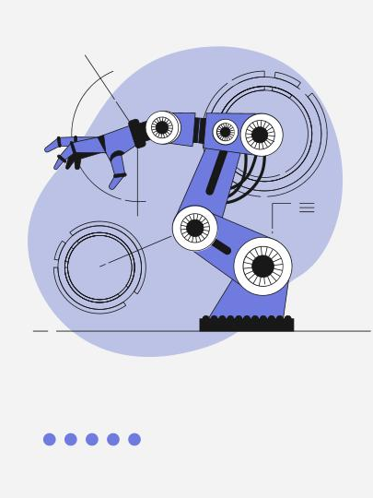
03
LITERATURE REVIEW (challenges and trends)

Slide 9
LANGUAGE DETECTION
As language models evolve, detection methods struggle to keep pace, leading to a technological arms race. This necessitates a focus on ethical guidelines rather than solely on detection capabilities.
TRENDS IN LANGUAGE DETECTION
AI-Generated Text: The rise of large language models (LLMs) has complicated the detection of AI-generated content, with existing tools often proving unreliable due to rapid advancements in AI writing capabilities.
Toxic Language Detection: The increasing prevalence of toxic communication online has spurred the development of automated detection systems. However, these systems face challenges due to the nuanced and context-dependent nature of toxic language.

Slide 10
CHALLENGES IN LANGUAGE DETECTION
Technical Limitations:
Current detection methods often rely on explicit markers (e.g., slurs), which may not capture the full spectrum of toxic language, leading to high false-negative rates(Singh et al. 2024)(Zhou et al. 2021).
Code-Switching Issues:
In spoken language diarization, detecting language changes in code-switched speech remains difficult due to overlapping features, resulting in poor identification rates(Mishra & Prasanna 2023)("Challenges in spoken language diarization in code-switched scenario", 2023).While advancements in language detection are promising, the challenges underscore the need for continuous improvement and ethical considerations in the development of these technologies..

Slide 11
TEXT SUMMARISATION
Text summarization techniques are evolving rapidly, driven by advancements in natural language processing (NLP) and the increasing volume of digital content. Current trends highlight the shift towards deep learning models, particularly transformer-based architectures, which enhance both extractive and abstractive summarization methods. However, challenges such as semantic drift, coherence, and domain-specific knowledge persist.
Current Trends in Summarization Techniques
Deep Learning Models: The rise of transformer-based models, such as BERT, has significantly improved abstractive summarization, allowing for better semantic understanding and context capture(Kaushik et al. 2024)(Chaudhari et al. 2024).

Slide 12
Personalization and Multilingualism: There is a growing focus on developing personalized summarization systems that cater to user preferences and support multiple languages(Bhattacharyya et al. 2023).
Integration of External Knowledge: Future directions include incorporating external knowledge sources to enhance summarization accuracy and relevance(Kaushik et al. 2024).
Challenges in Summarization
Semantic Drift: Maintaining semantic integrity across diverse documents remains a significant hurdle(Supriyono et al. 2024).
Coherence and Accuracy: Ensuring that generated summaries are coherent and accurately reflect the source material is an ongoing challenge(Bhattacharyya et al. 2023).
Evaluation Metrics: The need for robust evaluation metrics to assess summarization quality is critical, as current methods may not fully capture the effectiveness of summarization systems(Chaudhari et al. 2024).

Slide 13
DATASETS
04

Slide 14
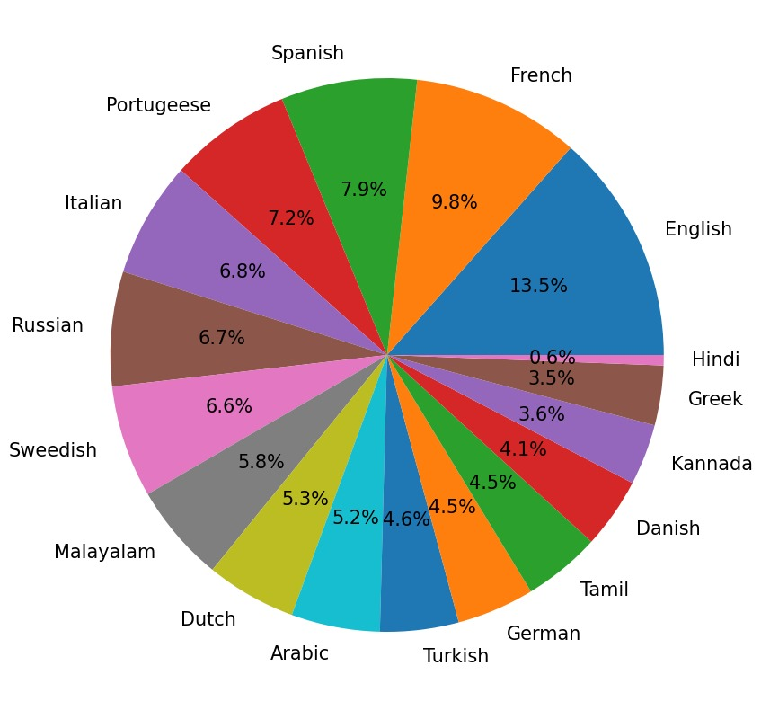
LANGUAGE DETECTION:-
This dataset consists of text details for 17 different languages
1) English 2) Malayalam 3) Hindi 4) Tamil 5) Kannada 6) French 7) Spanish 8) Portuguese 9) Italian 10) Russian 11) Swedish 12) Dutch 13) Arabic 14) Turkish 15) German 16) Danish 17) Greek

Slide 15
Summarisation
Corpus
Open parallel corpus
C4 (tensorflow)

Slide 16
FLOWCHARTS
05

Slide 17
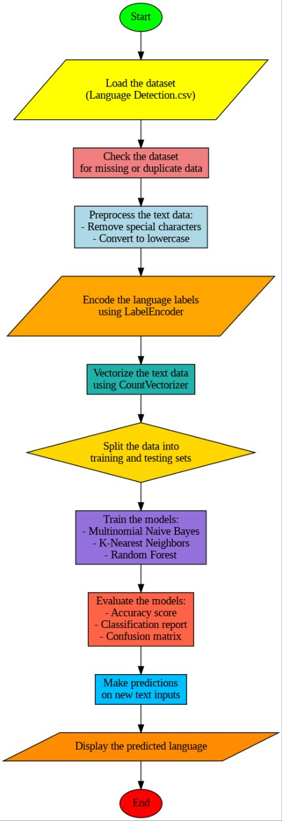
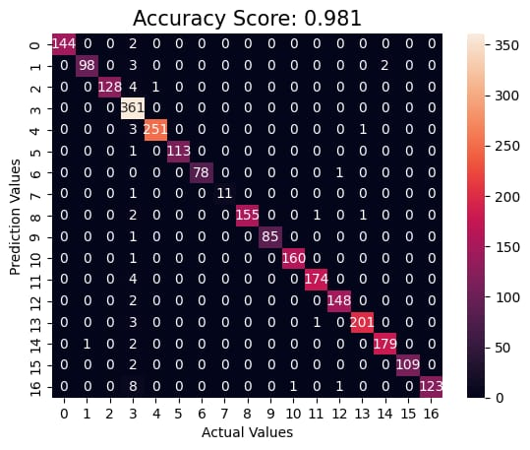
Flowchart of language detection
Multinomial naive bayes is best for prediction

Slide 18
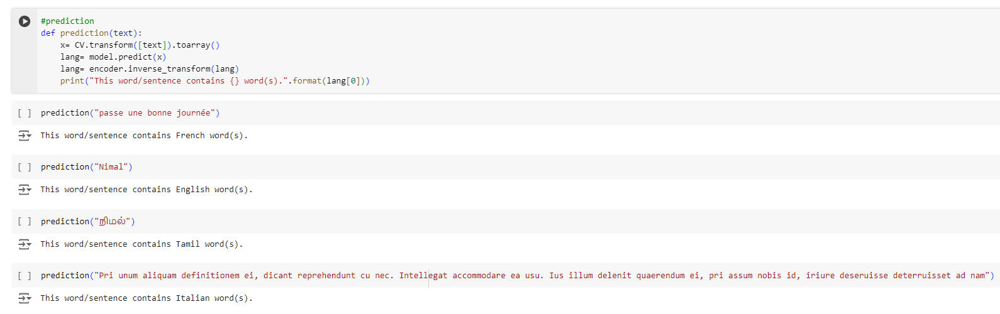
OUTPUT

Slide 19
ThankYou!

