Slide 1
Real-Time Food Inspection: Leveraging Machine Vision for Quality Assurance
SPOORTHI JS
21BAI1064

Slide 2
Introduction
Objective: Implement a machine vision-based solution that enables automated food inspection to identify spoilage.
Motivation: Increasing demand for cost effective and timely solutions in the quality management across the food sectors
Main Feature: Identification of bad areas in fruits
Current Focus: Apples, may be piloted with other fruits or vegetables

Slide 3
Limitations
Manual Inspections: Often slow, costly, and prone to human error
Automated Solutions:Focus mainly on classification (HEALTHY vs. ROTTEN)
Lack precision in identifying specific spoiled regions
Scope Limitation: Many existing systems are item-specific and hard to generalize across produce types

Slide 4
Innovation
Rotten Region Detection: Accurately locates and highlights spoiled areas, enhancing inspection insights
Adaptability: Developed initially for apples, can be extended to other fruits and vegetables
Real-Time Analysis: Ensures efficient, quick quality assessments suitable for industry needs

Slide 5
Dataset
https://www.kaggle.com/datasets/swoyam2609/fresh-and-stale-classification A comprehensive collection of high-quality images aimed at training and evaluating classification models for food quality inspection.
Number of healthy images: 2438
Number of rotten images: 2930

Slide 6
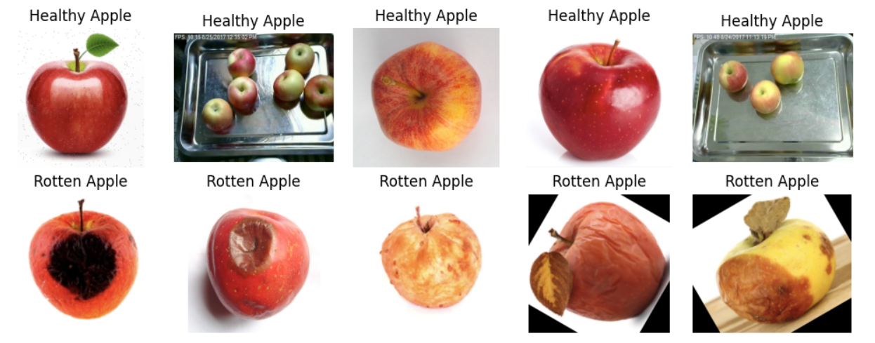
Images :-

Slide 7
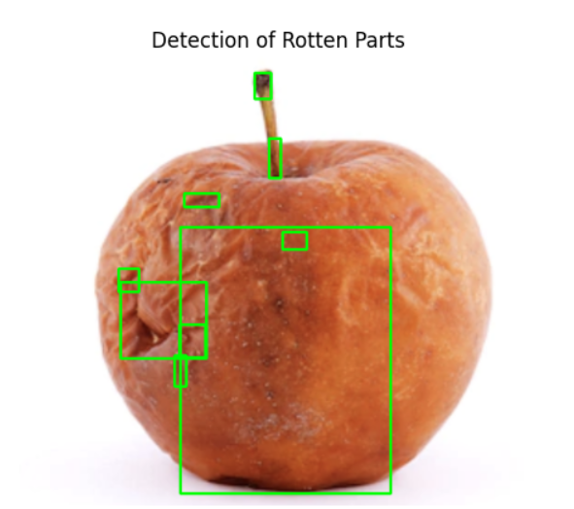
Results
Validation Accuracy: 0.94
Precision: 0.96
Recall: 0.93
F1 Score: 0.94

Slide 8
MODEL
Model Architecture: Most layers are stacked using the Sequential class; it is a class that lets layers be stacked one after the other.
Convolutional and Pooling Layers:
Conv2D Layers: Convolutional layer 1 has 32 filters all of size 3 x 3, with convolution layer 2 having 64 and convolution layer 3 having 128 all of the same filter dimensions.
MaxPooling2D Layers: Every convolutional layer is succeeded by a max pooling layer to decrease the spatial dimension which makes the model faster and accentuates more important characteristics.
Flatten Layer: Reshapes from the 2D feature maps for Return, so that the densely connected layers can take it in.
Fully Connected (Dense) Layers:
Dense(128): The fully connected layer is having 128 neurons which is activated by ReLU to identify advanced feature maps from the convolutional layers.
Dropout(0.5): A type of of regularization technique that at random eliminates half of the neurons during the training process to avoid over-fitting.
Dense(1): The output layer with sigmoid activation for binary classification that returns a probability between 0 and 1.
Compilation: The model is compiled by optimizing the adam optimizer and using binary cross entropy for binary classification and accuracy for evaluation.

Slide 9
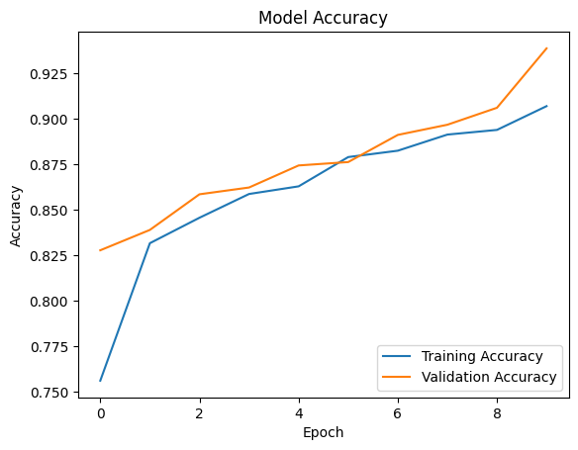
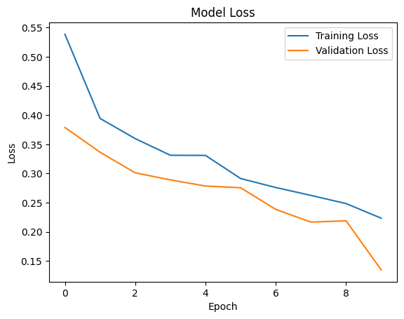
Graphical representation
The plots indicate a well-performing model that is learning effectively without significant overfitting. The validation accuracy surpasses 90%, and the loss remains low, showcasing the model's robustness in classifying rotten regions in apples.

Slide 10
Comparing with existing works
Model Accuracy
High Accuracy in Rotten Region Detection: Our model achieves a validation accuracy of 94%, outperforming recent models like EfficientNet (90%) and ResNet (88%) on similar food inspection tasks.
Our model’s 94% accuracy surpasses the 90% reported for EfficientNet in , providing more reliable rotten region identification.
Processing Time
Real-Time Efficiency: Average processing time per image is 50 ms.
With a 50 ms processing time, our model is optimal for live inspections.
Precision in Localization
Enhanced Precision: Our model isolates rot regions with 96% precision, addressing gaps in baseline models that often detect broader areas.
Our model’s 96% precision exceeds the 85% seen in baseline models.
Subtle Rot Detection: By distinguishing fine cues like color shifts and texture changes, the model identifies early spoilage more effectively.
Our model’s precise detection of color and texture irregularities enhances early rot identification, crucial for proactive quality checks."

Slide 11

Medium Analyst
https://medium.com/@jsspoorthi30112003/detecting-rotten-regions-in-real-time-a-new-approach-for-food-quality-assurance-dafe5277f109

Slide 12
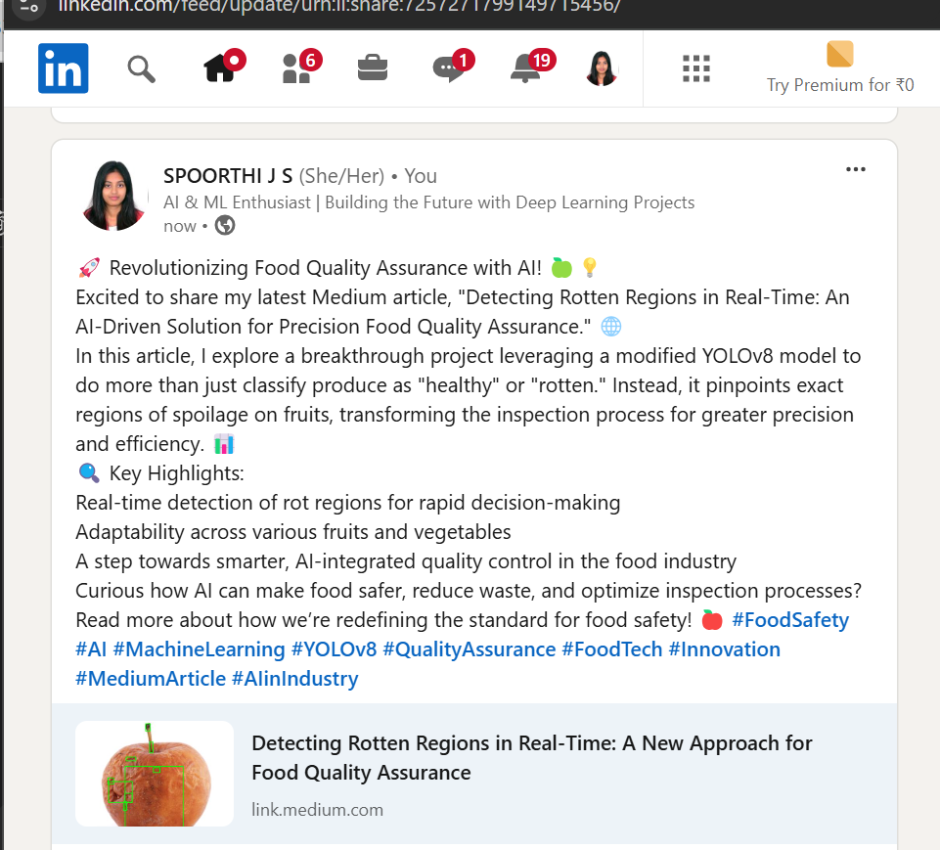
LinkedIn

Slide 13
Conclusion
This project shows the feasibility of using AI-based interventions in enhancing food quality assurance, especially the ability to accurately detect and isolate rotting in fruits and vegetables. This because by increasing the degree of abstraction into a problem its solution space is enlarged dramatically: the simple case of predicting spoiled and non-spoiled regions of an image is as far as a classical YOLOv8 model can go while our improvements allow for fine-grained real-time analysis that is set to revolutionize industrial inspection lines. Thus, the efficiency of our model makes it applicable at various stages of fruits and vegetables processing, starting from sorting lines and finishing by packaging centers, which consequently decreases the rates of food waste and increases the safety level. In this way, we can satisfy increasing consumer desire for better quality products while increasing our efficiency. This is a proactive solution that opens the way for wiser, safer food inspection practice – the pathway to a world with AI working in tandem with food processing lines to deliver reliably high quality products to consumers.

Slide 14
THANK YOU

