Slide 1
WEATHER FORECASTING
The weather forecasting techniques are continously being improved by the Data Science and Machine learning techniques.
The parameters like demand, capacity, budgets, and revenue are predicted by the Machine learning techniques like Time series forecasting.
Time series data is the kind of data collected over a period of time.

Slide 2
Machine learning is the segment of Computer Science where algorithms learn from data.
Artificial Neural Networks, Deep learning, Association rules, Bayesian Networks are the algorithms associated with Machine learning.
Machine Learning is associated with Statistics

Slide 3
The fundamental problem of Machine learning is to make prediction based on known data.
This is called supervised learning.
The Neural networks are techniques which performs better than the Time Series techniques.
The main issues which are encountered in Machine learning are Overfitting and Underfitting.
Time series techniques are good at decomposing data into different elements.

Slide 4
Researchers have started using the Machine learning techniques, a subfield of Artificial Intelligence to predict Weather forecasting than the traditional forecasting techniques.
Machine learning is giving a hope to solve many Weather puzzles.
In the traditional methods, Climatologists and meteorologists are using the data collected to make forecasts.

Slide 5
In recent times, the large computing systems are used to analyze large data sets.
The Weather patterns were assessed using the past data, which is called a data centric approach.
The Deep neural networks is widely being used in improving the accuracy of weather predictions and Speech recognition.

Slide 6
Researchers have used airplanes as wind sensors to make more
accurate weather predictions.
The Deep neural networks, Statistics and predictive models
combine to form a hybrid model for Weather predictions.
The predictive models are trained with the data to make
predictions about the elements of Weather such as
Atmospheric pressure, Temperature, Dewpoint and winds.

Slide 7
Researches are coming up with Hybrid models to make
Spatiotemporal inferences about Weather.
The weather forecasting in recent times include the ARIMA
models, Artificial neural networks and Support vector
machines.
The weather model is governed by three principles which are
Temporal mining, Spatial Interpolation and Inter-Variable
Interaction’s.

Slide 8
The study of the reccuring Weather pattern’s is called Temporal mining.
The Hybrid model formed for Weather prediction’s uses the phenomenon known as turbulence.
The atmospheric instability resulting from storm leading to unpredictable air movements is known as turbulence.

Slide 9
The weather predictions are made by Machine learning
algorithms using Network measures.
Researches are employing Machine learning algorithms such
as Artificial neural networks and symbolic regression with
Genetic programming.
Machine learning does automatic recognition of patterns
from data.

Slide 10
The Machine learning tasks are formulated by building
Statistical models and functional models.
Supervised learning, Unsupervised learning and Reinforcement learning are the three different kinds of algorithms in Machine learning.
Machine learning has also been very affective in the Solar energy prediction.

Slide 11
The road weather information is used to ensure safe driving
conditions.
The study of the current Weather conditions, sky conditions is called Weather forecasting
The Weather and Climate of the earth is monitored by the Weather satellite.
The meteorological satellite’s see beyond the cloud cover.

Slide 12
Sand and Dust storms, energy flows, snow cover are the information collected by the Weather satellites.
The combination of computer models and observations help in the Weather forecasting.
When the water starts to condense at a particular temperature, it is called dew point

Slide 13
The use of Science and Technology to predict the
condition of the atmosphere is known as Weather Forecasting.
The weather Forecasting has formally started since
the nineteenth century.
The quantitative data is collected and by the scientific understanding of the processes, Weather Forecasting is done.

Slide 14
Earlier the Weather predictions were based upon barometric
pressure, sky condition, but now Weather forecasting
relies mainly on the computer models.
The inaccuracy of Weather forecasting is due to massive computational power required and the nature of the atmosphere.
Weather forecasting are important as they protect life and property.

Slide 15
Agriculture depends on the Weather forecasts based on Temperature and Precipitation.
The daily Weather forecasts help people with the necessary precautions to be taken.
The term Weather forecast was coined in the year 1859, when the weather predictions formally started.
By understanding the physics of the atmosphere , the modern predictions had started.

Slide 16
The basics of the Weather prediction is that fluid
dynamics and thermodynamics are used to find out the state of the fluid at some time in the future.
The areas where traditional data sources are not available, data from the weather satellites is used.
The computer program which predicts the state of the atmosphere for future times is known as a
Weather model.

Slide 17
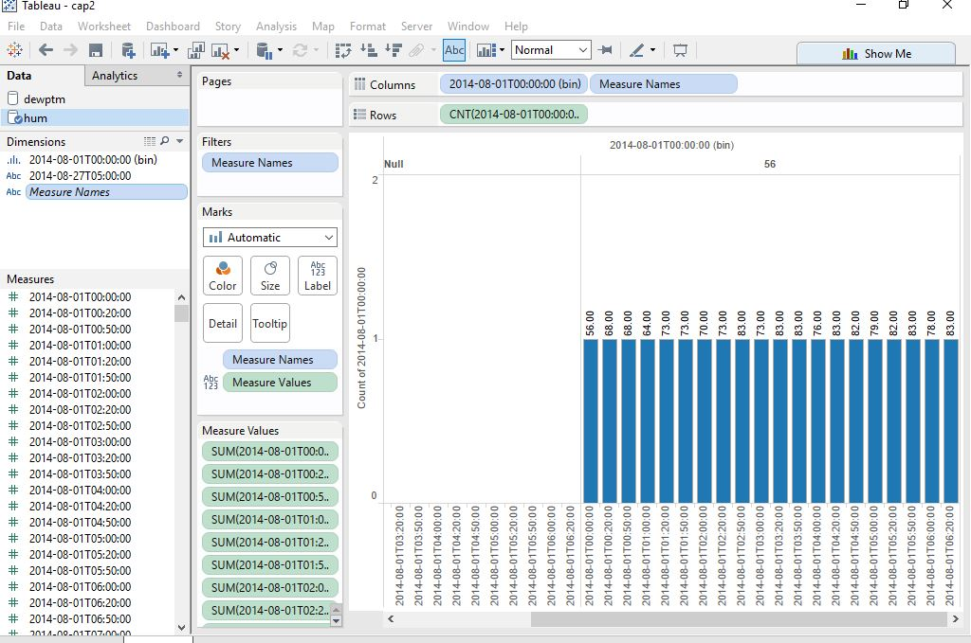

Slide 18
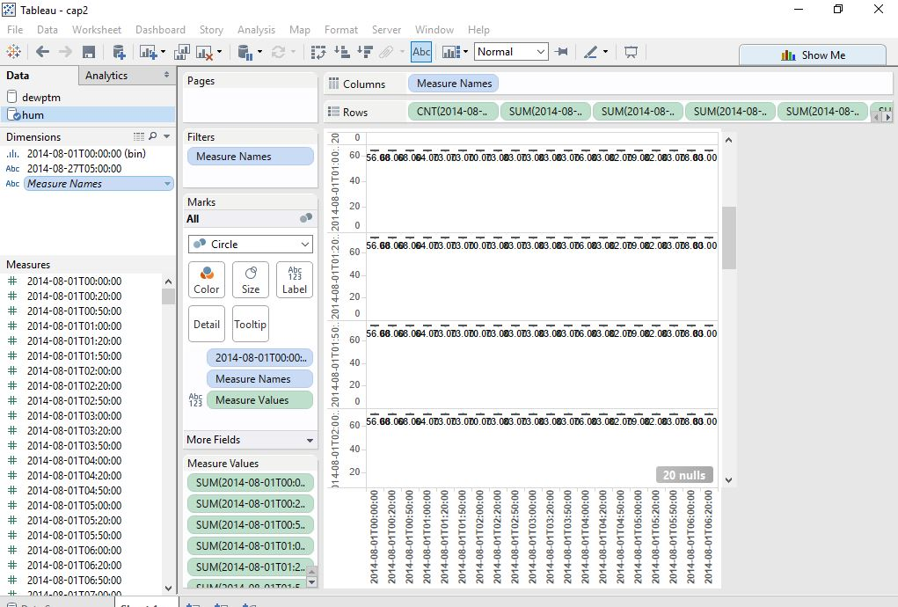

Slide 19
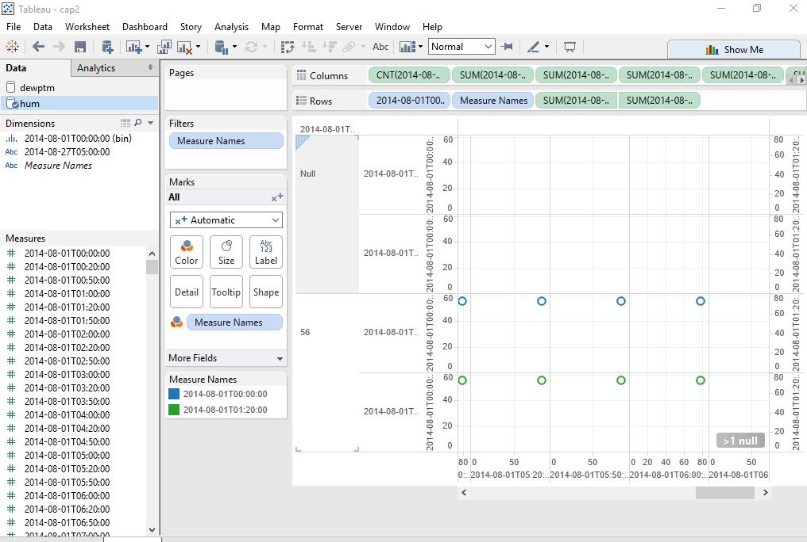

Slide 20
REFERENCES:
https://arnesund.com/2015/05/31/using-amazon-machine-learning-to-predict-the-weather/
http://research.microsoft.com/en-us/um/people/horvitz/weather_hybrid_representation.pdf
Software used for Visuals: Tableau

