Slide 1

BOOK MY SHOW/LIVE EVENTS
DYNAMIC PRICING STUDY
BY-SHAMSHIKA,SPOORTHI,UDAY SRI

Slide 2

INTRODUCTION
Dynamic pricing in live events is a modern strategy where ticket
prices change based on demand, timing, and availability.
Platforms like BookMyShow use data analytics and market
insights to optimize revenue and customer satisfaction.
This study connects Economics, Business Environment, and
Python to explore how technology drives smarter pricing
decisions in the Indian entertainment industry.

Slide 3
MOTIVATION
Why this project?
Ticket prices fluctuate dynamically — understanding elasticity helps
predict demand.
Businesses use data analytics to optimize revenue and customer
satisfaction.
BookMyShow’s model reflects modern market behavior and digital
transformation.
Visual:

Slide 4

CINEMA TICKETS

Slide 5
OBJECTIVE
Apply demand & supply analysis to ticket pricing.
Use Porter’s Five Forces to study competitive positioning.
Employ Python (Matplotlib & Plotly) for interactive dashboards.
Integrate insights into a yield-management model.
Visual:

Slide 6

ICONS OF ECONOMICS, BUSINEES AND PYTHON

Slide 7
ECONOMICS
Topic: Demand & Supply Analysis with Elasticity.
Application:
Study how ticket demand changes with price/time.
Estimate elasticity for different show timings.
Predict outcomes under taxes, subsidies, or regulations.
Justification: Helps optimize pricing and predict consumer
response.
Visual:

Slide 8
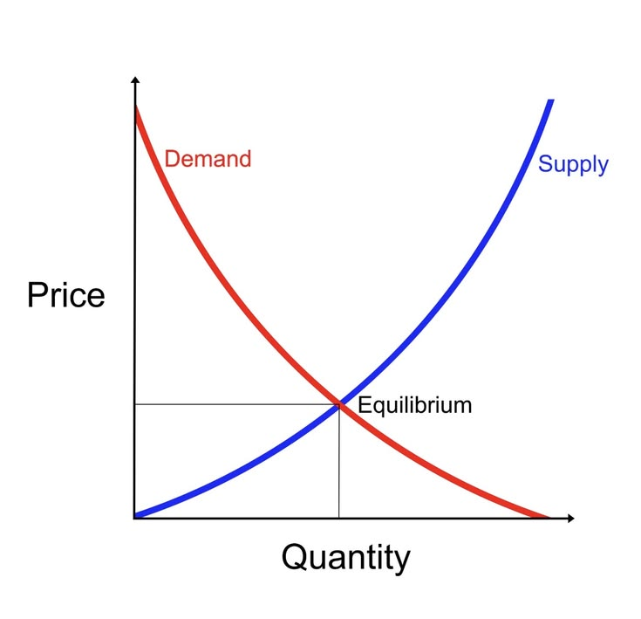

Slide 9
BUSINESS ENVIRONMENT
Topic: Porter’s Five Forces — Indian Entertainment Industry.
Application:
Analyse competition (OTT platforms, local events).
Assess supplier power (venues, artists).
Evaluate buyer power (audience preferences).
Justification: Explains scarcity and loss-aversion-driven booking
behavior.
Visual:

Slide 10
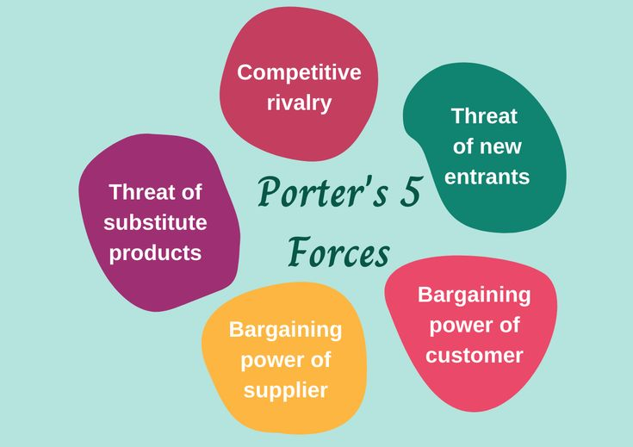

Slide 11
PYTHON
Topic: Matplotlib & Plotly Visualizations.
Application:
Create dashboards showing ticket demand vs. time, venue
capacity, and surge pricing.
Interactive charts for yield management and marginal cost
analysis.
Justification: Enables data-driven decision-making and real-time
insights.
Visual:

Slide 12
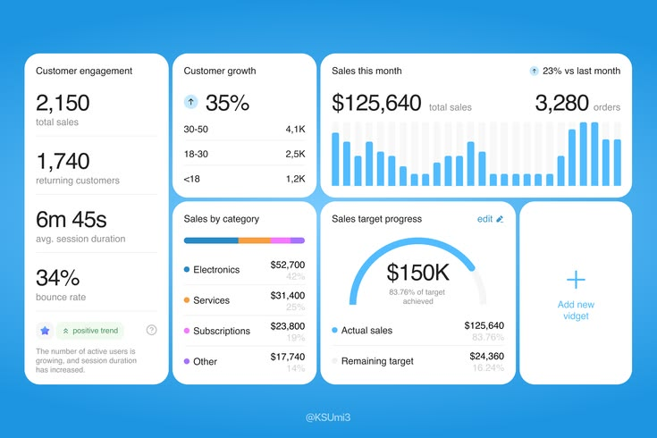

Slide 13
PROJECT APPROACH/METHODOLOGY
Steps:
Data Collection: Ticket sales, show timings, venue capacity.
Data Cleaning: Remove duplicates, handle missing values.
Data Analysis: Elasticity, competitive forces, surge pricing.
Visualization: Interactive dashboards using Python.
Findings & Report: Insights on dynamic pricing and consumer
behavior.
Visual:

Slide 14
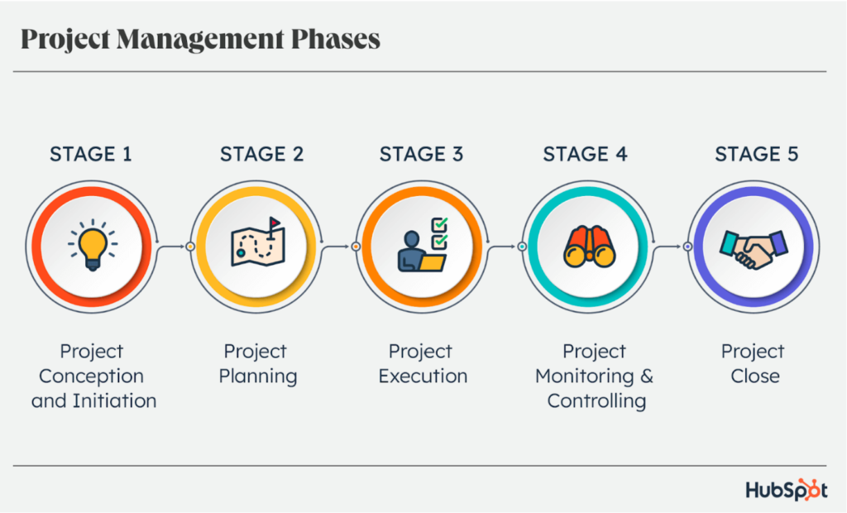

Slide 15
CONCLUSION
Dynamic pricing in live events, as seen in BookMyShow,
demonstrates how economics, Business Strategy, and
technology converge to optimize ticket sales.
By applying Elasticity Analysis , Porter’s Five Force,
And Python Visualization , this study shows how data‑driven
insights can balance profitability with customer satisfaction.
The project highlights the importance of integrated approaches
in shaping smarter pricing models for India’s entertainment
industry.

Slide 16


