Slide 1
PREDICTING CRISPR SCREEN Z-SCORES USING EPIGENETIC PROFILES, TF BINDING DATA, AND MOTIF SCORES USING MACHINE LEARNING.
GROUP_3
SUBMITTED BY:
Alisha (MT23240)
Harnoor (MT23229)
Neha (MT24305)
Riya (MT23235)
Spoorthy (MT24228)

Slide 2
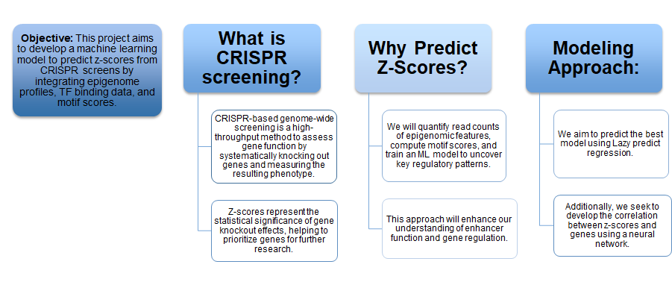
INTRODUCTION TO CRISPR SCREENING

Slide 3
METHODOLOGY
1. Data Collection – Gather CRISPR screen data, epigenomic profiles, and transcription factor (TF) binding datasets across multiple cell lines.
2. Data Preprocessing – Clean and normalize raw data, handle missing values, and ensure consistency across different datasets.
5. Lazy Predict Regressor – Used an automated model benchmarking tool to quickly test multiple regression models for baseline comparisons.
6. Model Optimization – Fine-tune hyperparameters and select the best-performing machine learning model for predicting CRISPR Z-scores.
7. Feature Importance Evaluation – Determine which mutations and sequence based features contribute most to enhancer activity and gene regulation.
8. Model Evaluation & Validation – Assess model performance using evaluation metrics like R² and RMSE to ensure reliability.
3. Exploratory Data Analysis (EDA) – Identify patterns, correlations, and distributions within the data across Z_scores to gain initial insights.
4. Embedding Generation – Biobart was used to generate embeddings corresponding to hg19 sequences.

Slide 4
DATA COLLECTION
We do have three different files to work on.
File 01- combined_enh_pro_4col_sorted.bed, the file likely contains enhancer-promoter mappings or annotated genomic regions where:
Each row corresponds to a genomic region (enhancer or promoter).
The region is defined by the chromosome, start, and end positions.
The associated gene or non-coding RNA (e.g., MIR1302-2HG, FAM138A) is listed in the last column.
File 02 - peakscores_hg19.csv, have z score value of mutations
File 03 - enhancer_curated_CRISPR_hg19.txt, in the file each row represents an enhancer region identified or curated from CRISPR screening datasets. These are regions believed to regulate gene expression and were experimentally perturbed to study their function. Chromosomes include autosomal (chr21) and sex chromosomes (chrX).
Final_dataset – Enhancer_Zscore_Peakscore.csv
Epigenomic Profile Data (chemical modifications that affect gene activity)
Prediction Factors
TF Binding Data (How TF interact with DNA?)
Motif Score data (patterns in DNA that predict where TF will bind)

Slide 5
DATA PREPARATION
Combined File 01 and 03 and then they were intersected with file 02.
Z_score data before generating embedding:
The dataset Enhancers_zscores_peakscores contains 45,481 sequences and 1,007 columns (features), indicating that each sample is described by 1,007 z-score or peak score features related to enhancers.
Z_score data along with embedding generated using Biobart:
The dataset embeddings.csv contains 45,481 sequences, each encoded as a 1,775-dimensional numerical vector representing its features.
Following the subtraction of the enhancer z-score features from the embedding features, the number of columns of embedding features are 768 (1,775 − 1,007).

Slide 6
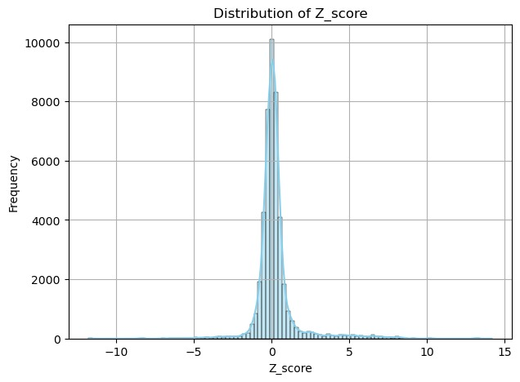
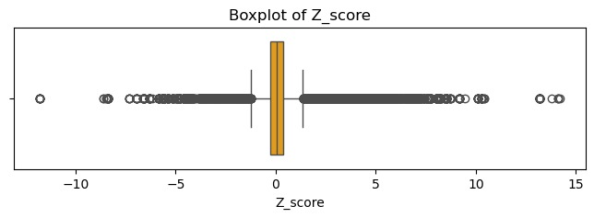
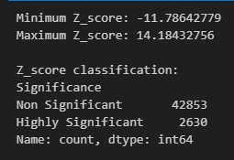
EDA: Exploratory Data Analysis
The histogram of Z-scores demonstrates a normal distribution with a few outliers is shown by the Z-score distribution's strong peak and symmetry around 0.
Z_score >= 2.0 is “Highly Significant” & Z_score < 2.0 is “Non-Significant”.
2. Boxplot of Z-score: The analysis revealed that the dataset exhibits a consistent distribution with no outliers present, ensuring robust and reliable model training.
3. The Z_score value for 42853 sequences is less than 2.0 while the Z_score for 2630 sequences is more than 2.0
Histogram of Z-scores
Boxplot of Z-scores

Slide 7
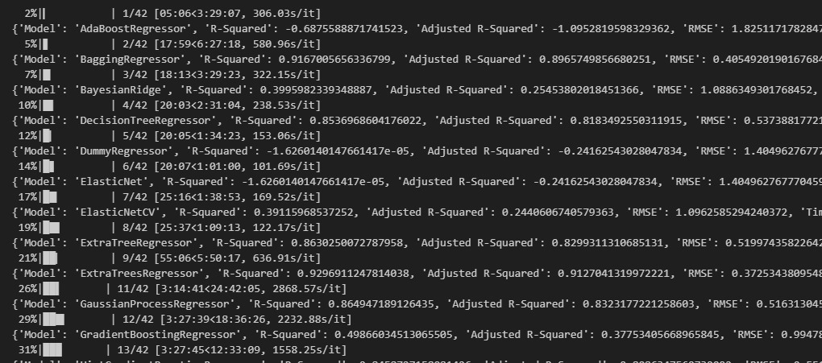
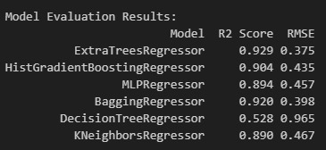
MODEL DEVELOPMENT
LAZY PREDICT: is an automated machine learning (AutoML) tool that quickly tests and compares multiple ML models with minimal code. Identified top regression models (Z-score target).
Based on the evaluation results, the top 6 models with fine-tuned hyperparameters are: ExtraTreesRegressor, BaggingRegressor, HistGradientBoostingRegressor, MLPRegressor, KNeighborsRegressor, and DecisionTreeRegressor, ranked by R² score and RMSE.
Top 6 ML Model Results
Lazy Predict Regression Model Results

Slide 8
RESULTS
Model Evaluation
Model | Definition | R² Score | RMSE | Interpretation
Extra Trees Regressor | Builds trees like Random Forest but uses random split points for added randomness. | 0.929 | 0.375 | Best performance – highest accuracy and lowest error.
Bagging Regressor | Trains multiple regressors on random data subsets and averages their predictions. | 0.920 | 0.398 | Very good performance, slightly below ExtraTrees.
Hist Gradient Boosting Regressor | Boosting method that builds trees sequentially, using histogram-based binning for speed. | 0.904 | 0.435 | Strong model, good accuracy.
MLP Regressor | Uses fully connected layers to learn complex data patterns. | 0.894 | 0.457 | Neural network with decent performance, slightly behind ensemble methods.
K-Neighbors Regressor | Predicts target by averaging outputs of k nearest neighbors. | 0.890 | 0.467 | Performs reasonably well, but less accurate than ensemble methods.
Decision Tree Regressor | Recursively splits data by features to reduce prediction error. | 0.528 | 0.965 | Weakest performance, suggesting overfitting or underfitting.

Slide 9
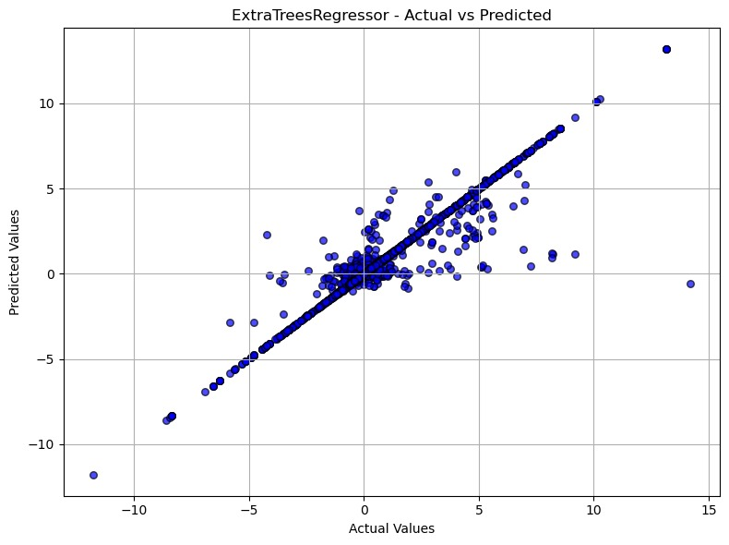
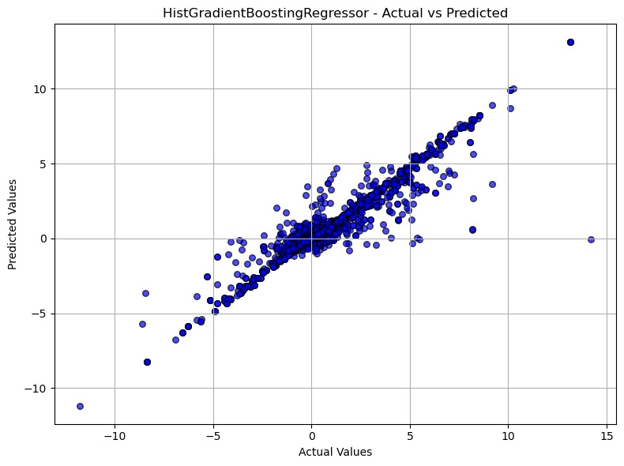
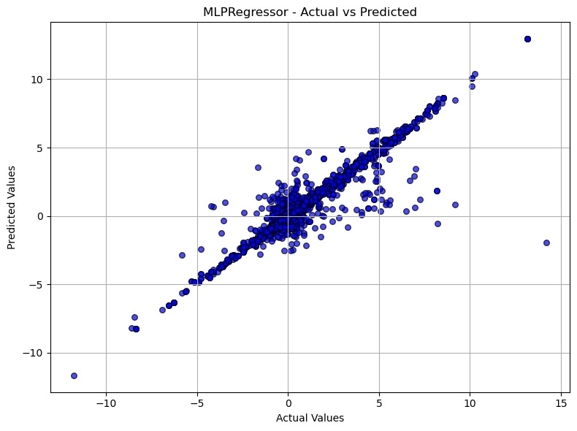

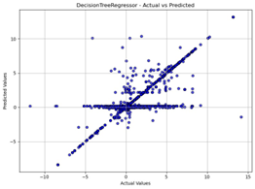
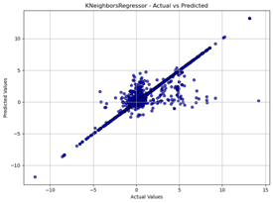
Model Visualization

Slide 10
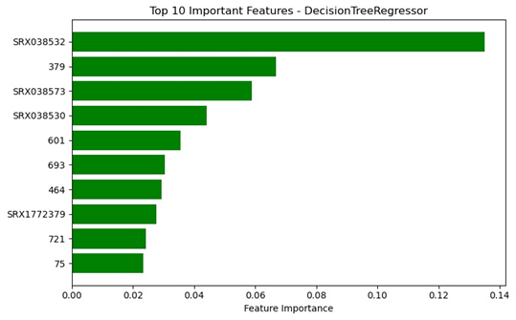
FEATURE IMPORTANCE
The feature importance graph shows that SRX038532 is the most influential feature in the DecisionTreeRegressor model, contributing about 14% to predictions. Other important features include SRX038573, SRX038530, and several numeric features. The SRX features represent mutation profiles, indicating that certain mutations strongly impact the model's output.

Slide 11
THANK YOU

