Slide 1

Elijah Cavan
William Ngana

Slide 2

Key Assumptions
Q. Which route combinations were most popular in the NFL in 2020? Of these route combinations, which perform best against each coverage type?
We assumed:
A route combination was a list of routes run on the play
Over a large enough sample, weather would play only a small part
Turnovers, TDs were less sticky then pass break ups and first downs
Receivers mainly played one position (i.e slot or out wide)
All plays are equally weighted (i.e a 10 yard gain in the 4th quarter is the same as a 10 yard game in the first - although this is handled by EPA)

Slide 3
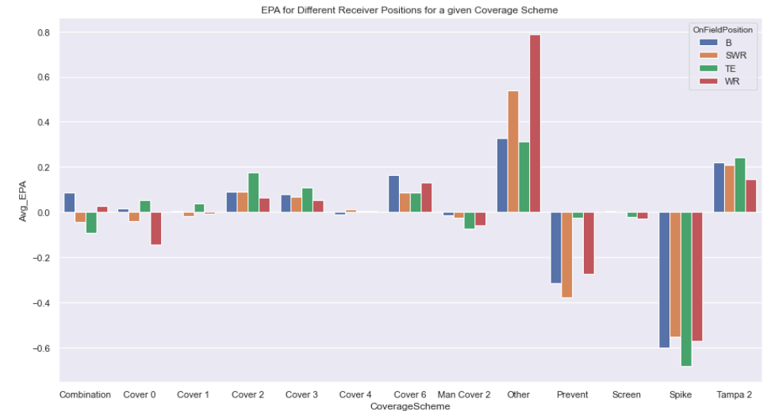
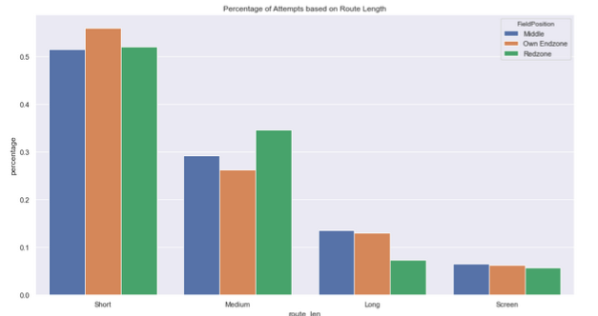
Exploratory Data Analysis (EDA)
Insights:
Slot receivers are generally better than wide outs against Tampa 2. TEs are the best receivers in general against cover 0, cover 1 & cover 2.
There is not much variation in terms of route length decisions between any part of the field

Slide 4



EDA II
These are the best routes/route combinations based by EPA. Here we are showing Cover 2 as an example.
Optimal route combination: [Go/Fly, Seam, Curl, Chip-Flat]

Slide 5
Feature Engineering
We added a variety of features to help train the ML models and draw insights from the data. In particular, we calculated results which depended solely on the Coverage Scheme. Some examples of new features we used:
Air yards
YAC (yards after the catch)
Pressure rate per Coverage Type
Pass breakups per coverage type
...Many more

Slide 6
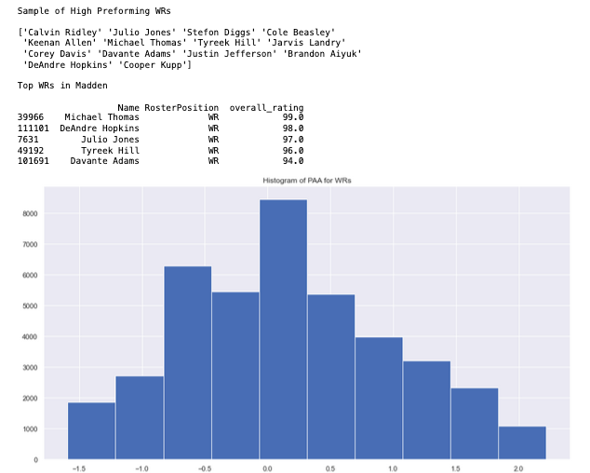
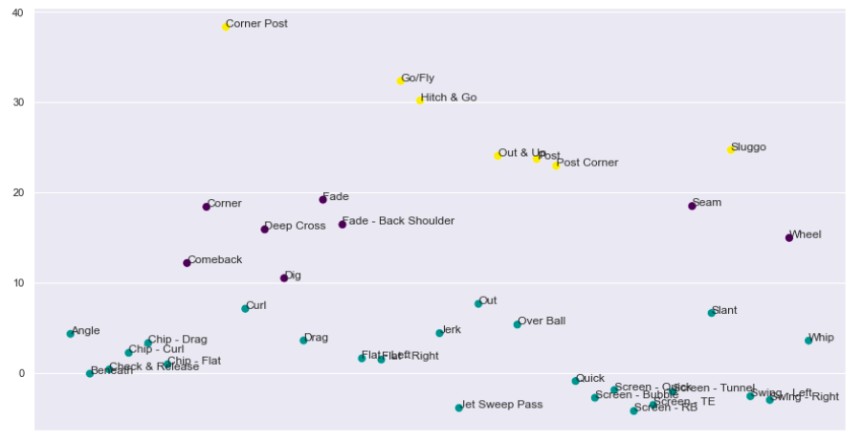
Feature Engineering II
In addition to defining new features, we also changed some of the pre existing columns. Here we are showing a scatter plot of the KMeans clusters for routes based on air yards (these are classified as Short, Medium, Long routes). As well as a histogram of Points above Average for WRs.

Slide 7
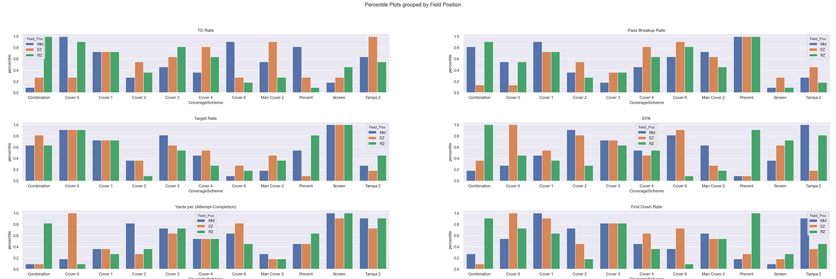
Percentile Plots
Plotting the most important features per coverage type based on percentiles relative to other coverages. Further split by Field Position (Redzone, Own Endzone, Middle of the Field)

Slide 8
Percentile Plots: Insights
We have determined that:
The cover schemes (cover 0, cover 1 for example) tend to be more steady, while schemes like Tampa 2, Combination can wildly fluctuate in effectiveness based on field position
The more DBs you have in coverage tends to limit targets; but you end up giving up high EPA plays/ many first downs
Prevent has a high pass break up rate; but also a high target rate. This tells us that game situation plays a huge role in what play schemes and coverages are run.

Slide 9
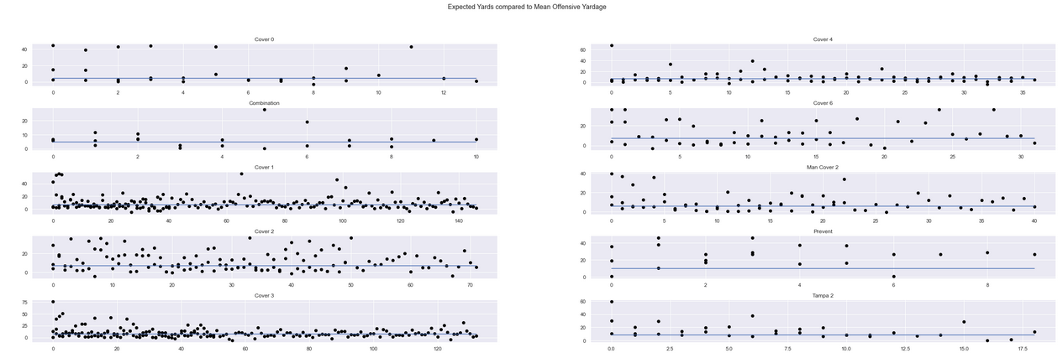
ML Model: Expected Yards
The blue line is the average Offensive Yardage for all route combinations against each coverage. The black dots are the models output for the combinations of routes that have the highest average EPA (i.e see EDA II slide)

Slide 10
Expected Yards: Insights
We have determined that:
The optimal routes are generally more effective routes than the average route that is run.
The cover schemes (eg. cover 0, cover 1) seem to give up more big plays compared to the Combination and Tampa 2 schemes
Oftentimes, even running the most optimal routes results in plays that perform below average (although we have not selected for what route was targeted)

Slide 11
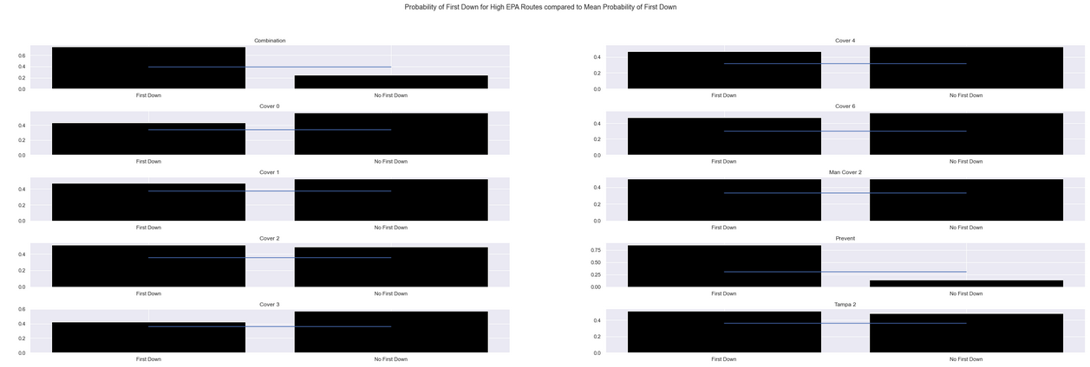
ML Model: Probability of First Down
ML model which calculates the probability of a first down based on the route being run on the play (as well as a number of other features). The plots show the probability of a first down given that an optimal route is being run, compared to the average probability for all routes.

Slide 12
Probability of First Down: Insights
We have determined that:
For every coverage scheme, running the optimal routes is more effective (obvious since they are chosen based on EPA). But for some coverages these optimal routes are more effective than for others (see EDA plot, receivers are not always the best position player to target for a given coverage).
The cover schemes (as opposed to combination schemes, Tampa 2, ect) are the most effective schemes at limiting first downs

Slide 13
The Answer to the Question
Optimal route combination against:
Cover 0: [Go/Fly, Curl, Swing-right,Deep Cross] Cover 3: [run fake, Go/fly, Seam, swing-left] Cover 6: [comeback, Go/fly, Chuck & release]
Cover 1: [Go/Fly, Deep Cross, Pick, Flat Left] Combination: [Curl, Slant, Corner] Man Cover 2: [slant, Go/fly, Post, Curl]
Cover 2: [Go/Fly, Seam, Curl, Chip-Flat] Cover 4: [curl, curl, flat-right, corner post] Prevent: [chuck & release, Go/fly, Deep Cross, Dig]
Tampa 2: [over ball, flat-right, Go/fly, curl] Screen: [corner, fade, jet sweep pass]

Slide 14
Limitations and Improvements
There are several ways we could improve this analysis. We were also limited by the data.
No tracking data (given us alternative ways to classify routes)
We did not take into account how often a receiver plays, or how a good receiver might ‘warp’ the defence
We did not take into account how running a play multiple times decreases its effectiveness
We didn’t look at different formation types (21 personnel v.s 12 personnel for example)
We did not account for the strength of a given DB and how that might affect plays run by the offense
Is a route effective or is the defense conceding the play. For example, if I get an 8 yard gain against a ‘prevent’ coverage; is this an effective play or am I doing what the defense wants me to do.

Slide 15
References: Additional Datasets Used
Madden ratings: https://maddenratings.weebly.com/
Strength indicators: https://www.pro-football-reference.com/years/2020/index.htm

Slide 16
That’s all Folks!

