Slide 1

Elijah Cavan
William Ngana

Slide 2
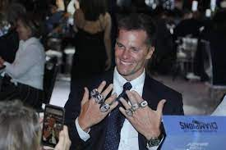
"The only sign we have in the locker room is from 'The Art Of War': Every battle is won before it is fought."
- Bill Belichick.

Slide 3
Part 1
Exploring the Data

Slide 4
Key Assumptions
Q. Which route combinations were most popular in the NFL in 2020? Of these route combinations, which perform best against each coverage type?
We assumed:
A route combination was a list of routes run on the play
Over a large enough sample, weather would play only a small part
Turnovers, TDs were less sticky then pass break ups and first downs
Receivers mainly played one position (i.e slot or out wide)
All plays are equally weighted (i.e a 10 yard gain in the 4th quarter is the same as a 10 yard game in the first - although this is handled by EPA)
A receiver is anyone who runs a route - including TEs and RBs
Removed all plays where the QB is not on the field

Slide 5
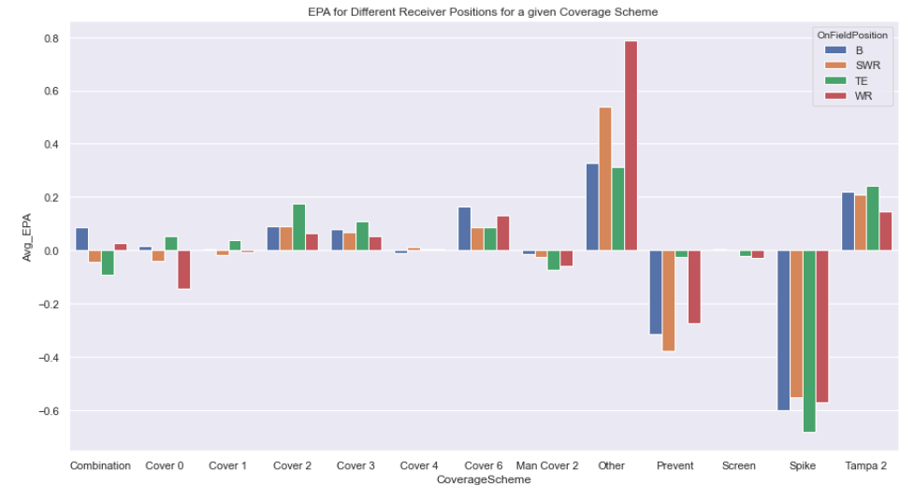
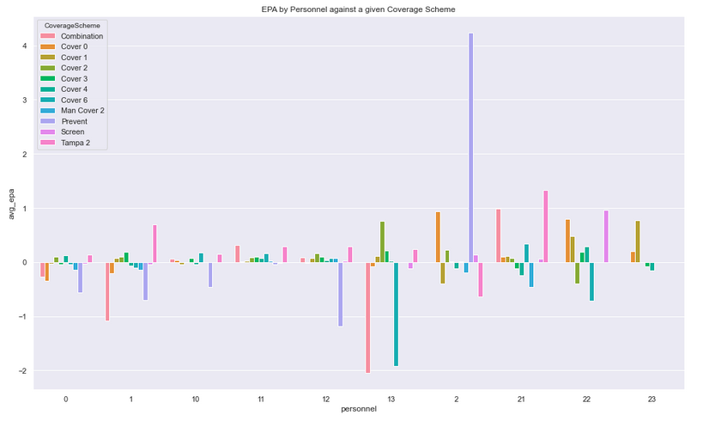
What position excels against what coverage?
Slot receivers are generally better than wide outs against Tampa 2. TEs are the best receivers in general against cover 0, cover 1 & cover 2. This makes sense since TEs are probably being covered by LBs in these schemes.
We also see how the various personnel groupings fare against a given coverage; for example 21 personnel is most efficient at the combination and tampa 2 coverages (and useless for the cover type - i.e cover 0, cover 1 coverages)

Slide 6
Part 2
Cleaning and Engineering

Slide 7
Feature Engineering
We added a variety of features to help train the ML models and draw insights from the data. In particular, we calculated results which depended solely on the Coverage Scheme. Some examples of new features we used:
Air yards
YAC (yards after the catch)
Pressure rate per Coverage Type
Pass breakups per coverage type
Receiver class (is a receiver especially good at running long routes, short routes, ect)
Route length (is a given route long or short)
Personnel groupings

Slide 8

Cleaning
Consolidated several route types into a route class (for example rb-screen and bubble-screen are credited with the ‘screen’ class)
Removed plays in which the QB is not on the field
Removed players who played less than 50 snaps
Removed the coverages ‘Spike’ and ‘Other

Slide 9
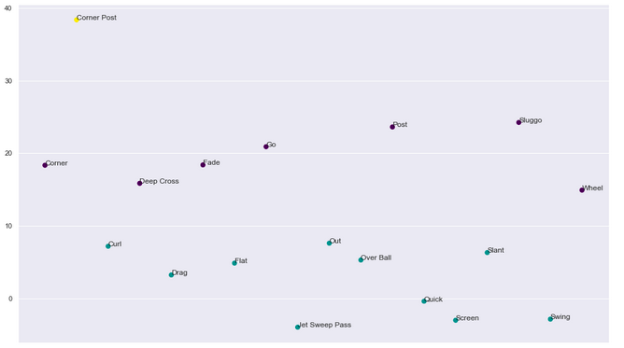
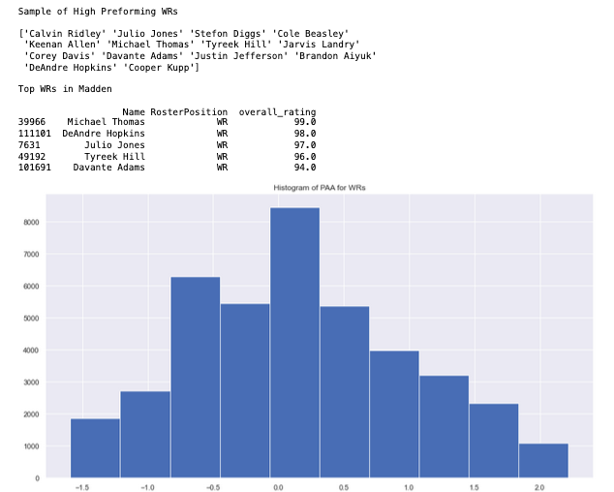
How long is that route?
In addition to defining new features, we also changed some of the pre existing columns. Here we are showing a scatter plot of the KMeans clusters for routes based on air yards (these are classified as Short, Medium, Long routes). As well as a histogram of Points above Average for WRs. This was done to simplify looking at the routes- there are less combinations if we replace the route names with the route length.

Slide 10
Part 3
Q. Part 1: What are the most Popular Routes/ Route Combinations

Slide 11
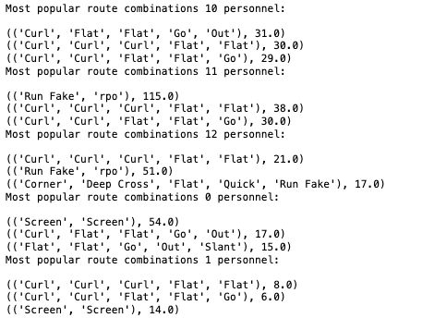
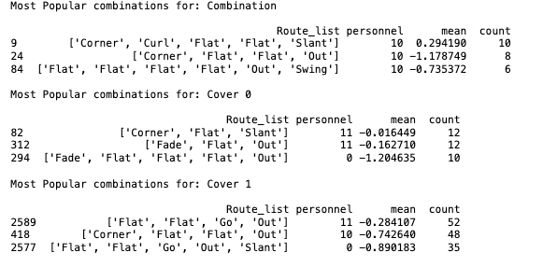
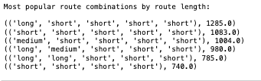
Most Popular Routes
Note: The combinations for the rest of the coverage types can be found in the notebook
Here we show the most popular route combinations by personnel groupings and by Coverage type. Notice- the most popular route combinations are not always the ones that seek to maximize EPA.

Slide 12
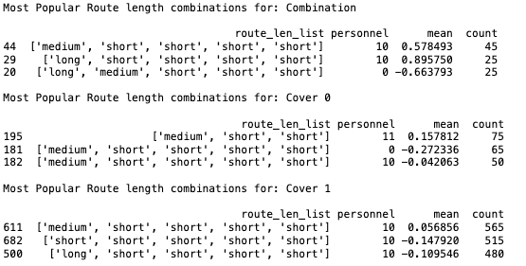
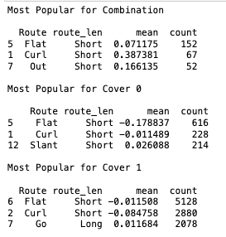
Most Popular Routes cont..

Slide 13
Part 4
Models & Analysis
Q. Part 2: Of these route combinations, which perform best against each coverage type?

Slide 14
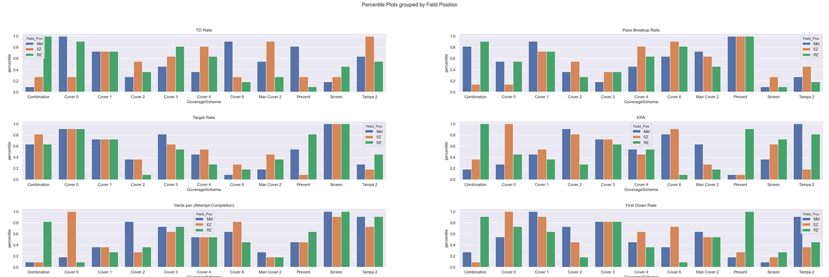
Stacking Coverage Schemes Against One-Another
Plotting the most important features per coverage type based on percentiles relative to other coverages. Further split by Field Position (Redzone, Own Endzone, Middle of the Field)

Slide 15
Percentile Plots: Insights
We have determined that:
The cover schemes (cover 0, cover 1 for example) tend to be more steady, while schemes like Tampa 2, Combination can wildly fluctuate in effectiveness based on field position
The more DBs you have in coverage tends to limit targets; but you end up giving up high EPA plays/ many first downs
Prevent has a high pass break up rate; but also a high target rate. This tells us that game situation plays a huge role in what play schemes and coverages are run.

Slide 16
ML Models: General Info
Logistic regression and random forests regression models used
Features used:
Team stats class: (ex. Point differential) allows the model to determine the difference between the two teams playing (including how good one offense is compared to the opposing defense)
Player stats (ex. Points above average) allows the model to distinguish between a good QB throwing to a good receiver v.s a bad QB throwing to a bad receiver
Cover Scheme class: coverage scheme statistics such as the average pass break ups or pressure rates for a given coverage scheme
Routes class: the route combinations and route lengths used on the play. Including if a receiver is running a ‘specialist’ route (a route the receiver is much better than the average receiver in running). Also the personnel grouping is included.

Slide 17
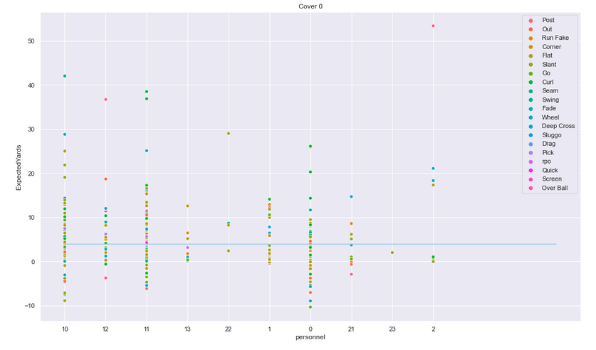
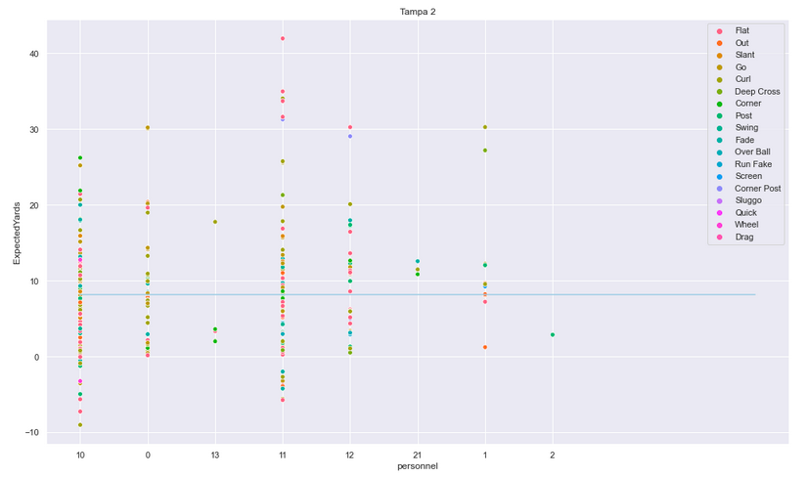
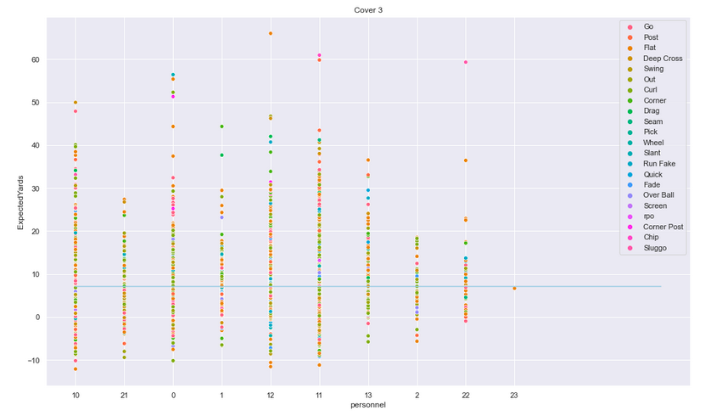
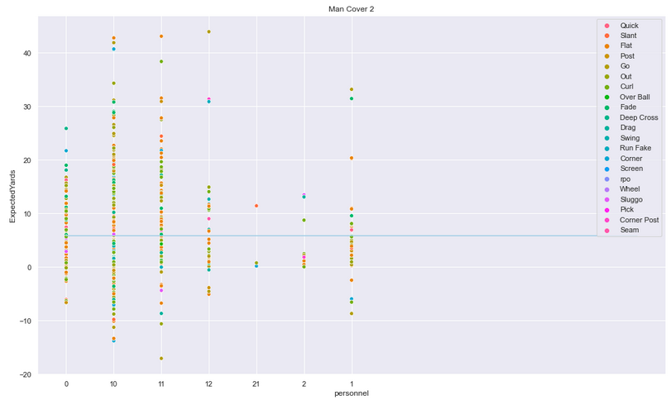
ML Model: Expected Yards (98% accuracy)

Slide 18
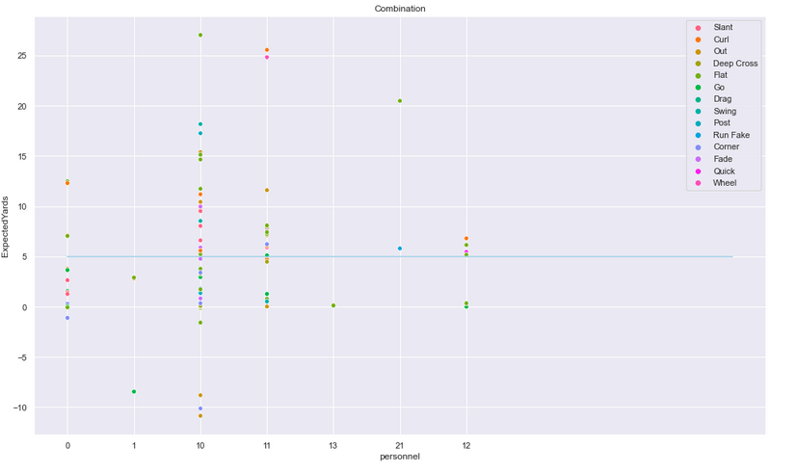
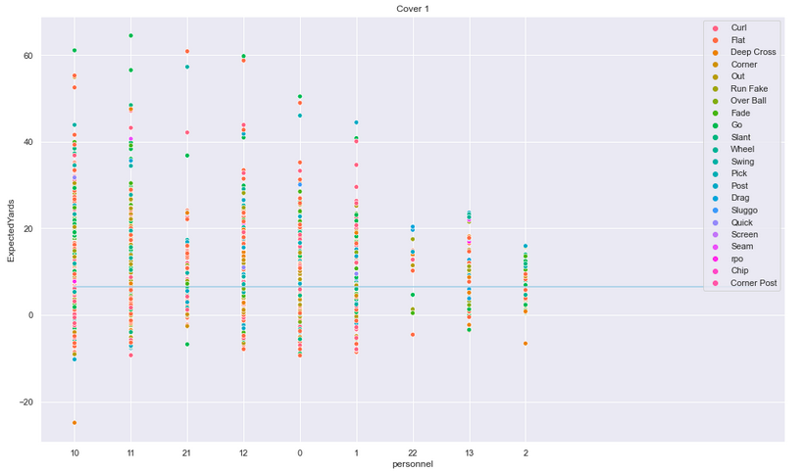
Expected Yards: Insights
The plots in the previous slide show a sample of the expected yards model (98% accuracy) versus personnel groupings and the targeted route on the play.We can draw several insights from these plots. For example: The combination scheme is least successful against 10 personnel, but does a good job versus 0, 12, 23 personnel. Routes that are effective against combination include slants, curls and flats.
Conversely, Cover 1 succeeds versus 22, 13 and 02 personnel; but is burned by 10,11,12 personnel for example. Routes that are effective against Cover 1 include Go routes, slants and flats.
The blue line represents the average offensive yardage against that coverage scheme

Slide 19
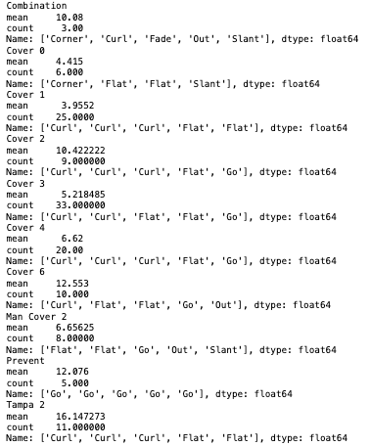
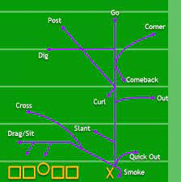
Best Route Combos by Expected Yards

Slide 20
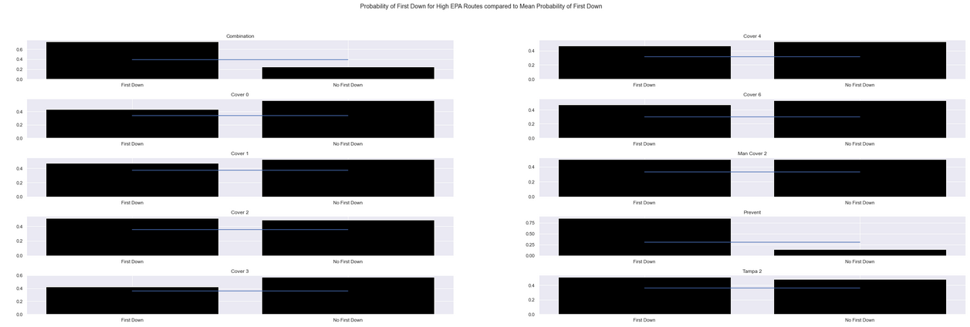
ML Model: Probability of First Down (97% accuracy)
ML model which calculates the probability of a first down based on the route being run on the play (as well as a number of other features). The plots show the probability of a first down given that an optimal route is being run, compared to the average probability for all route combinations. In part 1 we showed the most popular route combinations; the optimal routes are now the routes that maximize EPA against a given coverage. The blue line represents the probability of a first down for the average route combination.

Slide 21
Probability of First Down: Insights
We have determined that:
For every coverage scheme, running the optimal routes is more effective (obvious since they are chosen based on EPA). But for some coverages these optimal routes are more effective than for others (see EDA plot, receivers are not always the best position player to target for a given coverage).
The cover schemes (as opposed to combination schemes, Tampa 2, ect) are the most effective schemes at limiting first downs

Slide 22
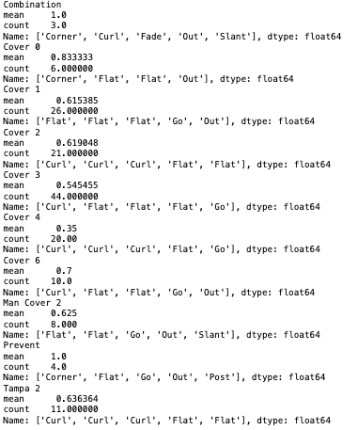
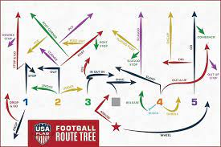
Best Route Combos by Probability of First Down

Slide 23
Limitations and Improvements
There are several ways we could improve this analysis. We were also limited by the data.
No tracking data (given us alternative ways to classify routes)
Only 1 year of data
We did not take into account how often a receiver plays, or how a good receiver might ‘warp’ the defence
We did not take into account how running a play multiple times decreases its effectiveness
We didn’t look at different formation types (21 personnel v.s 12 personnel for example)
We did not account for the strength of a given DB and how that might affect plays run by the offense
Is a route effective or is the defense conceding the play. For example, if I get an 8 yard gain against a ‘prevent’ coverage; is this an effective play or am I doing what the defense wants me to do.

Slide 24
References: Additional Datasets Used
Madden ratings: https://maddenratings.weebly.com/
Strength indicators: https://www.pro-football-reference.com/years/2020/index.htm

Slide 25
That’s all Folks!

