Slide 1
2021 SIS Analytics Challenge: General Track - Route Concepts
Keegan Abdoo, Dr. Bud Davis, Joey Ferraiola, Mark Schofield

Slide 2
Main Takeaways
Route concepts identified using a Convolution Neural Network model
Quantified concept performance against specific coverages
Found that “Novel” route concept variations performed similarly to “Traditional” route concepts
Identified which concepts performed best as an RPO dropback
The most effective 2020 NFL passing offenses utilized a blend of Explosive and On-Schedule route concepts
Compared concept performance in MOFO coverages against MOFC coverages
Distinguished which route concepts paired well together
Characterized route concepts as either “Explosive” or “On-Schedule”
Identified which route concepts were the most popular and effective

Slide 3
Data Adjustments
Initial Dataset contained 32,170 plays
Dataset reduced to 16,348 plays of interest
Dataset focused on typical passing plays with quality route information
Filtered out:
screen plays,
plays without defensive coverage assignment
plays w/ only non-route skill information (e.g., blocking, run fake)
non-passing plays

Slide 4

Route Combination Dictionary
A route combination dictionary was developed
Characterized common route concepts by route ordering, position, and/or combination
36 route concepts included
Vertical routes were grouped such as: “Out & Up”, “Hitch & Go”, “Go/Fly”, “Fade”, “Seam”, “Chip – Seam”, “Fade – Backshoulder”
Route combination dictionary provided a first-pass identification of route concepts for each play
An example of each route concept is shown in the subsequent slide

Slide 5
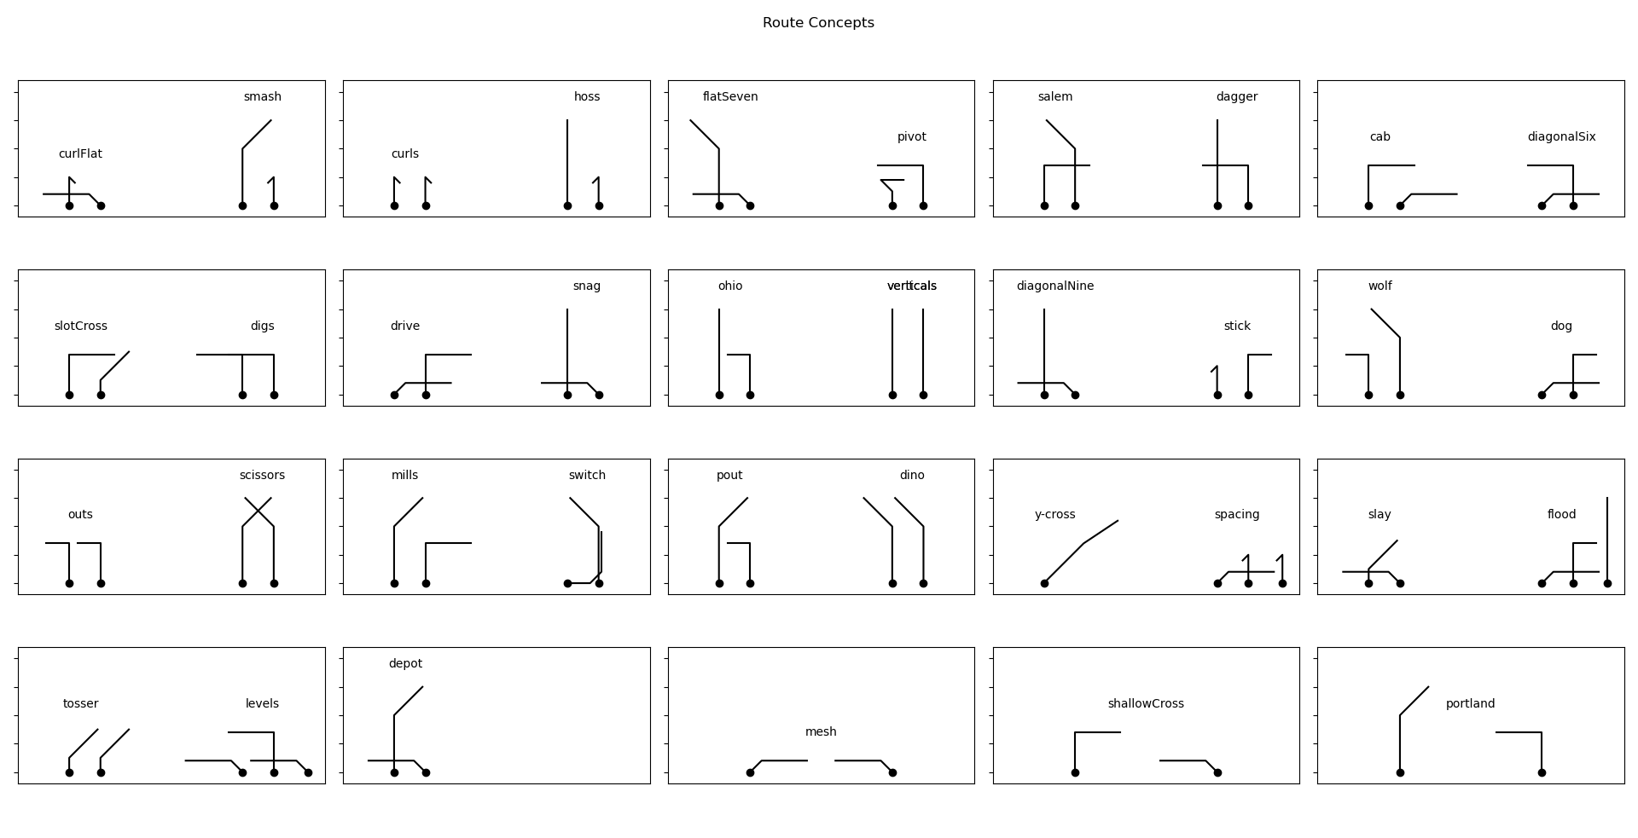
Route Concept Dictionary

Slide 6
Dictionary Route Concept Attempt
The route combination dictionary provided a first attempt at identifying route concepts within the dataset
Route concepts were identified for 11,580 plays of our dataset
But for the other ~30% of our dataset (4,768 plays) no route concept was identified
To overcome this limitation, techniques from computer vision methods were used to visually identify route concepts for every play in the dataset

Slide 7
Convolution Neural Network
Convolution Neural Networks (CNNs) are highly effective tools in computer vision methods
The same mathematical techniques used to identify handwriting samples or bird species can be used to identify NFL route concepts
We’ve built & utilized a CNN model to identify the route concepts within the SIS dataset
“the number five”
“parrot”
“hoss + ohio + curls”
example play image

Slide 8

CNN Route Concept Identification
The routes information for each play was plotted to a .png image
Dictionary-identified route concept labels were associated with 11,580 images
These images & labels were used to train and validate the CNN model
Multi-item classification (i.e., each play could be classified as one or more route concepts)
The CNN model utilized a layer structure similar to the standard Visual Geometry Group
play images
dictionary labels
“dagger”
“y-cross”
CNN Model
trained/validated on dictionary labeled data
expanded to identify route concepts on entire dataset
example play image

Slide 9
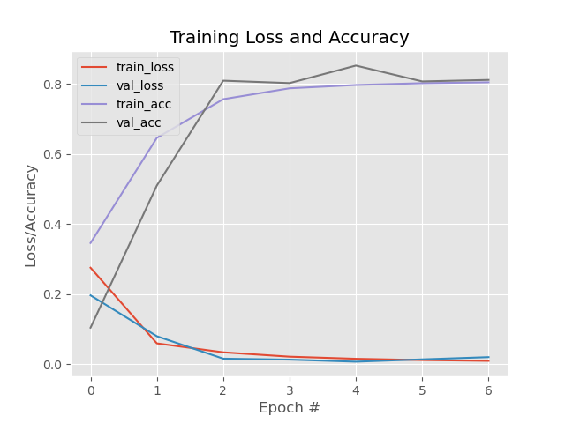
CNN Model Performance
CNN Model achieved ~80% accuracy
Most errors associated with either
False Positives: identified a route concept not labeled by the route concept dictionary
False Negatives: failed to identify the route concept labeled by the dictionary
Model Confusion Matrix (next slide) shows little systematic error
Potential errors that might affect data
Overestimate of Portland & Flat-Seven route concept frequency
Underestimate of Mesh & Shallow-Cross route concepts frequency

Slide 10
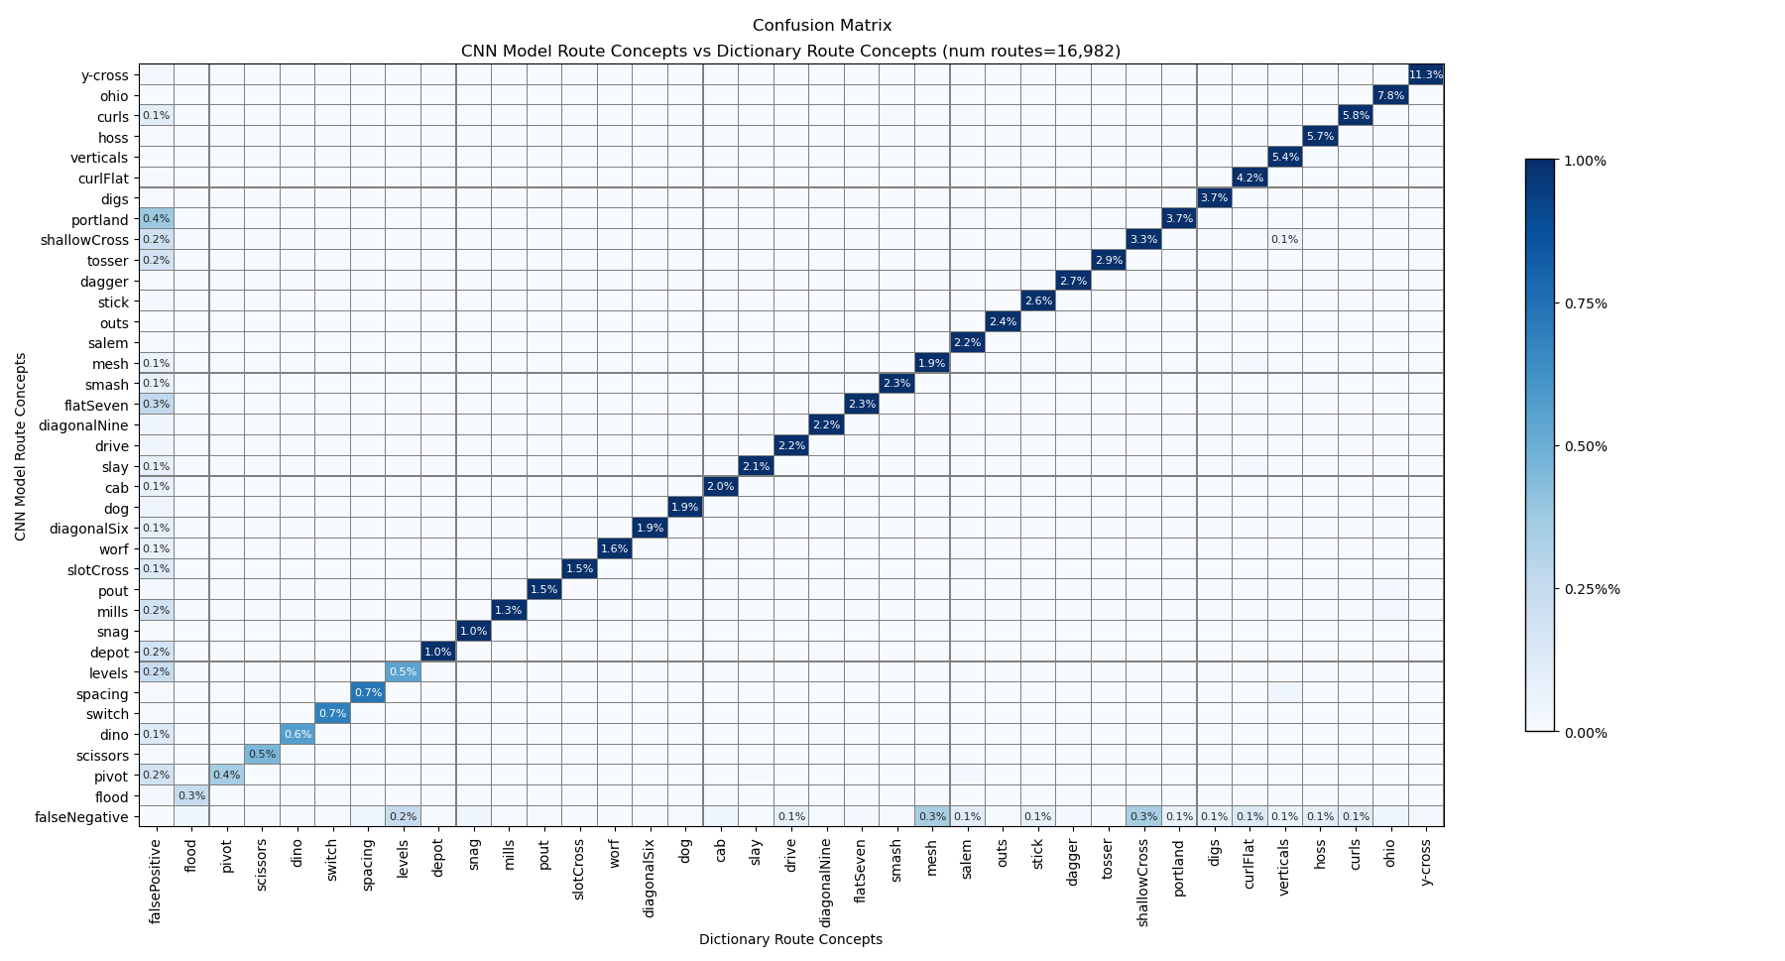
CNN Confusion Matrix

Slide 11
CNN Model Assessment
The CNN model was used to identify route concepts
Advantage:
Larger dataset
Route concepts identified based on spatial characteristics, not strict dictionary rules
Captures “Novel” atypical versions of route combination concepts
Disadvantage:
~20% error rate
Applied to the entire 16,348 play dataset
Identified the 1-3 route concepts which best characterized the play
May over/under-estimate frequency of some route concepts

Slide 12



CNN Model Examples
These are plays where the route combination dictionary failed to identify a route concept
But the CNN model was able to (1) assess at the spatial characteristics of the play and (2) suggest a route concept
CNN ID: flatSeven - usually a “corner+flat” combination - here a “corner+whip” combination
CNN ID: hoss - usually a “curl+go” combination - here a “comeback+go” combination
CNN ID: portland - usually a “post+dig” combination - here a “post+slant” combination

Slide 13
Application: Terminology
In the following section we will look at how our identified route concepts performed in various situations
Terminology that we will use
EPA/play: average expected points for the grouped concept of interest
MOFO: Middle Of the Field Open defensive coverage (Cover 0, Cover 2, Cover 4, Cover 6, Tampa 2)
MOFC: Middle Of the Field Closed defensive coverage (Cover 1, Cover 3)
Success Rate: The percentage of plays which resulted in positive EPA
Explosiveness: The average amount of EPA generated by successful plays
Traditional Route Concepts: route concepts which fit the dictionary definition (e.g., hoss = curl+go)
Novel Route Concepts: identified route concepts which did not fit the dictionary definition (e.g., hoss = comeback+go)
Explosive Route Concept: route concept that generates higher-than-average Explosiveness
On-Schedule Route Concept: route concept that achieves a higher-than-average Success Rate

Slide 14
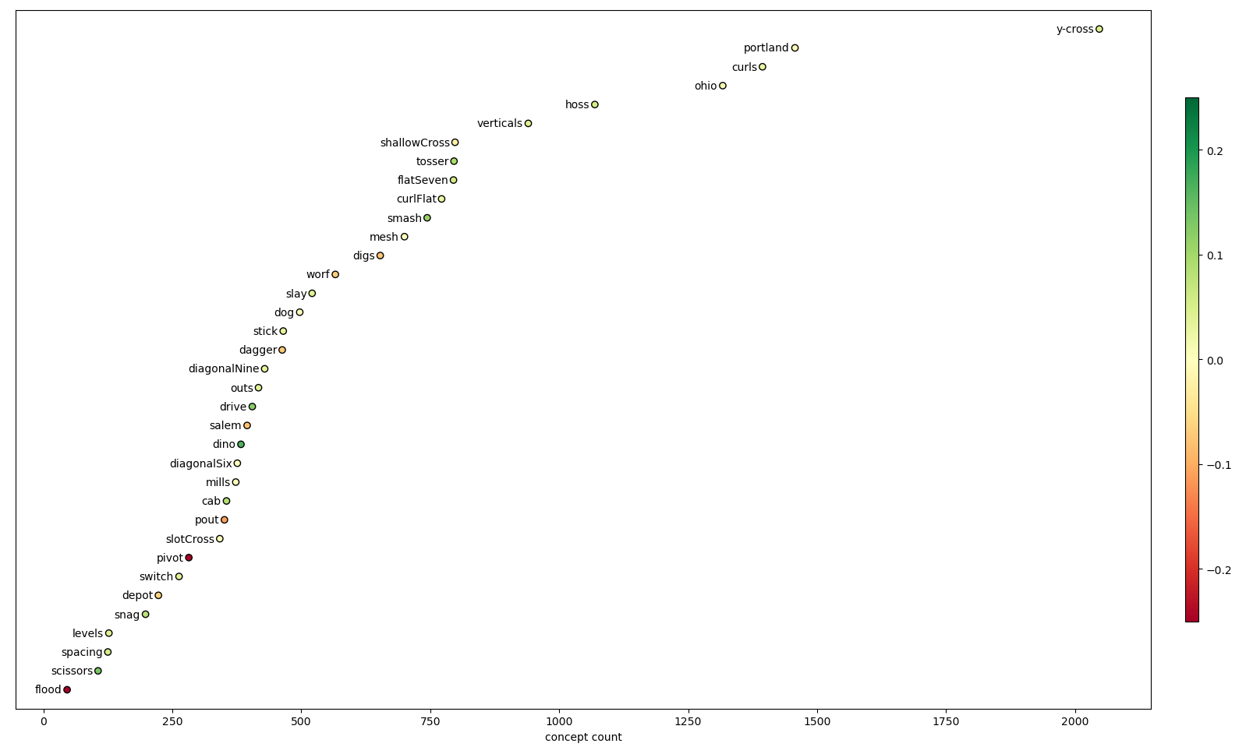
Route Concept Frequency
EPA/play
As our only one-route concept, y-cross was unsurprisingly the most popular concept in the dataset
Portland, curls, ohio, hoss, and verticals were our most popular two-route concepts
Three- route concepts like flood, spacing, and levels were the least frequently observed

Slide 15
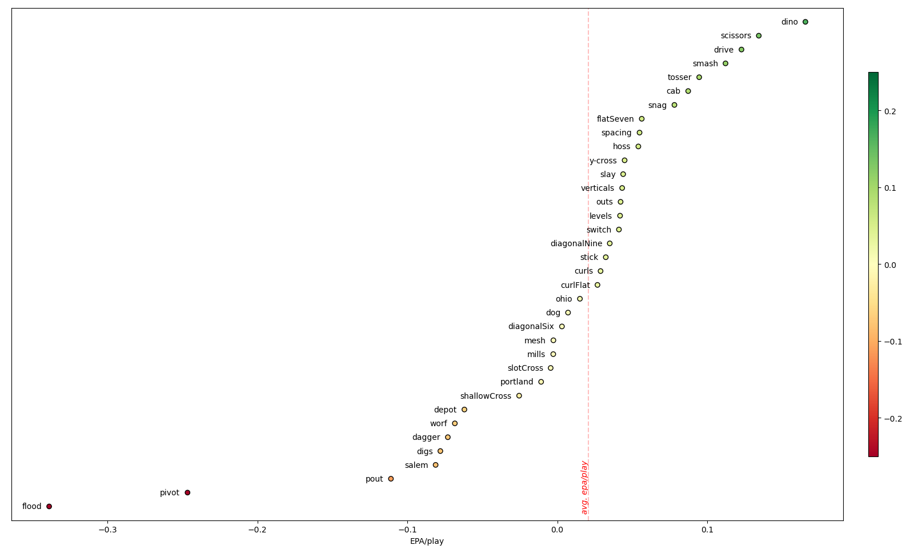
Route Concept Performance
Generally, route concepts performed similarly in terms of EPA/play
Concepts like dino, scissors, drive, and smash appeared to be slightly better than average
While concepts like flood and pivot generally performed below average, those these do reflect sample size issue
EPA/play

Slide 16
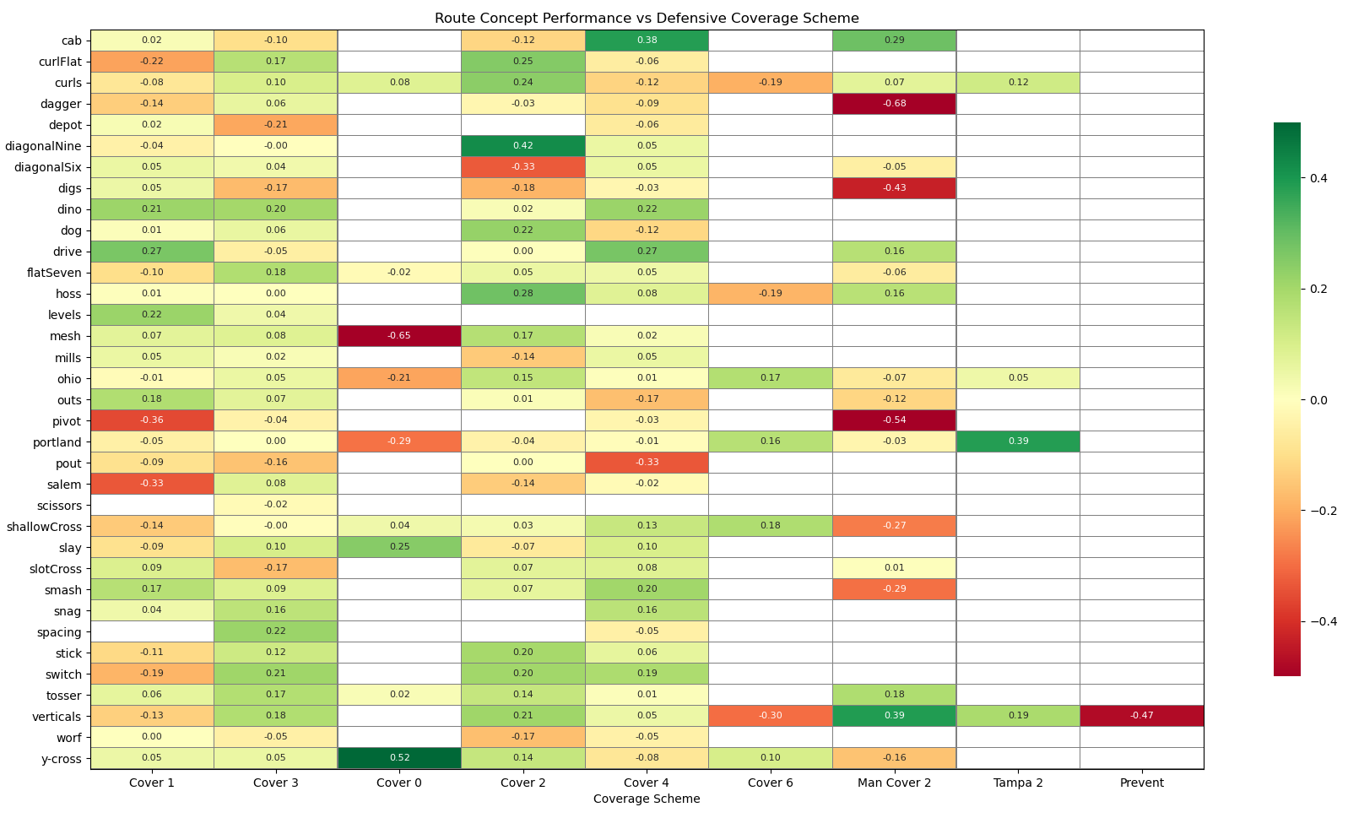
Route Concept vs Coverages
EPA/play was computed for each route concept and coverage pairing
Pairings with less than 25 instances were excluded for sample-size issues
Some route concepts (dino) performed well against most coverages
Some coverages (Man Cover 2) performed well against most route concepts
This table can be used as a lookup for which concept performed best against which coverage & vice-versa
EPA/play

Slide 17
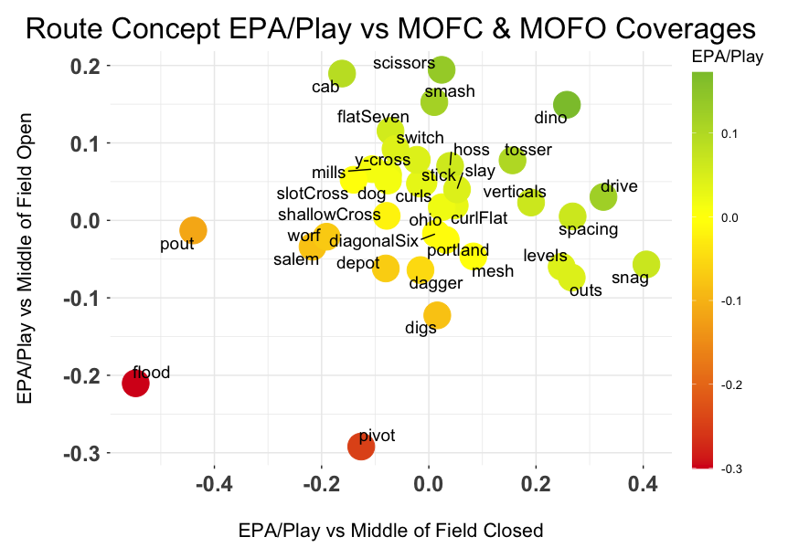
In addition to concept/coverage pairings, we classified coverages as MOFO vs MOFC (Prevent coverage was excluded)
We then computed the EPA/play for each coverage-type
This overcomes many of the sample size issues of specific concept-coverage pairings
Concepts that perform relatively better against MOFC: snag, drive, spacing, levels, outs
Concepts that perform relatively better against MOFO: cab, scissors, smash, flatSeven, switch, y-cross
Route Concept vs Coverages

Slide 18
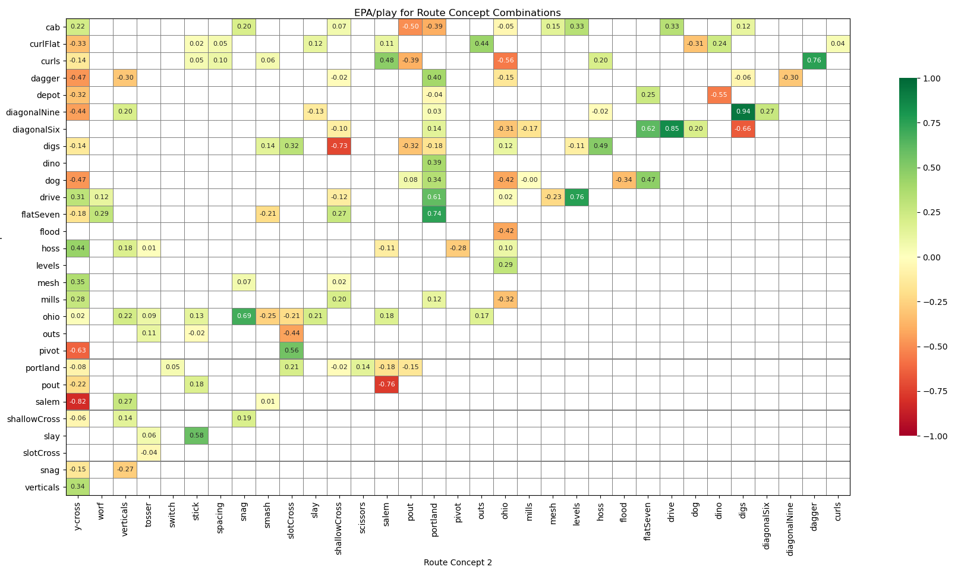
Route Concept Combinations
EPA/play was computed for each route concept pairing
Ex., Plays when cab was run in conjunction with y-cross averaged an EPA of 0.22
Pairings with less than 10 instances were excluded
Some concepts like portland & ohio seemed amenable to combination with other concepts
Other concepts like dagger and y-cross were much more varied in their pairing success
EPA/play

Slide 19
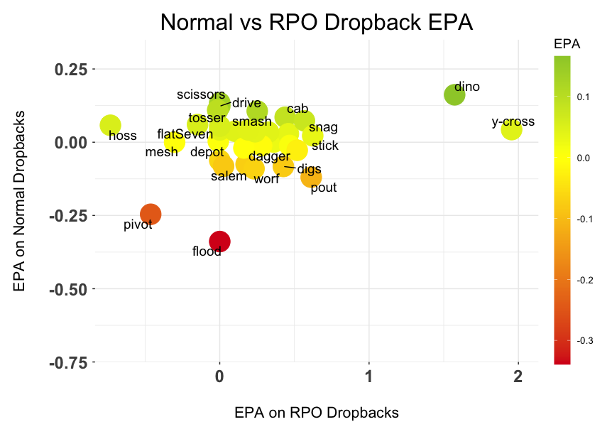
worse as RPO
better as RPO
Most concepts saw a minor improvement in EPA/play when run as part of a Run-Pass-Option (RPO)
Two concepts, dino & y-cross demonstrated the most improvement when executed as an RPO
Conversely, hoss & mesh saw worse performance out of RPO execution
This may suggest that RPO dropbacks best compliment route concepts that attack the middle of the field at the mid-to-deep level
Route Concepts in RPO’s

Slide 20
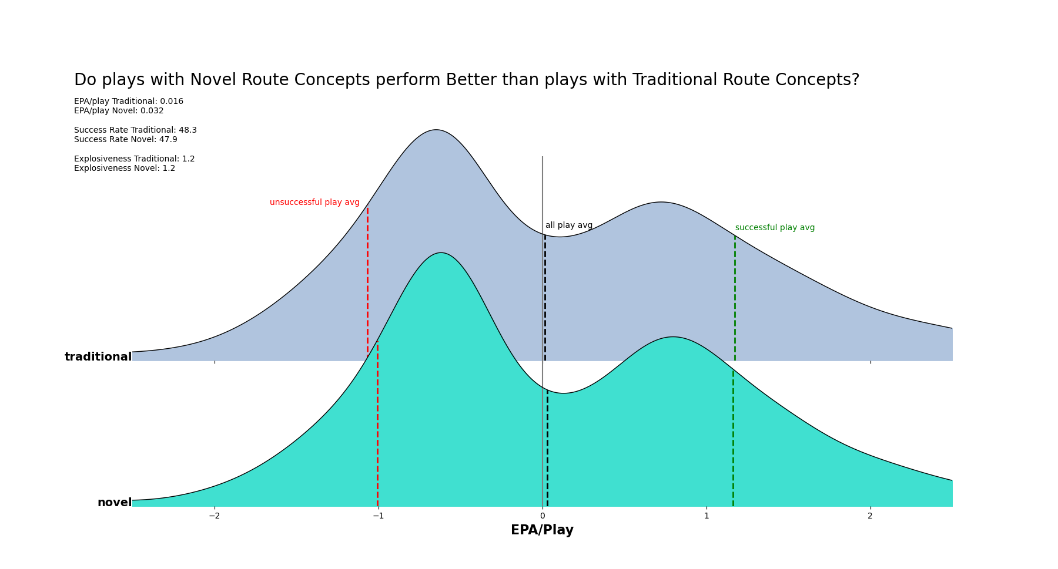
Traditional Route Concepts follow route combination dictionary (e.g., traditional hoss = curl+go)
Novel Route Concepts are those identified by our CV model being spatially similar to the traditional definition (e.g., novel hoss = comeback+go)
Plays with Novel Route Concepts (n=4,768) performed similarly to plays with Traditional Route Concepts (n=11,580)
Novels Route Concepts demonstrated:
Slightly higher EPA/play
Lower Success Rate
Identical Explosive Play Rate
Reduced impact on unsuccessful plays
No significant correlation between NFL passing offense performance and Novel Concept playcall rate (next slide)
Novel vs Traditional Route Concepts

Slide 21
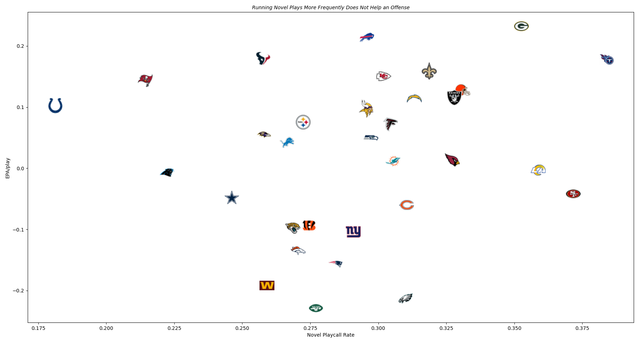
Novel vs Traditional Route Concepts

Slide 22
“Explosive” and “On-Schedule” Route Concepts
There is a tradeoff between how frequently a route generates a positive EPA, and the magnitude of that positive EPA
Explosive Route Concepts:
Generate positive EPA less frequently
Generate high amounts of EPA on successful plays
High risk + high reward plays, often vertical passing concepts that are either no gains or big gains
Example Concepts
Verticals
Dagger
Mills
On-Schedule Route Concepts:
Generate positive EPA plays more often
Generally have lower EPA on successful plays
Quick, reliable concepts that the defense tends to contain
Example Concepts
Stick
Outs
Curl + Flat

Slide 23
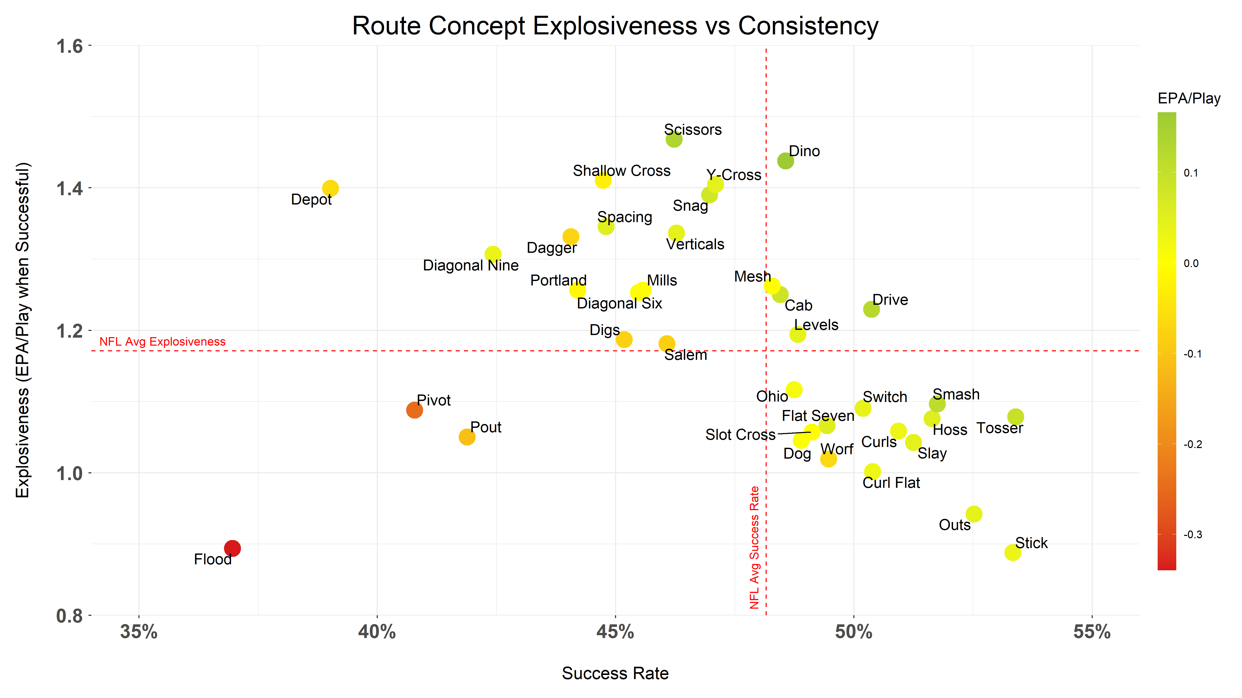
Explosive vs On-Schedule Route Concepts
Explosive
Concepts
On-Schedule Concepts

Slide 24
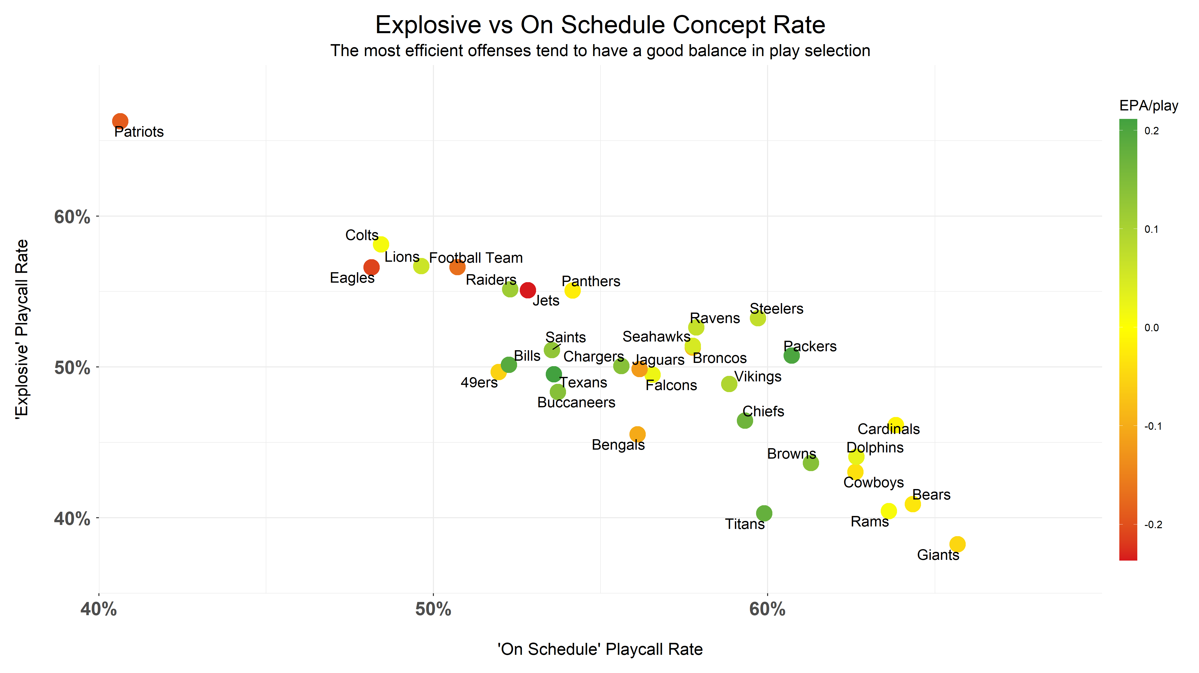
We looked at the playcalling rate of Explosive & On-Schedule route concepts for NFL teams
The best offenses called a blend of both explosive and efficient route concepts
Lower EPA/play offenses are associated with BOTH overly-conservative and overly-explosive playcalling
Overly Risky
Playcalling
Successful Passing Offenses
Overly Conservative Playcalling
What type of route concepts do the best NFL Offenses call?

Slide 25
Conclusions
Convolution Neural Networks can be used to identify route concepts from play diagrams
Some route concepts perform well against most coverages, while others are effective only against specific coverages
“Traditional” and “Novel” route concepts perform similarly
Most route concepts benefited from pairing with an RPO dropback
An effective passing offense should utilize a blend of Explosive and On-Schedule route concepts
Route concepts vary in productivity against MOFO vs MOFC coverage
Some concepts pair well with other concepts; while others are limited in their complimentary ability
Route concepts can be classified as either “Explosive” or “On-Schedule”
Identified y-cross as the most popular passing offense concepts, while dino was the most effective

Slide 26
Shortcomings & Areas of Improvement
CNN model performance could be further optimized to avoid false positive/negative identifications
RB-routes were excluded to help simplify the play images for the CNN model
Sample size issues with many route concepts (e.g., flood)
Sample size issues with many coverages (e.g., Cover 0 & Cover 6)
Sample size issues with RPO/concept pairings
This analysis did not distinguish which route concept deserves credit for the pass target on each play, all concepts on play were assigned the associated play EPA

