Slide 1
Introduction to ML
肖易佳 计83 2018011347

Slide 2
What is Machine Learning
Machine learning (ML) is the scientific study of algorithms and statistical models that computer systems use to effectively perform a specific task without using explicit instructions, relying on patterns and inference instead. It is seen as a subset of artificial intelligence. Machine learning algorithms build a mathematical model of sample data, known as "training data", in order to make predictions or decisions without being explicitly programmed to perform the task.
机器学习(ML)是对计算机系统用来有效执行特定任务的算法和统计模型的科学研究，不需要使用明确的指令，而是依赖于模式和推理。它被视为人工智能的一个子集。机器学习算法建立一个样本数据的数学模型，称为“训练数据”，以便在不显式编程执行任务的情况下做出预测或决策。

Slide 3
Machine learning algorithms are used in a wide variety of applications, such as email filtering, and computer vision, where it is infeasible to develop an algorithm of specific instructions for performing the task. Machine learning is closely related to computational statistics, which focuses on making predictions using computers. The study of mathematical optimization delivers methods, theory and application domains to the field of machine learning. Data mining is a field of study within machine learning, and focuses on exploratory data analysis through unsupervised learning.^{[3][4]} In its application across business problems, machine learning is also referred to as predictive analytics.
机器学习算法被广泛应用于各种各样的应用中，例如电子邮件过滤和计算机视觉，在这些应用中，开发一种特定指令的算法来执行任务是不可行的。机器学习与计算统计学密切相关，计算统计学侧重于使用计算机进行预测。数学优化的研究为机器学习领域提供了方法、理论和应用领域。数据挖掘是机器学习中的一个研究领域，主要通过无监督学习对数据进行探索性分析。在它的跨业务问题的应用中，机器学习也被称为预测分析。

Slide 4
From reading material
How can we build computer systems that automatically improve with experience, and what are the fundamental laws that govern all learning processes?
A particular task T, performance metric P, and type of experience E
If the system reliably improves its performance P at task T, following experience E. Depending on how we specify T, P, and E, the learning task might also be called by names such as data mining, autonomous discovery, database updating etc.

Slide 5
Introduction
Basic terminology
Hypothesis Space
Reduction bias
Development
Application

Slide 6
Basic terminology
(Attribute a1 = x1; Attribute a2 = x2; Attribute a3 = x3), (Attribute a1 = y1; …)
Attribute = attribute value
Instance/sample -> data set
Feature vector
Attribute space/ sample space /input space

Slide 7
About the data set
Training set (made up of training samples)
Testing set (made up of testing samples)
About the output
Example (instances with label information) -> (xi , yi)
Set Y = {y1, y2, y3,… yn} -> label space

Slide 8
positive class
classification
(discrete) negative class
regression
(continuous)

Slide 9
Learning tasks
Classify by whether the training data has labels
Supervised learning (classification & regression)
Semi-supervised learning
Unsupervised learning (clustering)
Ps. Clustering : dividing the training set into several groups, and each subset may help us to find some potential concepts and the intrinsic attributes

Slide 10
Hypothesis Space
The hypothesis space, which defines the class of functions mapping the input space to the output space. That is, the functions operate on the feature vectors of the input objects, and make predictions according to the format of the output space.
There is a mapping in the space that maps the eigenvectors in our sample space to our output space

Slide 11
Scientific reasoning
Induction & deduction
Induction：from instances to general rules->generalization
Deduction：from general to specific->specification
Inductive learning

Slide 12
Reduction bias
Q : Why does machine learning need bias ？
A : To make sure that the outcome of learning is confirmable
Scenario : when the instance fits more than one category
Occam’s razor :
We generally prefer those models that are simpler

Slide 13
However– there is no free lunch in the world!
No Free Lunch Theorem ( NLF for short ) ( David Wolpert and William Macready, 1995)
If an algorithm performs well on a certain class of problems, then it necessarily pays for that with degraded performance on the set of all remaining problems.
So we need bias to fit different models (problem-specific)

Slide 14
Development
Artificial intelligence :
1950-1970 reasoning
Mid 1970 knowledge -> knowledge-based expert system
1980 learning (from instances, observation, instructions)

Slide 15
application
Natural language processing
Translation
Virtual personal assistant
Computer vision
Face recognition
Intelligence safeguard system
Speech recognition
Speech evaluation
Expert systems
Autonomous vehicle
Bio-surveillance

Slide 16
Model evaluation
Empirical error
Evaluation methods
Performance measure
Bias-variance

Slide 17
Empirical error
E(Error rate): a/m
Accuracy : 1 – E
training error (empirical error)
Error
generalization error /泛化误差
Every coin has two sides !

Slide 18
Overfitting
The learning ability is so good that the model mistakes some specific features of the dataset for the general ones
Underfitting
The learning ability is not good enough
Solution
add branches to the decision tree
Increase the rounds in NN learning

Slide 19
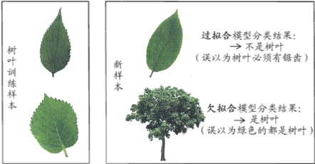

Slide 20
Evaluation methods
Hold-out
Dataset = training set (S)+ testing set (T)
Stratified sampling
Dilemma
Ensure the fidelity : training takes up 2/3 ~ 4/5

Slide 21
Evaluation methods
Cross validation
Divide the dataset into k subsets(mutually exclusive)
Each time, the combination of (k - 1) subsets is used as the training set, the last one as the testing set
K-fold cross validation
LOO (leave one out) (in which k == m<number of samples>)
K = 10 (usually)

Slide 22
Evaluation methods
Bootstrapping
Dataset D (m samples) -> generate D’
For i in range (m)
Randomly select a sample s, and place its copy into D’
End
About 36.8% of samples don’t appear in D’

Slide 23

Use D’ as the training set, and D\D’ as the testing set
We still have around 1/3 of samples the don’t appear in the training set
Out-of-bag estimate
Application scenario：smaller dataset & preferable for ensemble learning (many different training set)

Slide 24
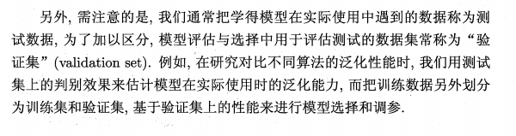
Parameter tuning
In many cases, the parameter varies in R (continuous)
Find the range and step length
Validation set

Slide 25


Performance measure
In regression tasks -> mean squared error
Discrete
Continuous

Slide 26

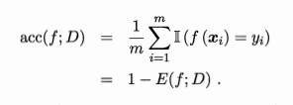
Error ratio and accuracy
For sample set D
Error rate
Accuracy
More general

Slide 27

Bias-variance
Bias-variance decomposition(偏差-方差分解)
Notation -> For sample x
y_{D} := label in the dataset
y := the real label of x
Expectation of the learning algorithm

Slide 28



Variance
Noise
Bias ( difference between expected output and actual label )

Slide 29
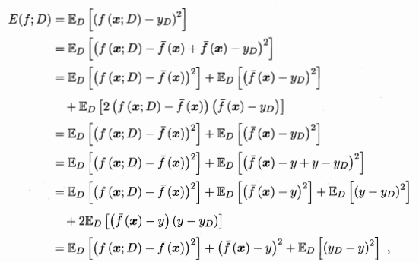

decomposition
We assume E_{D} [y_{D} - y] = 0

Slide 30
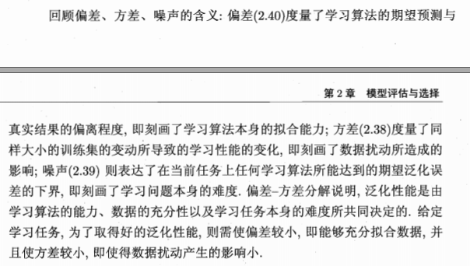

Slide 31
Linear model
Linear regression
Logistic regression
Maximum likelihood method
LDA
Class imbalance

Slide 32

Basic form
Linear model
Pros :
Easy form and easy to be built
High comprehensibility

Slide 33
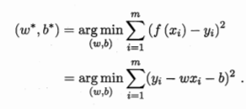
Linear regression
Mean square error
Least square method

Slide 34
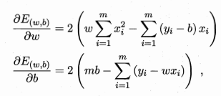
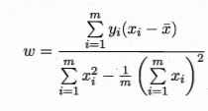

Closed form solution (analytical)

Slide 35
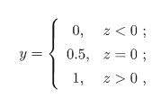
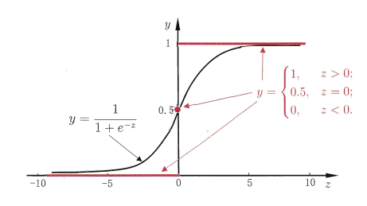

Some functoins
Unit-step function
Bad continuity -> logistic function ( sigmoid function)

Slide 36
Decision tree
Basic procedure
Information entropy
Pruning
Multivariable decision tree

Slide 37
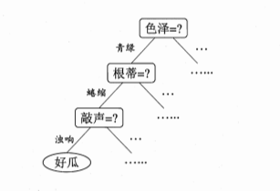
Basic procedure
来个瓜 [滑稽]
Start from binary classification (interaction)

Slide 38
A decision tree = root node + internal node + leaf node
Node set \ { leaf node } -> Each node corresponds to an attribute test
Strategy : divide and conquer

Slide 39
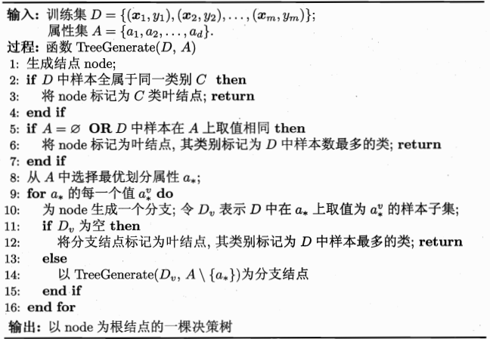

Slide 40
(1)same category ->no need to divide
(2)attribute set is empty / all sample are the same in every attributes
(3)the sample set is empty

Slide 41

Information entropy
An index used for measuring the purity of the sample
Proportion of Type k := p_{k}
The lower the Ent(D), the higher the purity

Slide 42

Information gain
There are V possible values of discrete attribute a:
{a¹ a²……a^{V}}
Let’s look at some examples (瓜)

Slide 43
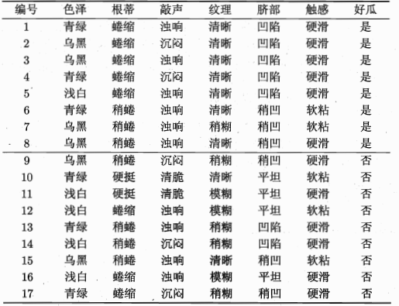
Table

Slide 44

Principal ： the higher information gain -> the higher improvement in purity
|y| = 2 (the number of categories in the sample)
p1(positive) = 8/17 , p2() = 9/17

Slide 45
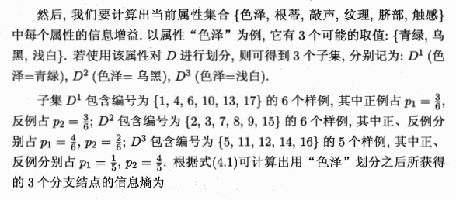

Slide 46
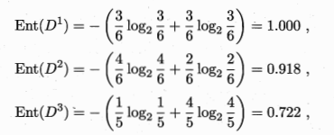
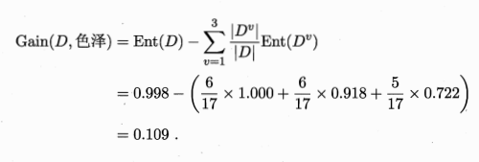

Slide 47
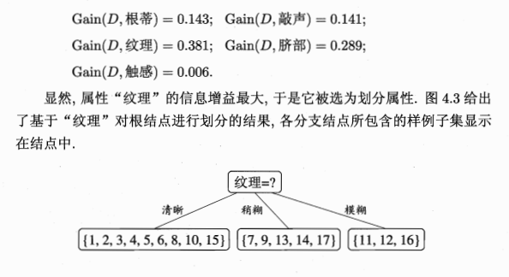

Slide 48
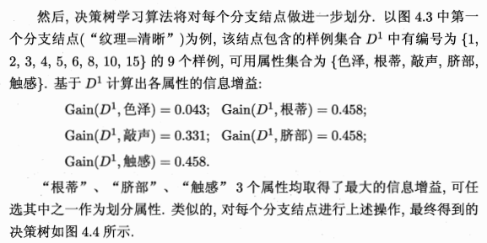

Slide 49
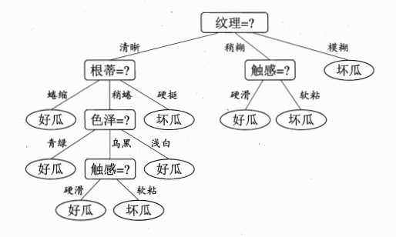

Slide 50
Pruning

Slide 51
Pruning
Goal ->
to improve the generalizing ability of decision trees
Prepruning (estimate before dividing : if dividing cannot improve the ability, mark the current node as a leaf node)
Postpruning (buttom-up analyze those non-leaf nodes : if replacing the node with a leaf node can improve the ability, then do it)

Slide 52
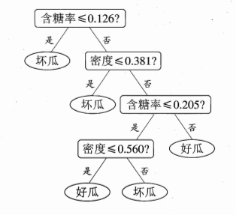
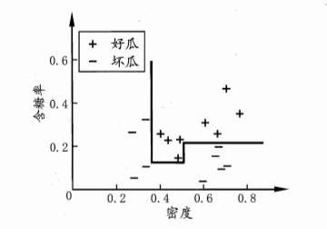
Multivariable decision tree

Slide 53
Neural network
Neuron model
Perceptron

Slide 54
neuron
Threshold : if the potential of a neuron is above the potential, then it will be activated
W_{i} : = the connection weight of No.i neuron
Theta : = threshold
The whole potential is the sum of all the input electric signals

Slide 55

Activation function :=

Slide 56

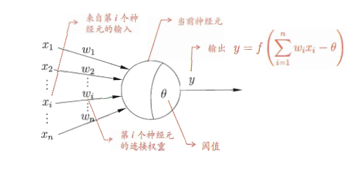
M-P model

Slide 57
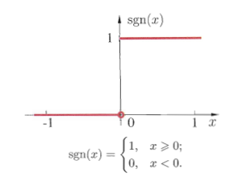
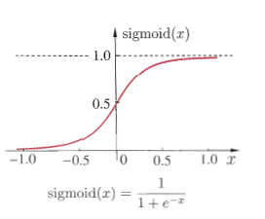
Ideal activation (step function)
Mapping the input to {0, 1}
1 stands for activated
0 stands for restrained
However, this function is not continuous, nor smooth
So we use Sigmoid instead

Slide 58
perceptron
Perceptron is made up of two layers of neurons:
The input layer receive the signals and pass them to the output layer
And the neurons in the output layer are M-P neurons (also names threshold logic unit)
Using perceptron, we can easily represent AND/OR/NOT

Slide 59

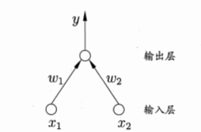



Slide 60

To be more general, we can regard the threshold as a “dummy node” whose input is constantly -1.0; and in this way, we can unify the learning of weight and threshold into the single learning of weight
Adjust the weight to learn
Sample (x, y), and for this instance, the output of perceptron is y’
If y’==y, then perceptron will not change
Else, add a modification value delta(w) to w, where the learning rate varies from 0 to 1

Slide 61
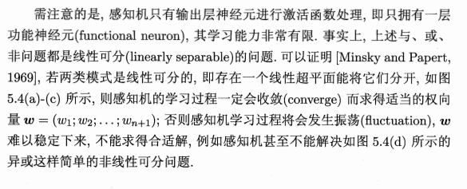

Slide 62
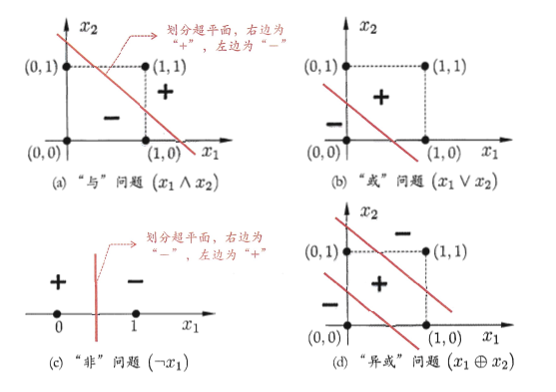

Slide 63
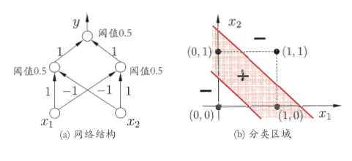
How to solve the problem of none-linearly separable
Use multilayer neurons !
As for the “XOR”, add hidden layer
Hidden layer and output layer both have activation function

Slide 64
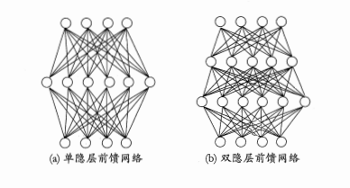
Multi-layer feedforward neural networks
In each layer, every neuron is connected to the neurons in the next layer
But neurons in the same layer don't connect to each other
There is no cross-layer connection

Slide 65
Thank you for your time!
肖易佳 计83

