Slide 1
Sydney

Slide 2
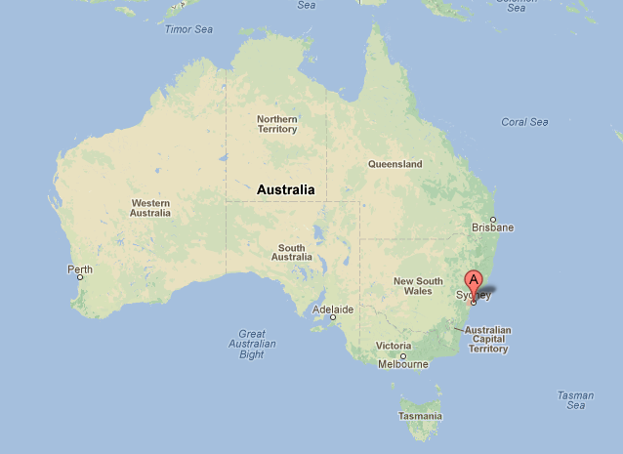
Sydney location
Sydney is located on Australia's east coast, the metropolis surrounds Sydney Harbour and extends about 70 km (43.5 mi) towards the Blue Mountains to the west, Hawkesbury to the north, the Royal National Park and Macarthur to the south and south-west.

Slide 3
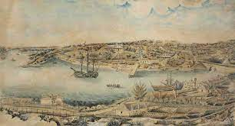
History
First inhabitants of the region
The first people to inhabit the area now known as Sydney were Aboriginal Australians who had migrated from northern Australia and before that from southeast Asia
Convict town (1788–1840)
Britain had been sending convicts to its American colonies for most of the eighteenth century, and the loss of these colonies in 1783 was the impetus for the decision to establish a penal colony at Botany Bay.

Slide 4
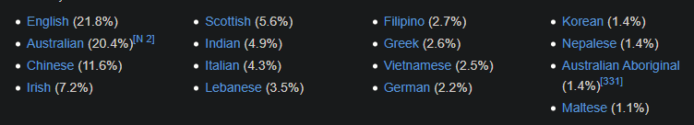
Demographics
Ancestry and immigration
Most immigrants to Sydney between 1840 and 1930 were British, Irish or Chinese. At the 2021 census, the most commonly nominated ancestries were:

Slide 5
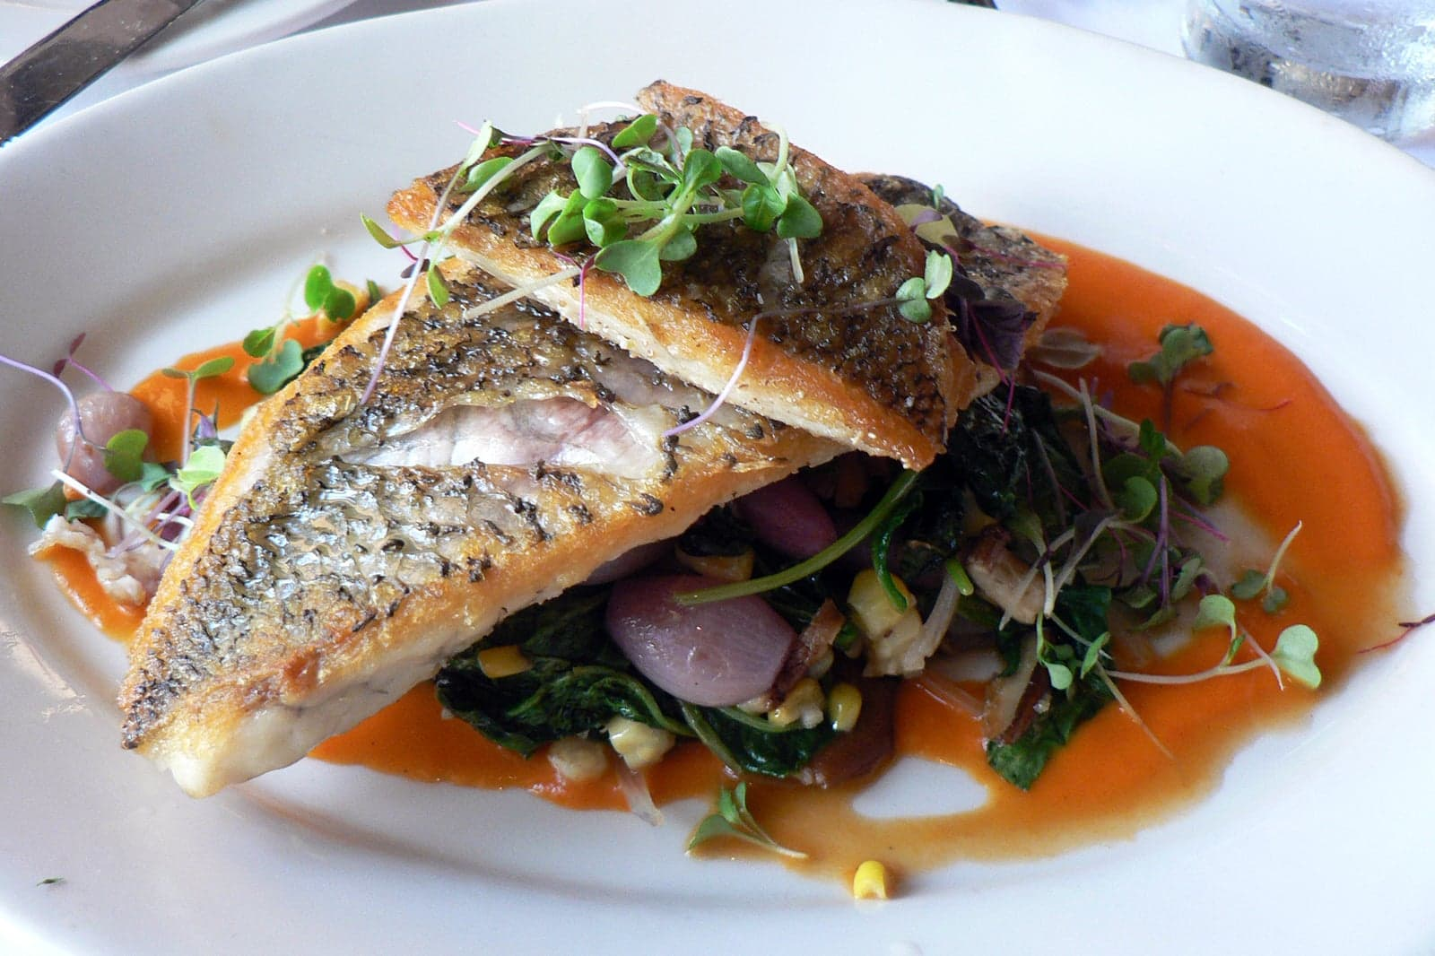
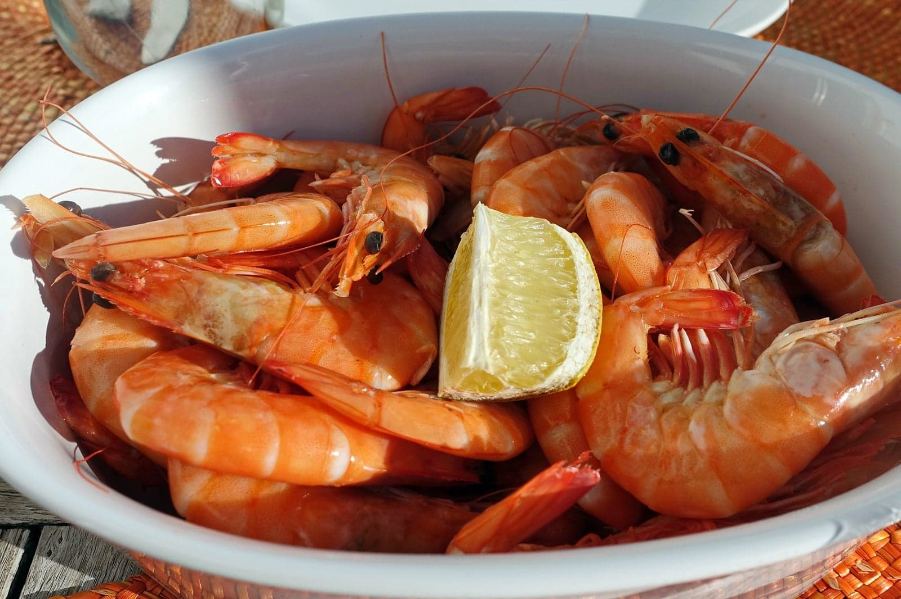
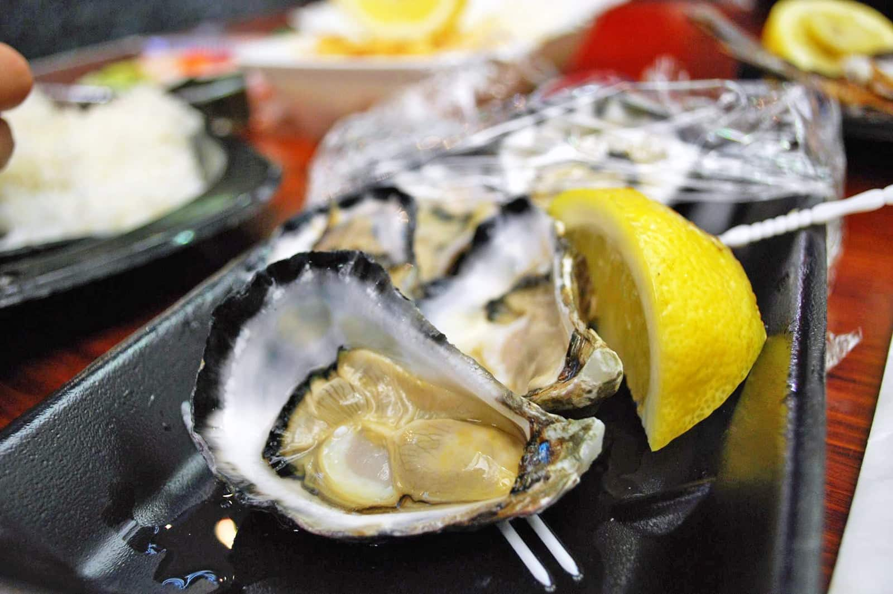
Best Foods to Eat in Sydney
Barramundi Australian prawns
Sydney rock oyster

Slide 6
Thanks for watching

