Slide 1
Exploring Scanners: A Comprehensive Overview
Unlocking the Power of Scanning Technology
Made By Kabai Koppány

Slide 2
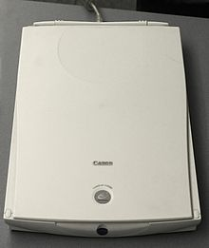
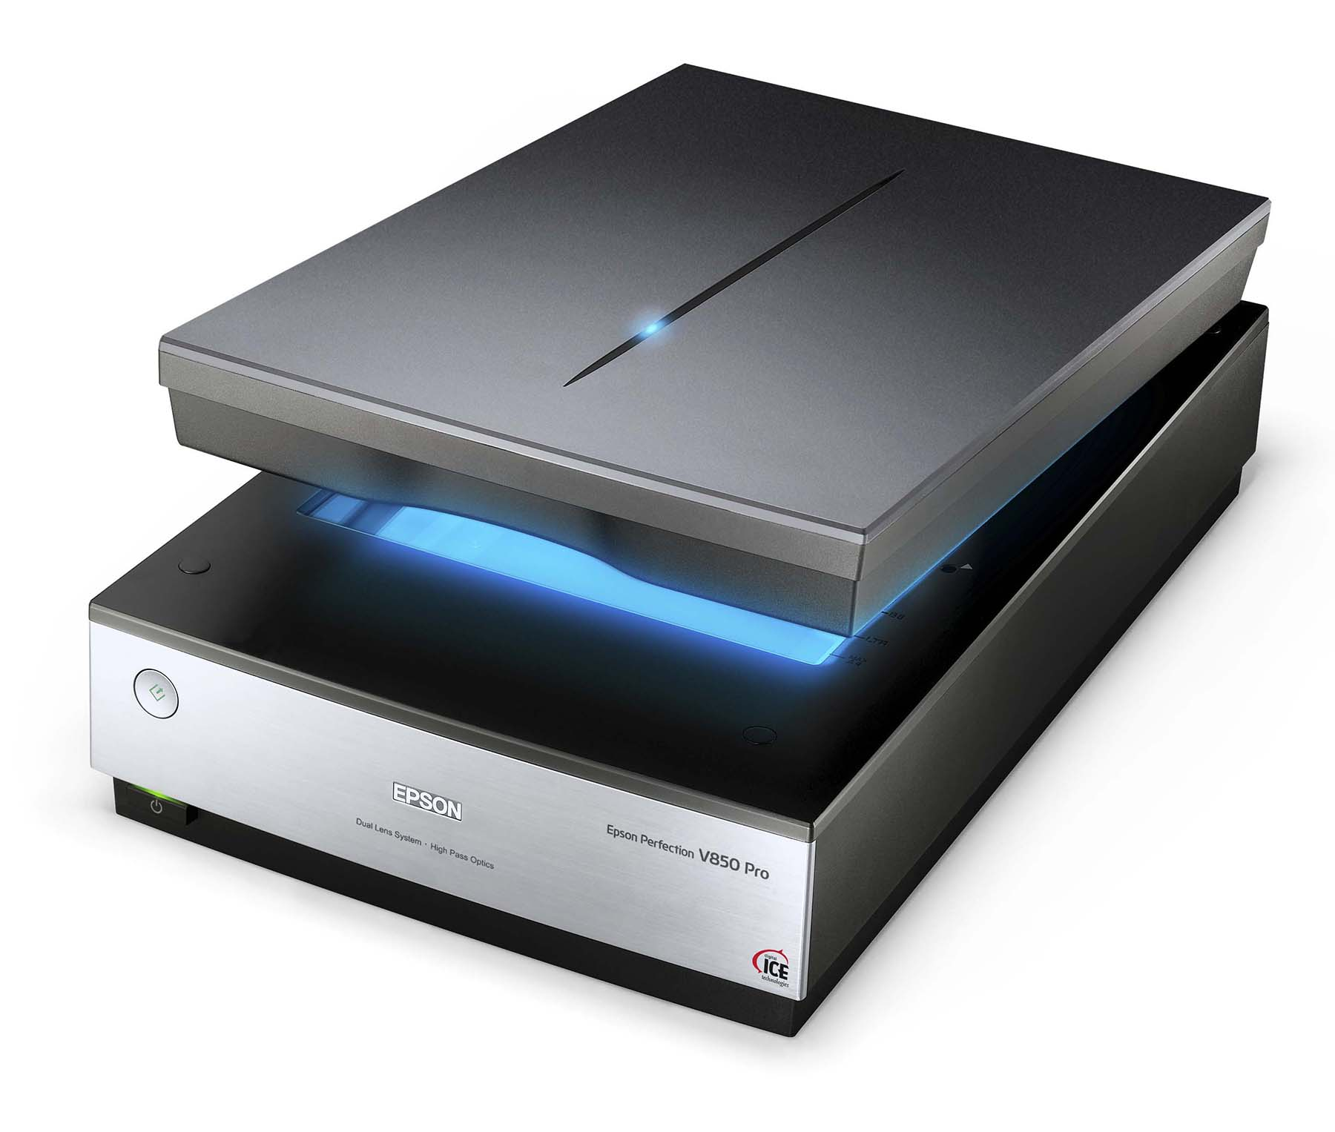
Introduction to Scanners
Definition of a scanner:A scanner is a device that captures images from photographic prints, posters, magazine pages and similar sources for computer editing and display.
Scanners work by converting the image on the document into digital information that can be stored on a computer through optical character recognition (OCR).
Importance of scanners in the digital age:
1 Faster searchability
Improved accessibility
Reclaimed physical space
Cost efficiency
Brief Hystory of scanners:
1. Early Phototelegraphy (1843-1860s)
2. Drum Scanners (1950s-1960s)
3. Flatbed Scanners (1970s-1980s)
4. CCD Technology (1980s)
5. Color Scanning (1990s)
6. Integration with Personal Computers (1990s)
7. Advancements in Optical Character Recognition (OCR) (2000s-2010s)
8. Mobile Scanning (2010s-present)
9. 3D Scanning (Recent Years):
Old
New

Slide 3
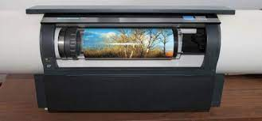
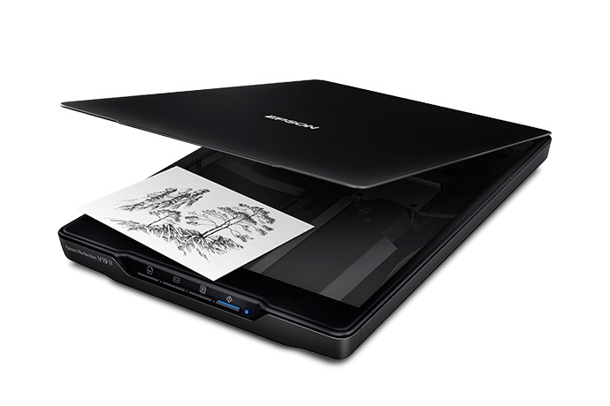
Types of Scanners
Flatbed
Drum scanners
Description: Flatbed scanners are the most common type, featuring a flat, glass surface on which documents or images are placed for scanning.
Use Cases: Ideal for scanning single or multiple pages, photographs, and other flat, delicate items.
Advantages: Versatile, suitable for a variety of materials, and provides high-quality scans.
Description: Drum scanners use a rotating drum to capture high-resolution images. They were more common in the past but have been largely replaced by newer technologies.
Use Cases: Historically used in graphic arts and publishing for high-quality image reproduction.
Advantages: Provided high resolution and color accuracy, but bulkier and more expensive compared to modern alternatives.

Slide 4
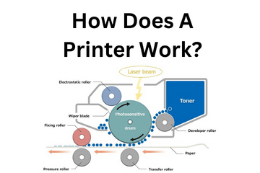
How Scanners Work
Scanning Process:
The scanning process involves the following steps:
Document Placement: The document is placed on the scanning surface, whether it's a flatbed, sheet-fed, or another type of scanner.
Illumination: The light source illuminates the document, and the reflected light carries the visual information.
Optical Sensor Capture: The optical sensor captures the reflected light, converting it into analog signals.
Analog-to-Digital Conversion: The analog signals are converted into digital data, creating a digital representation of the scanned image.
Image Processing: The scanner's electronics process the digital data, applying color corrections, adjustments, and enhancements as specified by the user or the scanner's settings.
Output: The final digitized image is then transferred to a computer or another output device for storage, editing, or printing.
Basic Principles of Scanning Technology:
Scanning technology operates on the principles of capturing and converting physical images or documents into digital data. The primary components of the scanning process include an optical sensor, a light source, and the determination of resolution.

Slide 5
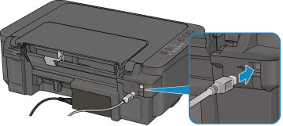
Scanner Features and Specifications
DPI:
Definition: Resolution refers to the level of detail that a scanner can capture, and it is commonly measured in dots per inch (DPI). DPI indicates how many individual dots of color or light the scanner can capture in one inch.
Bit Depth and Color Depth:
Bit Depth Definition: Bit depth refers to the number of bits used to represent each pixel in an image. Common bit depths include 24-bit and 48-bit.
Document Feeder Capacity (For Sheet-Fed Scanners):
Definition: Document feeder capacity refers to the number of sheets of paper or documents that a sheet-fed scanner can process in a single batch.
USB Connectivity:
Definition: Universal Serial Bus (USB) is a standard for connecting devices to computers. Most scanners feature USB connectivity.

Slide 6
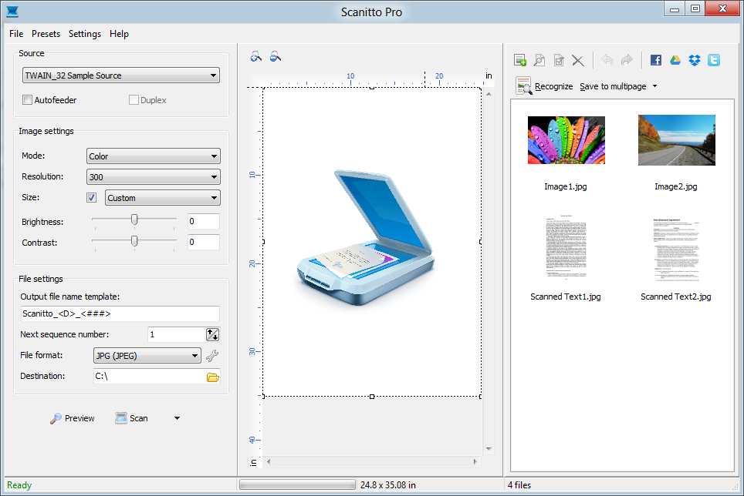
Scanner Software
Common Features:
Driver Software: Essential for communication between the scanner and the computer's operating system.
Scanning Utilities: Tools that facilitate scanning processes, including options for selecting scan settings, file formats, and destinations.
File Management: Software for organizing, naming, and saving scanned documents efficiently.
User Interface: An intuitive interface for controlling and managing scanning tasks.
OCR Software for Text Conversion:
Definition: Optical Character Recognition (OCR) software is designed to recognize and convert printed or handwritten text into editable and searchable digital text.

Slide 7
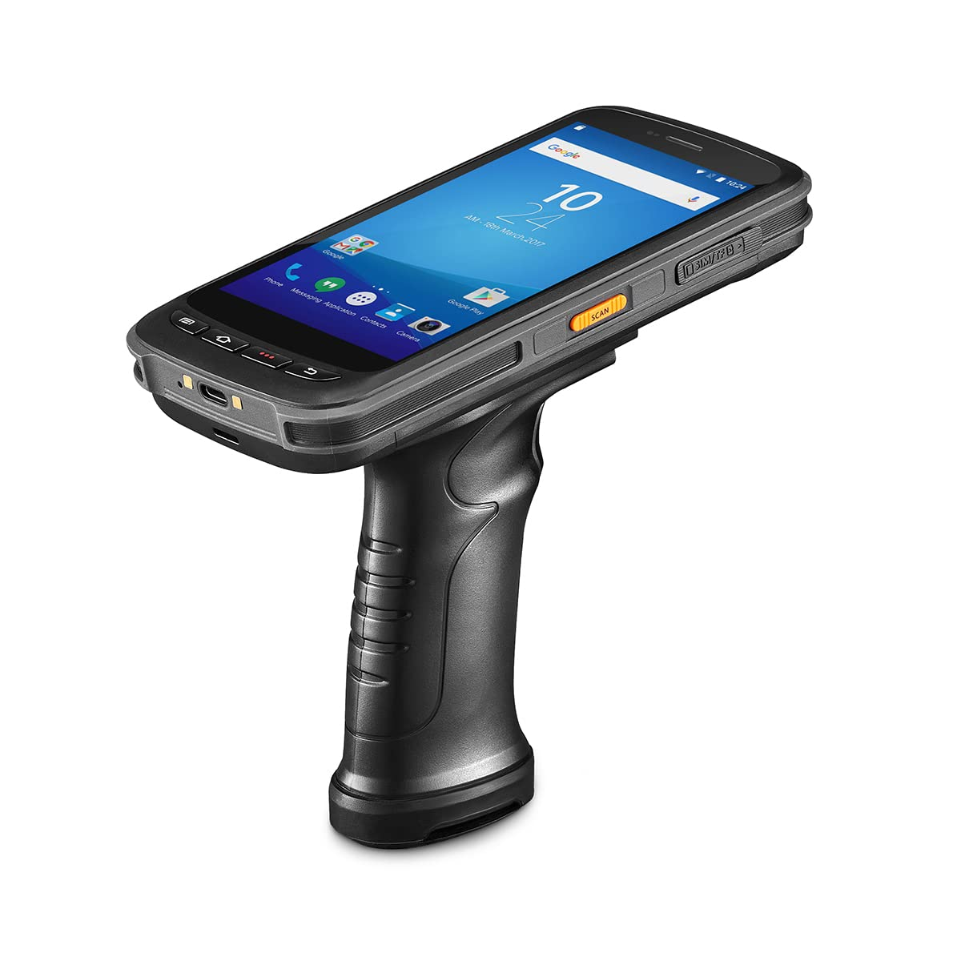
Advancements in Scanner Technology
3D Scanning Advancements:
Continued improvements in 3D scanning technology, enabling more accurate and detailed capture of three-dimensional objects. Applications include manufacturing, healthcare, and virtual reality.
Portable and Mobile Scanners:
Development of more compact and portable scanners, including those integrated into smartphones and tablets. Mobile scanning apps have become increasingly sophisticated, offering convenience for on-the-go scanning.

Slide 8
Thanks For Watching

