Slide 1
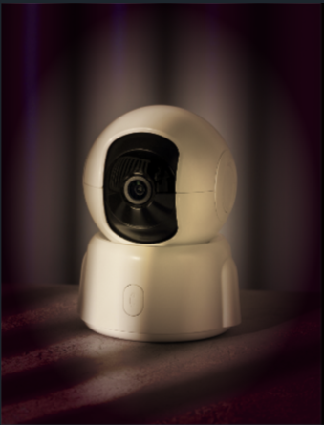
Spotter

Slide 2

How did we come up with the product?
Where should I sit?

Slide 3
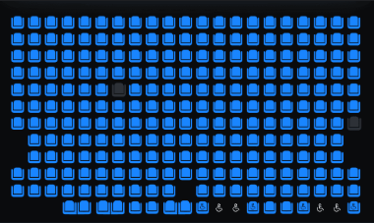
How it works

Slide 4

Target Audience

Slide 5
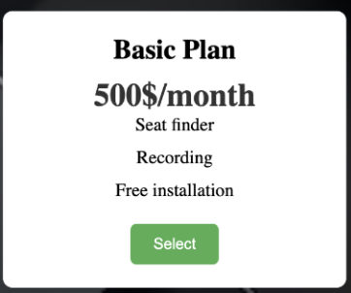
Pricing : basic plan

Slide 6
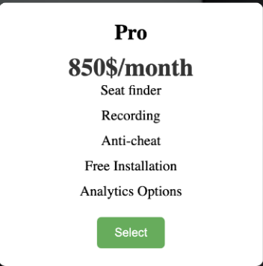
Pricing: Pro plan

Slide 7
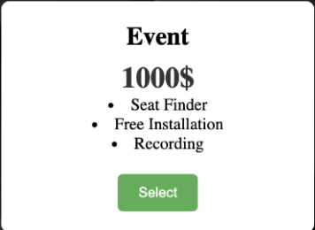
Pricing: Event

Slide 8
Website Demo

Slide 9



Our ask

Slide 10
Thank you
Do you have any questions?
spot-ter.github.io/Spotter_Website.github.io@YongEn0324 , @ipy06, @timanenasir, @Kiro025, @AlaeKabir

