Slide 1

Vidyalankar Polytechnic
Program:Information Technology

Slide 2
Project Title
Shubham Pote 18202A0002
Yash Hajare 18202A0024
Sanket More 18202A0025
Prasad Kashid 18202A0030
Guided By-
Prerana Jalgaonkar

Slide 3
Abstract
Online learning is when you take courses online instead of in a physical classroom.
Online learning is an essential part of life nowadays.
In this pandemic colleges, schools are working online for there students.
Students also have to perform there practical online.
This is the unique way for conducting practical online.
With online Learning students can do the exam online, in their own time, with their own device, regardless of where they live.

Slide 4
Introduction
Our Project Title is V-Practical . A system based on formalized submission of practical and assignment but with the help of electronic resources is known as V-Practical.
While submission can be based in or out of the classrooms, the use of computers and the Internet forms the major component of Submitting resource V-Practical.
However, with the rapid progress in technology and the advancement in systems, it is now embraced by the masses.
Practical submission can also be termed as a network enabled transfer of skills and knowledge, and the delivery of education is made to a large number of recipients at the same or different times.

Slide 5
Problem Statement
The V practical is mainly designed for the student and teacher for online practical submission.
The user has to login/signup in our web application.
The V practical system will provide teacher to add practical data online.
Once teacher complete there work of adding information about.
Practical student have to solve it and upload the output and code of practical.
Student have to solve the quiz related to it.
Student data will send to teacher.
Student can communicate with teacher.

Slide 6
Algorithm
Step 1: Start.
Step 2: Teacher logs into the System.
Step 3: Teacher adds practical.
Step 4: Student logs into the system.
Step 5: Student solves practical
Step 6: Student upload output and code.
Step 7: Data submitted.
Step 8: Data send to teacher.
Step 9: Stop.

Slide 7
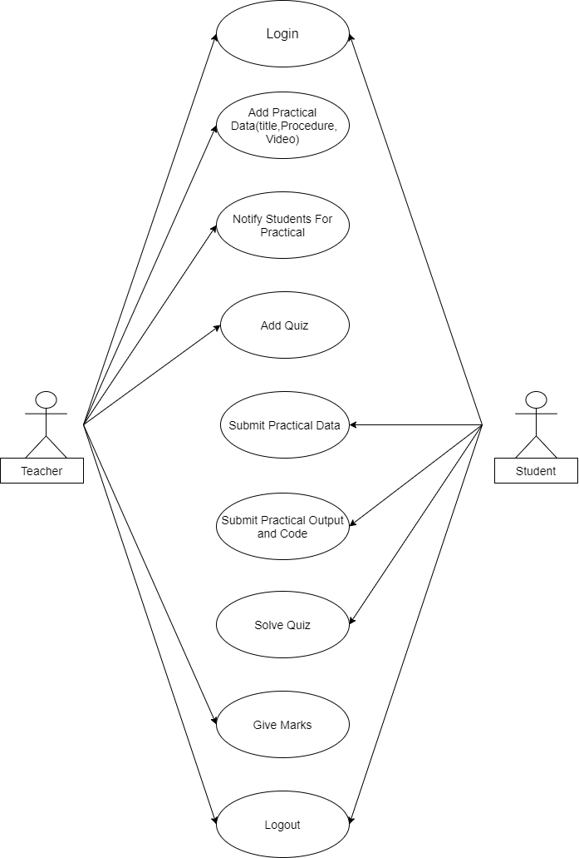
Use Case Diagram
Fig:- Use Case Diagram

Slide 8
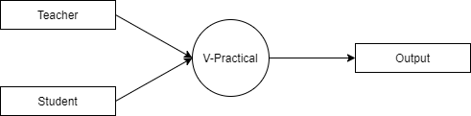
DFD Diagram
Fig:- DFD LEVEL (0)

Slide 9
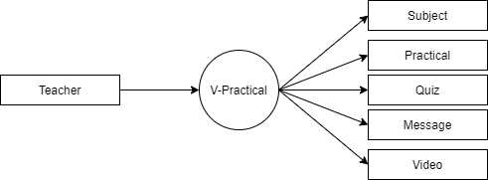
DFD Diagram
Fig:- DFD LEVEL (1)

Slide 10
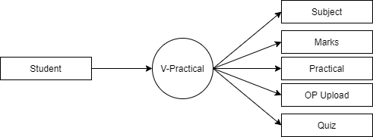
DFD Diagram
Fig:- DFD LEVEL (2)

Slide 11
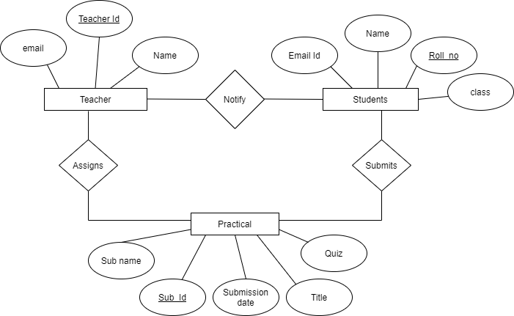
ER Diagram
Fig:- ER Diagram

Slide 12
Pros and Cons
Pros
Cons
It is an easy way to conduct practical online.
It will save time because it as easy way to interact online.
Simple UI and user friendly.
You can easily submit resources in several varying formats.
As you have access to the internet 24*7, you can perform practical anywhere and anytime.
Lack of social interaction.
If someone does not have access to internet then our application will not work.
Online Student feedback is limited.
Lack of communication skills.

Slide 13
Applications
Help to submit from anywhere at anytime.
It is interactive between teacher and students.
You can download practical uploaded by teacher.
Some reference link about concept will be provide for more information to the student.

Slide 14
Conclusion
A practical submission module is very essential for college/university. This proposed system is a web based application that provides facility for maintaining the practical data. This will help students to complete there practical and submit it online.

Slide 15
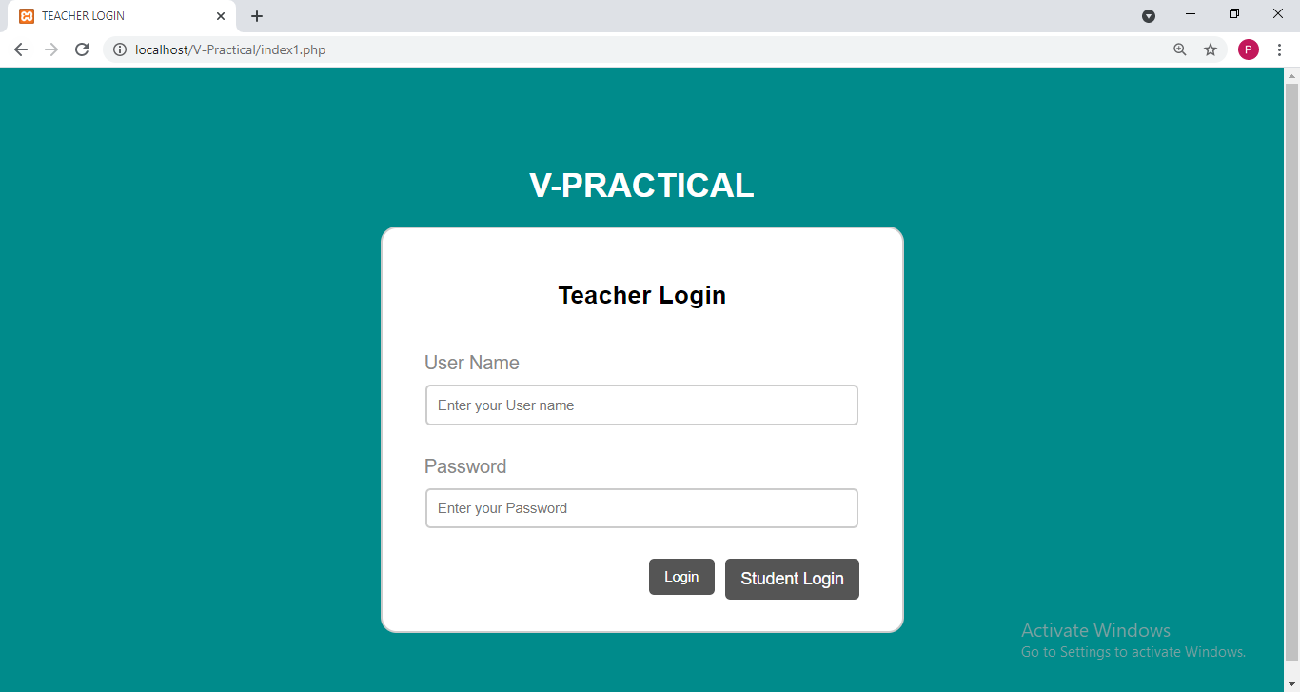
Output Screenshots
Fig:- Teacher’s Login

Slide 16
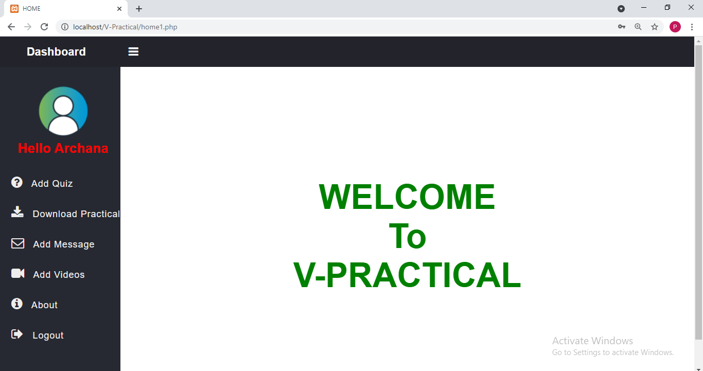
Output Screenshots
Fig:- Teacher’s Dashboard

Slide 17
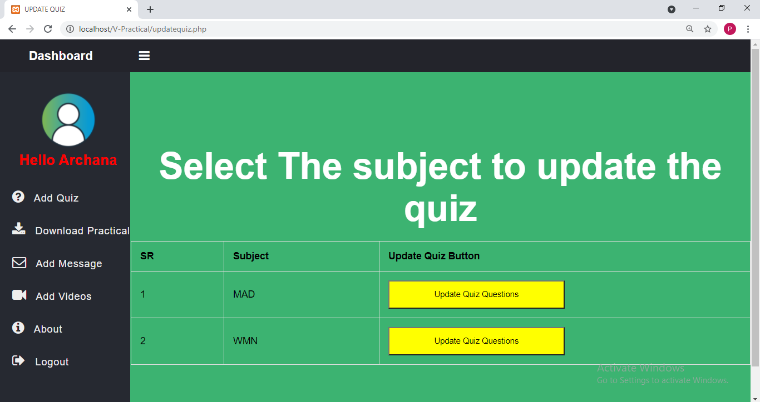
Output Screenshots
Fig:- Add Quiz

Slide 18
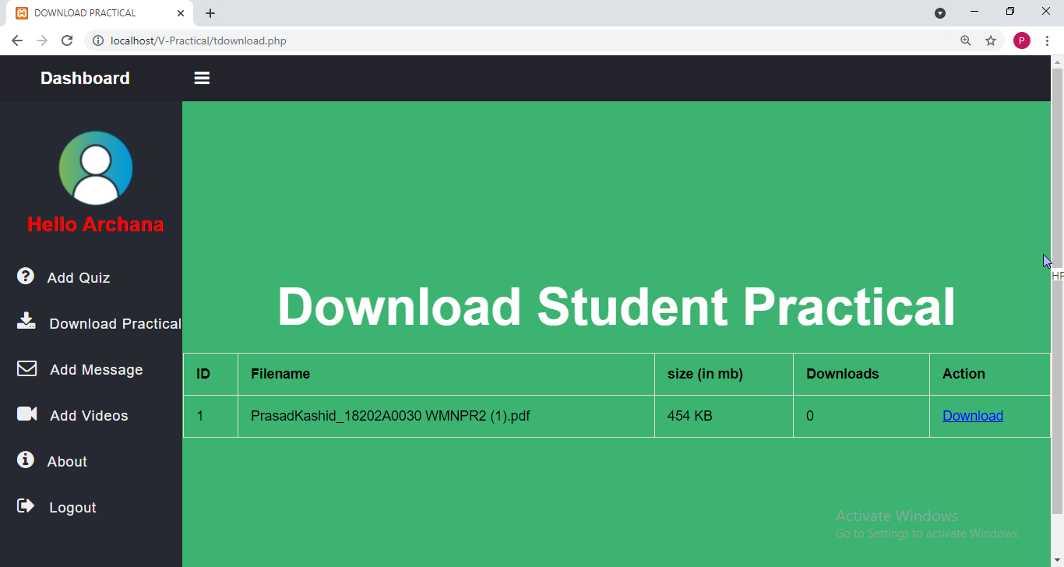
Output Screenshots
Fig:- Download Practical

Slide 19
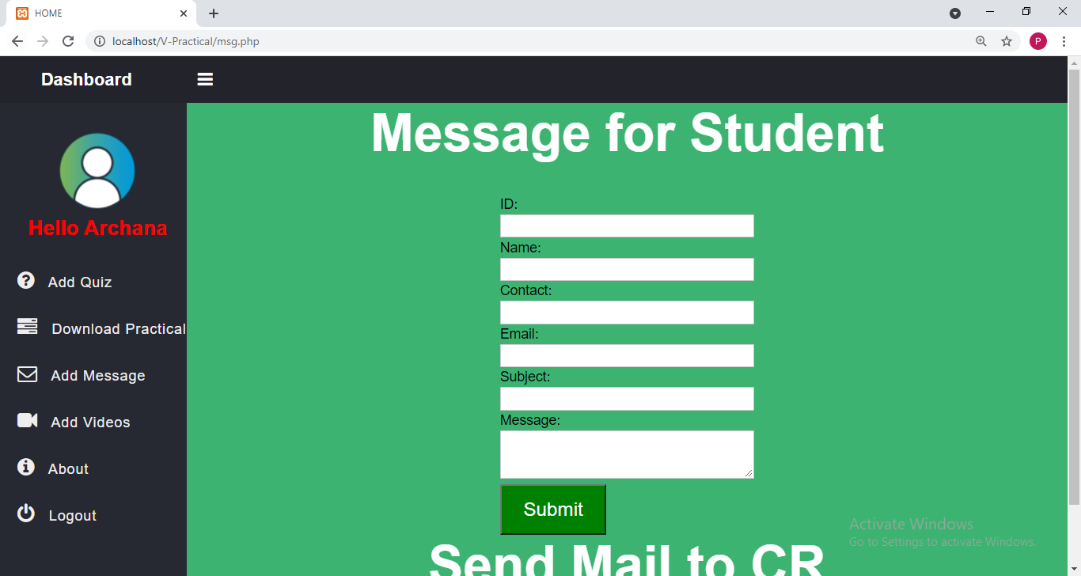
Output Screenshots
Fig:- Add Message

Slide 20
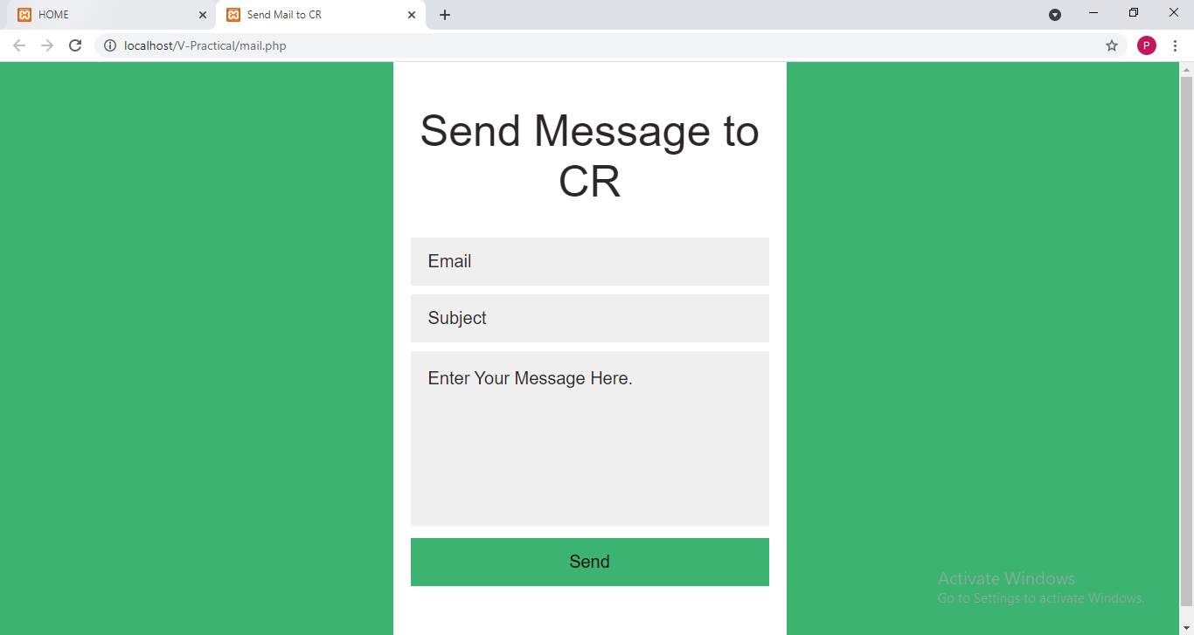
Output Screenshots
Fig:- Mail To CR

Slide 21
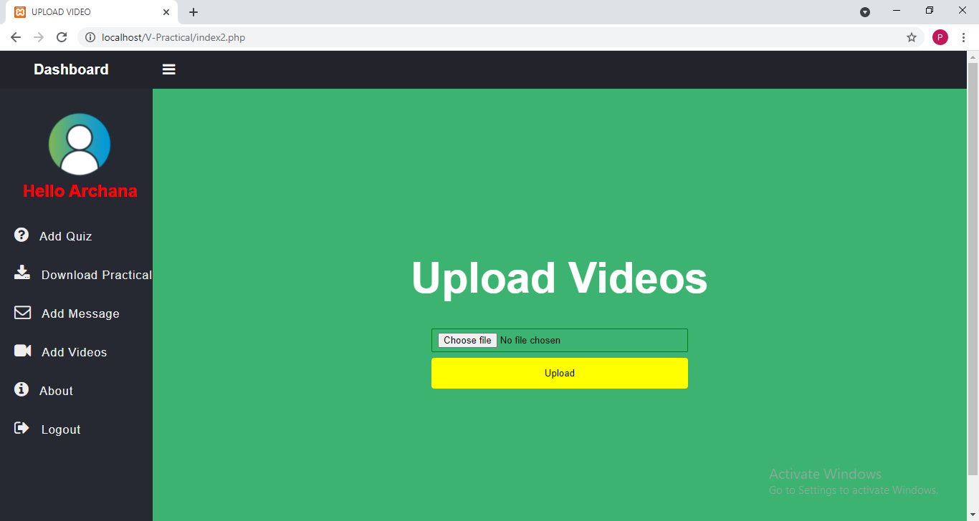
Output Screenshots
Fig:- Upload Video

Slide 22
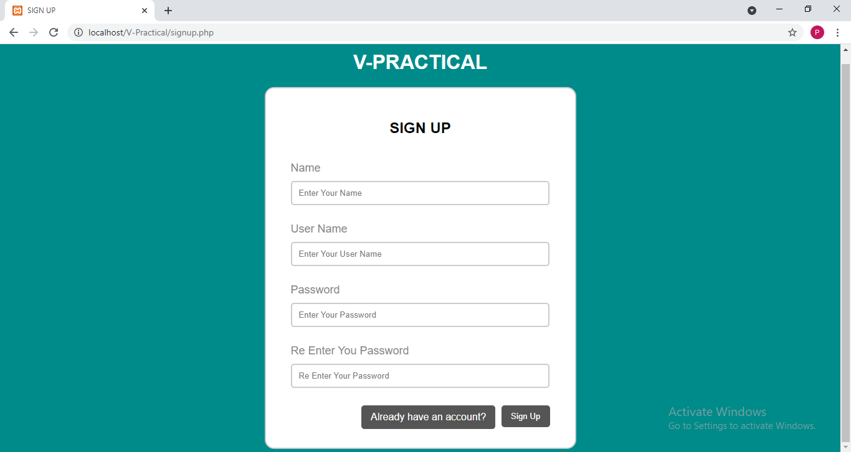
Output Screenshots
Fig:- Student Registration

Slide 23
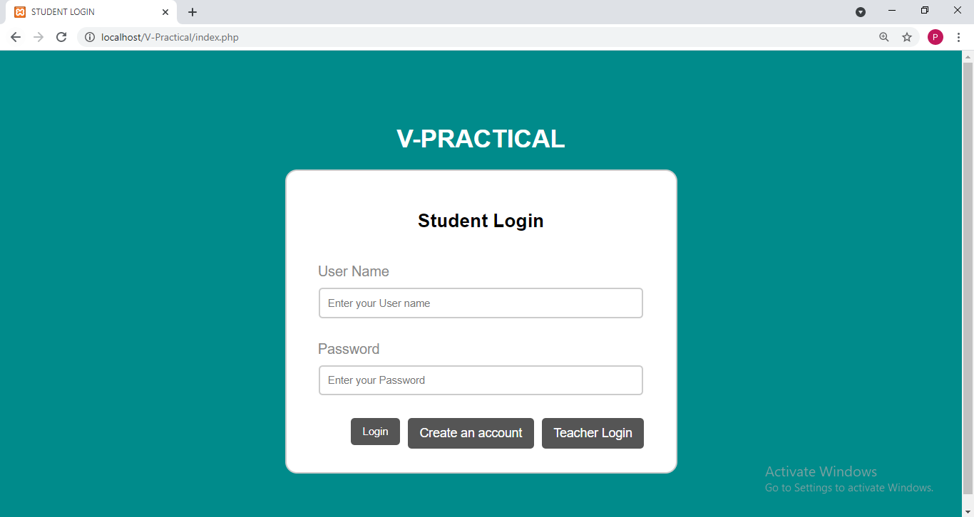
Output Screenshots
Fig:- Student’s Login

Slide 24
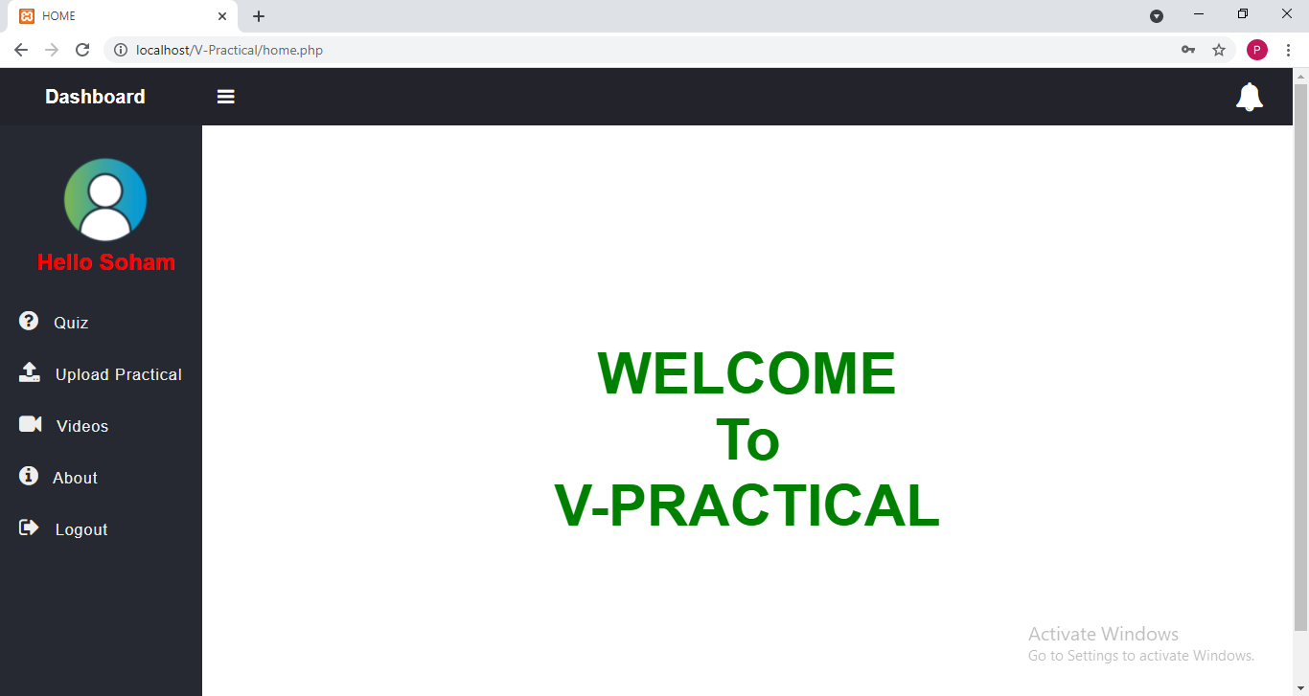
Output Screenshots
Fig:- Student’s Dashboard

Slide 25
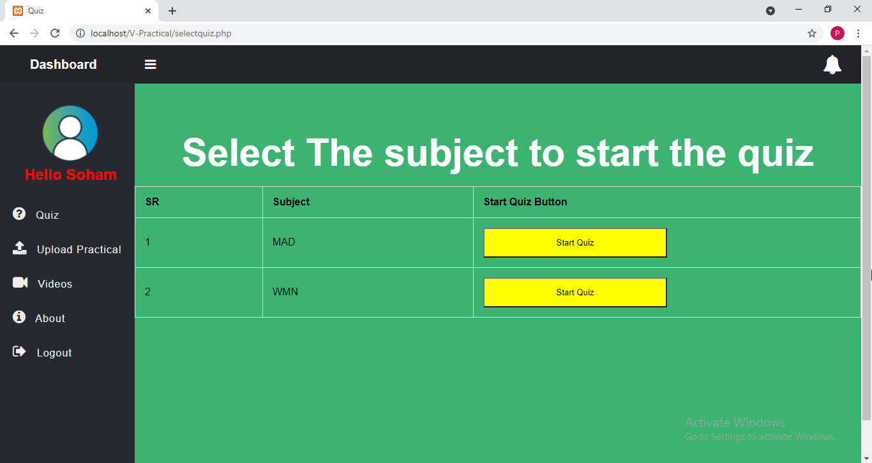
Output Screenshots
Fig:- Solve Quiz

Slide 26
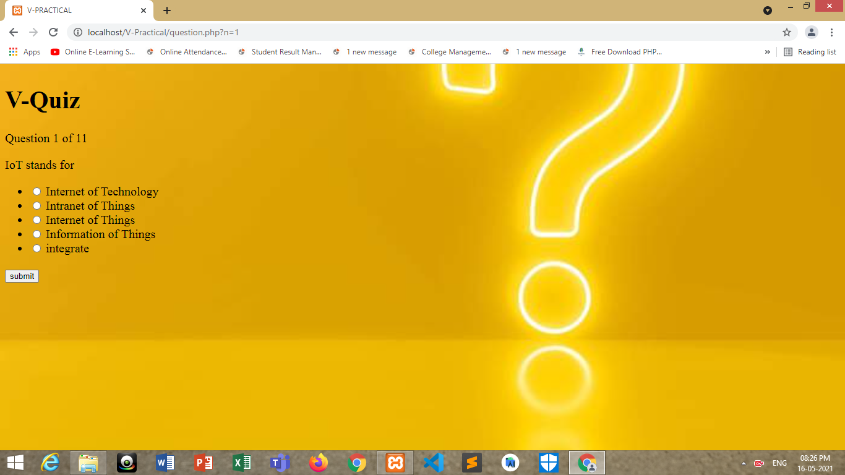
Output Screenshots
Fig:- Solve Quiz

Slide 27
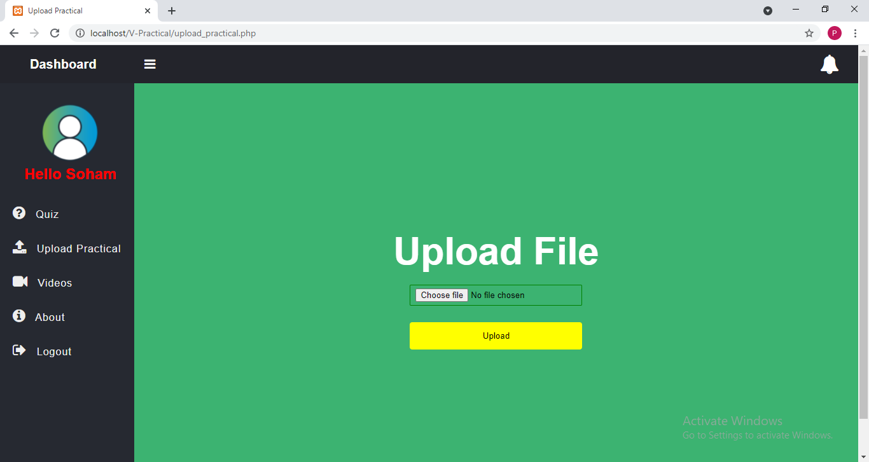
Output Screenshots
Fig:- Upload Solved Practical

Slide 28
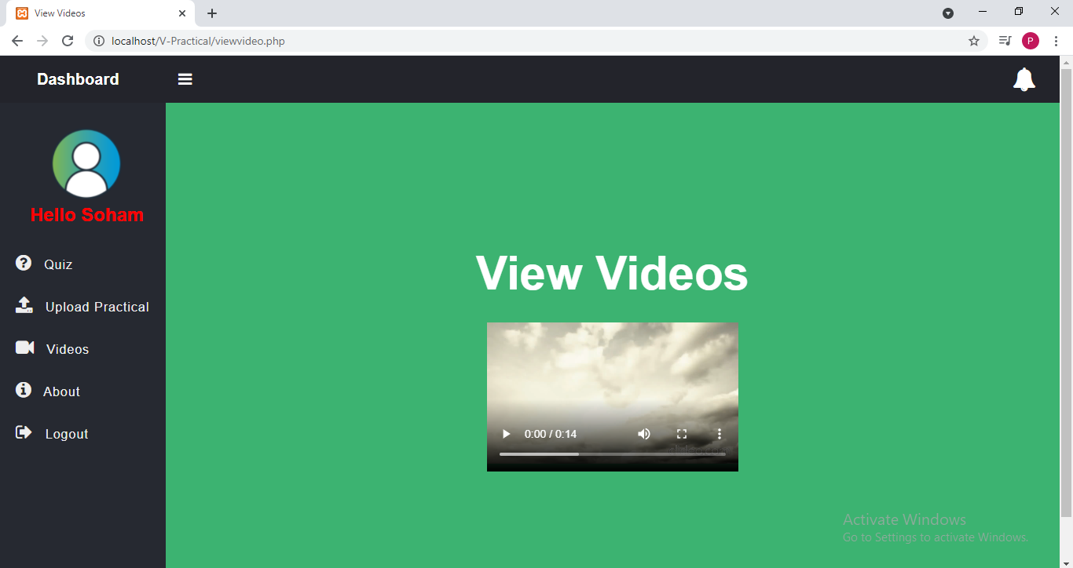
Output Screenshots
Fig:- View Videos

Slide 29
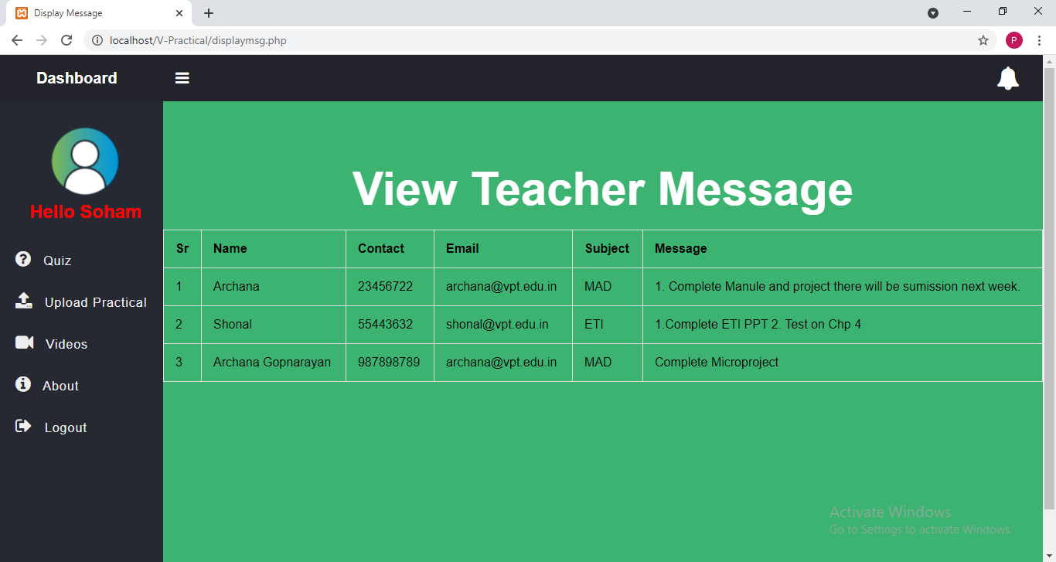
Output Screenshots
Fig:- Messages Sent By Teacher

Slide 30
Thank
You

