Slide 1
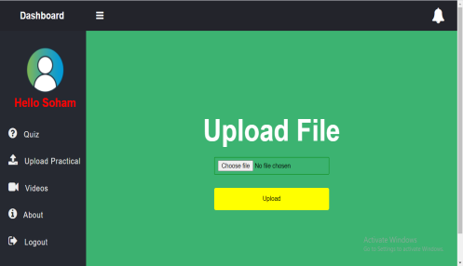
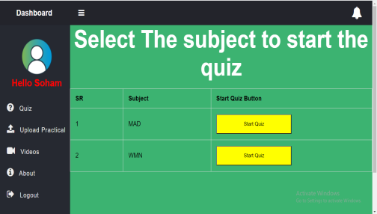
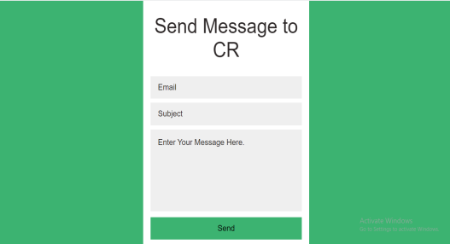
Program :Information Technology
Project Title : V-Practical
Domain (Area of Project) : Web Application
Name of Project Guide : Ms. Prerana Jalgaonkar
Name of Students : Yash Hajare
Prasad Kashid
Sanket More
Shubham Pote
Project Abstract : V-Practical is an integral part of smart education. The challenge is to easily integrate the V-Practical system into a smart educational environment based on the requirements of the users. The V-Practical services rely on a software system that allows access to all the materials for the educational process and makes them electronically available to all the students on the Internet whenever they need and wherever they are.
Screenshots of the Project / Photos of Working Model (Min.3):
Applications:
Students have to solve quiz.
Teacher can download practical submitted by students.
Students can Upload practical online.
Awards if Any for TPP / Competitions / Paper Publication / Any Other Pls. Specify: -- NA

