Slide 1
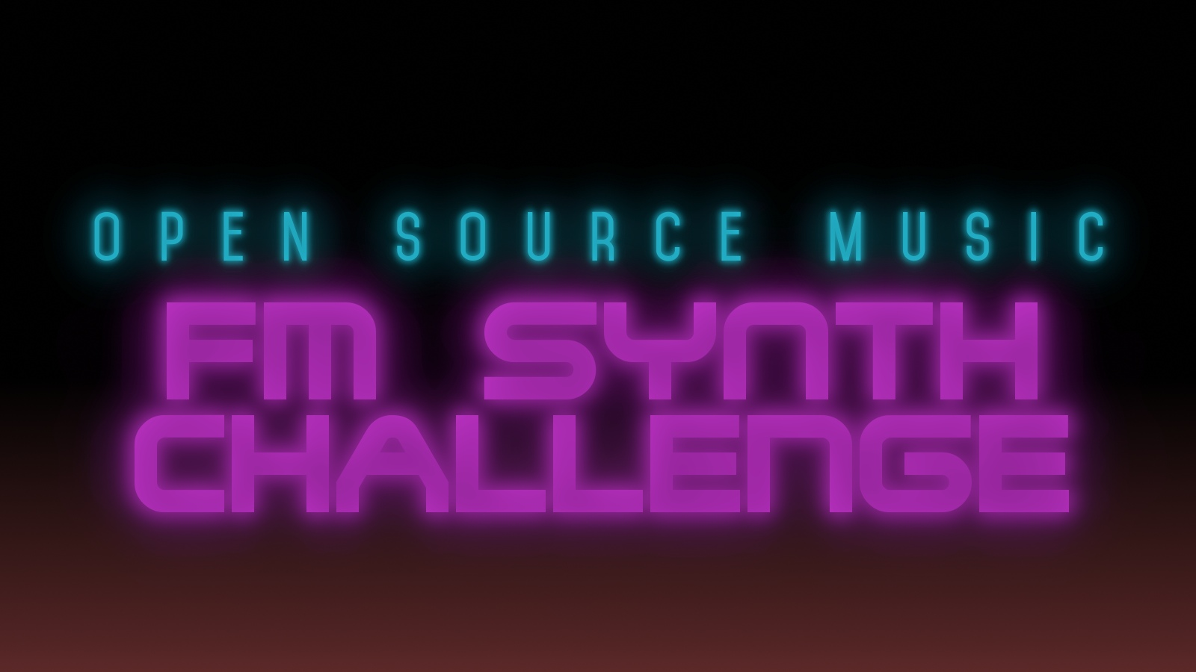

Slide 2
The Open Source Music
FM Synthesizer Challenge
2018
https://fmchallenge.osamc.de/

Slide 3
The Challenge
„Create a track using any of the selected Open Source FM Synthesizers and publish it on Archive.org under a Creative Commons License and enter the competition until the 15th October 2018.“
https://fmchallenge.osamc.de/rules/

Slide 4
The Process
One month submission period
Ten days voting period
All can vote
Winners presented at Sonoj Convention
(published on web site later today)

Slide 5
The FM Synths
6PM
ADLplug
Dexed
DX10 (MDA)
Hexter
JuceOPLVSTi
OpulenZ
Oxe FM Synth

Slide 6
The Prizes
First place wins a MOD Duo from MOD Devices.
Second and Third place each win a license for Cadmium by LHI Audio.
One voter selected by draw also wins a Cadmium license.
https://fmchallenge.osamc.de/prizes/

Slide 7
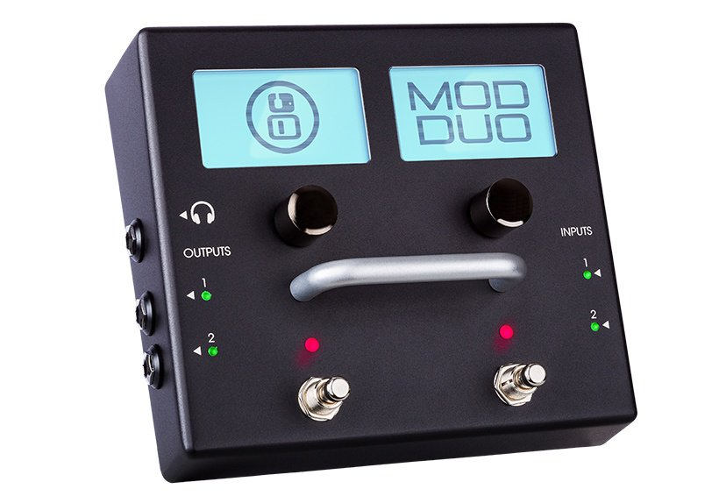
MOD Duo

Slide 8
The MOD Labs
MOD Devices invites developers to join the MOD Labs: https://www.moddevices.com/community/modlabs
Open-source plugin development, Arduino-based hardware creation and beta tester program
An environment for software and hardware development and experimentation
Invite-only area for certified community members to develop and test new ideas for new products

Slide 9
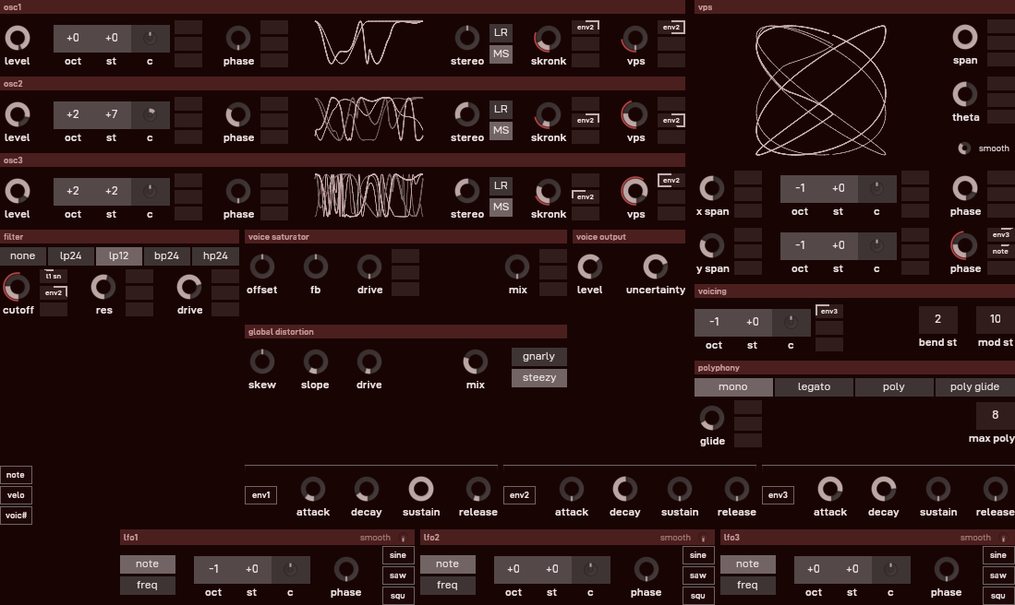
Cadmium

Slide 10
The Results
Fifteen entries
49 voters
15 points each
5 points to favourite entry, 4 points to second, 3 to third, and so on…
Entries received from 9 to 122 points.
Winner has clear margin of 34 points.

Slide 11
And the Third Place goes to...

Slide 12
Third Place
„C18H25NO“
by Lilith 93
(83 Points)

Slide 13
And the Second Place goes to...

Slide 14
Second Place
„End of the Desert“
by J.Ruegg
(88 Points)

Slide 15
And the Winner is...

Slide 16
First Place
„Bodacious“
by unfa
(122 Points)

Slide 17
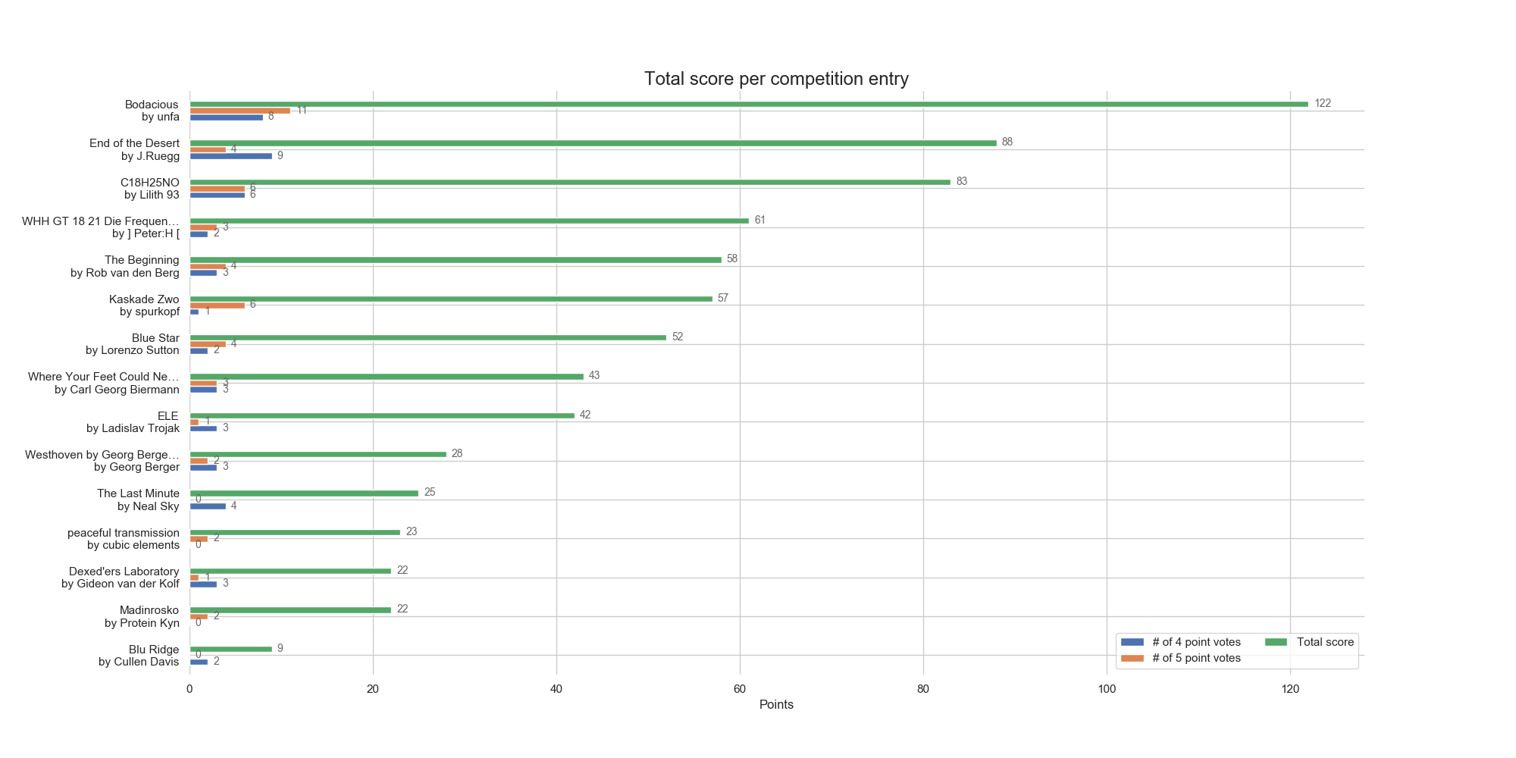

Slide 18
Voters Prize Draw

Slide 19
What Now
Winners are notified
Results published on web site later today
Spread the Word and the Music!
Tweets, Blogs, Podcasts, Playlists, Preset Packs
Check out the DAW projects and plugin presets
Enjoy the Music!

Slide 20
See you in 2019 for the next
Open Source Music Challenge...?

