Slide 1
Open Source Music Nexus Challenge
Award Presentation at
Sonoj Covention
26.10.2019 C4, Cologne

Slide 2
Open Source Audio Meeting Cologne
presents ...

Slide 3
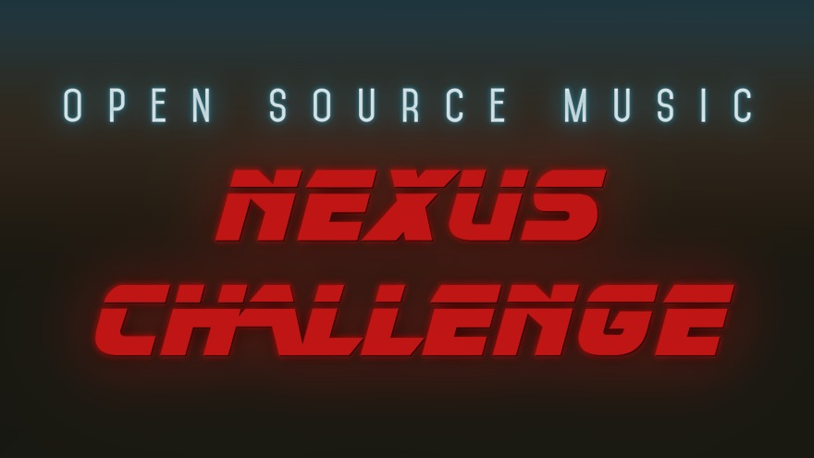

Slide 4
The Challenge
Make a musical track:
using Open Source Software
including a „real“ recording
homage or a pastiche

Slide 5
The Organizers
Open Source Audio Meeting Cologne (OSAMC)
Actual organizing & website: Christopher Arndt

Slide 6
Timeframe
Submission period: 19.9 – 19.10.2019
Voting period: 20.10 – 26.10.2019

Slide 7
Voting
Voting free to everyone
Participants must vote
Can‘t vote for their own entry
5 points for favorite track, 4 points for second favorite, and so on …
Entry with most points wins

Slide 8
Prizes
Samuel Aubert, from Tonstudio Tübingen, is sponsoring free mastering for the winners of the challenge:
First place: 3 songs mastered!
Second place: 2 songs mastered
Third place: 1 song mastered

Slide 9
The Results
Eight submissions
Very stylistically diverse
26 voters
89 – 26 points per track

Slide 10
Third Place
„Rainbow Brain“
by
Michele Marangon
68 points

Slide 11
Second Place
„Silver“
by
Jeanette C.
74 points

Slide 12
and the Winner is ...

Slide 13
First Place
„Another Day“
by
Spotlight Kid feat. Julia Cramer
89 points

Slide 14
Score Board
Spotlight Kid - „Another Day“: 89
Jeanette C. - „Silver“: 74
Michele Marangon - „Rainbow Brain“: 68
Nomys_Tempar - „Expression“: 43
chance to tliwosc - „Die Muckis des Jindrich Zank“: 32
Georg Berger - „Gemuesetreppe a la Reich“: 32
Maple Dye - „Hey Mister Mixer“: 26
cubic elements - „No Deep Fake“: 26

Slide 15
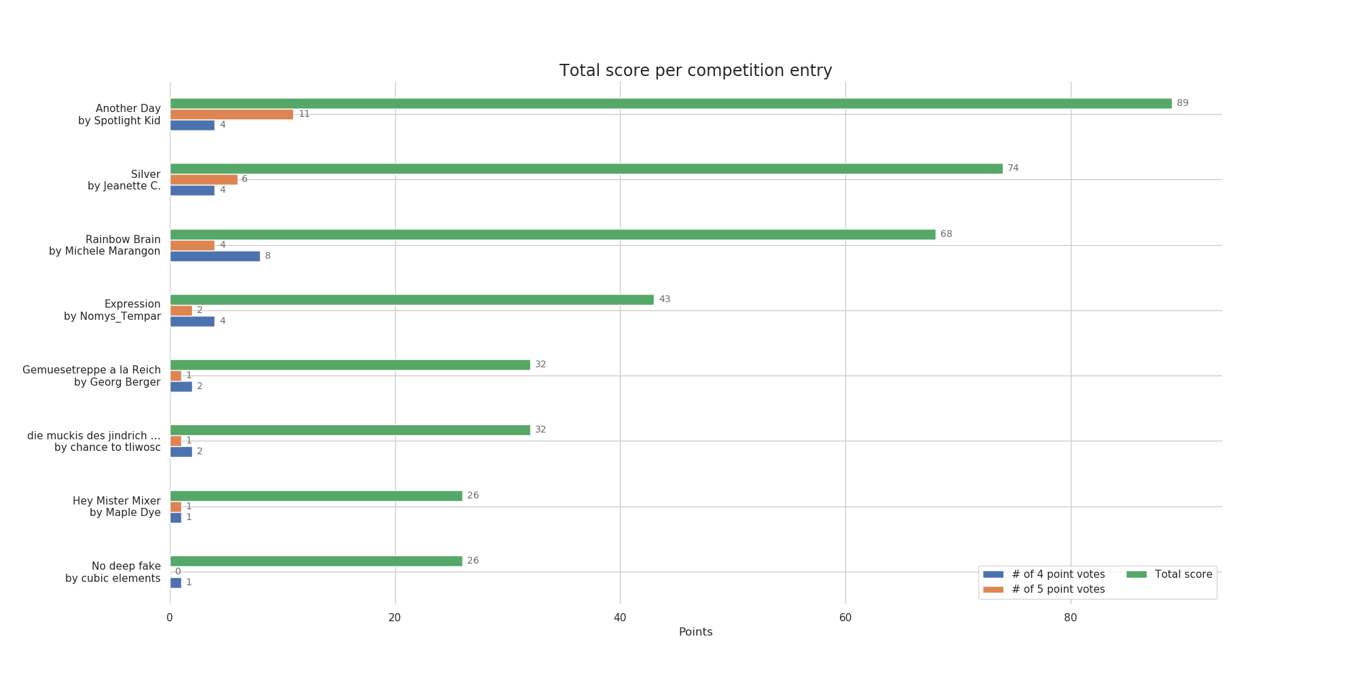
Score Graph

Slide 16
The Future
Results will be on the website later today (tonight):
https://nexus-challenge.osamc.de/results/
There will be a new challenge in 2020
Maybe even earlier than Sep. / Oct. (not sure)
Theme to be decided (but different)
Better marketing
Website improvements

Slide 17
See you for the next challenge
in 2020 ...

