Slide 1
ICU Mortality Prediction Tutorial
A step by step ML workflow to Predict ICU mortality using public ICU mortality dataset

Slide 2
Overview
Summary
Exploratory Data Analysis
Dataset extraction
Data Analysis
Data Cleansing
Machine Learning Models
Logistic Regression Model and
Random Forest Model
Codes
.venv
icu_data_analysis_and_cleansing.py
icu_mortality_logreg.py
icu_mortality_balanced_models.py
Result Analysis (Evaluation)
Logistic Regression Model with Original Dataset
Balanced Logistic Regression Model and Random Forest Model with Cleansing Dataset
Conclusion

Slide 3
Summary
Purpose:
Build a supervised ML classifier with ICU dataset to predict mortality
Demonstrate the pipeline: data extraction -> cleaning -> modeling -> evaluation
Background:
Mortality prediction plays a critical role in the intensive care unit (ICU) due to rapid changes in patient’s condition. Through reliable tools to identify risk factors, early intervention can be applied effectively
ML for ICU predictive risk model:
High dimension of ICU data
Non-linear and complex risk factors
Large dataset for training, and optimize for generalization

Slide 4
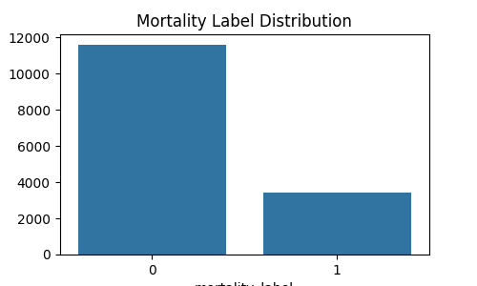
EDA I Exploratory Data Analysis
Dataset Extraction:
Use public available ICU data from Kaggle: ICU Patient Monitoring & Mortality Prediction
Contains 15,000 synthetic intensive care unit (ICU) patient records
Each row represents a single ICU admission with aggregated vital sign statistics, treatment interventions, organ failure severity scores, and outcome labels.
The mortality_label column represents:
0 = Survived ICU stay
1 = Deceased during ICU stay
Dataset Analysis
The mortality label distribution:

Slide 5
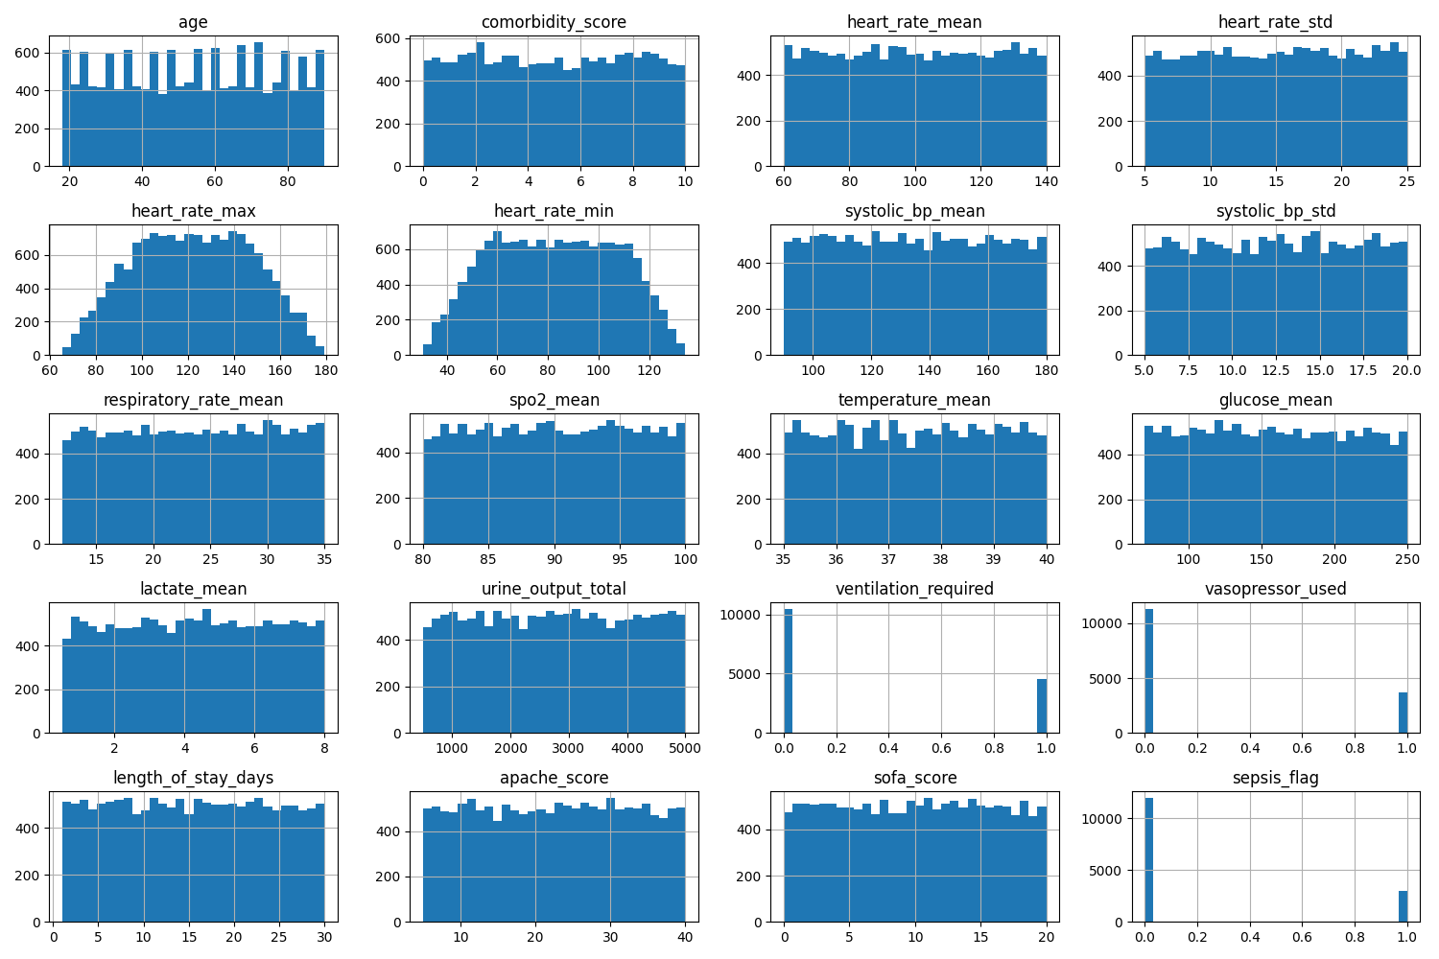
EDA II Exploratory Data Analysis
Dataset Analysis
Number of features distribution:

Slide 6
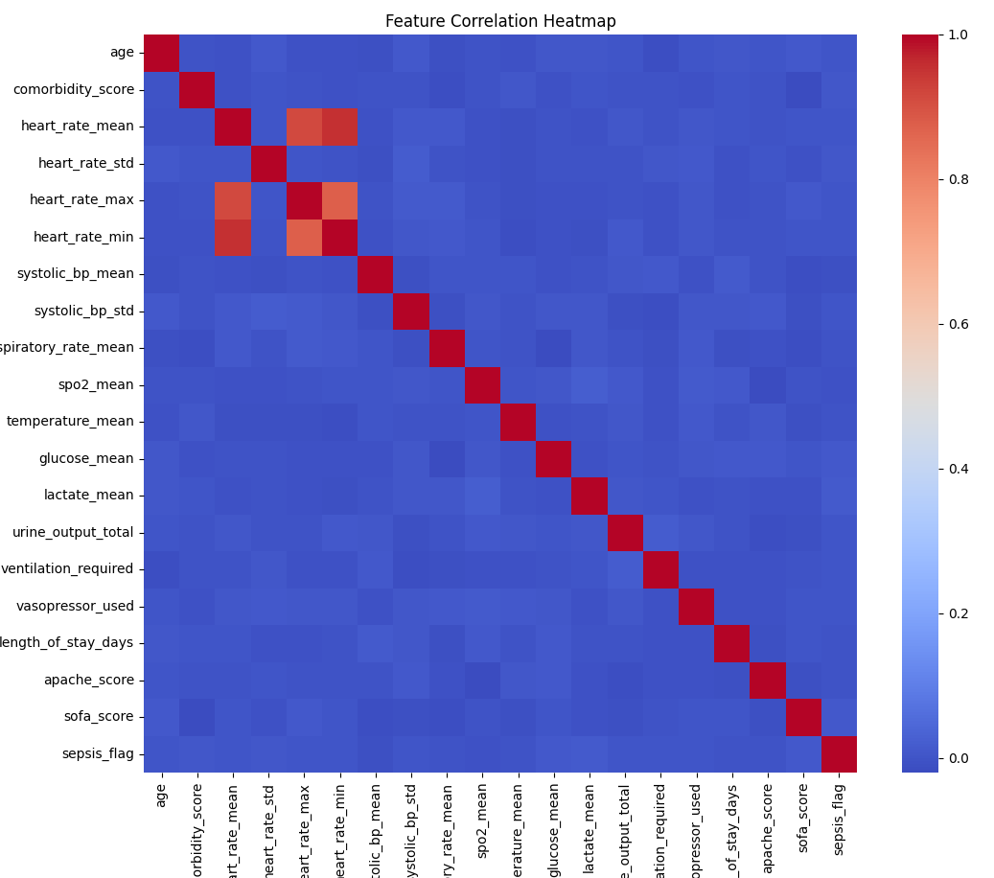
EDA III Exploratory Data Analysis
Dataset Analysis
Features correlation Map: heart_rate_max, heart_rate_min and heart_rate_mean are highly correlated due to same risk factor with different aggregation

Slide 7
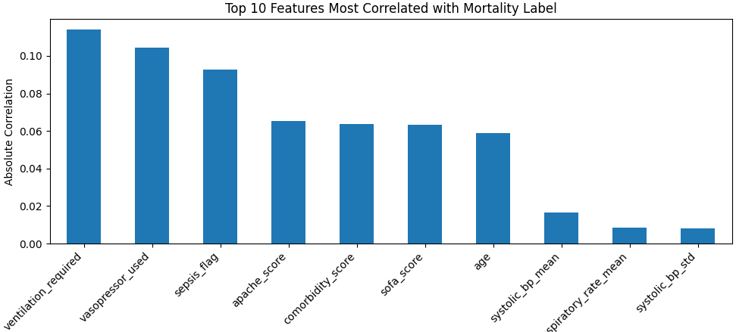
EDA IV Exploratory Data Analysis
Dataset Analysis
The next two charts show the potential high-risk factors based on correlations and mean differences
Top 10 features correlated with the mortality label

Slide 8
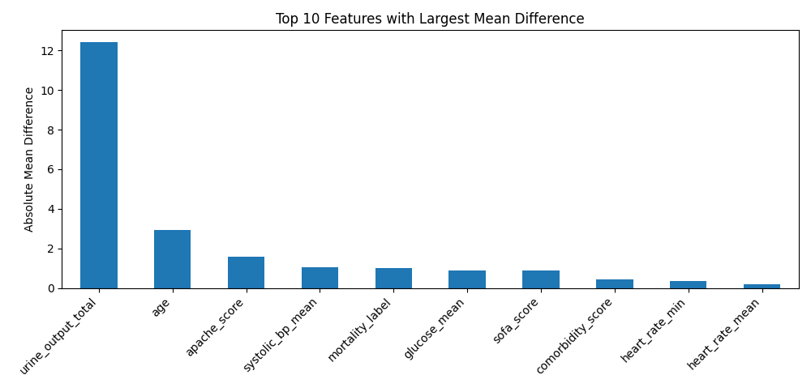
EDA V Exploratory Data Analysis
Dataset Analysis
Top 10 features with largest mean differences

Slide 9
Machine Learning Models
Models used in ICU mortality prediction
Logical regression model
Classic machine learning model used for binary classification problems
Works well for linear and approximate linear relationship
Easy to understand and computationally efficient
Random Forest Model
An ensemble machine-learning method, builds many decision trees and averages predictions to improve accuracy and reduce overfitting
Capture non-linear relationship
Robust to noise and missing data

Slide 10
Codes I
Virtual environment (.env)
Set up virtual environment with required packages for data analysis, ML, Charts.
Pandas, sklearn, matplotlib, imblearn and seaborn
EDA (icu_Data_analysis_and_cleansing.py)
Analyze the stats of features
Analyze correlations between features
Analyze the correlation between features and targets
Put the results in charts
Based on 30% missing rule to conduct data cleansing
Save the cleaned data for the ML

Slide 11
Codes II
Simple logistical regression model (icu_mortality_logreg.py)
All features are used, original dataset
Even though there is high correlation between heart_rate_max, heart_rate_min and heart_rate_mean, no action to remove any of them
Even though there is imbalance dataset between survive (o) and not survive(0), no action is taken
Key Parameters:
Test data size 0.2
Max_iter =1000
Threhold = 0.5
Key functions:
Call the logisticregression model, train the model with max_iter, weight
Generate accuracy, confusion matrix and classification report for

Slide 12
Codes III
Balanced model (icu_mortality_balanced_models.py)
Cleaned dataset
heart_rate_max, heart_rate_min are dropped for ML training and test
imbalance dataset between survive (o) and not survive(0) is handled through class_weight
Key Parameters:
Test data size = 0.2
Max_iter =1000
Threhold = 0.5
Class_weight = balanced
Key functions:
Train the logistic regression and random forest model with the key parameters
Generate accuracy, confusion matrix and classification reports

Slide 13
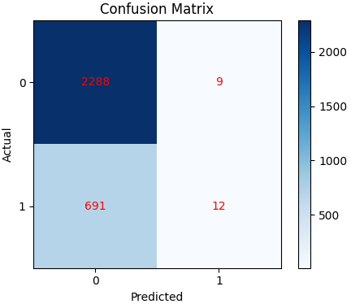
Result Analysis (Evaluation) I
Simple logistical regression model (icu_mortality_logreg.py)
Accuracy: 76.7%
Confusion Matrix: we can see the survivor prediction is high, but the non survivor prediction is poor.

Slide 14
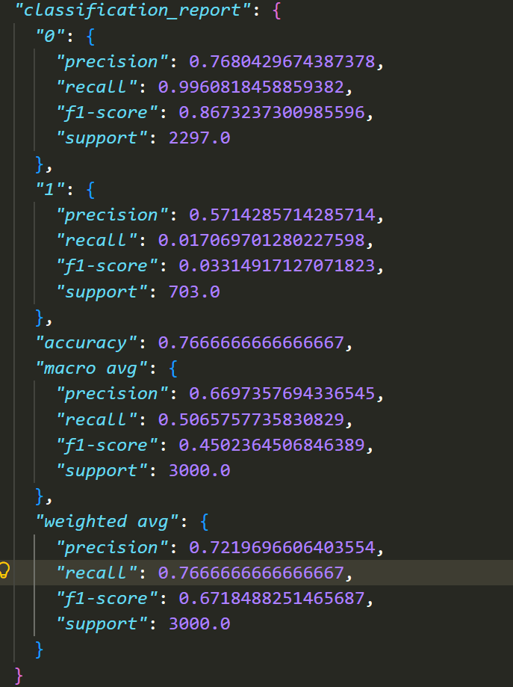
Result Analysis (Evaluation) II
Simple logistical regression model (icu_mortality_logreg.py)
Detail classification Results:
For survivor (0): works well
of all predictions, 77% were correct
Of all actual class, 99.6% were correctly identified
Harmonic mean of precision and recall is 87%
2297 number of true samples
For non survivor (1): works poor
of all predictions, 57% were correct
Of all actual class, 1.7% were correctly identified
Harmonic mean of precision and recall is 3%
703 number of true samples
Conclusion: this simple model is very good at identify class 0 but poorly at identify class 1, suggest imbalance class may contribute to the model bias

Slide 15
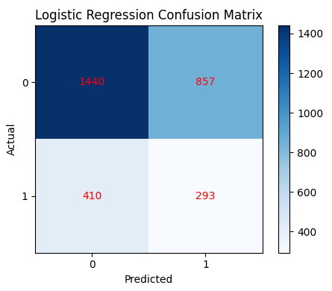
Result Analysis (Evaluation) III
Balanced models (icu_mortality_balanced_models.py)
Balanced Logistic regression model:
Accuracy: 57.8%
Confusion matrix
Survivor prediction accuracy is reduced
Non survivor prediction accuracy is improved

Slide 16
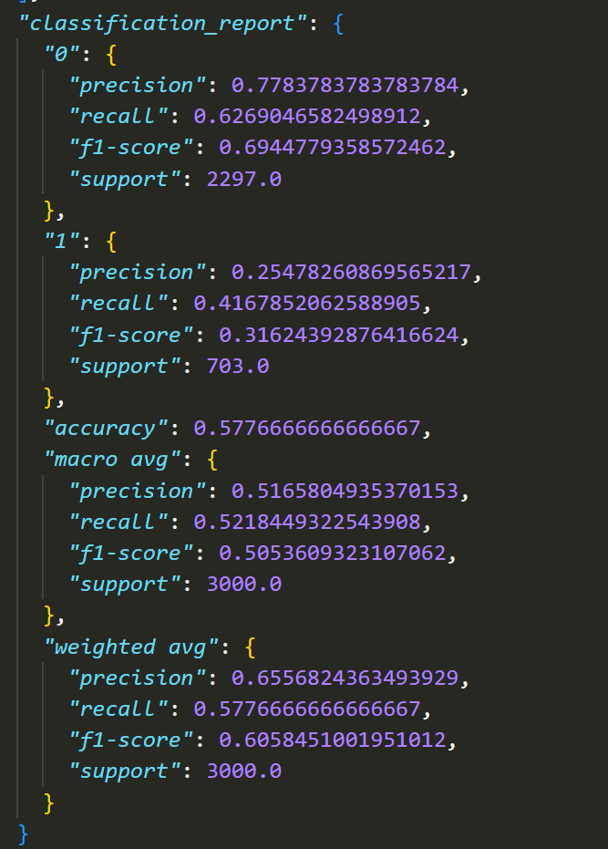
Result Analysis (Evaluation) IV
Balanced models (icu_mortality_balanced_models.py)
Balanced Logistic regression model:
Detail classification Results:
Survivor (0)
Of all the prediction precision: 77.8% were correct
Of all the actual class, 62.7% were correctly identified
Harmonic mean of precision and recall is 69%
2297 number of true samples
Non Survivor (1)
Of all the prediction precision: 25% were correct
Of all the actual class, 41.7% were correctly identified
Harmonic mean of precision and recall is 31.6%
703 number of true samples
Conclusion: balanced logistic regression model improves the non survivor prediction performance, reduced the model biased, hence the class_weight balanced parameter works as expected.

Slide 17
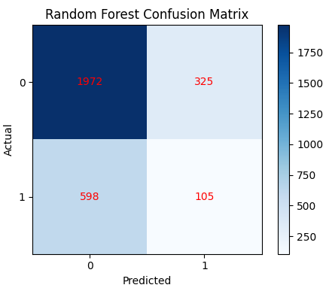
Result Analysis (Evaluation) V
Balanced models (icu_mortality_balanced_models.py)
Balanced Random forest model:
Accuracy: 69.3%
Confusion matrix
Survivor prediction accuracy is improved compare with balanced logistic regression model
Non-Survivor prediction accuracy is reduced compare with balanced logistic regression model

Slide 18
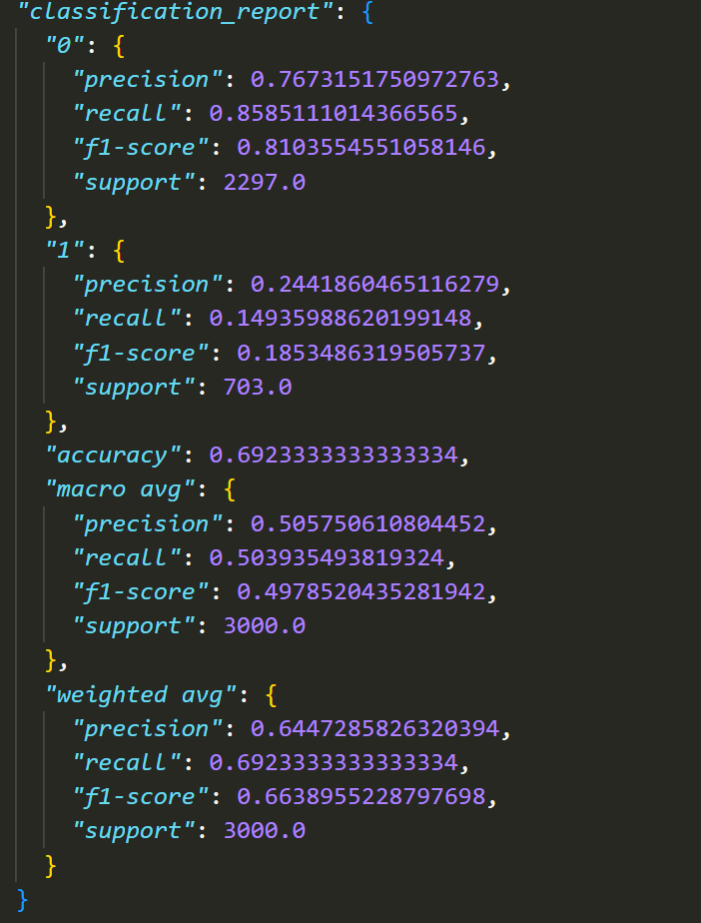
Result Analysis (Evaluation) VI
Balanced models (icu_mortality_balanced_models.py)
Balanced Random forest model:
Detail classification Results:
Survivor (0)
Of all the prediction precision: 76.8% were correct
Of all the actual class, 85.9% were correctly identified
Harmonic mean of precision and recall is 81%
2297 number of true samples
Non Survivor (1)
Of all the prediction precision: 24% were correct
Of all the actual class, 15% were correctly identified
Harmonic mean of precision and recall is 18.5%
703 number of true samples
Conclusion: compare to balanced logistic regression model, the balanced random forest model improves the overall accuracy but still bias towards the survivor class prediction. And all the code is located at SpotsMom/AI_380H

Slide 19
Conclusion
ML is powerful too in the clinic risk factor identify and prediction
Data play a key role for the performance of ML
Even though parameters and different models can be applied to reduce the bias, but there always a trade off between class prediction
Next step: would suggest to get more synthesized data to improve the data quality and try to run the same model to validate the performance

