Slide 1

Team Nautilus
Kenny Kline - TL 1
The Shipwreck Protocol

Slide 2
Team Members
TL1 - Kenny - Bosses
TL2 - Sam - Levels
TL3 - Davin - UI/Menus
TL4 - Shawn - Audio/Items
TL5 - Alice - Enemies
TL6 - Ben - Player/Controls

Slide 3
Gantt Charts

Slide 4
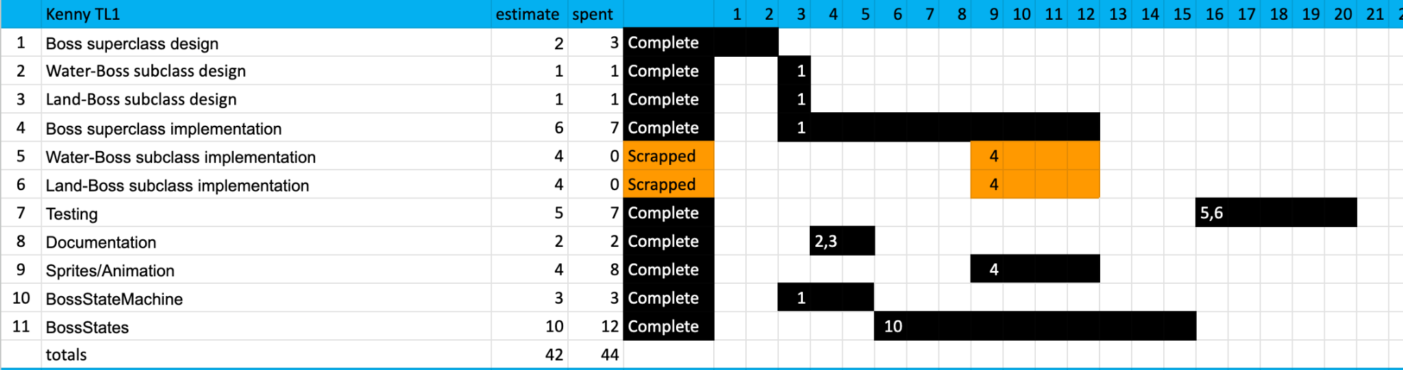
Gantt - Kenny TL 1
Notes:
State machine took longer than I thought, scrapped different types of bosses

Slide 5
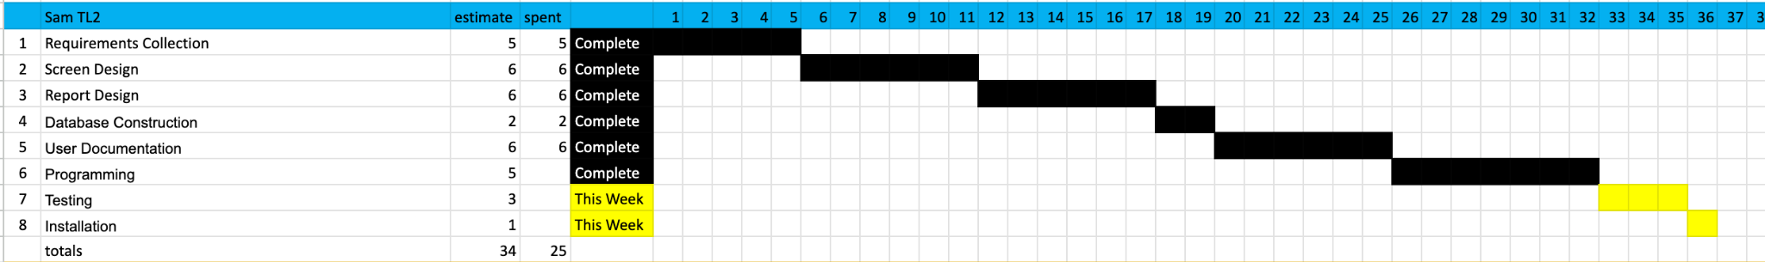
Gantt - Sam TL 2

Slide 6
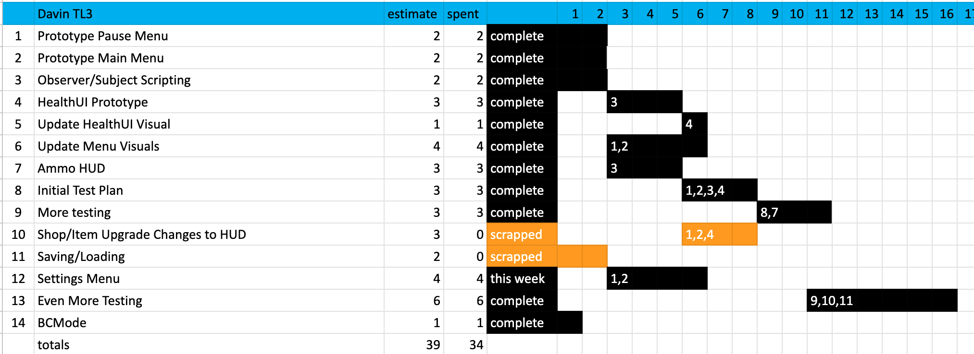
Gantt - Davin TL 3
Notes:
BC Mode, initial load screen, scrapped saving game

Slide 7
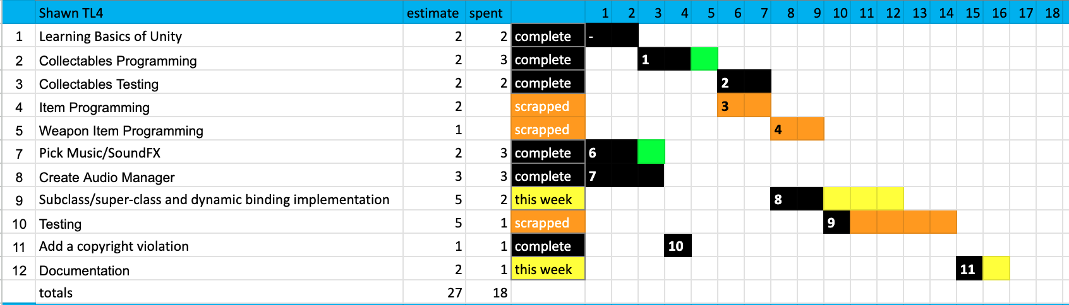
Gantt - Shawn TL 4
Notes:
Little out of date, green is longer than estimated

Slide 8
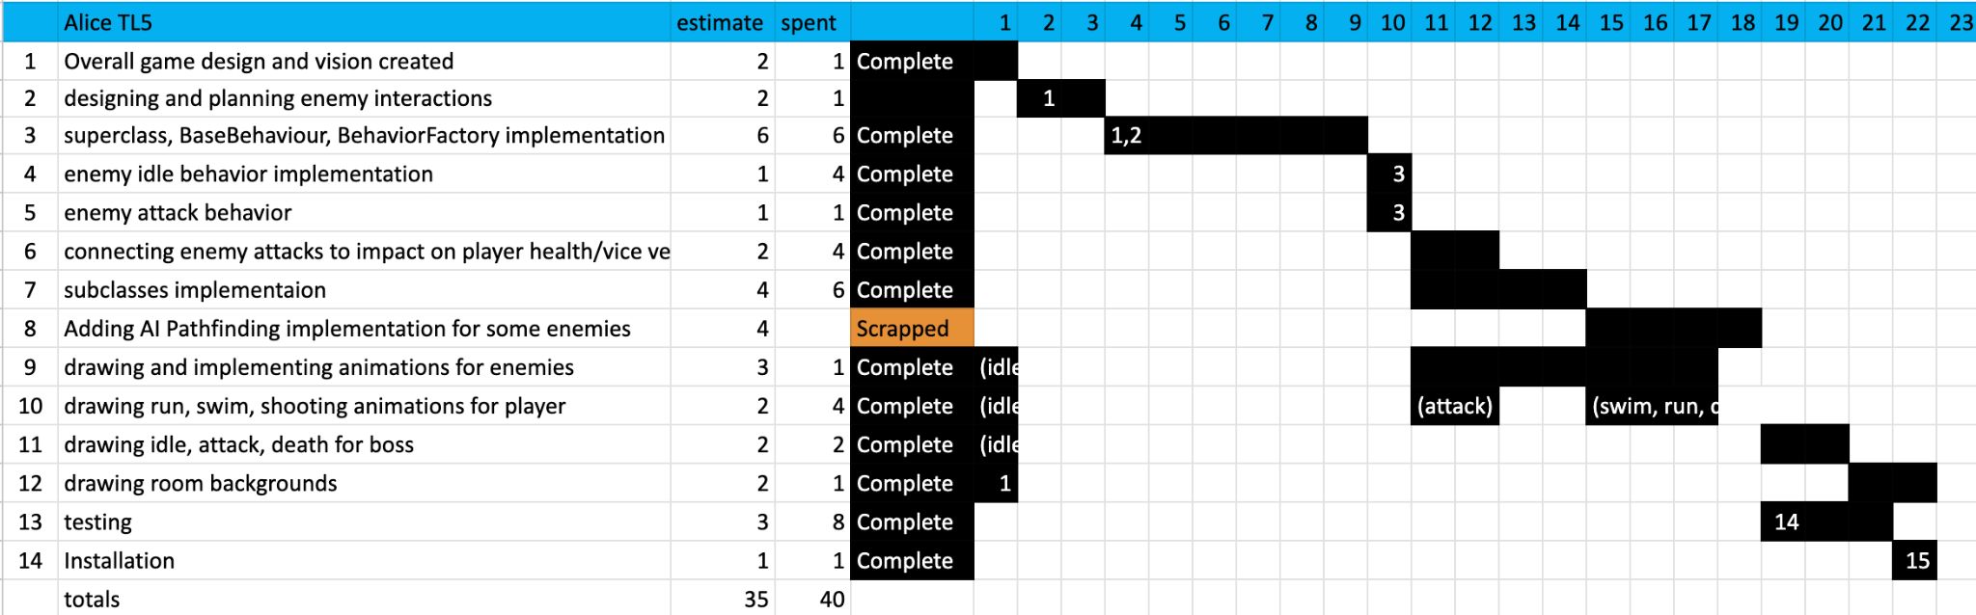
Gantt - Alice TL 5
Notes:
Enemies, different types

Slide 9
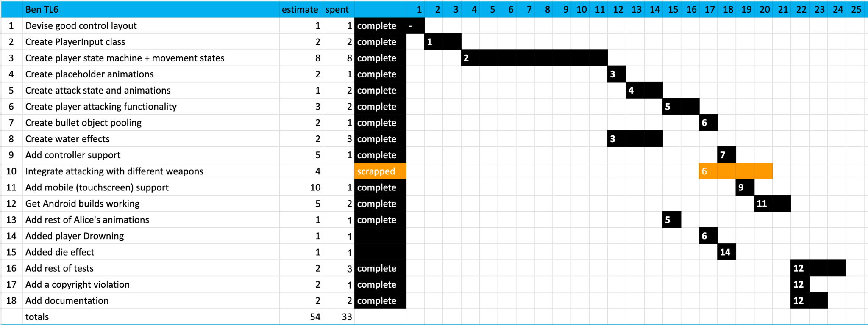
Gantt - Ben TL 6
Notes:
Player drowns, death effect

Slide 10
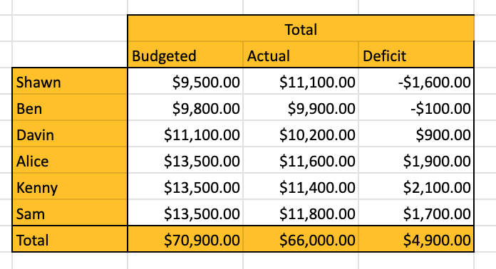
Costs

Slide 11
Pair Programming
Ben/Davin - Continued work with items (interactions with the environment, required items to open certain doors)
Kenny/Alice/Sam - Map and level design
Shawn - Working on a different group’s game

Slide 12
Final Demo Prep
Level design to give the game an actual objective (will be done in the pair programming)
Make sure that the game is working across platforms

Slide 13
Team Nautilus
Demo

Slide 14
Team Nautilus
Questions?

