Slide 1
Machine Learning NLP Price Negotiation Chatbot
DETAILED PROJECT REPORT
- Sarampenta Praveen

Slide 2
Title: | Machine Learning NLP Price Negotiation Chatbot
Technologies: | Python Flask
Domain: | Business
Project Difficulty level: | Intermediate
Organization: | iNeuron Intelligence Private Limited
Tools used: | Vscode,Jupyter Notebook,Github,

Slide 3
Abstract This project focuses on the development of a Machine Learning Natural Language Processing (NLP) Price Negotiation Chatbot, employing various technologies to enhance its functionality. The chatbot utilizes Dialogflow as an interface for seamless communication between the backend and frontend, providing a user-friendly experience. The Cassandra Database is employed to efficiently store login details, track product availability, and preserve negotiated prices and entire conversation histories. The backend of the chatbot is powered by Python Flask, ensuring robust and scalable performance. To facilitate accessibility across devices, NGROK is employed to run the chatbot as an HTTPS server. This setup allows users to engage in price negotiations and product inquiries effortlessly, while also enabling the system to store and retrieve pertinent information for a streamlined user experience. The amalgamation of these technologies forms a comprehensive solution for an intelligent, efficient, and adaptable price negotiation Chatbot.

Slide 4
Problem Statement:
A chatbot system that can negotiate the price of the products.
Many ecommerce companies are researching on this project as it has a lot of scope in business. The chatbot should be able to communicate with users and handle the bargaining of customers just like in the real world.
Objective:
1. Chatbot should be able to communicate with users.
2. It can negotiate the price of the products.
3. Maintain a database to store each and every data.

Slide 5
Requirements:
Hardware requirements: A working computer to code with active internet connection.
Tools/Software requirements:
Account in Dialogflow (https://dialogflow.cloud.google.com/).
Python 3.11. ( python.org )
NGROK application downloaded based on the operating system (https://ngrok.com/download).
Account created in the Cassandra Database (https://astra.datastax.com/).
Necessary Python libraries: TensorFlow, NLTK, Flask, json, cassandra, hashlib, datetime
Integrated Development Environment (IDE) such as Visual Studio Code or PyCharm.
Web browser for testing and interacting with the frontend.
Operating System: Compatible with any OS, including Windows, mac OS, and Linux

Slide 6
Data Collection:
The dataset has been created using Dialogflow.
https://dialogflow.cloud.google.com/#/editAgent/limupa-chatbot-wmug/

Slide 7

Architecture design

Slide 8
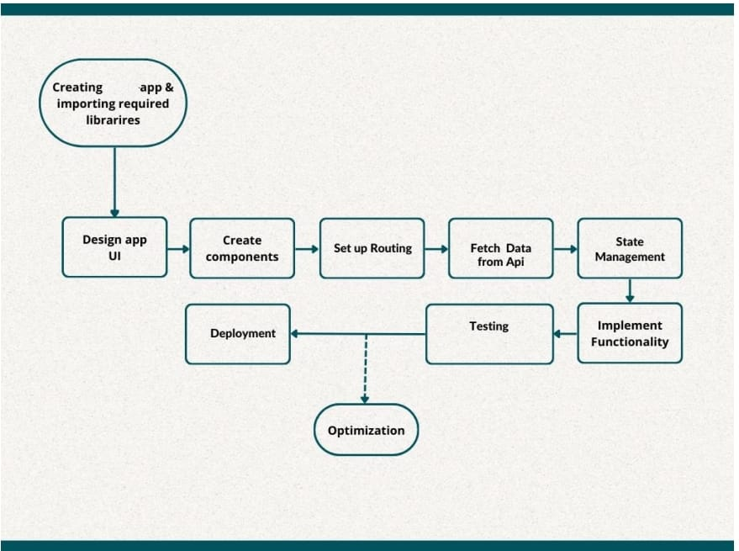
Architecture

Slide 9
User
InterFace

Slide 10
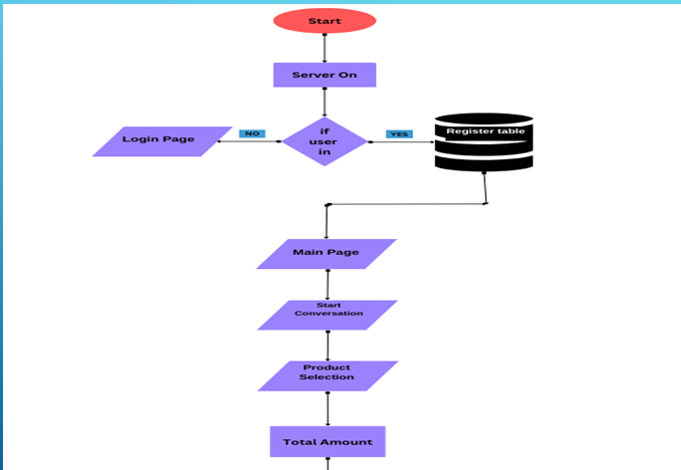

Slide 11
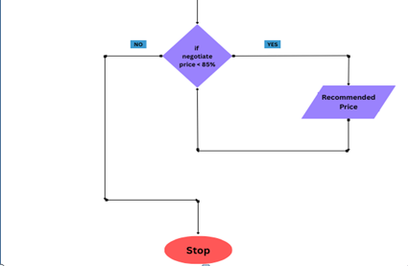

Slide 12
Machine Learning NLP Price Negotiation Chatbot
1. Introduction
This project introduces a Machine Learning Natural Language Processing (NLP) Price Negotiation Chatbot designed to facilitate seamless and intelligent communication between users and an e-commerce platform. Leveraging the power of Dialogflow for intuitive interactions, Cassandra Database for efficient data storage, and Python Flask for a robust backend, the chatbot enables users to negotiate prices, inquire about product availability, and engage in conversations effortlessly. The use of NGROK ensures accessibility across devices, making the chatbot a versatile and user-friendly solution for enhancing the online shopping experience.

Slide 13
2. Features Overview
Dialogflow Integration: Facilitates natural language interactions between users and the chatbot.
Cassandra Database Integration: Stores login details, manages product availability, and records negotiations securely.
Python Flask Backend: Processes user requests efficiently, ensuring seamless communication with the frontend.
NGROK for Universal Accessibility: Deploys NGROK for an HTTPS server, allowing the chatbot to run on every device.
Price Negotiation and Product Inquiry: Enables users to dynamically negotiate prices and inquire about product details through natural language.
Secure and Versatile System: Implements secure user authentication, offers a user-friendly interface, and provides real-time updates on product availability and negotiated prices.

Slide 14
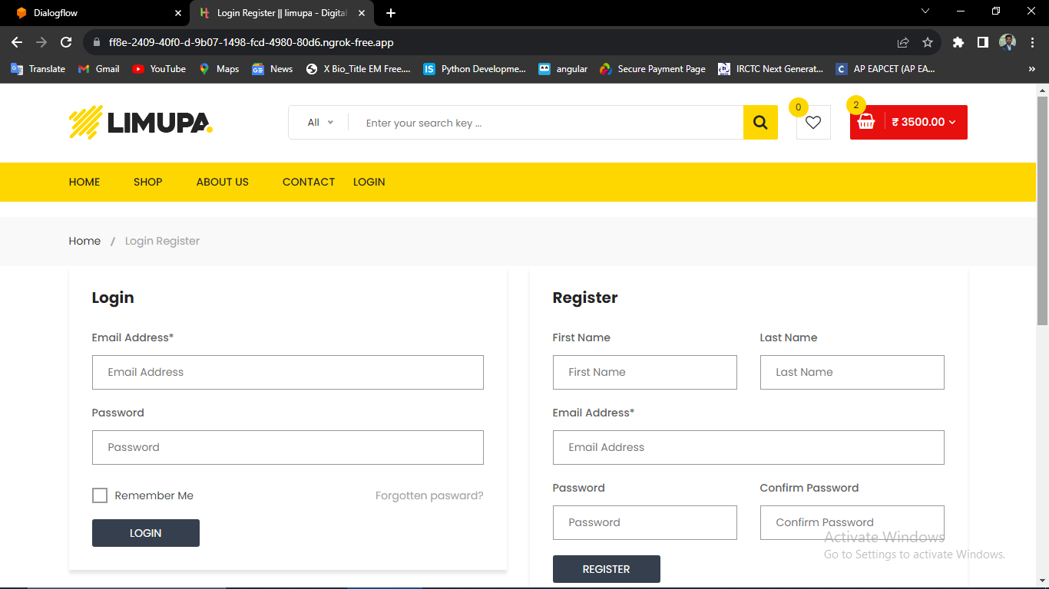
Login page

Slide 15
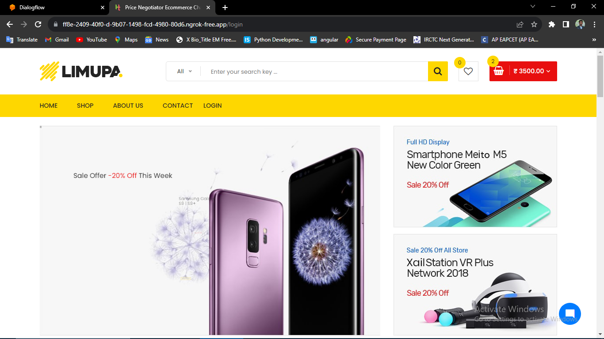
Homepage

Slide 16
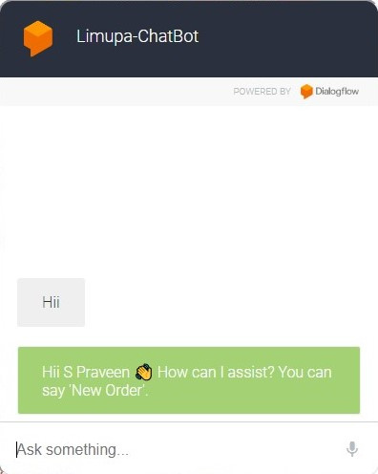
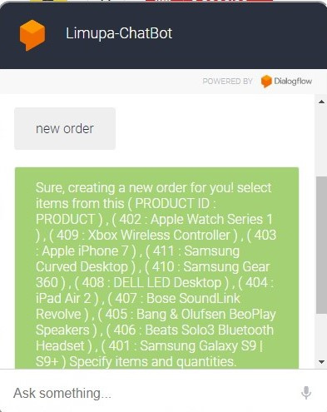
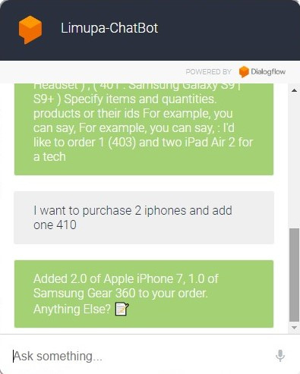
Start Conversation

Slide 17
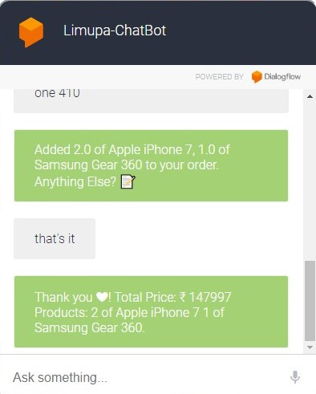
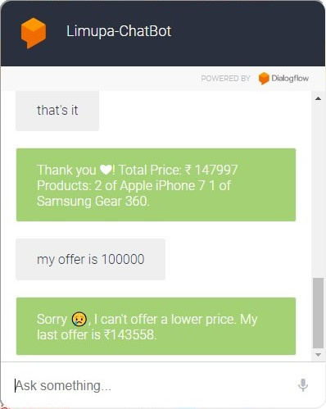
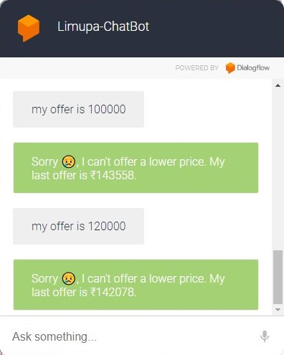
Price Negotiation

Slide 18
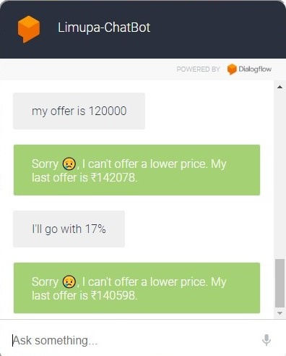
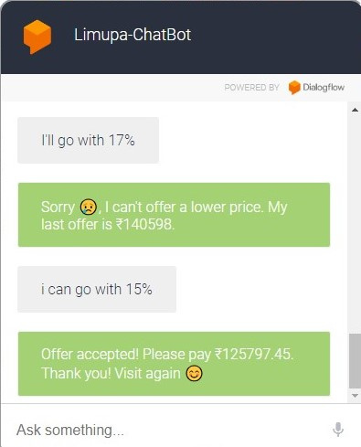
Finalizing amount

Slide 19
Functionality
Market Analysis
In order to understand the potential success of our machine learning NLP price negotiation chatbot, we conducted a thorough market analysis.
Market Size
The chatbot market is expected to reach $9.4 billion by 2024, with a compound annual growth rate of 27.9% from 2019 to 2024. This indicates a growing demand for chatbots in various industries.

Slide 20
Competitive Landscape
Our chatbot will be competing with established players such as IBM Watson, Google Assistant, and Amazon Alexa. However, our focus on price negotiation sets us apart from the competition and opens up new opportunities in industries such as e-commerce and retail.
Target Markets
Our target markets include e-commerce, retail, and travel industries. These industries have a high volume of price negotiations and our chatbot can provide an efficient and effective solution.

Slide 21
In conclusion, our Price Negotiation Chatbot project represents a convergence of cutting-edge technologies to redefine the e-commerce landscape. The utilization of Machine Learning and Natural Language Processing in Dialogflow empowers users with an intuitive and responsive interface, allowing for dynamic price negotiations and inquiries about product availability. The integration of Cassandra Database ensures efficient and reliable data storage, enabling the seamless retrieval of user interactions, product details, and negotiation histories.
Conclusions

Slide 22
THANK YOU
Sarampenta Praveen
Project details location: https://github.com/Spraveen8-chary/price-negotiation
Mail: sarampentapraveen@gmail.com
Linkedin: https://www.linkedin.com/in/sarampentapraveen/

