Slide 1



Cognis
MindCache
Your Personal Browser Memory Engine

Slide 2
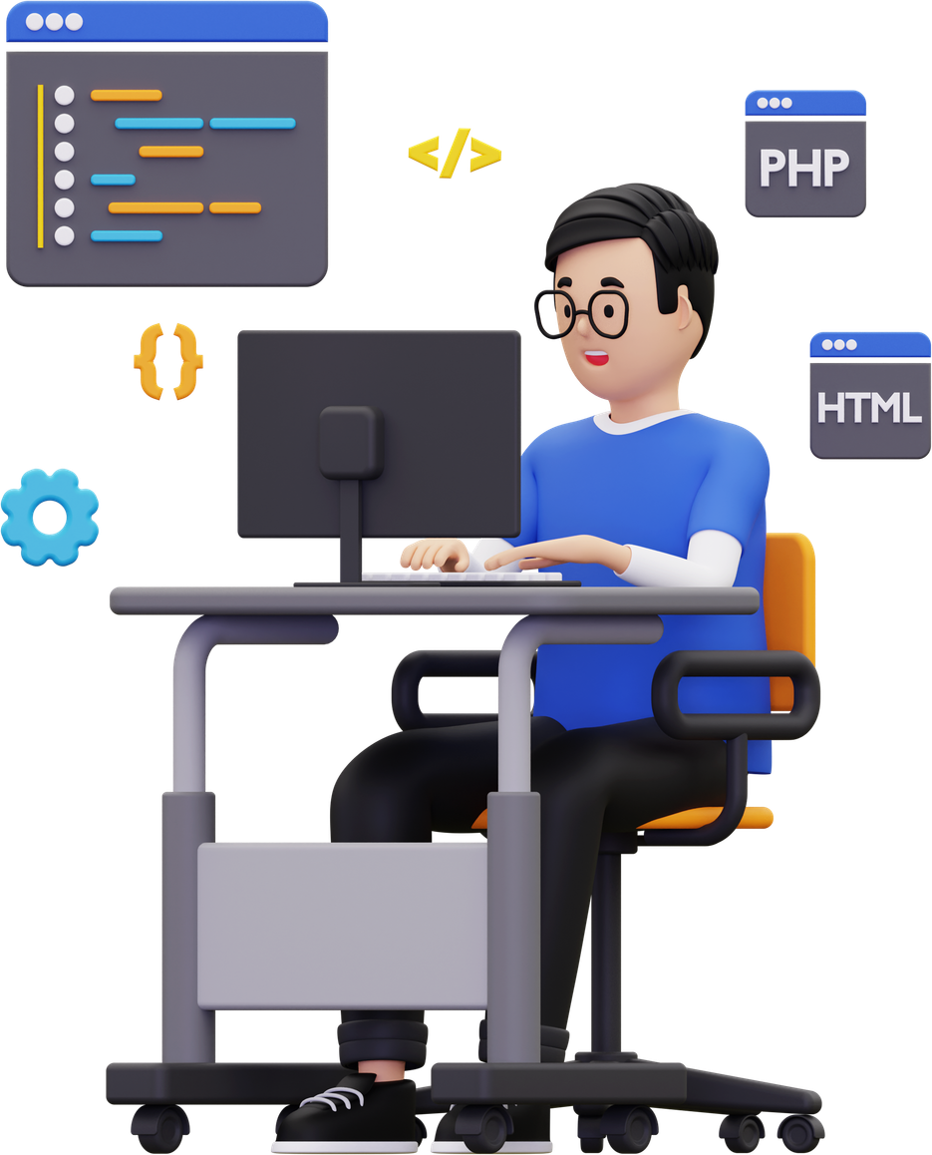
Cognis
Humans remember ideas.
Browsers remember URLs.
We Consume More Than We Remember.
Everyday we read Read articles, Watch YouTube videos, Browse GitHub repositories, Open PDFs and research papers ...
But days later we remember ~
"that rust pdf parser"
"that paper about transformers"
"that youtube video explaining RAG"
We do NOT remember ~ URLs, Titles or Bookmarks
Current Solutions ? Browser History, Bookmarks, Open Tabs ...
BUT Knowledge is found once and then lost.

Slide 3



Cognis
Introducing MindCache ...
Tracks Valuable Content
Extracts Knowledge
You Search For ~ “that video about RAG pipelines”
MindCache instantly retrieves ~
“Is RAG Still Needed? Choosing best LLM approach.”
“What is Retrieval-Augmented Generation (RAG)?”
All from your history ...
Builds A Personal Knowledge Base
Allows natural language search

Slide 4


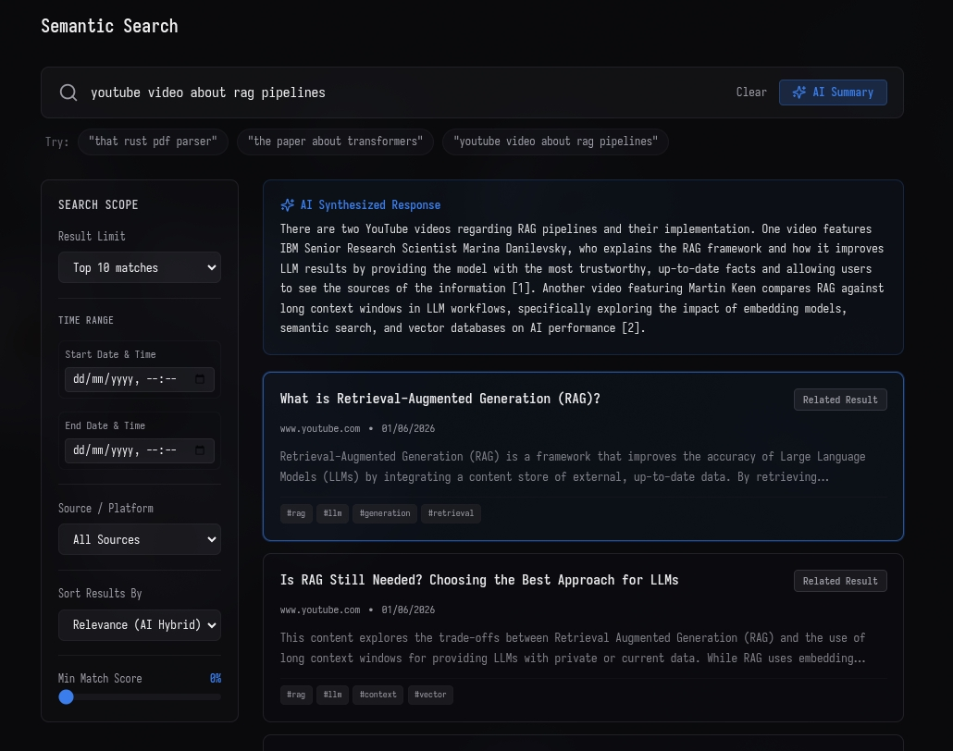
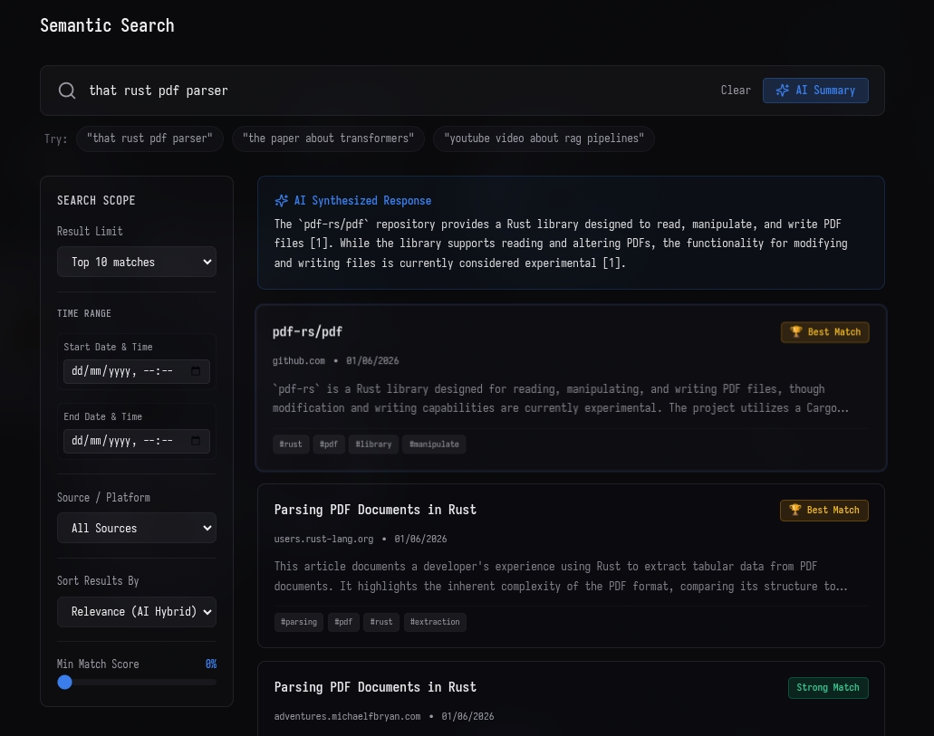
Cognis

Slide 5
Cognis
What Makes MindCache Different?
Search By Memory, Not Keywords - Instead of remembering exact titles, links, or filenames, users can search using what they remember.
Private & Local First - All AI processing, indexing, and search run entirely on the user’s machine. No CLOUD. No TRACKING. No DATA LEAKS.
Understands Multiple Content Types - Websites, YouTube videos, GitHub repositories, PDF Documents ~ nothing is incomprehensible.
Builds Personal Knowledge - MindCache doesn't store links. It stores understanding. keywords, entities, relationships and concepts becomes searchable.

Slide 6
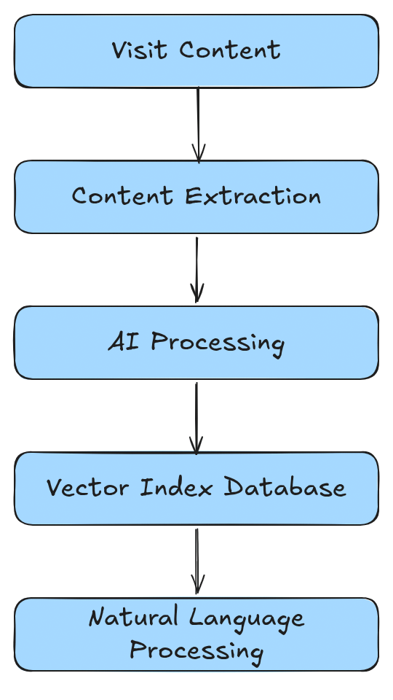
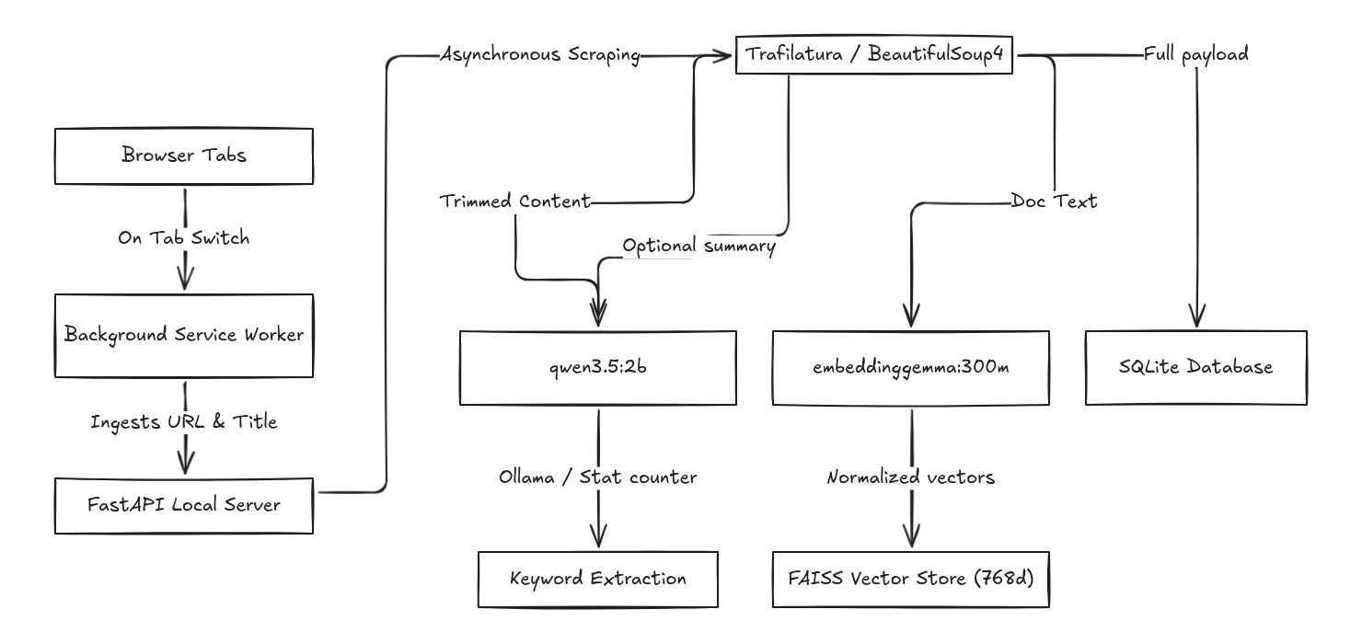
Cognis
How It Works ?

Slide 7
Cognis
Thank You!

