Slide 1

GraphSAGE
Results and Trends

Slide 2
Pollution Rates
Used a Wide Range to capture trends
Real-life error rate largely dependent on context
Sources:
“Basic Error Rates”
http://panko.shidler.hawaii.edu/HumanErr/Basic.htm
“The State of Data Quality”
https://www.experian.com/assets/decision-analytics/white-papers/the%20state%20of%20data%20quality.pdf
"Error rates in a clinical data repository: lessons from the transition to electronic data transfer—a descriptive study"
https://bmjopen.bmj.com/content/3/5/e002406
The error rate for individual fields appears to run between 0.5-6.0%, with text fields on the higher end.
However, according to “The State of Data Quality,” companies believe approximately 25% of their data to be inaccurate, 60% of which is attributed to human error, the rest of which is attributed to technological issues.
“Error rates in a clinical data repository” records an “outright accuracy” of 76% in manually entered fields.

Slide 3
Results

Slide 4
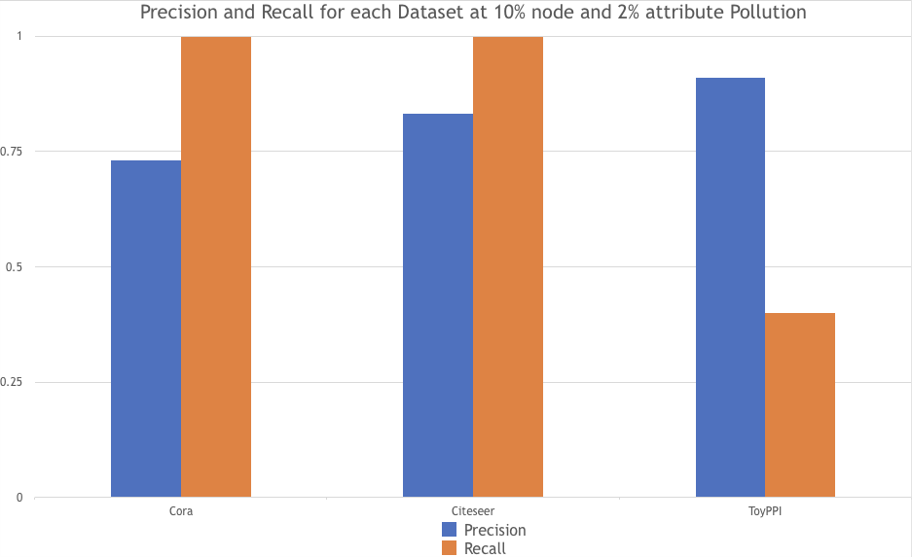

Slide 5
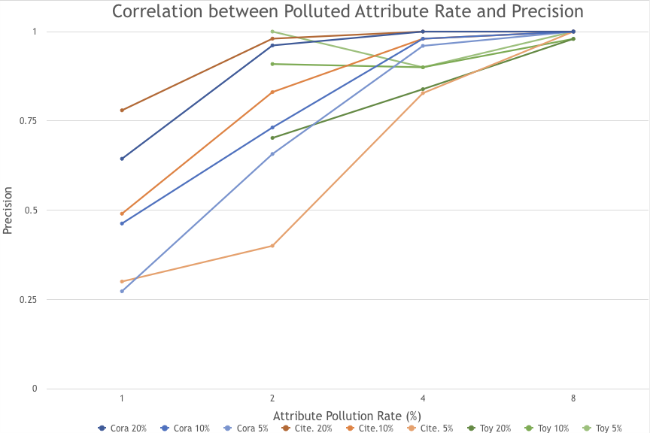

Slide 6
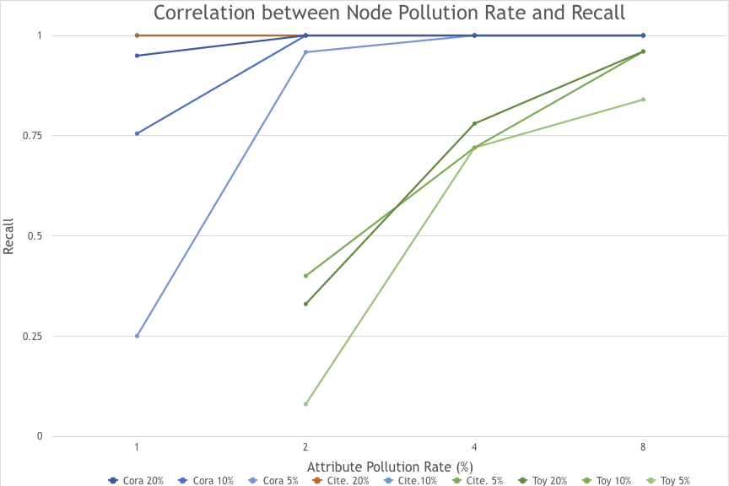

Slide 7
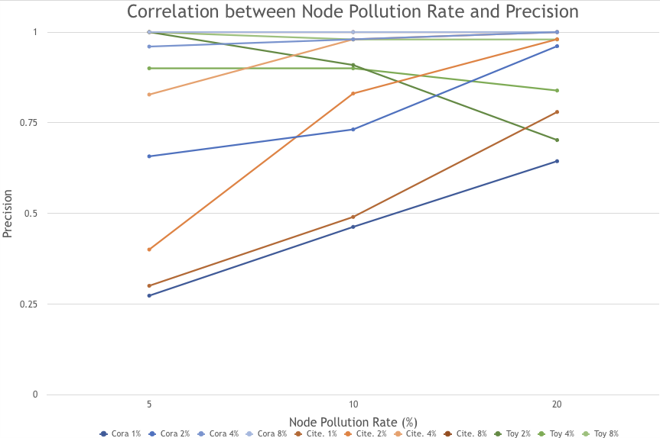

Slide 8
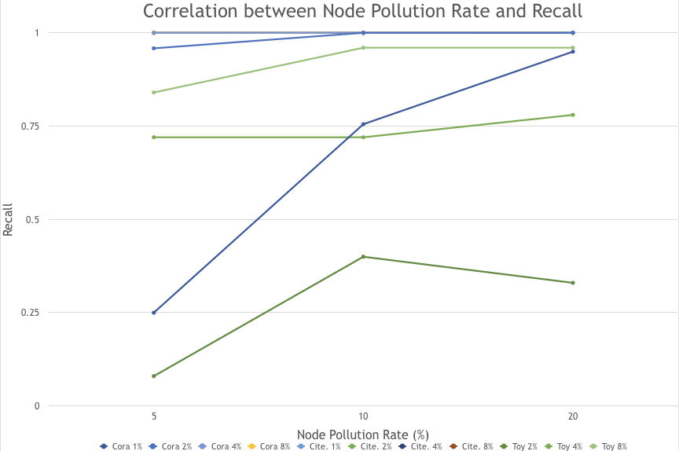

Slide 9
A Note on the Datasets
Toy-PPI
Protein-Protein Interactions
Each node is a protein
Features are positional gene sets, motif gene sets and immunological signatures.
Reddit
Each node is a post
Features:
Title
Comments averaged together
Number of comments
Score (upvotes)
Concatenated together, text embedded with GloVe: Global Vectors for Word Representation

