Slide 1
CS 47205/57205 · Project 3
Measuring Online Password Guessing Resistance
A reproducible measurement framework for authentication defenses
Austin & Ian

Slide 2
The problem
Why measure password-guessing defenses systematically
• Online password guessing is the single most common identity attack on the public Internet.
• Every authentication system ships a different mix of defenses:
- account lockout, IP rate limiting, progressive delays, CAPTCHAs, MFA, anomaly detection, bot filters …
• These defenses interact in non-obvious ways and are often misconfigured.
• Question: how do these defenses actually compare under controlled, repeatable measurement?
• Goal: build attacker + target framework, drive each defense through hundreds of trials, produce a comparable security profile so two configurations can be argued about with data.

Slide 3
Threat model
What we model and what we don't
Dimension | In scope | Out of scope (future work)
Attempts | Sequential HTTP login requests | Parallel / distributed
Source IPs | Single IP | Botnets, proxy pools
Targets | One known username | Credential stuffing, password spraying
Wordlist | Real public corpora (SecLists 10k) | Adaptive / personalised guesses
Knowledge | Black-box: only HTTP responses | Insider / source-code visibility
Attacker capability tiers - naive bot, PoW-solving bot, human-in-the-loop - are explicit knobs in the framework.

Slide 4
Section 1
Testbed
How we measure each defense reproducibly

Slide 5
Testbed architecture
Four pieces, each independently configurable
• Target system: a small Flask login service. Every defense is a tunable knob.
• Attacker client: a single password-guessing tool with capability flags for naive bots, PoW-solving bots, and human-in-the-loop attackers.
• Orchestrator: boots a fresh target per configuration, runs the attacker, aggregates results.
• Wordlist source: real public corpora (SecLists), sampled per trial.
• Each trial gets an isolated process and a fresh port - no state leaks between configurations.
• Every measurement is seeded and reproducible from the same inputs.

Slide 6
Wordlist methodology
Distribution, not anecdote
• Old approach: one fixed wordlist with the password at a known position. One data point.
• New approach: every trial gets its own randomized wordlist:
- Sample N entries from a real public password corpus (SecLists 10k).
- Insert the target password at a uniformly-random position.
- Record the seed and target position so the trial is reproducible.
• 50 trials per config x 21 configs x 4 wordlist sizes (100 / 200 / 300 / 500) = 3,500+ trial measurements.
• Each defense exercised against 50 randomized target depths per wordlist size.
• Headline 100-word run finished in 13.7 hours; longer runs were stopped after the layered configs.

Slide 7
Attacker capability tiers
Defenses that beat one tier are bypassed by another
Tier | Behaviour
Naive scripted bot | Sends username and password. No JavaScript, no humans, no header spoofing.
Header-aware bot | Same as above, but spoofs a normal browser User-Agent.
PoW-solving bot | Includes a SHA-256 puzzle solver in its loop.
Human-in-the-loop | A human (or commercial solver service) handles CAPTCHAs.
Same attacker tool models all four tiers - we toggle behaviour per run to compare each defense across the spectrum.

Slide 8
Section 2
Protections
Ten mechanisms across four categories

Slide 9
Ten defenses, four required categories
Required project categories highlighted in navy
Category | Mechanism | What it does
Account lockout | Account lockout | Freezes the account for a duration after N consecutive failures.
Rate limiting | IP rate limit | Caps attempts from a single IP in a sliding window.
Rate limiting | Permanent IP ban | Blacklists the IP after K failures within a long window.
Progressive delays | Tarpit | Server sleeps a fixed amount before each failed response.
Progressive delays | IP exponential backoff | Per-IP cooldown that doubles with each failure, with a cap.
Cost amplification | Slow password hash | pbkdf2 or scrypt to inflate per-attempt CPU cost on the server.
Bot vs human filter | Proof-of-work | Server demands a SHA-256 puzzle after N failures.
Bot vs human filter | CAPTCHA challenge | Server demands a human-solvable token after N failures.
Bot vs human filter | Honeypot usernames | Contact with watched usernames (admin, root) triggers an instant ban.
Bot vs human filter | Header anomaly detection | Block requests missing typical browser headers.

Slide 10
How they're measured
Six metrics per config form a comparable security profile
• Breach rate - fraction of trials where the attacker hit the password.
• Median time-to-crack - wall-clock seconds, with min/max range.
• Effective request rate - requests/sec the attacker could sustain.
• Response status mix - 401 / 423 / 429 / 403 by reason (PoW required, CAPTCHA, account locked, IP banned, anomaly).
• First-hit position - where in the wordlist the password was found.
• Position vs time scatter - how time-to-crack scales with target depth.

Slide 11
Section 3
Results
What blocked, what just slowed the attacker down

Slide 12
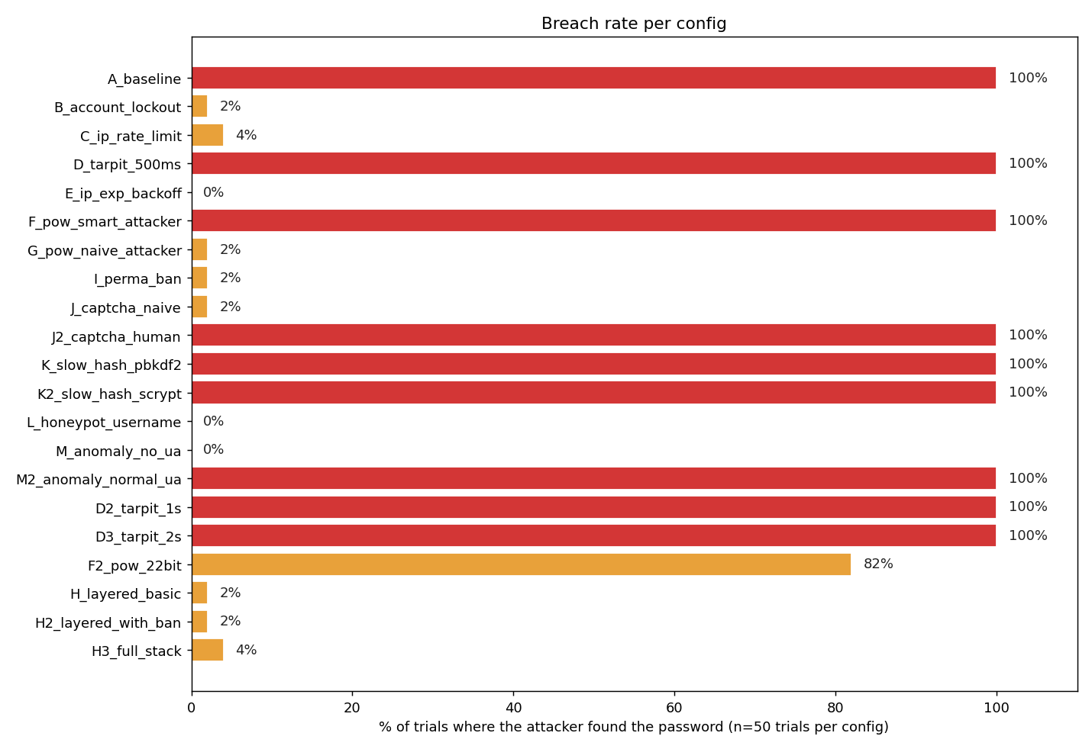
Summary across 21 configs x 50 trials (100-word run)
Three regimes: hard block, lottery window, slow-down only
Hard block (0%)
3 of 21: defense fires from request 1 (honeypot, anomaly, exp-backoff).
Lottery window (2-4%)
8 of 21: gated on N=5 fails - breach when password lands in attempts 1-5.
Slow-down only (100%)
9 of 21: attacker waits, password comes out every trial.
Probabilistic (82%)
F2_pow_22bit - solver sometimes blew its budget.

Slide 13
Hard block (0% breach in 50 trials)
Defense fires from request 1 - attacker never gets a foothold
Config | Median elapsed | Why it blocks instantly
L_honeypot_username | 0.5s | Username 'admin' triggers permanent ban on request 1
M_anomaly_no_ua | 0.5s | Missing User-Agent flagged on request 1
E_ip_exp_backoff | 0.7s | Per-IP backoff hits cap before any breach window opens
• These are the only configs that block before the password could possibly be tried.
• Honeypot and anomaly only work because the attacker is naive (admin user / missing UA).
• A header-aware attacker bypasses both - see M2_anomaly_normal_ua at 100% breach.

Slide 14
Lottery window (2-4% breach in 50 trials)
Defenses gated on N=5 failures: breach when password lands in attempts 1-5
Config | Breach | Median elapsed | Defense threshold
B_account_lockout | 2% | 1.3s | 5 fails -> 60s lock
G_pow_naive_attacker | 2% | 1.3s | 5 fails -> PoW (no solver)
J_captcha_naive | 2% | 1.3s | 5 fails -> CAPTCHA (no solver)
I_perma_ban | 2% | 1.8s | 8 fails -> permanent ban
C_ip_rate_limit | 4% | 2.1s | 10 attempts / 30s window
H_layered_basic | 2% | 26.8s | lockout dominates the stack
H3_full_stack | 4% | 30.1s | every mechanism enabled
• P(breach) ~= 5/N where N is the wordlist size - the gating window is a structural blind spot.
• Median first-success position across all lottery breaches: 3.
• Pair with a defense that's active from request 1 (slow hash, honeypot) to cover the window.

Slide 15
Slow-down only (100% breach in 50 trials)
Cost the attacker time, but the password came out every trial
Config | Median time | Slowdown vs baseline
A_baseline | 14.5s | 1.0x
K2_slow_hash_scrypt | 14.4s | 1.0x - no slowdown
M2_anomaly_normal_ua | 14.4s | 1.0x - bypassed by spoofed UA
J2_captcha_human | 14.5s | 1.0x
F_pow_smart_attacker (18-bit) | 34.4s | 2.4x
D_tarpit_500ms | 64.0s | 4.4x
K_slow_hash_pbkdf2 (600k iters) | 83.5s | 5.8x
D2_tarpit_1s | 113.5s | 7.8x
D3_tarpit_2s | 212.5s | 14.7x
F2_pow_22bit (smart, 22-bit) | 305.9s (82% breach) | 21x
Tarpit and slow-hash slowdowns are linear in wordlist depth - predictable and tunable. (Next slide.)

Slide 16
Finding 1: scrypt was barely a defense
Default werkzeug scrypt:32768:8:1 was statistically indistinguishable from baseline
• scrypt:32768:8:1 - 14.40s (vs 14.46s baseline). Lost in HTTP roundtrip noise.
• Server-side scrypt cost dominated by n=32768 (~16ms on test hardware).
• pbkdf2:sha256:600000 was meaningfully slower (83.5s, 5.8x baseline).
Lesson: "we use a slow hash" is not a defense unless parameters are tuned for the target hardware. Production deployments should benchmark and aim for ~100 ms per verify. Don't trust library defaults.

Slide 17
Finding 2: PoW sits on a probabilistic cliff
Past a difficulty threshold, PoW shifts from slow-down to probabilistic block
Config | Difficulty | Breach rate (50 trials) | Median time
F_pow_smart_attacker | 18-bit | 100% | 34.4s
F2_pow_22bit | 22-bit | 82% | 305.9s
• At 22-bit difficulty the attacker's 5M-attempt-per-puzzle budget runs out on roughly 1 in 5 trials.
• Defense moves from slow-down to probabilistic block.
• At 200-word the same config breached 30/33 (91%) - more depth means more puzzles, but the solver kept squeaking through.
• Cliff is a function of solver-budget per puzzle, not just difficulty bits.

Slide 18
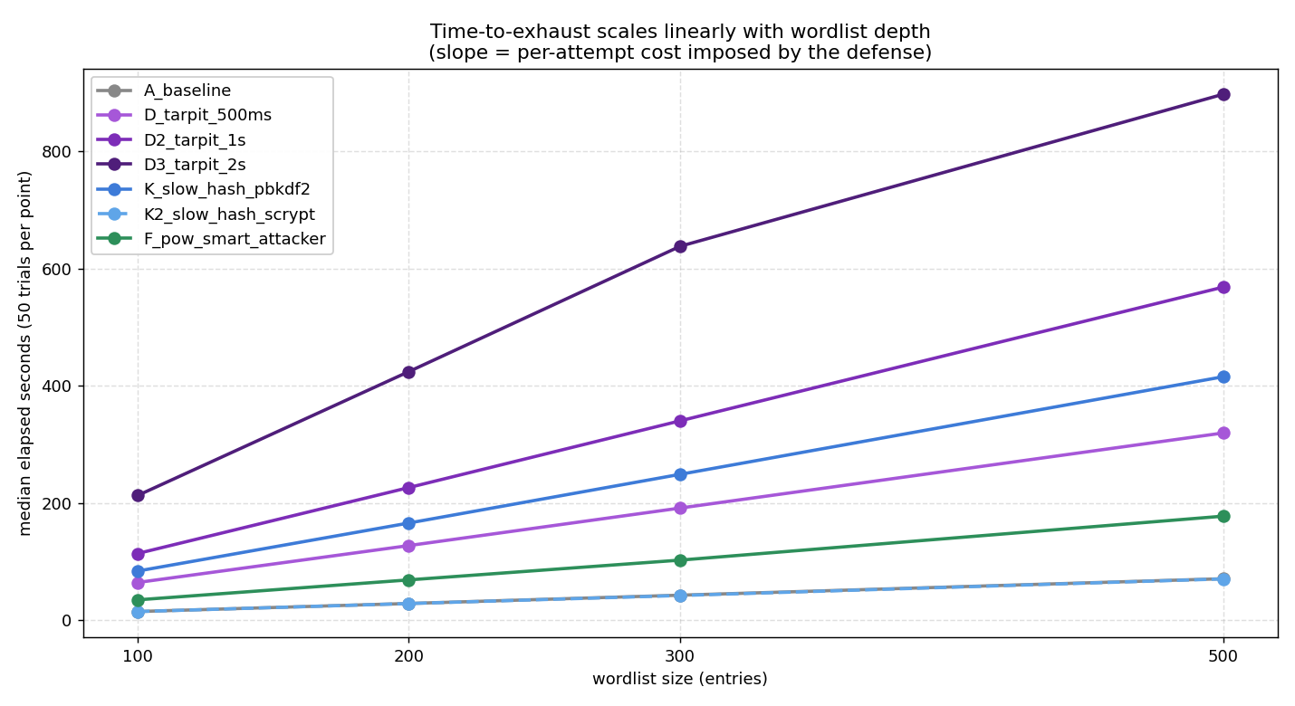
Finding 3: time scales linearly with wordlist depth
Each line's slope is the per-attempt cost the defense imposes
Per-attempt cost
• D3_tarpit_2s: ~2.0 s / attempt
• D2_tarpit_1s: ~1.0 s / attempt
• K_slow_hash_pbkdf2: ~0.83 s / attempt
• D_tarpit_500ms: ~0.5 s / attempt
• F_pow_smart_attacker: ~0.4 s / attempt
• A_baseline / K2_scrypt: overlap - scrypt added zero observable cost
Buying time per attempt: budget = cost x depth.

Slide 19
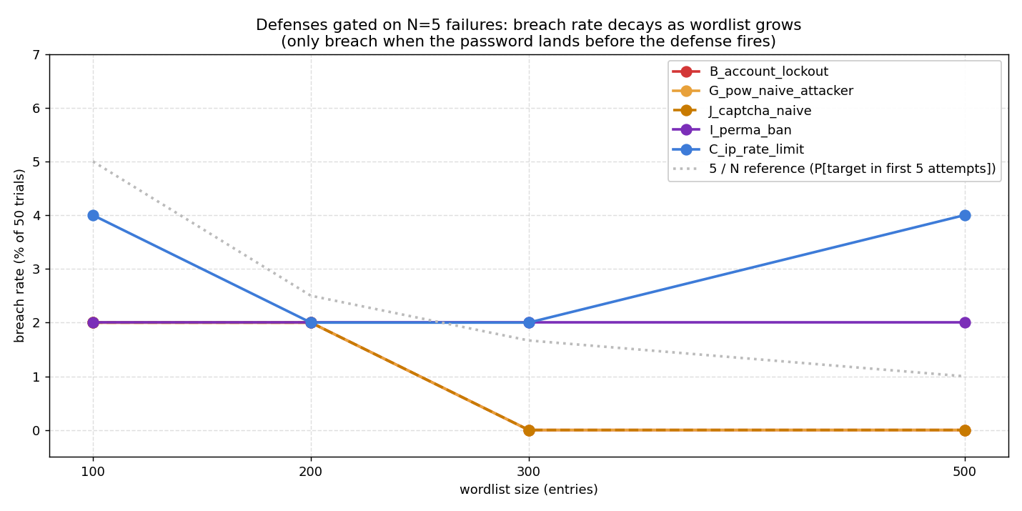
Finding 4: lottery breaches track 5/N
Defenses gated on N=5 failures leak when password lands in attempts 1-5
• 100-word: 5/100 = 5% expected, 2-4% observed
• 200-word: 5/200 = 2.5%, 2% observed
• 300-word: 5/300 = 1.7%, 0% observed (sampling noise)
• 500-word: 5/500 = 1%, 2-4% observed for some
• I_perma_ban gated on 8 fails - 8/N decays slower
Operational fix: pair gated defenses with one that's active from request 1 (slow hash, honeypot, anomaly).

Slide 20
Layered defense converges
Account lockout dominates - the rest are insurance for when it fails
Config | Defenses | Median time | Breach
H_layered_basic | lockout + rate-limit + tarpit + PoW | 26.8s | 2%
H2_layered_with_ban | + perma-ban + slow hash | 30.4s | 2%
H3_full_stack | + CAPTCHA + honeypot + anomaly | 30.1s | 4%
• Wall-clock is dominated by account lockout - other defenses never get exercised.
• The 2-4% breach is the same lottery-window effect: password lands in attempts 1-5 before lockout activates.
• That's a feature, not a bug: the cheapest defense wins, the rest are insurance for when it fails or is misconfigured.
• Defense-in-depth is about failure modes, not steady-state performance.

Slide 21
Section 4
Recommendations
What to actually deploy

Slide 22
What to actually deploy
Minimum-viable stack - three layers with tuned parameters
Layer | Configuration
1. Account lockout | ~5 failures -> ≥60s lockout. Reset on legitimate login. Cheap, hard-stops named-target attacks.
2. IP-based throttling | Sliding window or exponential backoff. Cap, don't permanent-ban (avoid IP-reuse pain).
3. Slow password hash | argon2id or pbkdf2, tuned to ~100ms/verify on prod hardware. Verify cost - defaults are weak.
• Don't rely on (against motivated attackers): tarpits alone, default-parameter scrypt, header anomaly checks (trivially defeated by a User-Agent string), low-bit PoW.
• Useful add-ons: honeypot usernames, geographic anomaly scoring, MFA on sensitive accounts.

Slide 23
Future work
Where the framework can be extended
• Distributed attacker - multi-IP, multi-process to expose IP-only defenses.
• Cross-system comparison - point the same attack client at WordPress, Authelia, Gitea, Keycloak. The framework already speaks plain HTTP.
• Adaptive attackers - observe response timing and codes, switch strategy mid-run.
• Real CAPTCHA / MFA endpoints - replace magic-token stubs with hCaptcha or TOTP.
• Cost modeling - translate "13x slowdown" into dollar cost per credential at cloud-attacker rates.

Slide 24
Questions?

