Slide 1
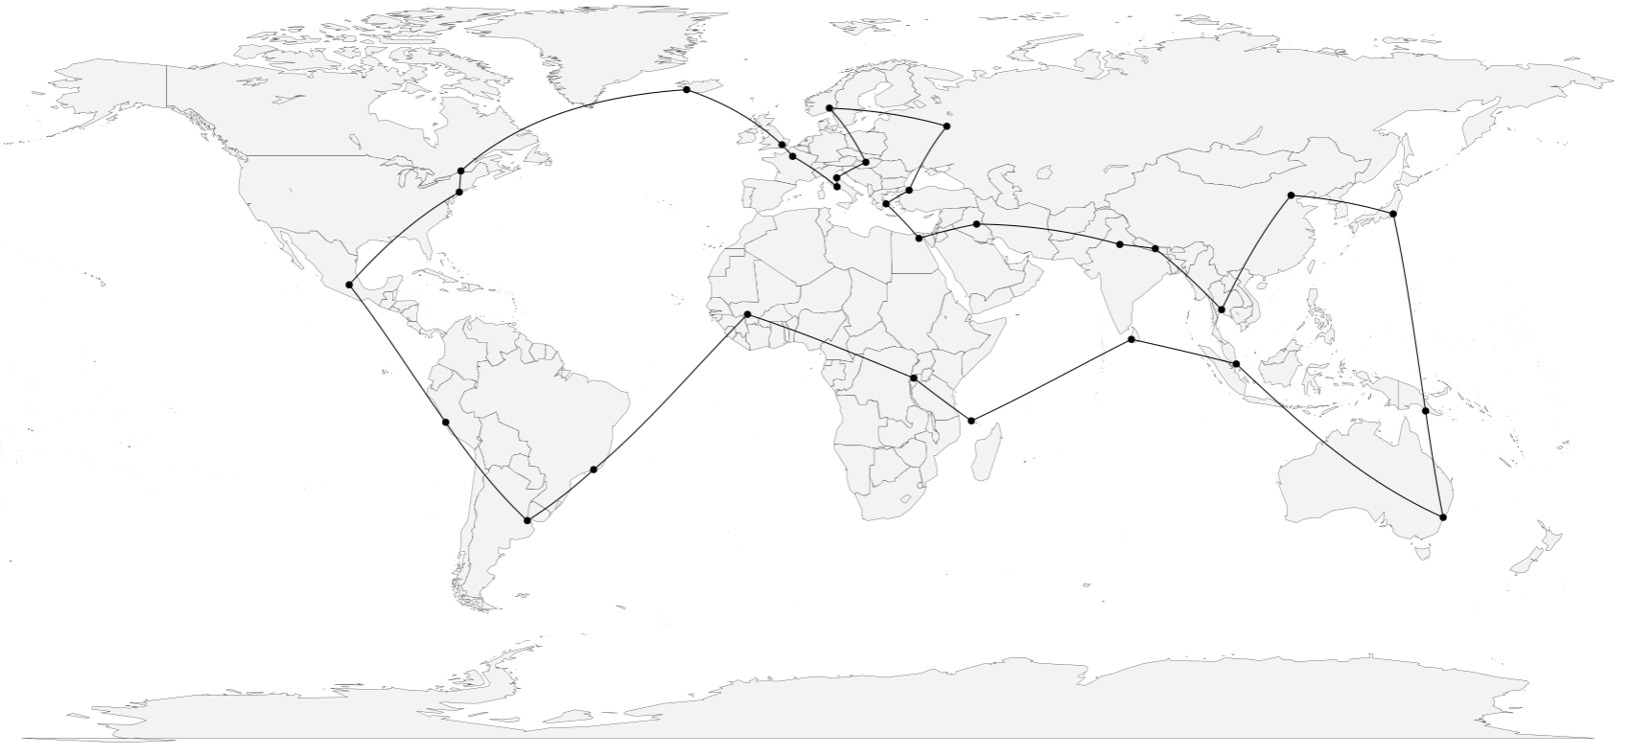
Travelling Salesman Problem Optimization Graph Theory 沈尧 黄以清 洪如玥 耿鑫

Slide 2
Outline
Background
Exhaustive Search
Heuristics: Greedy 2-Opt
Optimization: Simulated Annealing

Slide 3





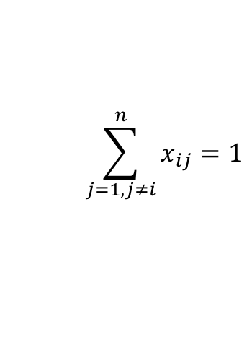

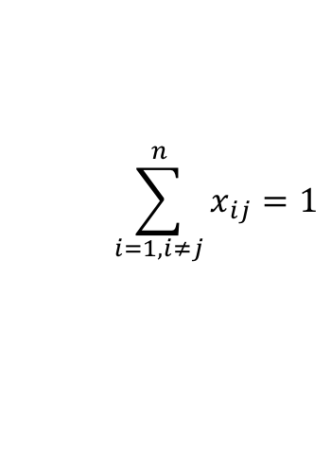



A salesman wishes to travel around a given set of cities once and return to the beginning, covering the smallest total distance.
$$\min{\sum_{i=1}^{n}{\sum_{j≠i,j=1}^{n}{c_{ij}x_{ij}:}}}$$
$$0≤x_{ij}≤1$$
$$i,j=1,…,n$$
$$u_{i}∈Z$$
$$i=1,…,n$$
$$\sum_{i=1,i≠j}^{n}{x_{ij}=1}$$
$$j=1,…,n$$
$$\sum_{j=1,j≠i}^{n}{x_{ij}=1}$$
$$i=1,…,n$$
$$u_{i}−u_{j}+nx_{ij}≤n−1$$
$$2≤i≠j≤n$$

Slide 4
NP-Complete
NO polynomial algorithms
NO fast solution is known
i.e. time consumption increases
rapidly as the size of the problem
grows

Slide 5
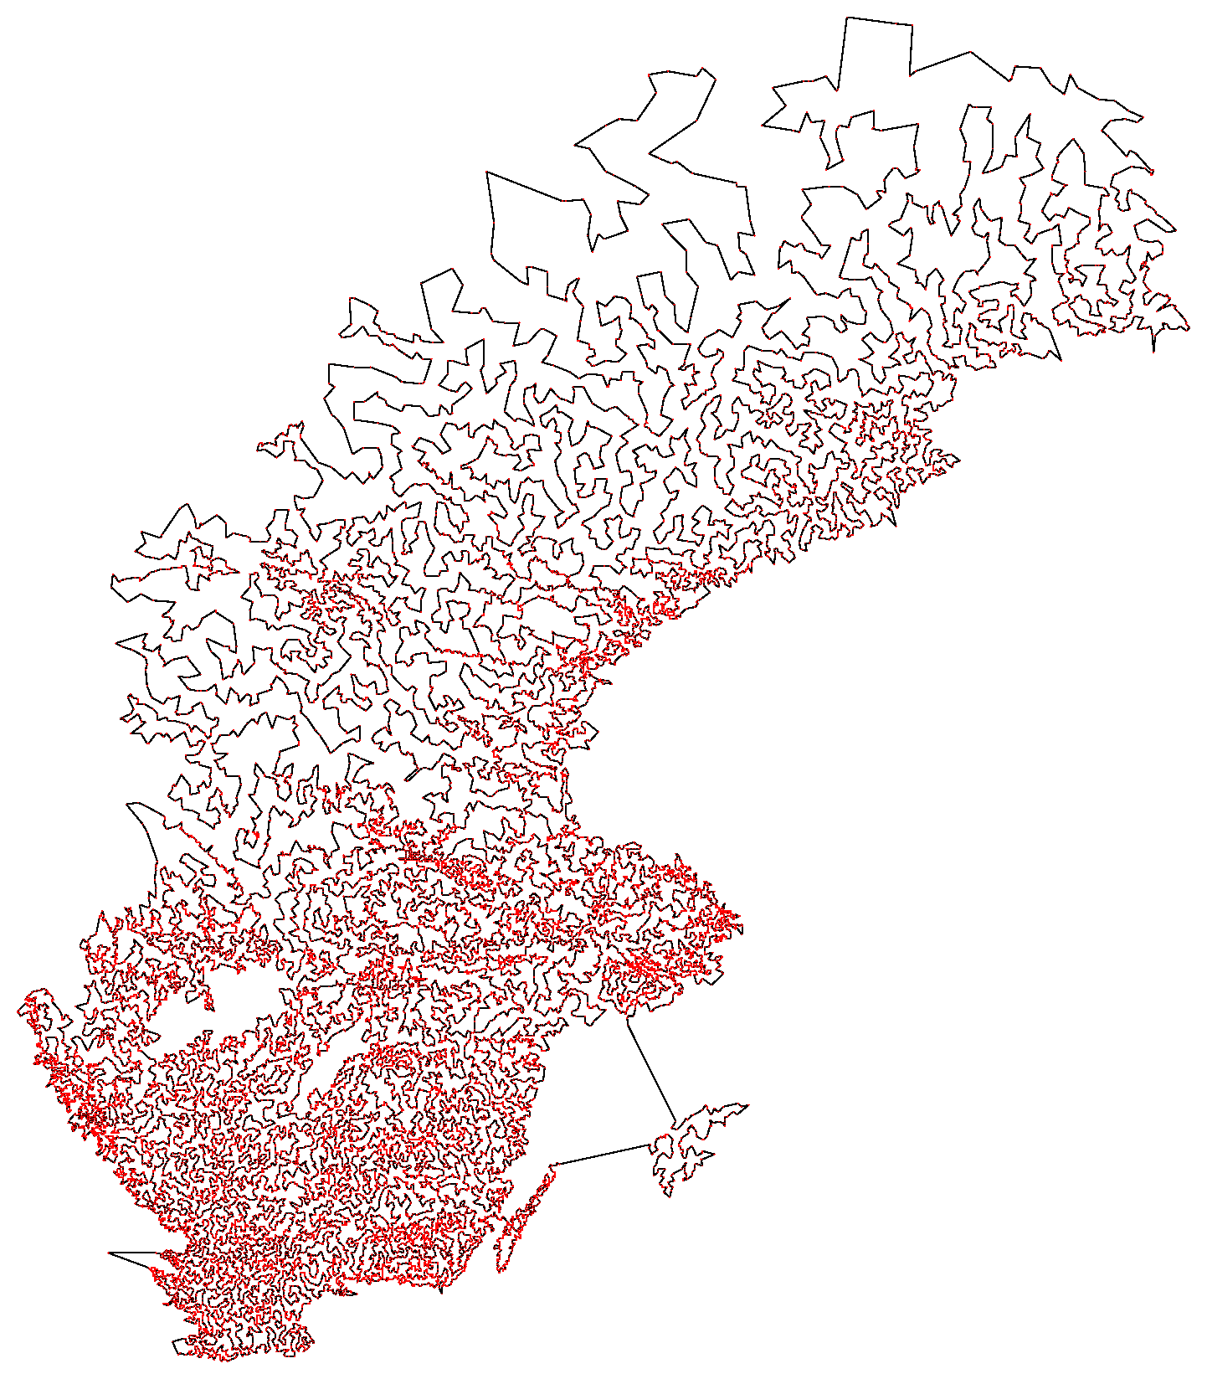
NP-Complete
Sweden 24978 locations
Cutting-edge
96 Xeon 2.6GHz
March 2003 – May 2004
CPU time 85 years
NO polynomial algorithms
NO fast solution is known
i.e. time consumption increases
rapidly as the size of the problem
grows

Slide 6
Outline
Background
Exhaustive Search
Heuristics: Greedy 2-Opt
Optimization: Simulated Annealing

Slide 7
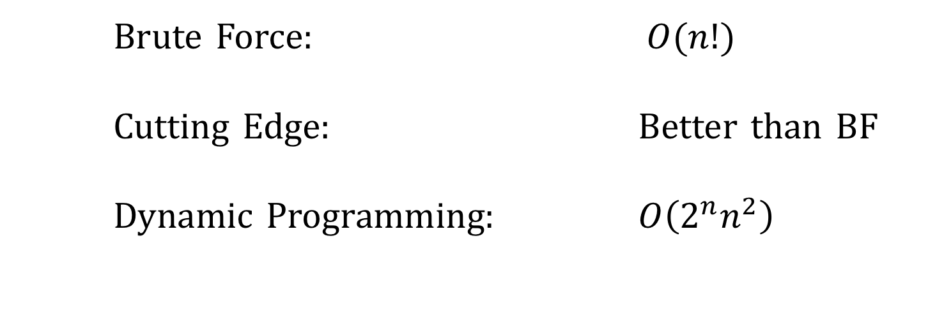
Exhaustive: consider all possible paths
Brute Force: $O(n!)$
Cutting Edge: Better than BF
Dynamic Programming: $O\left(2^{n}n^{2}\right)$

Slide 8
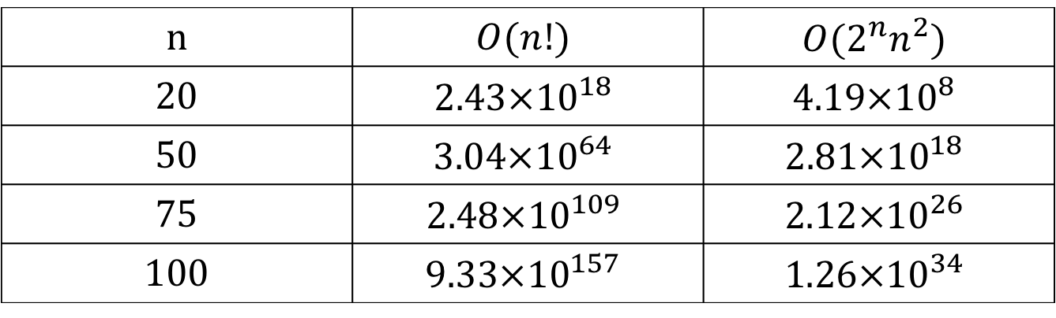
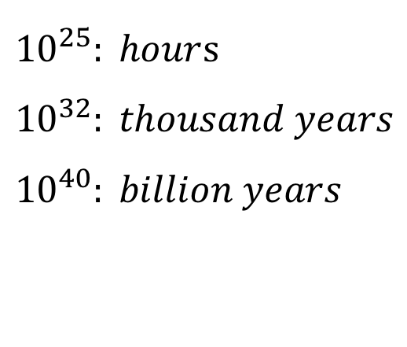
Exhaustive: consider all possible paths
Brute Force: $O(n!)$
Cutting Edge: Better than BF
Dynamic Programming: $O\left(2^{n}n^{2}\right)$
n | $$O(n!)$$ | $$O(2^{n}n^{2})$$
20 | $$2.43×{10}^{18}$$ | $$4.19×{10}^{8}$$
50 | $$3.04×{10}^{64}$$ | $$2.81×{10}^{18}$$
75 | $$2.48×{10}^{109}$$ | $$2.12×{10}^{26}$$
100 | $$9.33×{10}^{157}$$ | $$1.26×{10}^{34}$$
${10}^{25}: hour$s
$${10}^{32}: thousand years$$
$${10}^{40}: billion years$$

Slide 9
Exhaustive: consider all possible paths
Able to generate global optimal solution
NOT suitable for Large Scale problem
China has 3 583 715 km of roadways and 77 834 km of railways, with millions of intersections to consider and a virtually unfathomable number of possible routes to follow.

Slide 10
Outline
Background
Exhaustive Search
Heuristics: Greedy 2-Opt
Optimization: Simulated Annealing

Slide 11
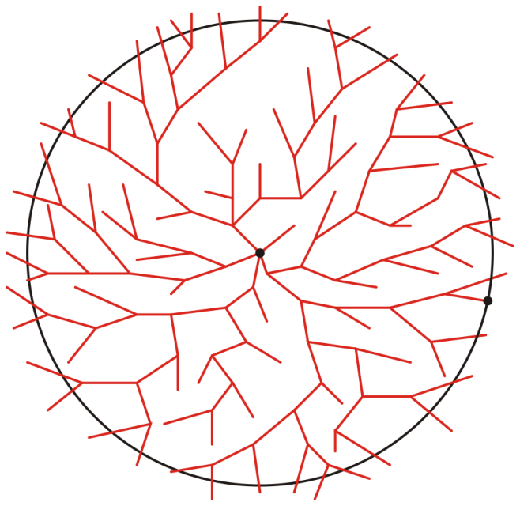
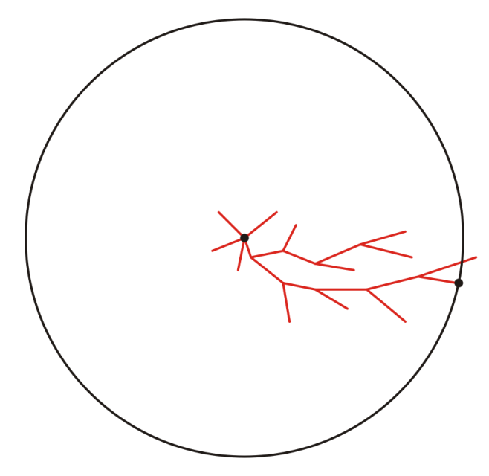
Heuristics
Modern methods can find solutions for extremely large problems (millions of cities) within a reasonable time which are with a high probability just 2–3% away from the optimal solution. (From Wikipedia)
Not guaranteed to be optimal
But sufficient for the immediate goals

Slide 12
Heuristics
Greedy Heuristic: making the local optimal choice at each stage,
with the hope of finding a global optimal
(usually not for TSP).

Slide 13
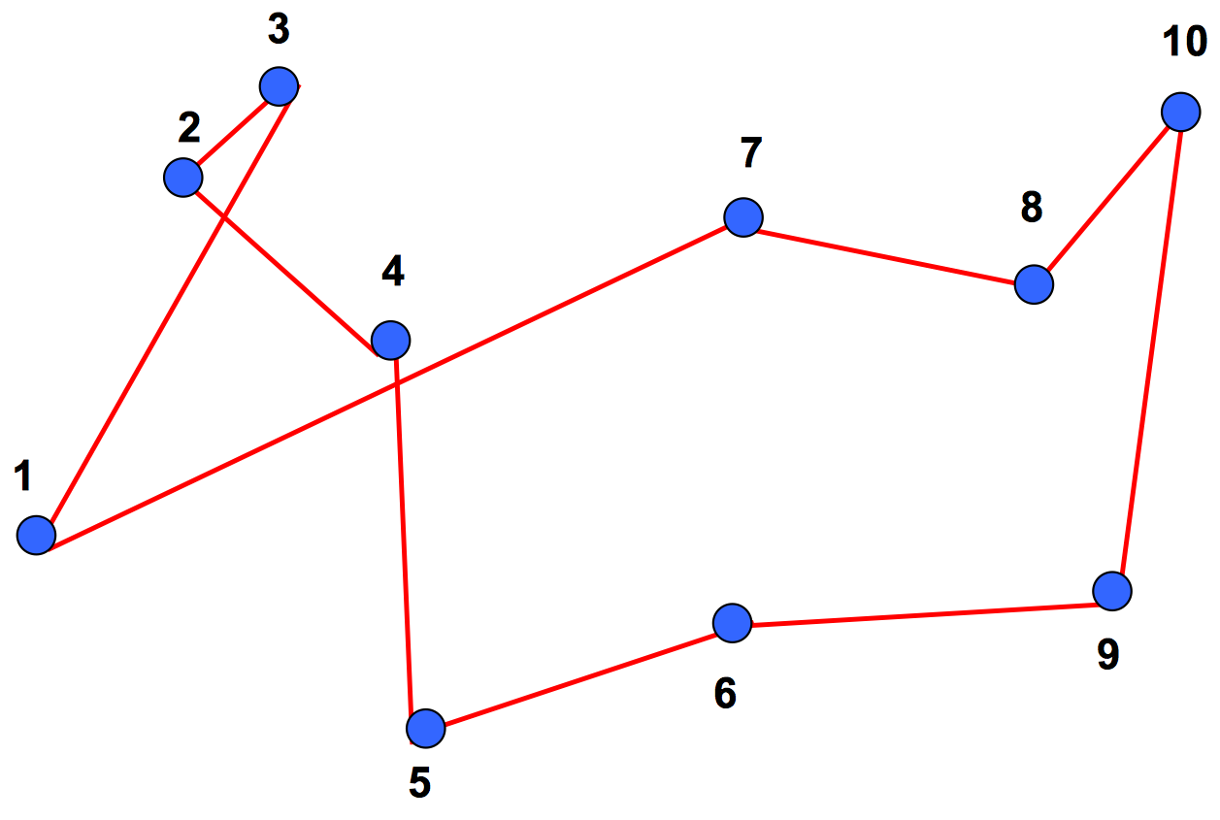
Heuristics
Greedy Heuristic: making the local optimal choice at each stage,
with the hope of finding a global optimal
(usually not for TSP).

Slide 14
Heuristics Optimization
2-Opt Heuristic: search for a 2-adjacent tour with lower cost
than current tour. Replace current tour with
the new tour. Until there is a 2-optimal tour.

Slide 15
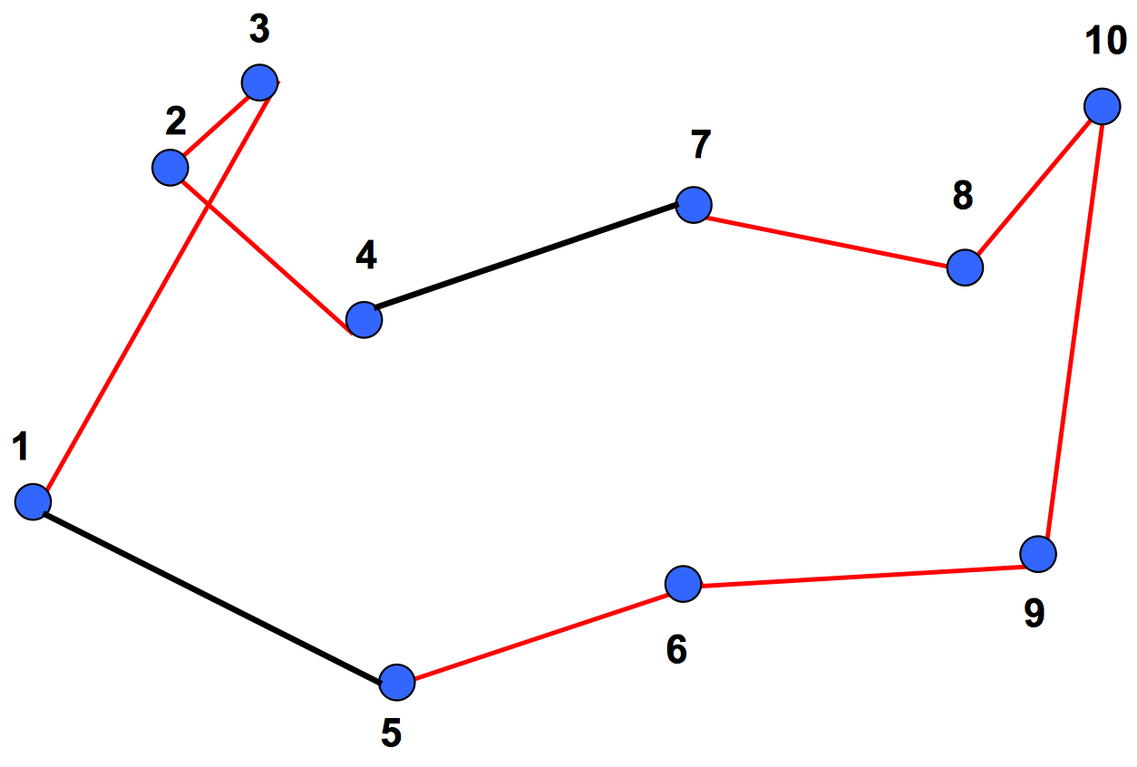
Heuristics Optimization
2-Opt Heuristic: search for a 2-adjacent tour with lower cost
than current tour. Replace current tour with
the new tour. Until there is a 2-optimal tour.

Slide 16
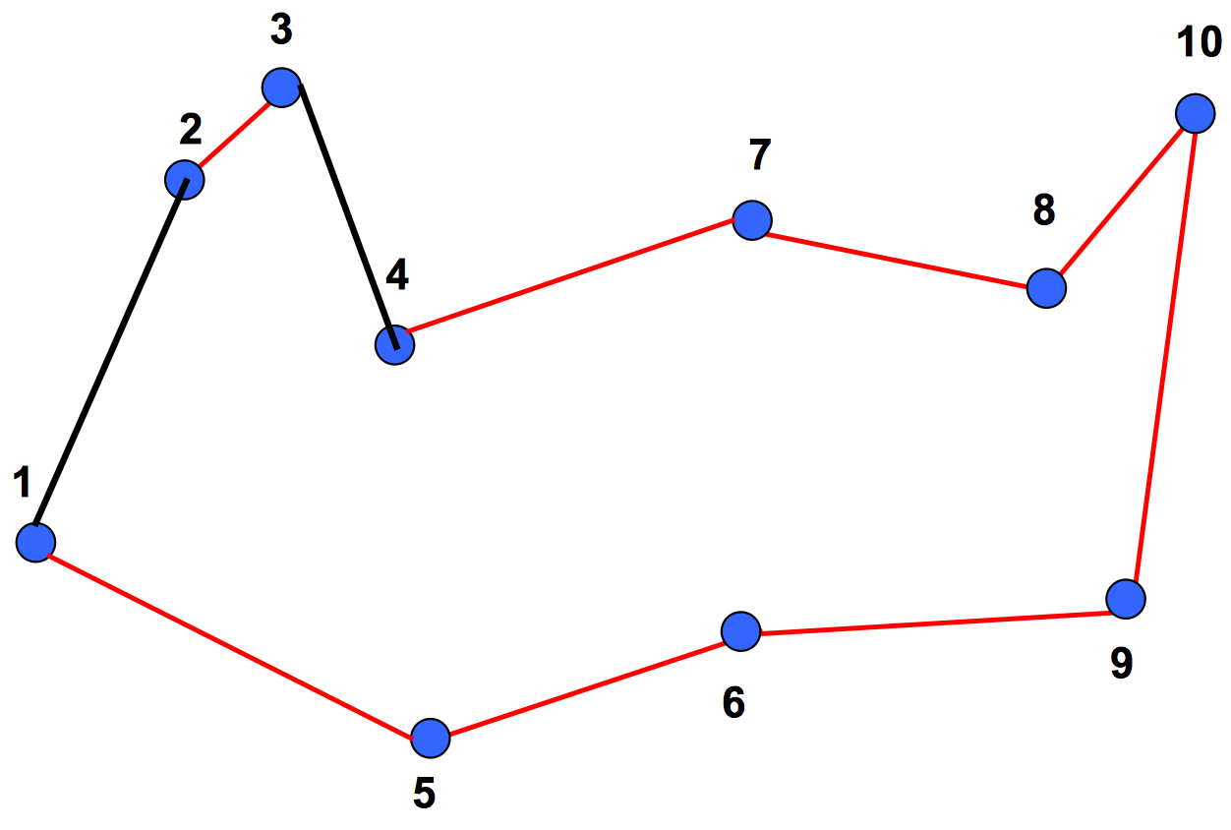
Heuristics Optimization
2-Opt Heuristic: search for a 2-adjacent tour with lower cost
than current tour. Replace current tour with
the new tour. Until there is a 2-optimal tour.

Slide 17
Outline
Background
Exhaustive Search
Heuristics: Greedy 2-Opt
Optimization: Simulated Annealing

Slide 18
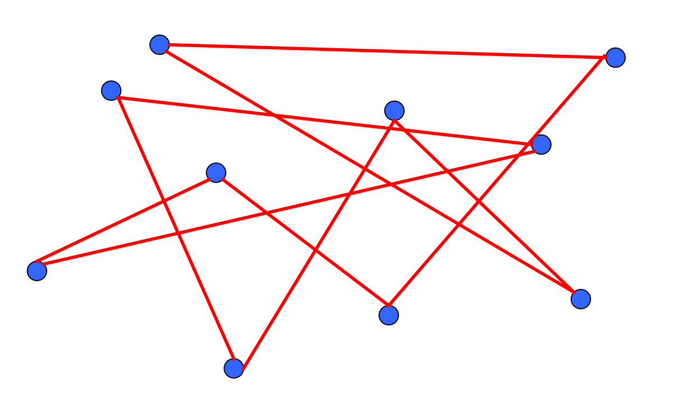
Heuristics Optimization
Randomization: start with a random tour
at first glance, it could be terrible……

Slide 19
Heuristics Optimization
Simulated Annealing:
The name and inspiration come from annealing in metallurgy, a technique involving heating and controlled cooling of a material to increase the size of its crystals and reduce their defects.(From Wikipedia)
Optimization based on
Greedy + 2-Opt + Randomization

Slide 20
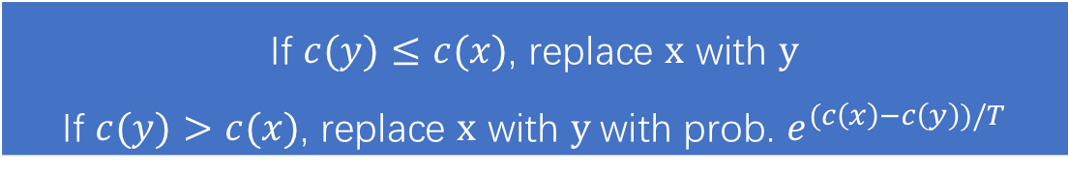
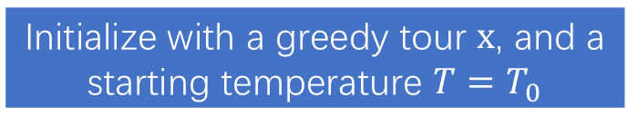
Simulated Annealing
Initialize with a greedy tour x, and a starting temperature $T=T_{0}$
Choose a random neighbor y of x
Start to anneal with 2-Opt
If $c(y)≤c(x)$, replace x with y
If $c(y)>c(x)$, replace x with y with prob. $e^{(c\left(x\right)−c\left(y\right))/T}$
Lowering T a bit at each iteration
No
T is low enough?
Yes
Quit

Slide 21
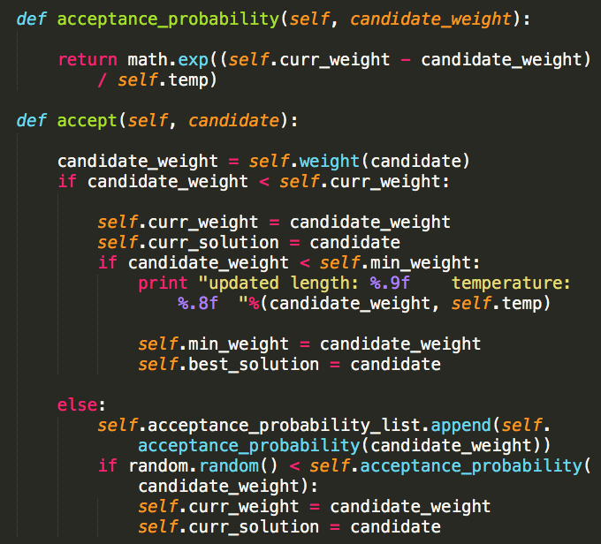
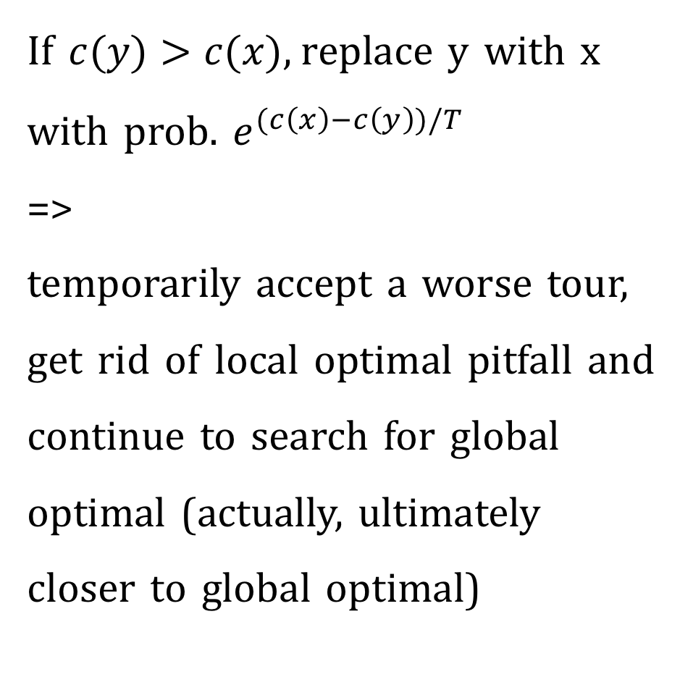
Key point of SA
If $c(y)>c(x)$, replace y with x with prob. $e^{(c\left(x\right)−c\left(y\right))/T}$
=>
temporarily accept a worse tour,
get rid of local optimal pitfall and continue to search for global optimal (actually, ultimately closer to global optimal)

Slide 22
SA Property 1: Get rid of local optimal pitfall

Slide 23
SA Property 2: Convergence to global optimal

Slide 24
Demo
100 cities
Initial temperature: 100
Rate of lowering T at each iteration: 0.995 i.e. T *= 0.995
Stopping temperature: 0.00000001

Slide 25
References
www.math.uwaterloo.ca
https://en.wikipedia.org/wiki/Travelling_salesman_problem
https://ocw.mit.edu/courses/sloan-school-of-management/15-053-optimization-methods-in-management-science-spring-2013/lecture-notes/MIT15_053S13_lec17.pdf

Slide 26
THANKS !

