Slide 1

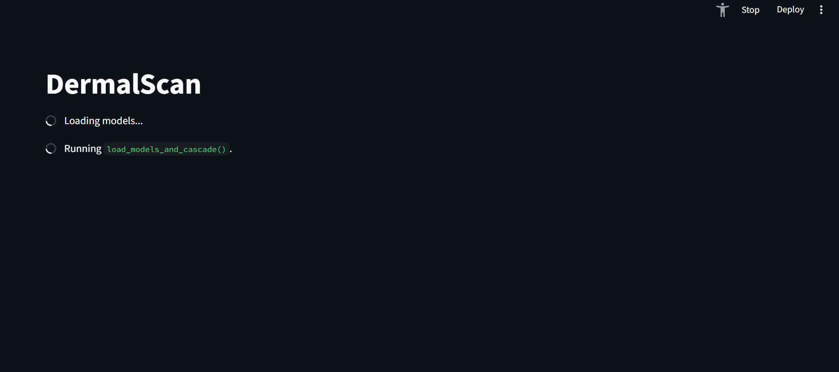
Siddhesh Bhatt
Siddhesh Bhatt

Slide 2
Project Statement and Key Outcomes
Objective:
The primary goal is to develop a deep learning-based system capable of detecting and classifying facial aging signs.
Key Classification Categories: The system is trained to classify facial ageing features into four categories:
Wrinkles
Dark spots
Puffy eyes
Clear skin
Core Outcomes/Deliverables:
1. Detect and localize facial features indicating aging.
2. Classify detected features using a trained CNN model.
3. Build a web-based frontend for uploading facial images and viewing annotated outputs.
4. Display predictions as percentages (probability) along with age

Slide 3
System Architecture: From Upload to Annotation
USER Uploads Image
Image is preprocessed cropped and converted
Image is supplied to models for ageing symptoms and facial age prediction
User downloads image and annotated csv
image is displayed to the user along with %age prediction of localized features
labelled ima

Slide 4
Technical Architecture
Model: Pretrained EfficientNetB0 for transfer learning and robust classification.
• Framework: TensorFlow/Keras.
• Image Operations/Libraries: OpenCV, NumPy, Haarcascade.
Processing Flow:
1. Image Input (Frontend): User uploads a facial image via the web UI.
2. Face Detection: Haar Cascade (OpenCV) is used to accurately detect the face region.
3. Preprocessing: Image resizing (to 224x224), normalization, and one-hot encoding are applied.
4. Inference (Backend): The processed image is fed into the loaded EfficientNetB0 model.
5. Output Generation: The model returns predictions (class probability percentages).
6. Visualization: The web frontend displays the image with annotated bounding boxes and labels.

Slide 5
Milestones and Evaluation
Milestone | Focus Area | Weeks | Target/Goal | Achieved | Metric/Evaluation Method
M1 | Data Preparation &Processing | 1-2 | Balenced & Clean dataset | 1000+images per category augmented and processed | dataset quality, augmentation, effectiveness
M2 | Model training and Performance | 3-4 | >=90% classification accuracy | ~92 % accuracy on testing the model | Accuracy and loss metrics(categorical cross entropy, confusion matrix)
M3 | UI & Backend integration | 5-6 | <=5 seconds per image | streamlit app provides ~4 seconds per image | Upload to output time & Usability
M4 | Final delivery | 7-8 | Complete and professional | documentation, presentation, export logs | Export functionality, log consistency and documentation
Milestone | Focus Area | Weeks | Target / Goal | Metric / Evaluation Method
M1 | Data Preparation & Preprocessing | 1–2 | Balanced & clean dataset | Dataset quality, augmentation effectiveness
M2 | Model Performance | 3–4 | ≥ 90% classification accuracy | Accuracy & loss metrics
M3 | UI & Backend Integration | 5–6 | ≤ 5 seconds per image | Upload-to-output time & usability (Seamless input-to-output flow)
M4 | Final Delivery | 7–8 | Complete & professional | Export functionality, log consistency, and documentation

Slide 6

Data Collection and Preprocessing
Milestones and Evaluation
Milestone | Focus Area | Weeks | Target/Goal | Achieved | Metric/Evaluation Method
M1 | Data Preparation &Processing | 1-2 | Balenced & Clean dataset | 1000+images per category augmented and processed | dataset quality, augmentation, effectiveness
M2 | Model training and Performance | 3-4 | >=90% classification accuracy | ~92 % accuracy on testing the model | Accuracy and loss metrics(categorical cross entropy, confusion matrix)
M3 | UI & Backend integration | 5-6 | <=5 seconds per image | streamlit app provides ~4 seconds per image | Upload to output time & Usability
M4 | Final delivery | 7-8 | Complete and professional | documentation, presentation, export logs | Export functionality, log consistency and documentation
Searched on web for various types of age related dark spots and got two names, sunspots and hyperpigmentation
used fatkun batch downloader to mine the images of clear faces frontals, darkspots, puffy_eyes and wrinkles
manually visited each image and removed bad images and unrelated and corrupted files
used preprocessing by resizing after cropping face, if larger than 224x224 shrink, else pad with black border to make of desired size
used augmentation to increase number of images by flip rotation , contrast, brightness adjustments
used os and csv to traverse 4 folders and generate a onehot csv labels for our dataset

Slide 7
Data Collection and Preprocessing
Model Training and Testing
approach followed
Split each part of the dataset into training and testing, after which shuffle them into one single set and feed it to our model
Challenge: systm did not had the ability to sustain so much processing
solution: used google colab-> uploaded zip to drive, copied it to colab env, extract it and then finally use dataset
Searched on web for various types of age related dark spots and got two names, sunspots and hyperpigmentation
used fatkun batch downloader to mine the images of clear faces frontals, darkspots, puffy_eyes and wrinkles
manually visited each image and removed bad images and unrelated and corrupted files
used preprocessing by resizing after cropping face, if larger than 224x224 shrink, else pad with black border to make of desired size
used augmentation to increase number of images by flip rotation , contrast, brightness adjustments
used os and csv to traverse 4 folders and generate a onehot csv labels for our dataset

Slide 8
Model Summary and Approach
Goal: Classify face conditions (clear_face, darkspots, puffy_eyes, wrinkles)
Approach:
Dataset Prep: Extract, cap 1000/class, clean images, split train/val
Pipeline: tf.data with resizing (224×224) + preprocessing
Model: EfficientNetB0 backbone (ImageNet weights, frozen initially)
+ GAP → Dense(256, ReLU) → Dropout(0.5) → Dense(4, Softmax)
Training: 2-Stage
1. Train classifier head
2. Fine-tune top ~30 backbone layers (low LR)
Optimization: Adam + EarlyStopping + ReduceLROnPlateau
Outcome: Lightweight, fine-tuned model → efficientnet_b0_face_classifier_finetuned.h5

Slide 9
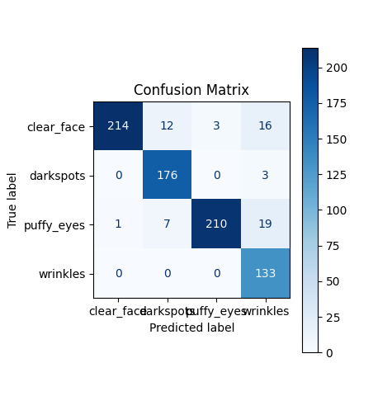
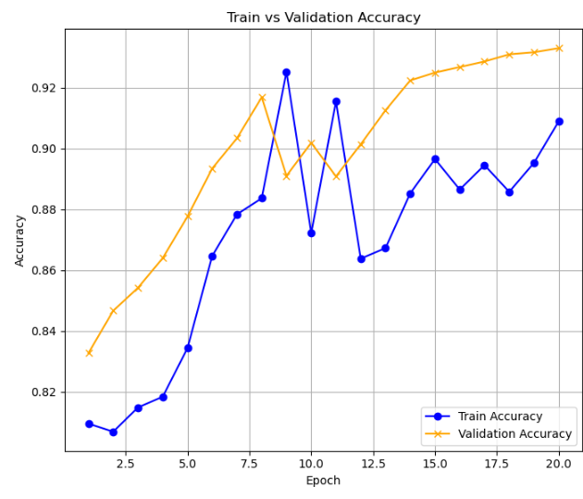
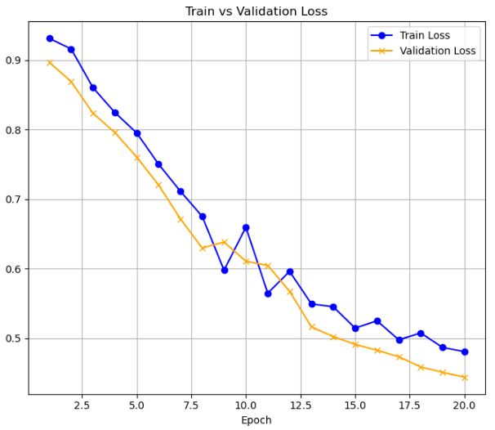
Training Results

Slide 10
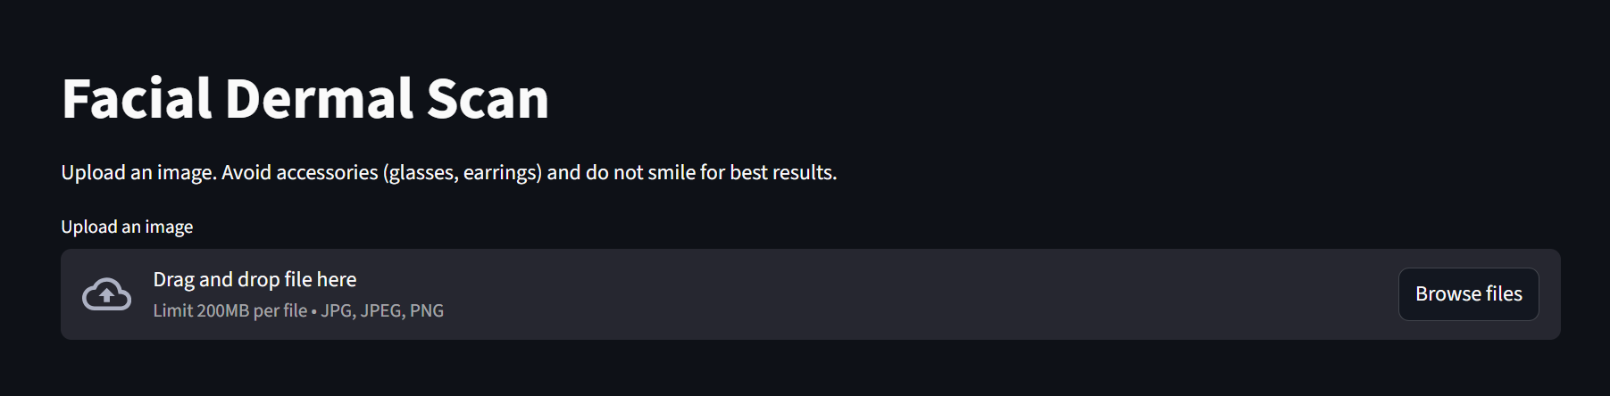
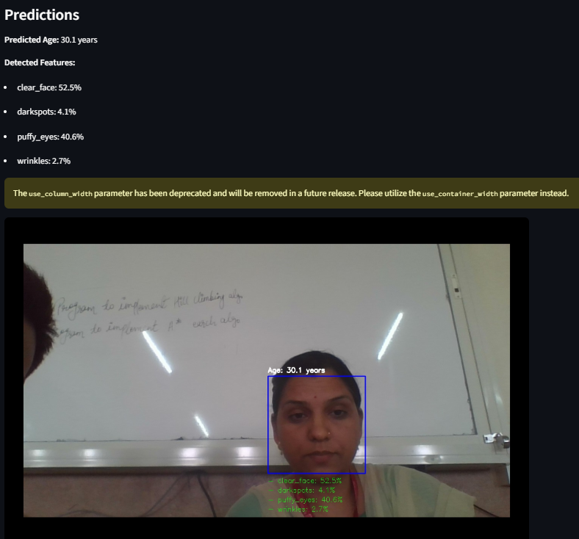
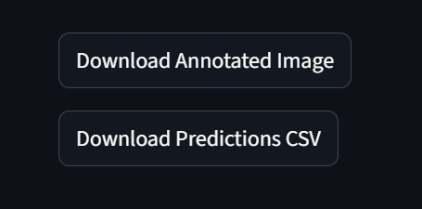
DermalScan Web Interface and Visualization

Slide 11
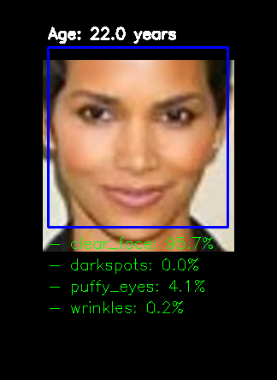
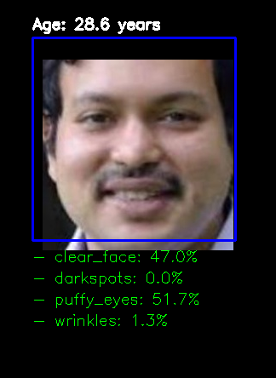
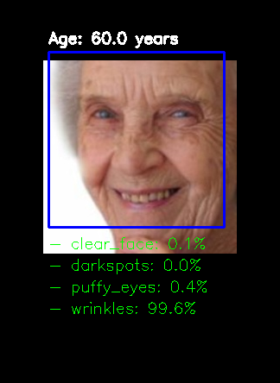
Samples and Examples

Slide 12
Applications
Dermatology Clinics – Assist doctors in quick screening for aging-related skin changes.
Cosmetic & Skincare Industry – Personalized product recommendations based on detected aging signs.
Wellness Apps – Mobile/online integration for self-check skin monitoring.
Research – Tracking long-term facial aging trends across populations.
Telemedicine – Remote consultation with annotated facial scans.

Slide 13
Conclusion
Lightweight yet accurate solution for facial aging detection.
Demonstrates practical AI application in dermatology & wellness.
Next steps: larger dataset, more categories, mobile deployment.

Slide 14
Model Architecture References
EfficientNetB0 Architecture
Introduced in EfficientNet: Rethinking Model Scaling for Convolutional Neural Networks (ICML 2019).
Proposes compound scaling: jointly scales depth (layers), width (channels), and resolution (input size) using a single coefficient .
Employs depth-wise separable convolutions to cut down on computation.
Uses inverted residual blocks to improve information flow and memory efficiency.
Achieves strong accuracy while requiring fewer computational resources compared to traditional CNN architectures.

Slide 15
Thank You

