Slide 1
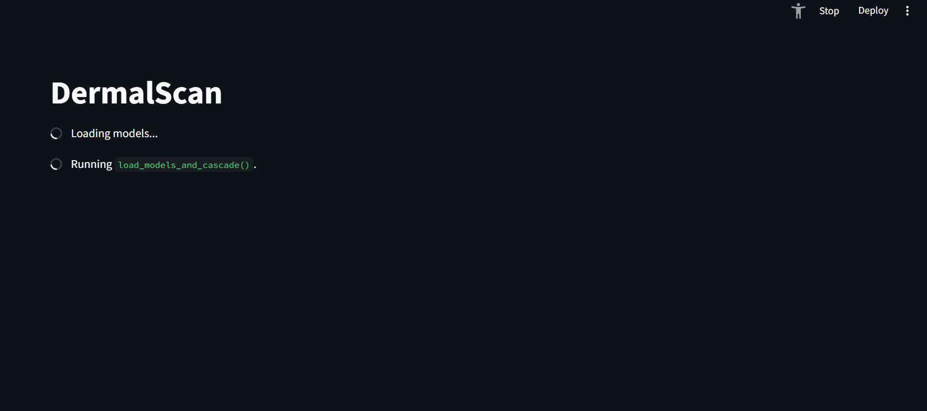
Siddhesh Bhatt
Siddhesh Bhatt

Slide 2
Project Statement and Key Outcomes
The primary goal is to develop a deep learning-based system capable of detecting and classifying facial aging signs.
Key Classification Categories: The system is trained to classify facial ageing features into four categories:
Wrinkles
Dark spots
Puffy eyes
Clear skin
Core Outcomes/Deliverables:
1. Detect and localize facial features indicating aging.
2. Classify detected features using a trained CNN model.
3. Build a web-based frontend for uploading facial images and viewing annotated outputs.
4. Display predictions as percentages (probability) along with age

Slide 3
Technical Architecture
Model: Pretrained EfficientNetB0 for transfer learning and robust classification.
• Framework: TensorFlow/Keras.
• Image Operations/Libraries: OpenCV, NumPy, Haarcascade.
Processing Flow:
1. Image Input (Frontend): User uploads a facial image via the web UI.
2. Face Detection: Haar Cascade (OpenCV) is used to accurately detect the face region.
3. Preprocessing: Image resizing (to 224x224), normalization, and one-hot encoding are applied.
4. Inference (Backend): The processed image is fed into the loaded EfficientNetB0 model.
5. Output Generation: The model returns predictions (class probability percentages).
6. Visualization: The web frontend displays the image with annotated bounding boxes and labels.

Slide 4
Milestones and Evaluation
Milestone | Focus Area | Weeks | Target/Goal | Achieved | Metric/Evaluation Method
M1 | Data Preparation &Processing | 1-2 | Balenced & Clean dataset | 1000+images per category augmented and processed | dataset quality, augmentation, effectiveness
M2 | Model training and Performance | 3-4 | >=90% classification accuracy | ~92 % accuracy on testing the model | Accuracy and loss metrics(categorical cross entropy, confusion matrix)
M3 | UI & Backend integration | 5-6 | <=5 seconds per image | streamlit app provides ~4 seconds per image | Upload to output time & Usability
M4 | Final delivery | 7-8 | Complete and professional | documentation, presentation, export logs | Export functionality, log consistency and documentation
Milestone | Focus Area | Weeks | Target / Goal | Metric / Evaluation Method
M1 | Data Preparation & Preprocessing | 1–2 | Balanced & clean dataset | Dataset quality, augmentation effectiveness
M2 | Model Performance | 3–4 | ≥ 90% classification accuracy | Accuracy & loss metrics
M3 | UI & Backend Integration | 5–6 | ≤ 5 seconds per image | Upload-to-output time & usability (Seamless input-to-output flow)
M4 | Final Delivery | 7–8 | Complete & professional | Export functionality, log consistency, and documentation

Slide 5

Data Collection and Preprocessing
Milestones and Evaluation
Milestone | Focus Area | Weeks | Target/Goal | Achieved | Metric/Evaluation Method
M1 | Data Preparation &Processing | 1-2 | Balenced & Clean dataset | 1000+images per category augmented and processed | dataset quality, augmentation, effectiveness
M2 | Model training and Performance | 3-4 | >=90% classification accuracy | ~92 % accuracy on testing the model | Accuracy and loss metrics(categorical cross entropy, confusion matrix)
M3 | UI & Backend integration | 5-6 | <=5 seconds per image | streamlit app provides ~4 seconds per image | Upload to output time & Usability
M4 | Final delivery | 7-8 | Complete and professional | documentation, presentation, export logs | Export functionality, log consistency and documentation
Images of clear faces, dark spots, puffy eyes, and wrinkles were collected using Fatkun Batch Downloader.
Manual curation was performed to remove irrelevant, low-quality, and corrupted samples.
Faces were cropped and standardized to a 224×224 resolution; smaller images were padded, larger ones rescaled.
Data augmentation (flipping, rotation, contrast, and brightness adjustment) was applied to enhance variability.
Automated scripts (os, csv) generated one-hot encoded labels for all classes.

Slide 6
Data Collection and Preprocessing
Model Training and Testing
The curated dataset was divided into training and testing subsets to ensure balanced representation across all classes.
Each subset was randomly shuffled to eliminate ordering bias and improve model generalization.
The unified dataset was then fed into the model pipeline for training and validation.
Challenge: The local system lacked sufficient GPU/CPU resources and memory to handle preprocessing and training efficiently.
Solution: The workflow was migrated to Google Colab, where the dataset (in compressed format) was uploaded to Google Drive, copied to the Colab runtime environment, extracted, and then utilized for model training and evaluation within the cloud infrastructure.
Searched on web for various types of age related dark spots and got two names, sunspots and hyperpigmentation
used fatkun batch downloader to mine the images of clear faces frontals, darkspots, puffy_eyes and wrinkles
manually visited each image and removed bad images and unrelated and corrupted files
used preprocessing by resizing after cropping face, if larger than 224x224 shrink, else pad with black border to make of desired size
used augmentation to increase number of images by flip rotation , contrast, brightness adjustments
used os and csv to traverse 4 folders and generate a onehot csv labels for our dataset

Slide 7
Classification Model: Summary and Approach
Goal: To classify facial conditions into Clear Face, Dark Spots, Puffy Eyes, and Wrinkles.
Approach: Dataset Preparation: Extracted and cleaned images (capped at 1000/class), then split into training and validation sets.
Pipeline: Implemented using tf.data, including face resizing (224×224) and preprocessing for normalization.
Model Architecture:
Backbone: EfficientNetB0 (pretrained on ImageNet, initially frozen).
Head: Global Average Pooling → Dense(256, ReLU) → Dropout(0.5) → Dense(4, Softmax).
Training Strategy (2-Stage):
Train only the classifier head.
Fine-tune top ~30 layers of the backbone using a low learning rate.
Optimization: Adam optimizer with EarlyStopping and ReduceLROnPlateau callbacks.
Outcome:
Achieved a lightweight, fine-tuned model saved as
efficientnet_b0_face_classifier_finetuned.h5, optimized for performance and efficiency.

Slide 8
Classifier Model Training flow
Combined Raw Dataset: Merged provided dataset with web-scraped images using Fatkun Batch Downloader.
Preprocessing & Augmentation: Detect and crop faces, resize/pad to 224×224, then augment to 1,000 images per class.
Dataset Setup in Colab: Upload zipped dataset to Google Drive, copy to Colab, and extract.
Data Preparation: Normalize and shuffle image paths, then split into train, validation, and test sets.
Model Training: Train on split dataset using Adam Otimizer, ReduceLROnPlateau, and categorical cross-entropy loss; unfreeze backbone after 10 epochs and continue training for 10 more epochs.
Save the model as a .h5 file
Model Setup: Load EfficientNetB0 backbone with ImageNet weights (frozen), add ReLU + Softmax head.

Slide 9
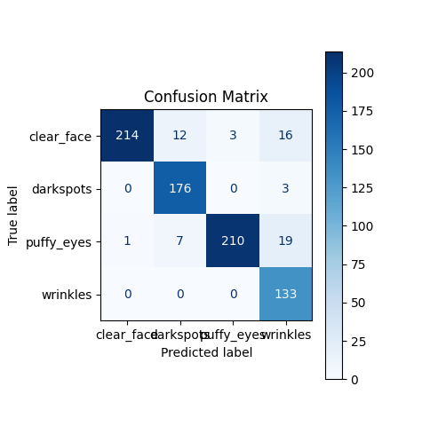
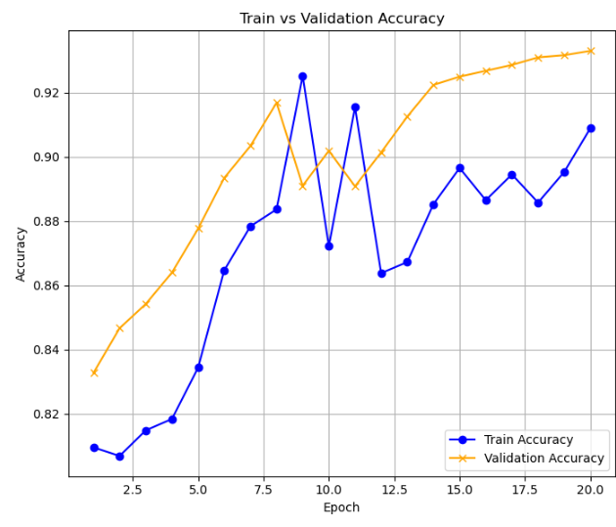
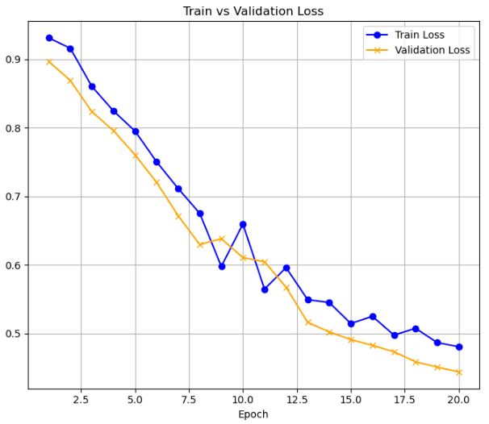
Training Results: Symptoms model

Slide 10
Skin Age Model training and Results
Dataset & Model
UTKFace, resized to 224×224.
EfficientNetB0 (ImageNet) backbone + linear regression head.
Approach
Loaded dataset ZIP into Colab environment.
Took balanced samples across age groups.
Split into train/val/test = 8:1:1, with shuffling for bias reduction.
Trained on 80%, validated on 10%, tested on 10%.
Outcome
Achieved MAE ≈ 5 years for age prediction.

Slide 11
Skin Age prediction Model Training flow
Dataset:Used UTKFace
Preprocessing: Detect and crop faces, resize/pad to 224×224
Dataset Setup in Colab: Upload zipped dataset to Google Drive, copy to Colab, and extract.
Data Preparation: Map images to age categories, split each category into train, validation, and test, then shuffle training set.
Model Training: Train head with Adam/MSE for 20 epoch, then unfreeze backbone and fine-tune at lower LR for 20 epochs.
Save the model as a .h5 file
Model Setup: Load EfficientNetB0 backbone with ImageNet weights (frozen), add ReLU + regression head.

Slide 12
Application Flow: from upload to annotation
USER Uploads Image
Image is preprocessed cropped and converted
Image is supplied to models for ageing symptoms and facial age prediction
Image’s colored copy is submitted to labeler with the skin age and facial features
User downloads image and annotated csv
image is displayed to the user along with %age prediction of localized features
labelled image

Slide 13
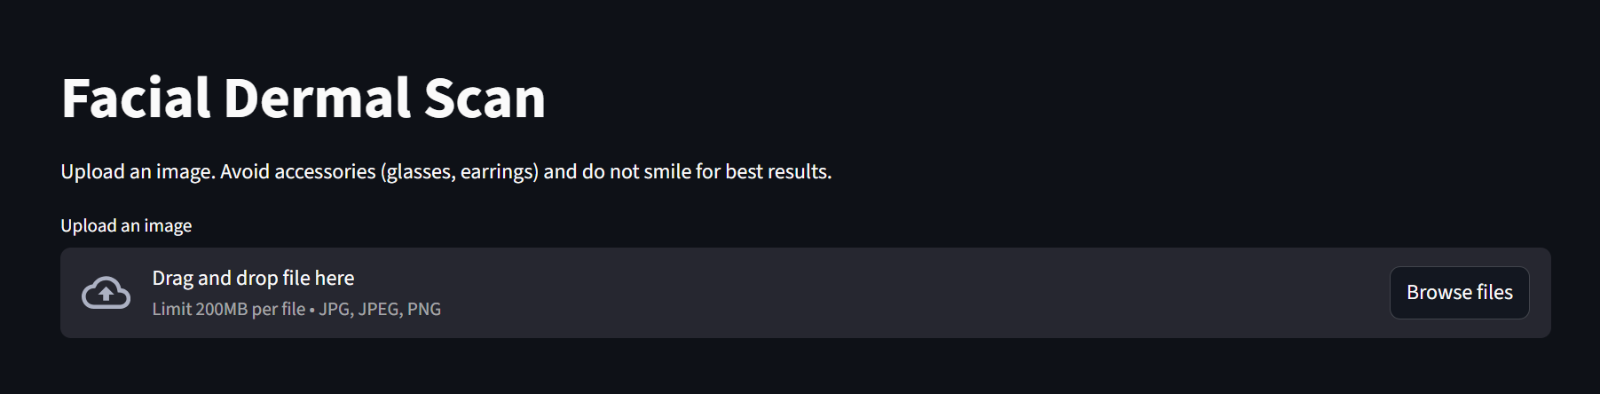
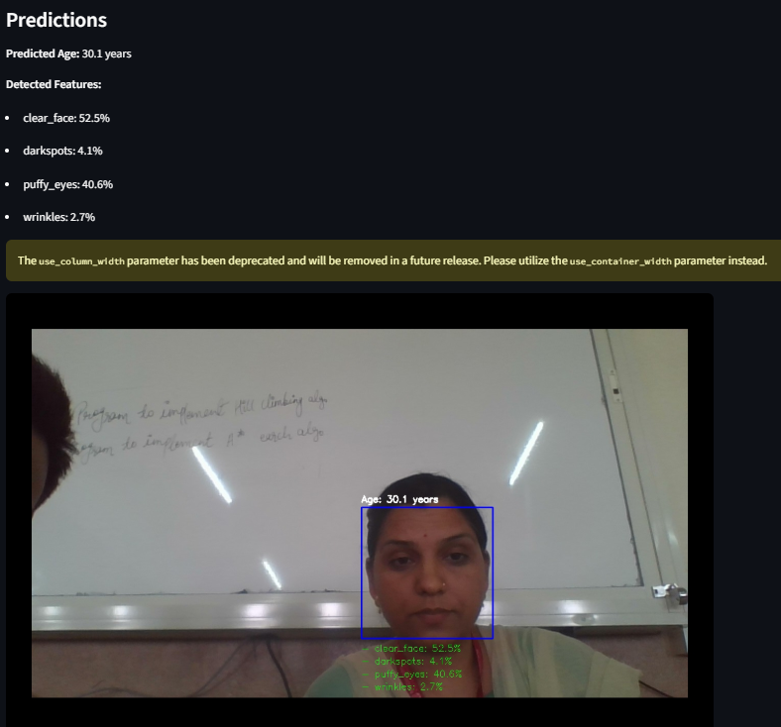
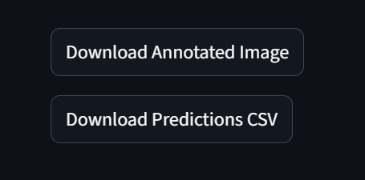
DermalScan Web Interface and Visualization

Slide 14
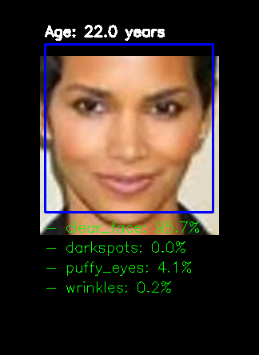
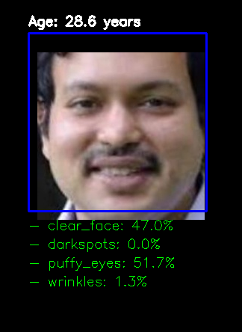
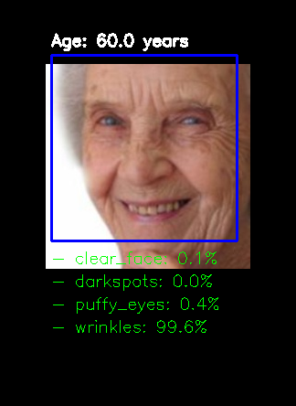
Samples and Examples

Slide 15
Applications
Dermatology Clinics: Assist doctors in rapid screening of aging-related skin changes.
Cosmetic & Skincare Industry: Enable personalized product recommendations based on facial condition analysis.
Wellness Apps: Integrate with mobile platforms for self-assessment and skin monitoring.
Research: Support studies on long-term facial aging trends across diverse populations.
Telemedicine: Facilitate remote consultations with annotated facial scans.

Slide 16
Conclusion
Lightweight yet accurate solution for facial aging detection.
Demonstrates practical AI application in dermatology & wellness.
Next steps: larger dataset, more categories, mobile deployment.

Slide 17
Model Architecture References
EfficientNetB0 Architecture
Introduced in EfficientNet: Rethinking Model Scaling for Convolutional Neural Networks (ICML 2019, Tan & Le).
Proposes compound scaling: jointly scales depth, width, and resolution using a single coefficient.
Utilizes depthwise separable convolutions to reduce computation cost.
Incorporates inverted residual blocks for better information flow and memory efficiency.
Achieves high accuracy with significantly lower computational resources than conventional CNNs.
Reference
Tan, M., & Le, Q. V. (2019). EfficientNet: Rethinking Model Scaling for Convolutional Neural Networks. Proceedings of the 36th International Conference on Machine Learning (ICML).

Slide 18
Other References
Viola, P., & Jones, M. (2001). Rapid Object Detection using a Boosted Cascade of Simple Features. Proceedings of the 2001 IEEE Computer Society Conference on Computer Vision and Pattern Recognition (CVPR).
Bradski, G. (2000). The OpenCV Library. Dr. Dobb’s Journal of Software Tools.
Harris, C. R., et al. (2020). Array programming with NumPy. Nature, 585, 357–362.
McKinney, W. (2010). Data Structures for Statistical Computing in Python. Proceedings of the 9th Python in Science Conference.
Streamlit Inc. (2020). Streamlit Documentation. https://docs.streamlit.io

Slide 19
Thank You

