Slide 1


SentinelNet
AI-POWERED NETWORK INTRUSION DETECTION SYSTEM
MENTOR :
Dr. N. Jagan Mohan
INTERNS :
Aarifa R
Amit Yadav
Anisetty Bhavitha
Bhaskar Mekala
Bhavana Thota
Chaganti Sai Sarvani
Indhuja V
Katherine Olivia R
Khushalha Giduthuri
Krushna Shinde
Mehak Tripathi
Mohan Raaj C
Naga Lakshmi Durga Enugu
Omkar Marakwar
Poornitha S
Prathap V
Sai Sathwik Balabhadra
Saravanan S
Shreyanshi Srivastava
Sumithra G
Surya Sindhu Guthula
Upasana Prabhakar
Vimala Reddy Tummuru
Vitesh Bhardwaj Mallibhat
Yasaswita
Experienced Data Scientist with a PhD in Computer Vision and Medical Image Processing from IIT Delhi

Slide 2
Agenda
Introduction
03
Literature Review
Current State & Research Gaps
Proposed Model (Novelty)
04
07
Methodology
Datasets
Preprocessing Pipeline
Model Selection & Training
Evaluation Framework
08
10
11
12
Results
Binary Classification Performance
Multi-Class Classification Performance
Comparative Analysis
13
18
21
Conclusion
25
Future Work
26
References
27

Slide 3
Introduction - The Cybersecurity Challenge
1
The Problem
2
The Solution
Modern networks face sophisticated threats: DDoS attacks, zero-day exploits, APTs, polymorphic malware
Traditional signature-based systems cannot detect novel attacks
95-99% of network traffic is benign, making attack detection challenging
AI-powered Network Intrusion Detection System (NIDS)
Combines signature-based and anomaly-based detection
Real-time threat identification with automated classification
03

Slide 4

Objectives
Core Goals
Automated Threat Detection: Distinguish benign traffic from malicious activities using ML
Real-Time Classification: Process network flows instantly for immediate response
Multi-Attack Recognition: Identify specific attack types (DoS, DDoS, Probe, Web attacks)
Handle Class Imbalance: Address the majority-class bias problem in intrusion data
Performance Benchmarking: Compare algorithms across accuracy, efficiency, and detection rates
04

Slide 5
Literature Review - Current State
Evolution of NIDS
Early systems: Signature-based detection (effective only against known threats)
Modern approaches: Anomaly-based detection using statistical methods and ML
Current trend: Hybrid systems combining both approaches
05

Slide 6
Literature Review - Current State
Research Gaps Identified
Limited evaluation on modern, realistic datasets and Class imbalance handling remains problematic
Trade-off between detection accuracy and computational efficiency unclear
Need for comprehensive benchmarking across multiple algorithms
06

Slide 7
Proposed Model - Novelty
SentinelNet Contributions:
1) Dual-Dataset Evaluation:
[1]
[2]
NSL-KDD (legacy) + CICIDS2017 (modern realistic traffic)
2) Comprehensive Preprocessing Pipeline:
Strategic undersampling instead of synthetic oversampling (SMOTE avoided)
Feature correlation analysis and dimensionality optimization
3) Multi-Algorithm Comparison:
Logistic Regression, Decision Trees, Random Forest, Gradient Boosting
4) Dual Classification Approach:
Binary (attack vs. normal) + Multi-class (specific attack types)
5) Production-Ready Framework:
Balances accuracy with computational efficiency
07

Slide 8
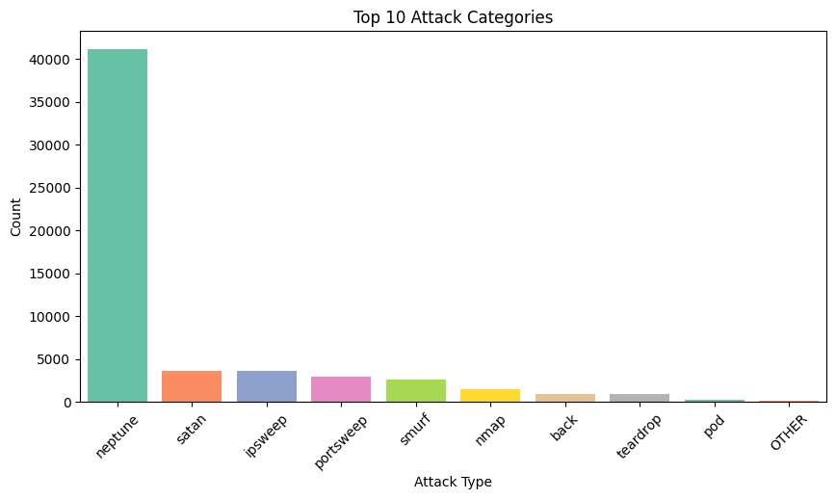
Methodology -
Datasets Overview
NSL-KDD Dataset
41 features, ~150K records
Attack types: DoS, Probe, U2R, R2L
Simulated legacy network traffic
Use case: Algorithm comparison, academic evaluation
08
Fig 1 : NSL-KDD Dataset attack categories

Slide 9
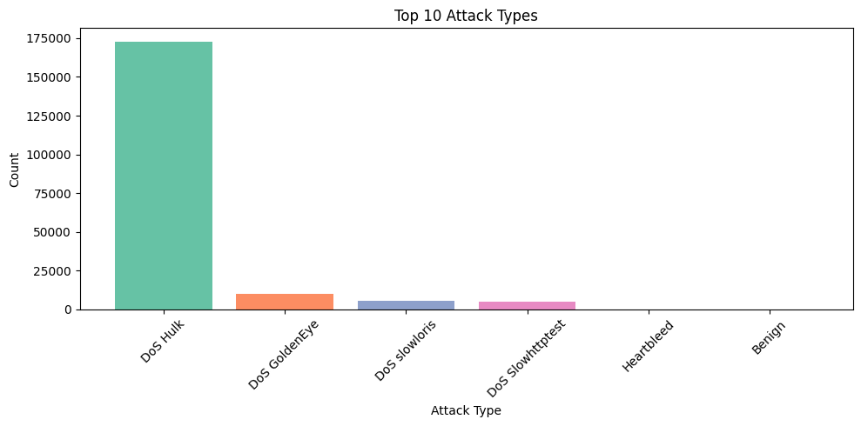
Methodology -
Datasets Overview
CICIDS-2017
78 features, >2.8M records
14 contemporary attack types: DDoS variants, Web attacks, Infiltration, Botnet
Real enterprise network traffic over 5 days
Use case: Production deployment testing
Fig 2 : CICIDS 2017 Dataset attack categories
09

Slide 10
Methodology -
Preprocessing Pipeline
Key Preprocessing Steps:
Data Cleaning: Handle missing values, remove duplicates, fix infinite values
Feature Scaling: Standardization (Z-score normalization) for consistent feature ranges
Categorical Encoding: One-hot encoding for protocols, services, flags
Feature Selection: Correlation analysis (remove features with r > 0.95)
Class Imbalance Handling: Strategic undersampling of majority class
Train-Test Split: 70-15-15 stratified split maintaining class distributions
10

Slide 11
Methodology -
Model Selection
Algorithms Evaluated
Model
Type
Key Characteristics
Baseline,
interpretable, fast
Logistic Regression
Linear
Training Strategy
Cross-validation for hyperparameter tuning
Stratified sampling to preserve class distributions
Performance metrics: Accuracy, Precision, Recall, F1-Score, Specificity, AUC
Decision Tree
Simple, prone to
Non- Linear
overfitting.
Random Forest
Mutliple trees,
Ensemble
robust,balanced
Sequential learning,
highest accuracy
Gradient Boosting
Ensemble
Table 1 : Evaluated Algorithms
11

Slide 12

Methodology -
Evaluation Framework
Accuracy :
Percentage of total predictions that are correct (both normal and attack).
Precision :
Proportion of predicted attacks that are actually attacks (measures reliability of
positive predictions).
Recall
(Sensitivity) :
Proportion of actual attacks correctly detected (measures detection ability).
F1-Score :
Harmonic mean of precision and recall, useful for imbalanced data
Specificity :
Proportion of actual normal traffic correctly identified.
AUC-ROC :
Evaluates model performance across thresholds by comparing TPR vs FPR.
Training
Time :
Time required for the model to learn patterns from the training data, reflecting computational efficiency.
12

Slide 13
Results -
NSL-KDD Binary Classification
Key Findings
MODEL | TEST ACCURACY | F1 - SCORE | RECALL | TRAINING TIME
LOGISTIC REGRESSION | 97.11% | 96% | 96.15% | 1.57S
DECISION TREE | 99.32% | 99% | 99.54% | 0.72S
RANDOM FOREST | 98.56% | 98% | 97.15% | 2.73S
GRADIENT BOOSTING | 99.87% | 99% | 99.81% | 43.09S
Gradient Boosting achieves best balance of accuracy (99.87%) and AUC (1.00)
All ensemble methods significantly outperform Logistic Regression
Decision Tree fastest but lower AUC indicates poorer generalization
Table 2 : Results of NSL-KDD Binary classification
13

Slide 14
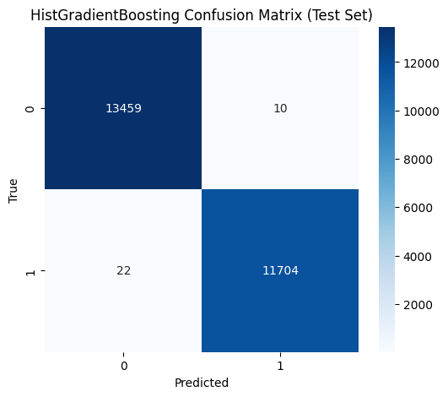
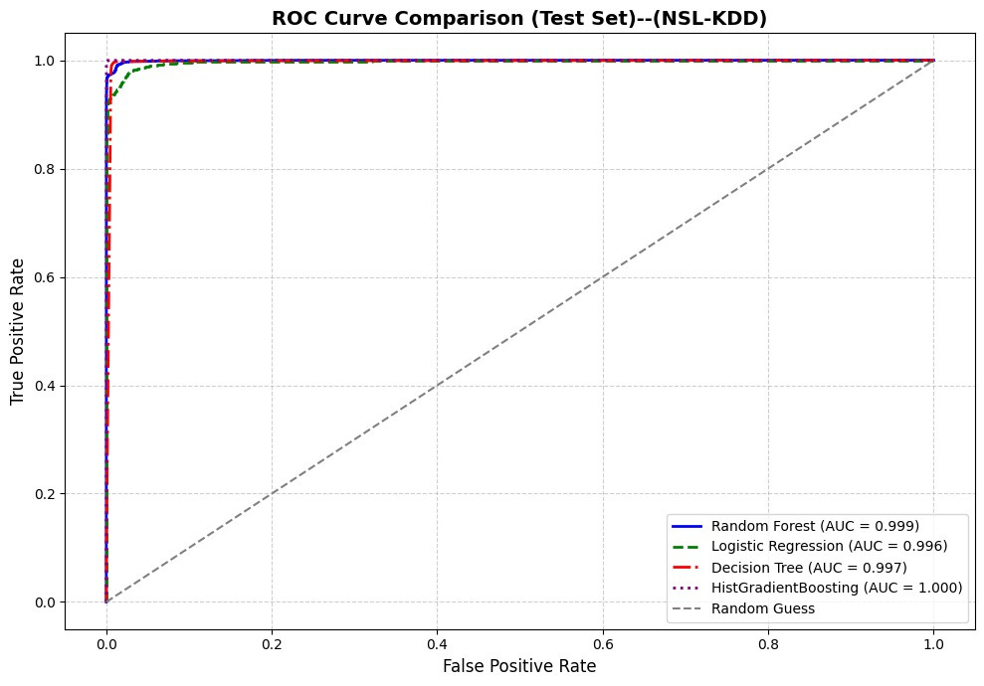
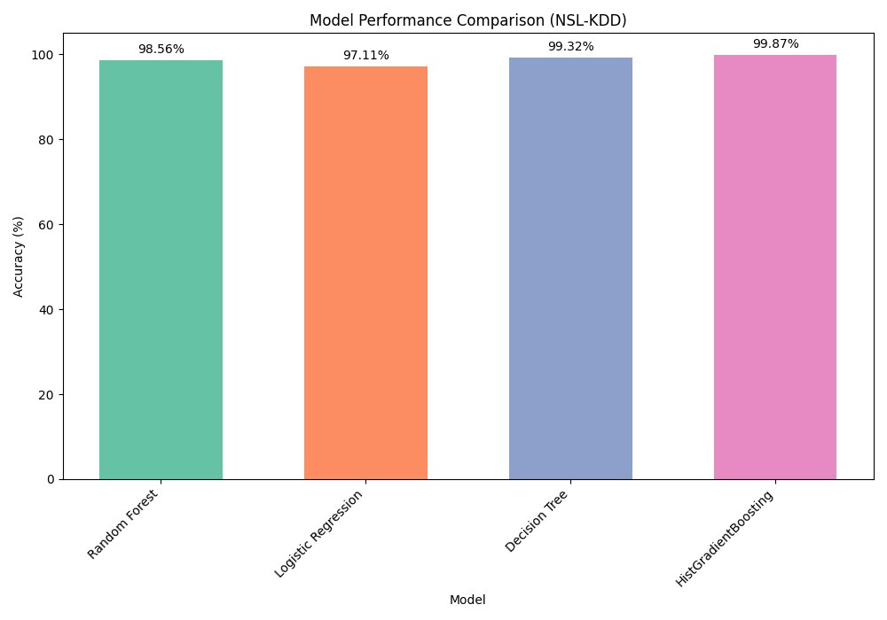
Binary Classification
Fig 3 : NSL Binary Result : ROC Curve
14
Fig 4 & 5 : NSL Binary Result : Confusion matrix and model comparison

Slide 15
Results -
NSL-KDD Multiclass Classification
Key Findings
MODEL | TEST ACCURACY | PRECISION | RECALL | F1 SCORE | TRAINING TIME
LOGISTIC REGRESSION | 82.54% | 60% | 56% | 53% | 4.78S
DECISION TREE | 86.27% | 66% | 64% | 62% | 1.55S
RANDOM FOREST | 86.59% | 61% | 64% | 61% | 8.04S
GRADIENT BOOSTING | 86.54% | 66% | 65% | 63% | 270.39S
Multi-class classification more challenging (lower F1-scores vs. binary)
Gradient Boosting achieves best balanced metrics
Significant computational cost trade-off (270s vs. 1.55s for Decision Tree)
Table 3 : Results of NSL-KDD Multi-class classification
15

Slide 16
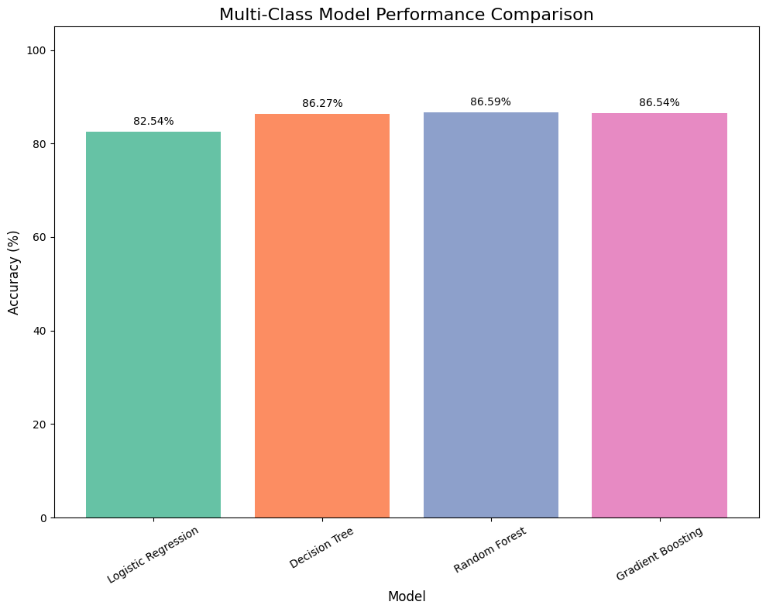
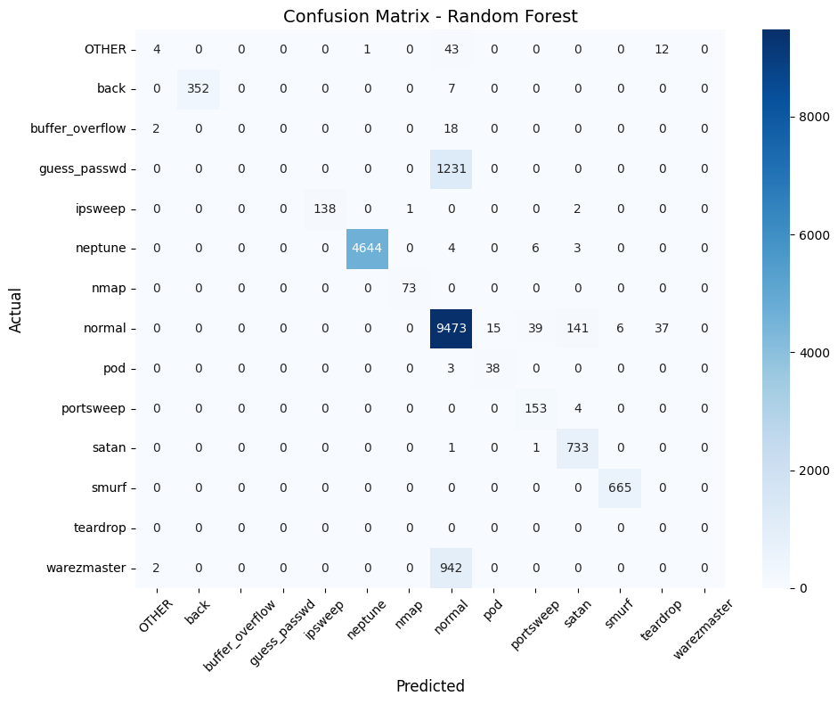
Multiclass Classification
Fig 6 : NSL Multi-class Result : Confusion matrix
Fig 7: NSL Multi-class Result : Model Performance Comparison
16

Slide 17
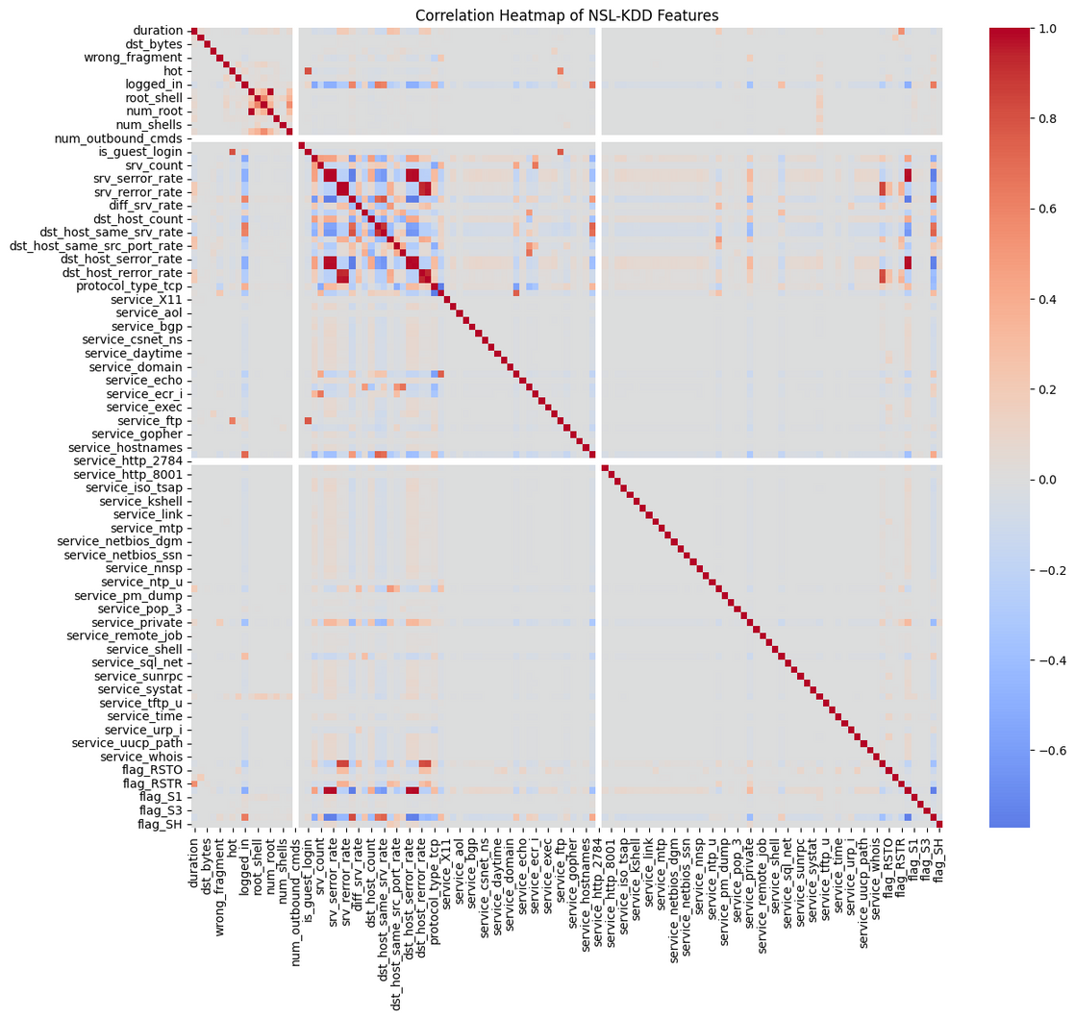
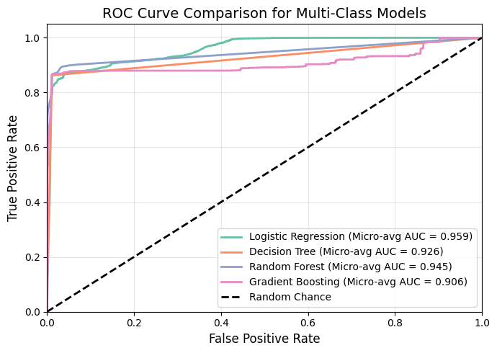
Multiclass Classification
Fig 9: NSL Multi-class Result : ROC Curve
17
Fig 8: NSL Multi-class Result : Correlation Heatmap

Slide 18
Results -
CICIDS2017 Binary Classification
Key Findings
MODEL | TEST ACCURACY | PRECISION | RECALL | F1 SCORE | AUC
LOGISTIC REGRESSION | 97.04% | 96% | 97% | 97% | 0.994
DECISION TREE | 99.08% | 99% | 99% | 99% | 0.996
RANDOM FOREST | 99.77% | 100% | 100% | 100% | 0.999
GRADIENT BOOSTING | 99.83% | 100% | 100% | 100% | 0.999
Near-perfect detection on modern realistic traffic
Random Forest and Gradient Boosting achieve 100% precision and recall
Even Logistic Regression performs well (97.04%), showing dataset quality
Table 4 : Results of CICIDS 2017 Binary classification
18

Slide 19
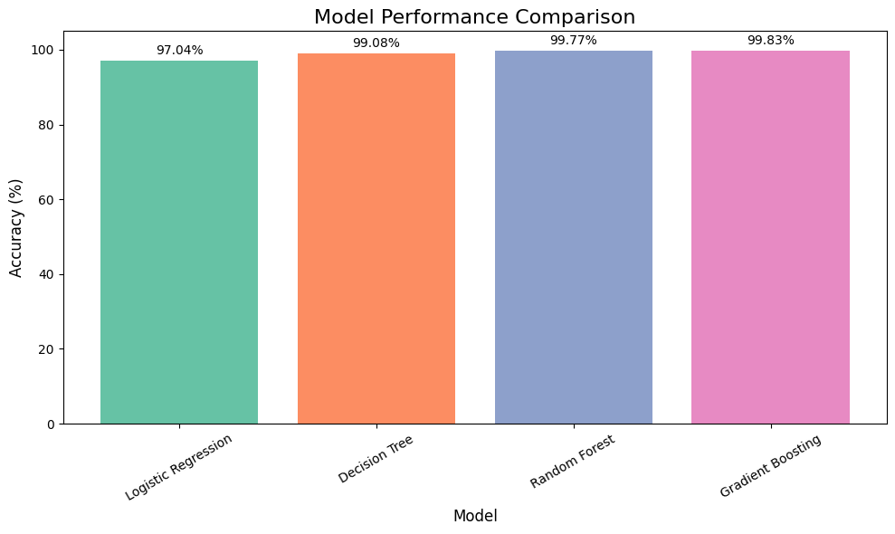
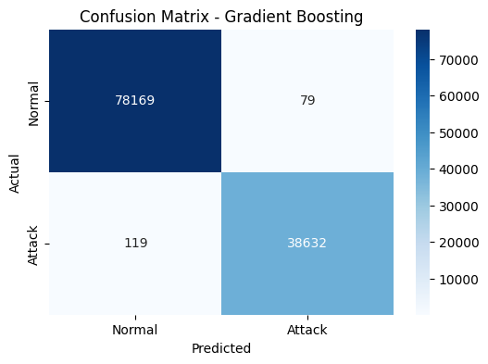
Binary Classification
Fig 10: CICDS Binary Result : Model Performance Comparison
Fig 11: CICDS Binary : Confusion Matrix
19

Slide 20
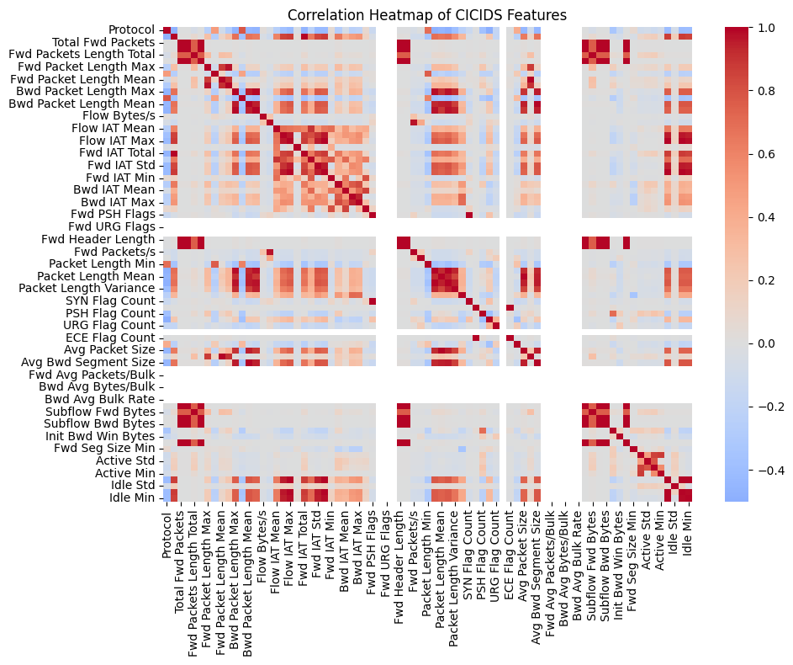
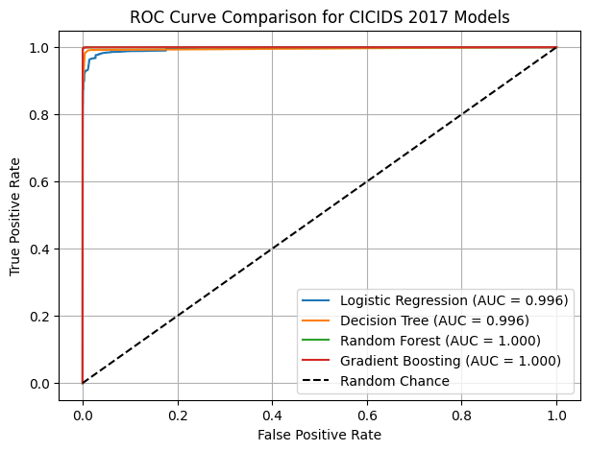
Binary Classification
Fig 12: CICDS Binary Result : ROC Curve Comparison
Fig 13: CICDS Binary Result : Correlation Heatmap
20

Slide 21
Results -
CICIDS Multiclass Classification
Key Findings
MODEL | TEST ACCURACY | PRECISION | RECALL | F1 SCORE | TRAINING TIME
LOGISTIC REGRESSION | 94.21% | 66% | 97% | 76% | 16.55S
DECISION TREE | 99.41% | 99% | 89% | 93% | 6.51S
RANDOM FOREST | 98.82% | 92% | 94% | 91% | 12.28S
GRADIENT BOOSTING | 99.87% | 99% | 99% | 99% | 1133.07S
Gradient Boosting excels at distinguishing multiple attack types (99.87% accuracy)
Decision Tree offers strong balance (99.41% accuracy, 6.51s training)
Significant computational investment required for best performance (1133s)
Table 5 : Results of CICIDS 2017 Multi-class classification
21

Slide 22
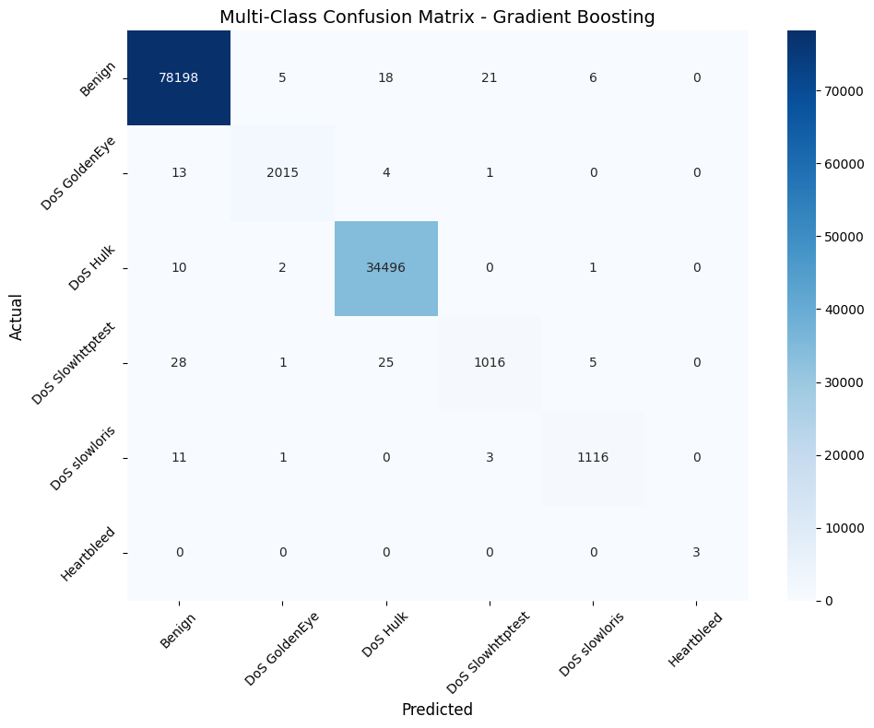
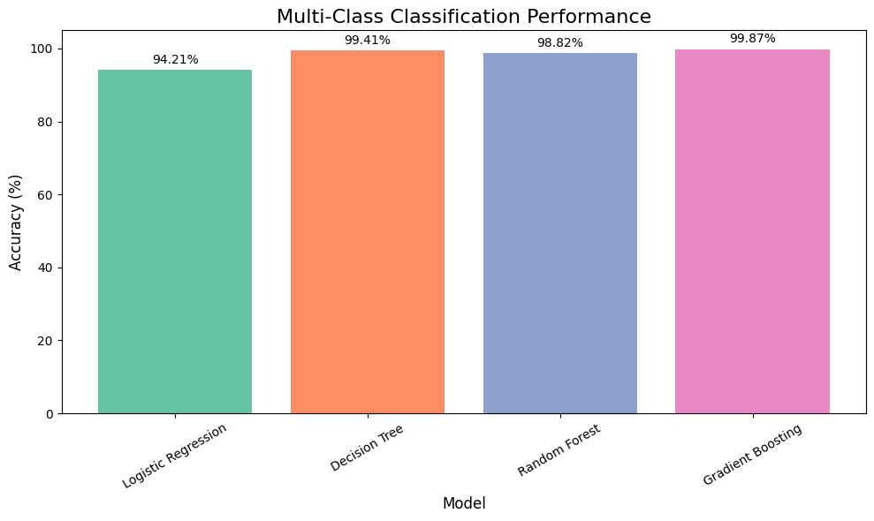
MultiClass Classification
Fig 14: CICDS Multi Class Result : Model Performance Comparison
Fig 15: CICDS Multi Class Result : Confusion Matrix
22

Slide 23
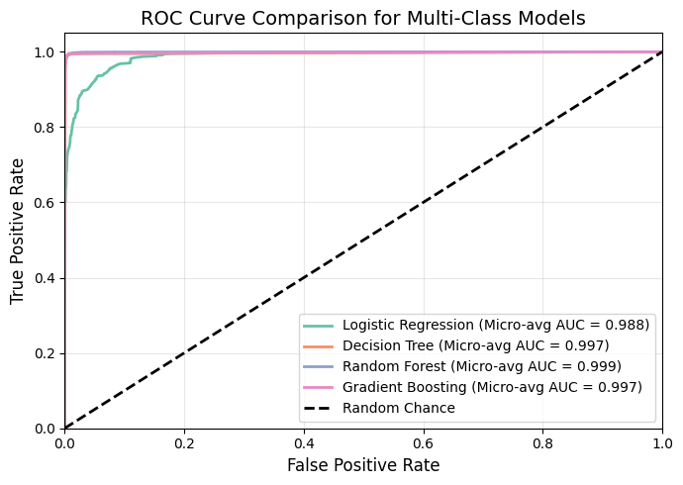
MultiClass Classification
Fig 16: CICDS Multi Class Result : ROC Curve Comparison
23

Slide 24
Model Selection Recommendations
For Production Deployment:
Random Forest - Recommended for most scenarios
Excellent accuracy-spped trade-off
Robust against overfitting
Good interpretability through feature importance
Training time: Moderate (2-97 s depending on dataset size)
Gradient Boosting- When accuracy is paramount
Highest detection rates (99.83-99.87% on CICIDS2017)
Best for multi-class classification
Trade-off: Significantly higher training time (up to 1133s)
Decision Tree- For resource-constrained environments
Fastest training (0.72-15s)
Reasonable accuracy (86-99%)
Risk of overfitting on complex patterns
24

Slide 25
Conclusion
Key Achievements:
Comprehensive Evaluation: Dual-dataset approach validates across legacy and modern threats
Ensemble Superiority: Random Forest and Gradient Boosting significantly outperform linear models
Near-Perfect Detection: 99.8%+ accuracy on realistic modern traffic (CICIDS2017)
Practical Insights: Clear trade-offs identified between accuracy and computational efficiency
Contributions:
Empirical evidence for ensemble methods in NIDS
Production-ready preprocessing pipeline avoiding synthetic data generation
Performance benchmarks for practical deployment decisions
Framework applicable to enterprise security operations
25

Slide 26
Future Work
Research Extensions:
Deep Learning Integration
CNN/LSTM architectures for temporal pattern recognition
Automated feature extraction from raw packet data
Adversarial Robustness
Evaluation against adversarial examples
Evasion-resistant model architectures
Real-Time Deployment
Stream processing integration (Apache Kafka, Spark)
Edge computing for distributed detection
Continuous Learning
Online learning for adapting to evolving threats
Transfer learning across network environments
Explainable AI
SHAP/LIME for decision interpretation
Compliance with security audit requirements
26

Slide 27
References & Acknowledgements
Key Datasets:
1. NSL-KDD Dataset: https://www.unb.ca/cic/datasets/nsl.html
2. CICIDS2017 Dataset: https://www.unb.ca/cic/datasets/ids-2017.html
Foundational Research References
Tavallaee et al. (2009) – NSL-KDD dataset analysis.
Sharafaldin et al. (2018) – CICIDS2017 dataset methodology.
Breiman (2001) – Random Forest algorithm.
Friedman (2001) – Gradient Boosting Machines.
Buczak & Guven (2016) – ML methods for intrusion detection.
27

Slide 28

The End
THANK YOU FOR LISTENING
28

