Slide 1


Presented by:
Amit Yadav
Intern, Infosys Springboard 6.0

Slide 2
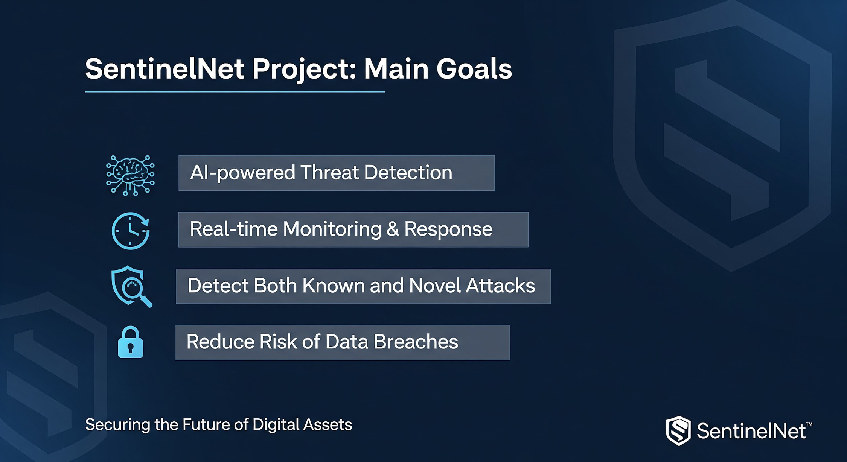

Slide 3
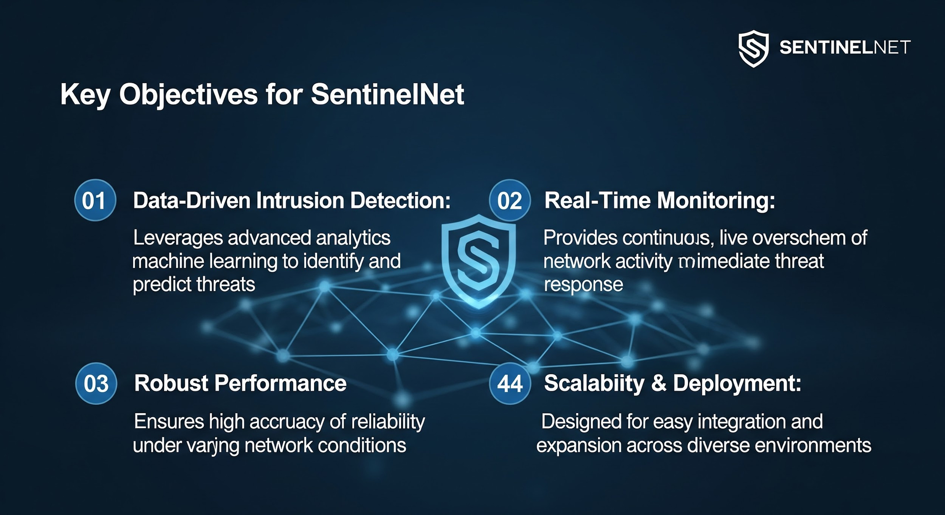

Slide 4
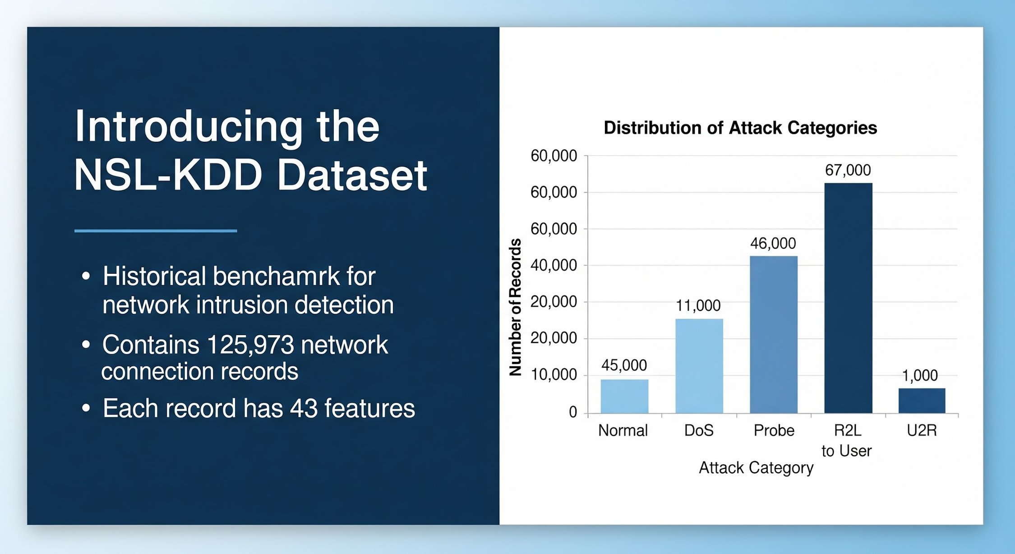

Slide 5
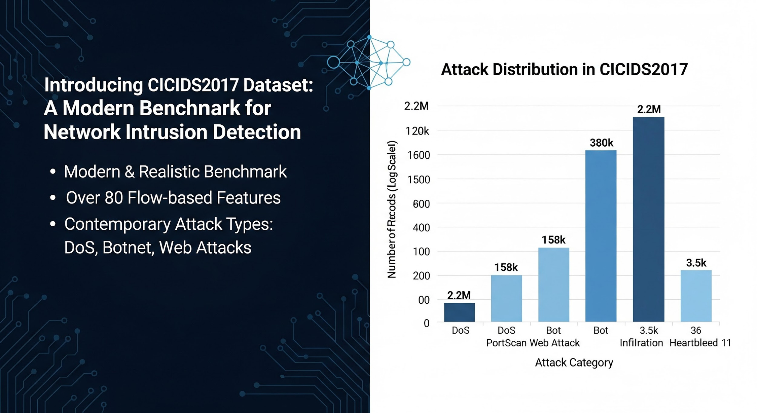

Slide 6
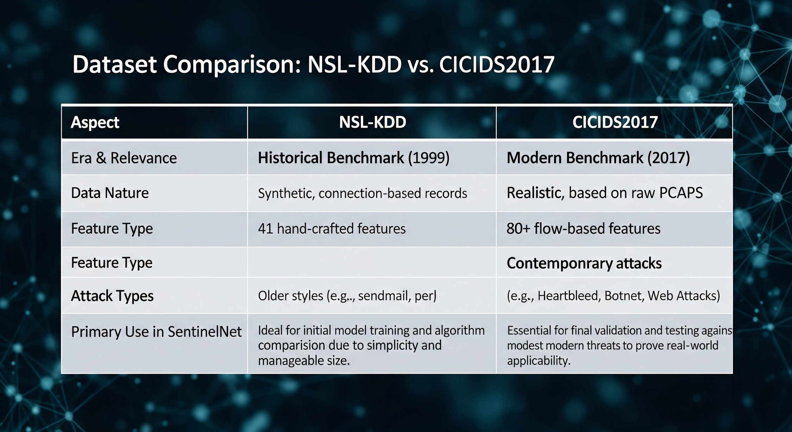

Slide 7


Slide 8
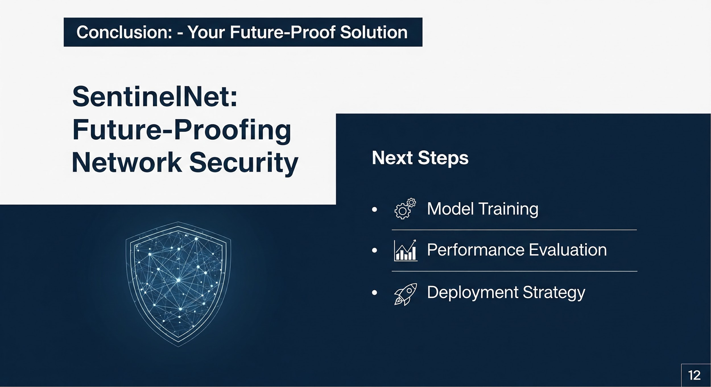

Slide 9


Presented by:
Amit Yadav
Intern, Infosys Springboard 6.0

