Slide 1
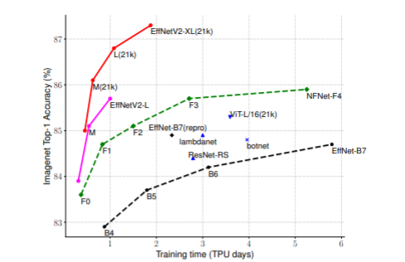
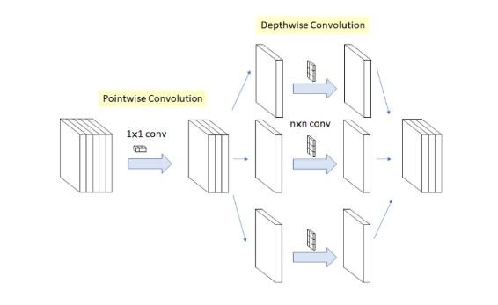
Pretrained Model Example
EfficientNetV2(Acc : 88.9%)
Xception(Acc : 86.0%)
Training Efficiency를 극대화한 CNN 모델
독립적인 Spatial Correlation을 통한 성능 향상
Training with very large image sizes is slow
Inception hypothesis
Depthwise convolutions are slow in early layers
Depthwise Separable Convoltuion
Equally scaling up every stage is sub-optimal
Modified Depthwise Separable Convolution
[ EfficientNetV2: Smaller Models and Faster Training(2021) ]
[Xception: Deep Learning with Depthwise Separable Convolutions(2017) ]

Slide 2
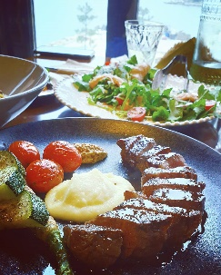
모델 구현(Ensemble Model)
17 Class Image Dataset 학습
Transfer Learning
EfficientNetV2
Xception
InceptionResNetV2
VGG16
Fine Tuning : 전체 Weight Update, Class에 맞춰 FC Layer 수정
각 모델의 마지막 Layer에 Softmax를 사용 → Voting을 위한 확률 평준화
Ensemble
Ensemble Classification : Weighted Vote
Model 1
Softmax
×
Acc Weight
Model 2
Softmax
×
Acc Weight
Argmax(Sum)
Osteria
Model 3
Softmax
×
Acc Weight
Model 4
Softmax
×
Acc Weight
Input
Ensemble Model
Output

