Slide 1

CS-EJ3311 –
Deep Learning with Python
Regularization
Alexander Jung

Slide 2
What I want to teach you today:
basic idea of regularization
regularization via data augmentation
regularization via transfer learning

Slide 3
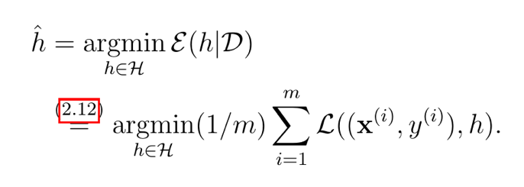
What is ML ?
informal: learn hypothesis out of a hypothesis space or “model” that incurs minimum loss when predicting labels of datapoints based on their features
“training error”
see Ch. 4.1 of mlbook.cs.aalto.fi

Slide 4

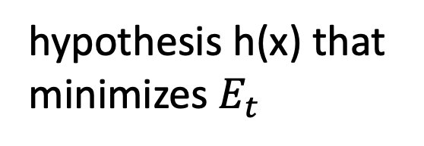
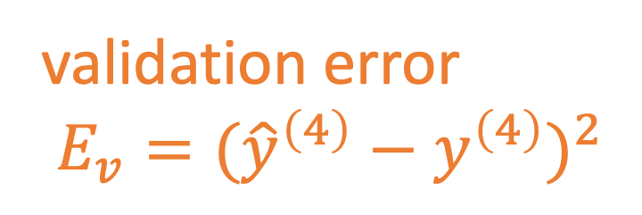
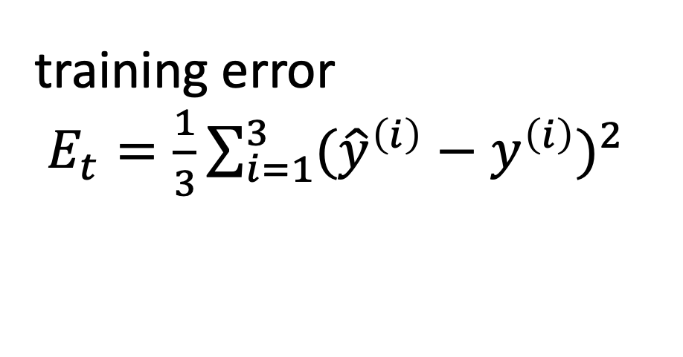
hypothesis h(x) that
minimizes $E_{t}$
$$x^{(i)},y^{(i)}$$
label y
training error
$E_{t}=\frac{1}{3}\sum_{i=1}^{3}{({\hat{y}}^{\left(i\right)}−y^{\left(i\right)})^{2}}$
validation error
$E_{v}=({\hat{y}}^{\left(4\right)}−y^{\left(4\right)})^{2}$
feature x

Slide 5
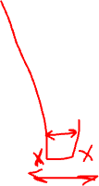
label y
feature x

Slide 6
Data and Model Size
training set
m
hypospace/model
nr. of features n
crucial parameter is the
ratio d/m
d
Notes:
The sample size m is the nr. of different datapoints in the training set

Slide 7
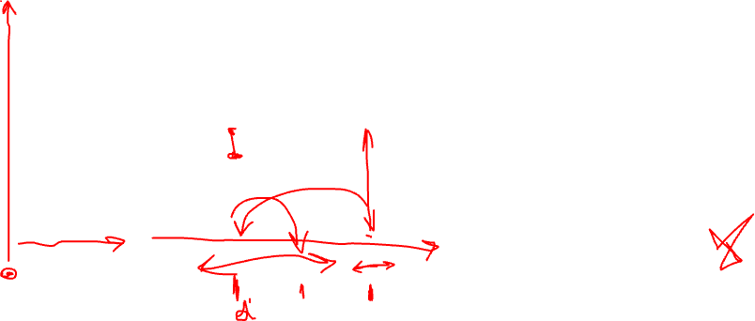
training error
validation error
“critical value” (d/m=1)
d / m
adjust model and/or data to reach

Slide 8

bring d/m below critical value 1:
increase m by using more training data
decrease d by using smaller hypothesis space

Slide 9
Data Augmentation
Notes:
consider the first option to adjust the ratio d/m. We could collect more data points for training set. What could be the problem here ? Note that we must know the labels of datapoints in the training set. However, we can use some domain knowledge do generate new datapoints synthetically(simulate it).

Slide 10
bring d/m below critical value 1:
increase m by using more training data
decrease d by using smaller hypothesis space

Slide 11
add a bit of noise to features
original datapoint
label y
augmented
feature x
we have enlarged dataset by factor 3 !

Slide 12

rotated cat image is still cat image

Slide 13
flipped cat image is still cat image

Slide 14
shifted cat image is still cat image

Slide 15
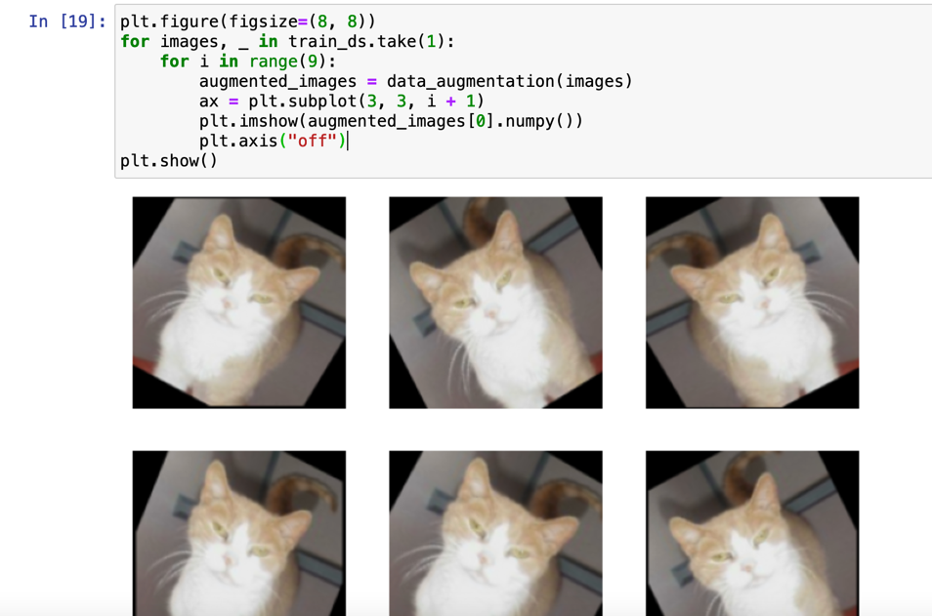

Slide 16
Transfer Learning
Notes:
consider the first option to adjust the ratio d/m. We could collect more data points for training set. What could be the problem here ? Note that we must know the labels of datapoints in the training set. However, we can use some domain knowledge do generate new datapoints synthetically(simulate it).

Slide 17
bring d/m below critical value 1:
increase m by using more training data
decrease d by using smaller hypothesis space

Slide 18
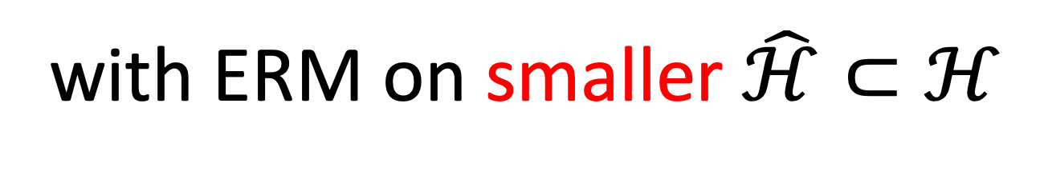
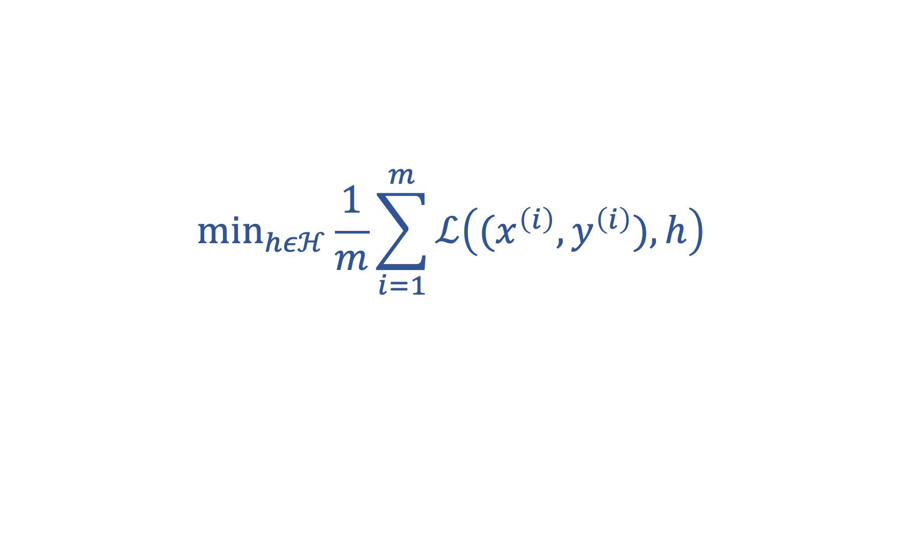
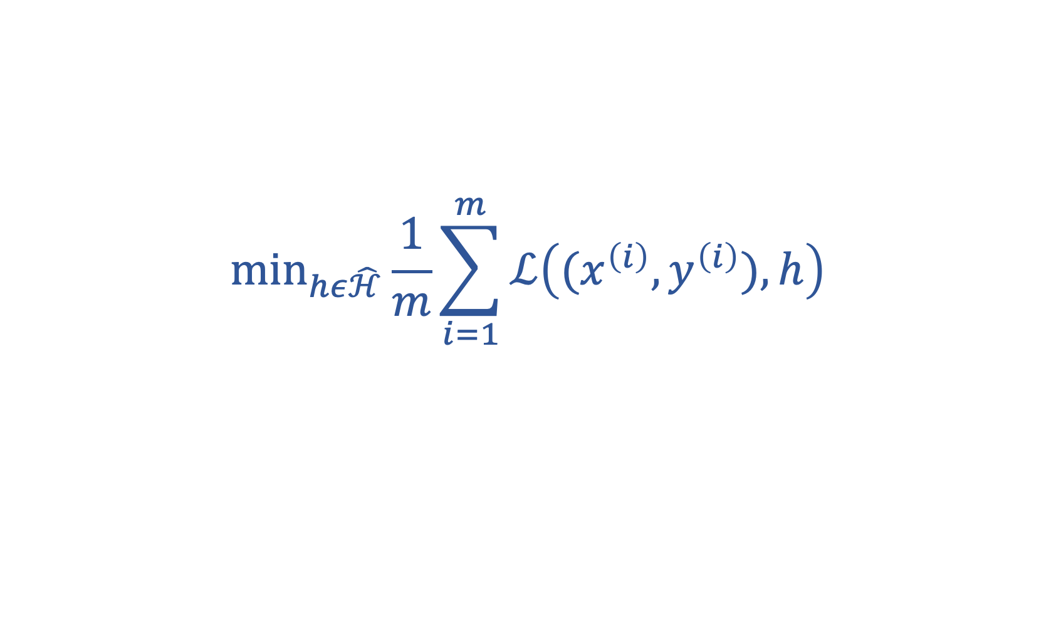
replace original ERM
$${\text{min}}_{hεℋ}\frac{1}{m}\sum_{i=1}^{m}{ℒ\left((x^{\left(i\right)},y^{\left(i\right)}),h\right)}$$
with ERM on smaller $\hat{ℋ}⊂ℋ$
$${\text{min}}_{hε\hat{ℋ}}\frac{1}{m}\sum_{i=1}^{m}{ℒ\left((x^{\left(i\right)},y^{\left(i\right)}),h\right)}$$

Slide 19
Prune Network Architecture
three hidden layers
two hidden layers
.
one hidden layer

Slide 20

Prune Hypospace by Early Stopping
10000 iterations
100 iterations
10 iterations

Slide 21
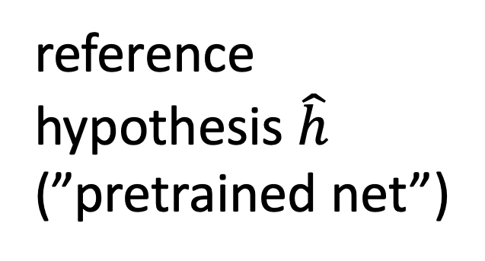
reference
hypothesis $\hat{h}$
(”pretrained net”)
Transfer Learning
all possible maps h(.)
r

Slide 22
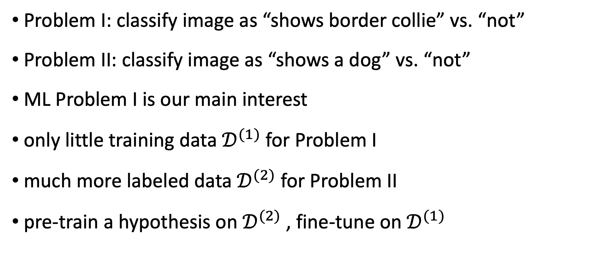
Problem I: classify image as “shows border collie” vs. “not”
Problem II: classify image as “shows a dog” vs. “not”
ML Problem I is our main interest
only little training data $𝒟^{(1)}$for Problem I
much more labeled data $𝒟^{(2)}$ for Problem II
pre-train a hypothesis on $𝒟^{(2)}$, fine-tune on $𝒟^{(1)}$

Slide 23
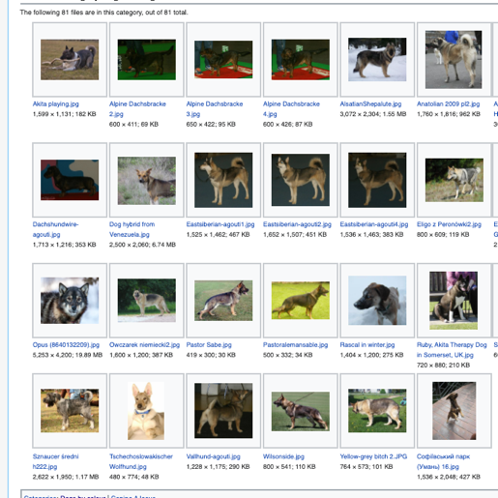


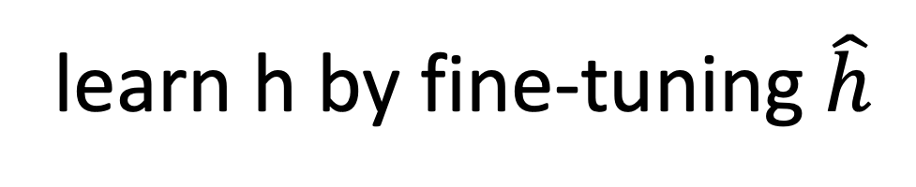
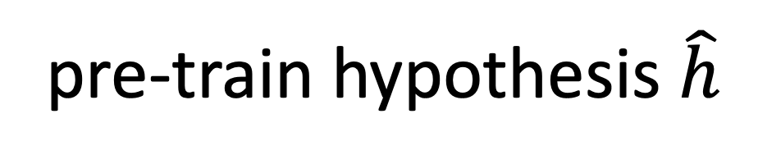


$$𝒟^{(1)}$$
$$𝒟^{(2)}$$
learn h by fine-tuning $\hat{h}$
pre-train hypothesis $\hat{h}$

Slide 24
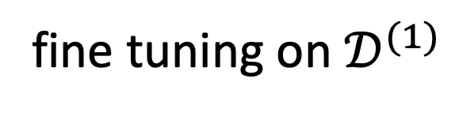
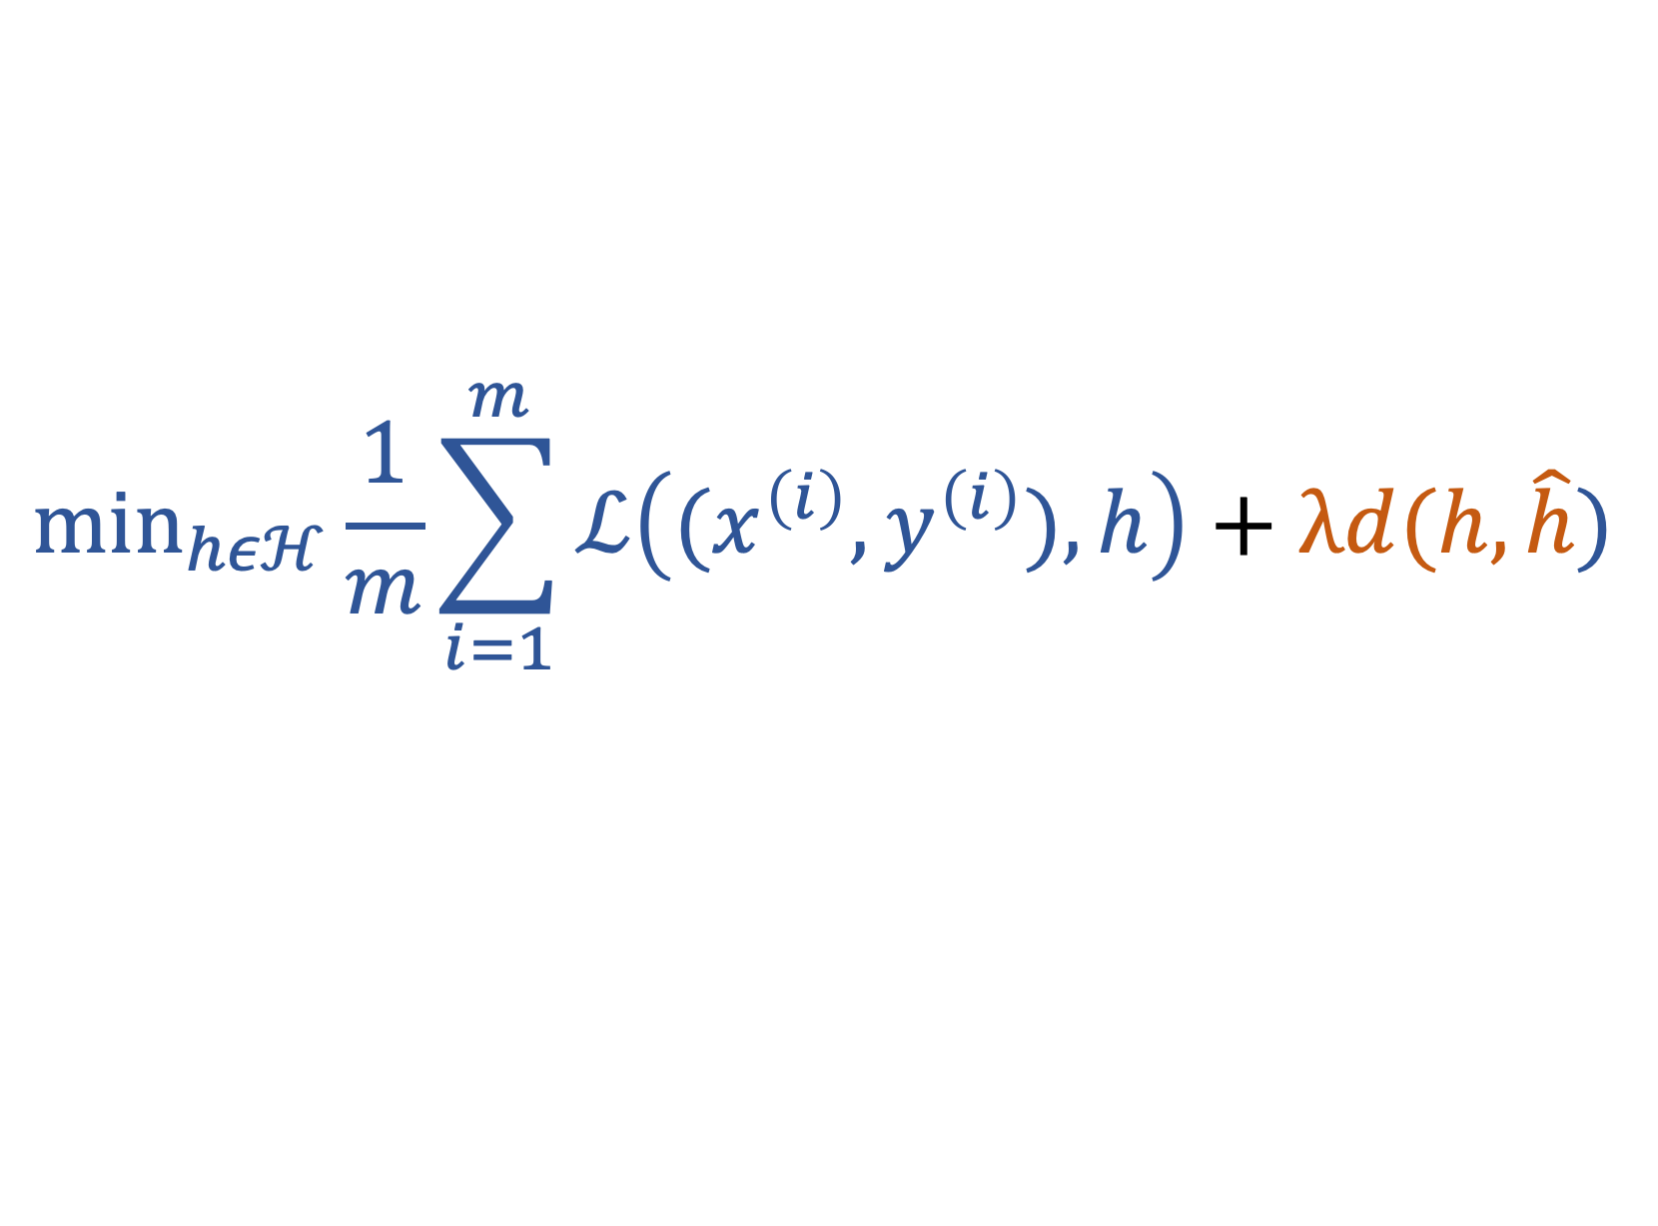
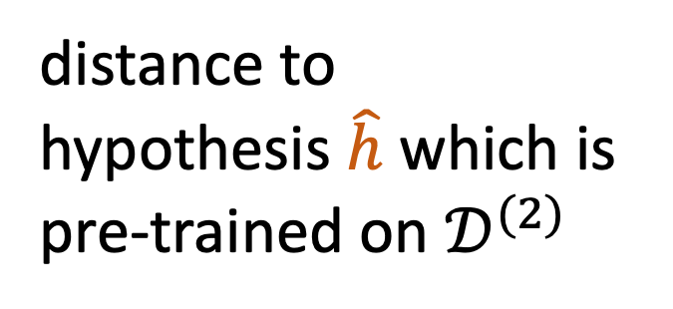
$${\text{min}}_{hεℋ}\frac{1}{m}\sum_{i=1}^{m}{ℒ\left((x^{\left(i\right)},y^{\left(i\right)}),h\right)}+λd(h,\hat{h})$$
distance to
hypothesis $\hat{h}$ which is
pre-trained on $𝒟^{(2)}$
fine tuning on $𝒟^{(1)}$

Slide 25
Fine Tuning a Pretrained Net
all possible maps h(.)
learning rate/step size used during fine tuning determines
effective model size

Slide 26
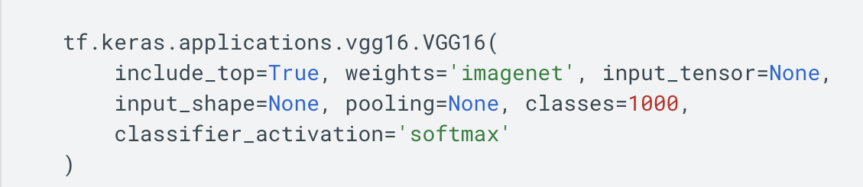
https://www.tensorflow.org/api_docs/python/tf/keras/applications/vgg16/VGG16

Slide 27
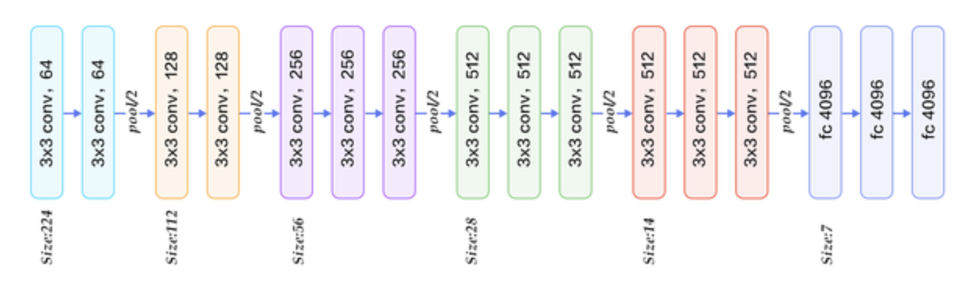

Layer-Wise Fine Tuning
fine –tune deeper layers
“freeze” input layers
“cat”
https://www.quora.com/What-is-the-VGG-neural-network

Slide 28
Feature Extraction
“frozen” input layers perform feature extraction
“feature extractor” or ”base” model
“head”
“cat”
https://www.quora.com/What-is-the-VGG-neural-network

Slide 29
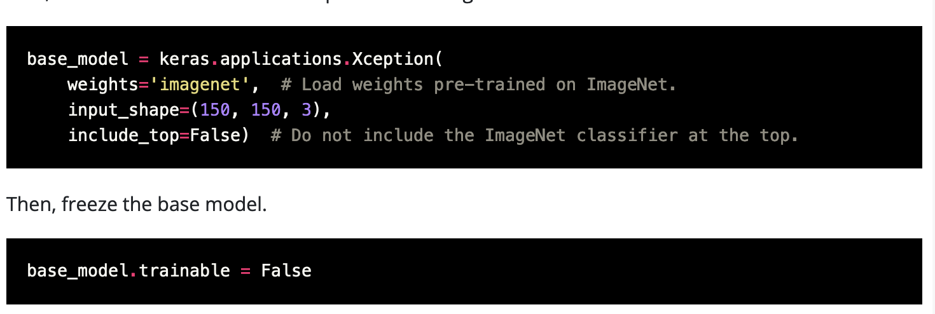
https://keras.io/guides/transfer_learning/

Slide 30
Questions ?

