Slide 1
Spring XD Internals: A Guided Tour
Patrick Peralta / David Turanski

Slide 2


Who Are We?
David Turanski
XD Developer
Spring Integration
Spring Data GemFire
Enterprise, Systems Integration
dturanski@pivotal.io
@dturanski
Patrick Peralta
XD Developer
Oracle Coherence
Distributed Systems, Networking, Concurrency
pperalta@pivotal.io
@patrickperalta

Slide 3

Agenda
Review of Spring XD
Architecture Overview
Distributed Runtime
Custom Modules

Slide 4
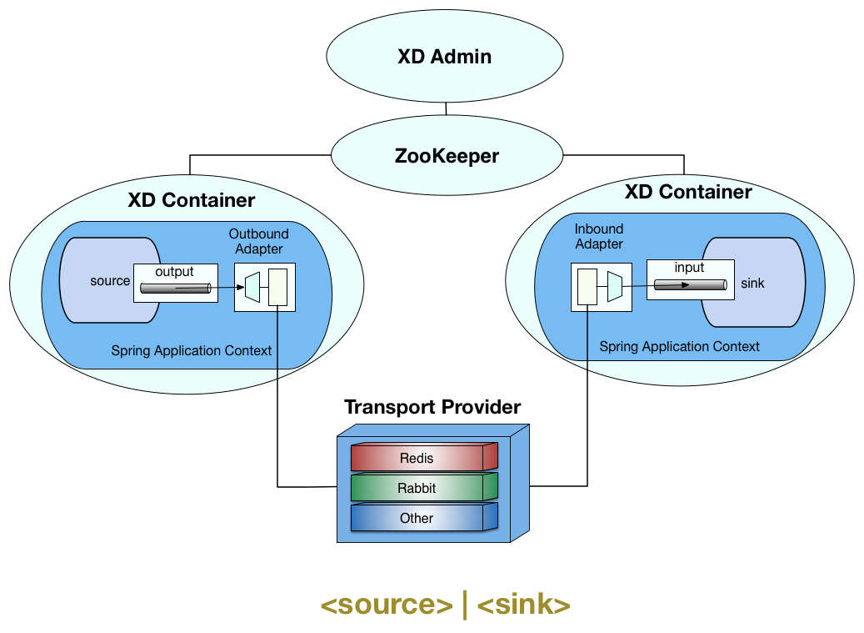
A Quick Review of Spring XD
A stream is composed from modules. Each module is deployed to a container and its channels are bound to the transport.

Slide 5
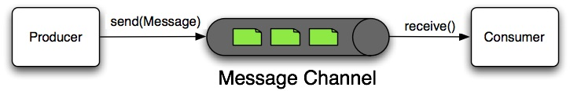
Modules
Name: http, rabbit, log, file
Type: source, processor, sink, job
Modules used in streams are simple, reusable Spring Integration message flows

Slide 6
Module Application Context
Each module has its own application context
Enables different property values per instance
Avoids bean name collisions, e.g. ‘input’ and ‘output’
Better encapsulation and lifecycle management
SimpleModule - uses Boot to load and configure the Application Context

Slide 7
Spring XD Architecture Overview

Slide 8
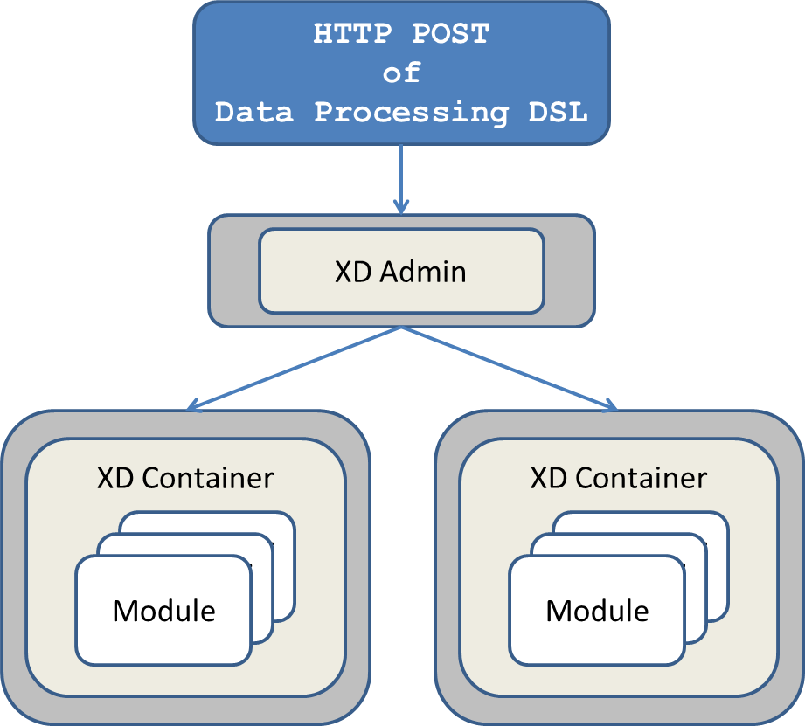
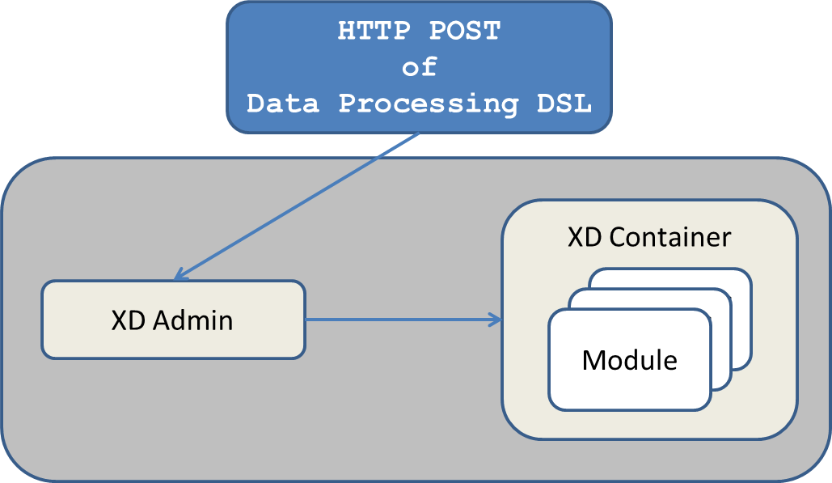
Spring XD Architecture Overview
Runs as a distributed application or as a single node

Slide 9
Container Components
ContainerRegistrar
Registers the container with the cluster (ZK)
Handles module deployment/undeployment events
ModuleDeployer
Deploys and undeploys modules on request.
Initializes the module application context and invokes lifecycle methods on registered plugins (any bean of type Plugin)

Slide 10
Plugins
public interface Plugin {
void preprocessModule(Module module);
void postProcessModule(Module module);
void removeModule(Module module);
void beforeShutdown(Module module);
boolean supports(Module module);
}
The Container discovers any bean of type Plugin. The ModuleDeployer will invoke these methods during deploy and undeploy. Spring XD is configured with some plugins: StreamPlugin, JobPlugin, etc.
You can register custom plugins

Slide 11
Message Bus
Used by StreamPlugin and JobPlugin to bind a module’s input and output channels to a transport.
Binds tap points and named channels
Performs object serialization (Kryo)
Admin uses the MB to send a message to trigger a Job
XD comes with Rabbit and Redis implementations
Additional transports are easily pluggable
https://github.com/SpringOne2GX-2014/Spring-XD-Internals/tree/master/jms-message-bus

Slide 12
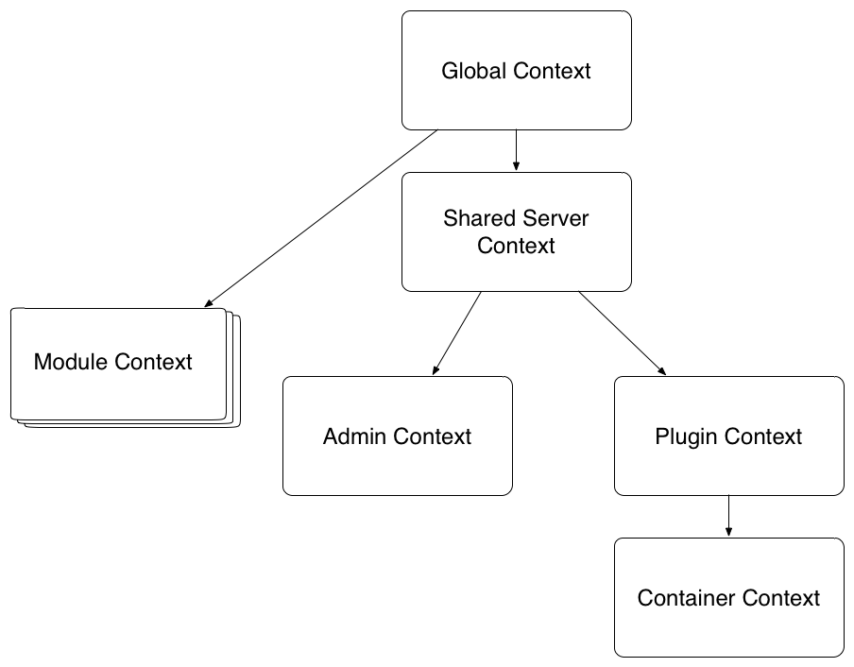
Spring XD Application Contexts
The same configuration composable (via BOOT) for distributed Admin and Container processes or single node runtime
Do not expose beans unnecessarily to extensible components - e.g. the plugins and modules should not have access to core runtime
Extensible: You may add your own Plugins plus any bean definitions to the Plugin context

Slide 13
Extending Spring XD
Add a custom module (stay tuned for Demo)
Implement a new transport (Message Bus)
Add a custom plugin - process modules during deployment lifecycle
Add bean definitions to the plugin context
https://github.com/spring-projects/spring-xd/wiki/Extending-XD

Slide 14
Distributed Runtime

Slide 15


Distributed Runtime Requirements
Ability to deploy & un-deploy modules on containers
Ability to dynamically discover new containers
Ability to reassign modules when containers fail

Slide 16
Distributed Runtime: 1st Generation
Dedicated message bus - “control bus”
Used to issue deployment and un-deployment requests from admin to containers (round robin allocation)
Extreme decoupling from admin to container
Inability to determine status
Did all the modules for this stream deploy?
Only solves 1st requirement

Slide 17
Distributed Runtime: The Present
Admin selects containers for deployment
Streams and job modules may be deployed to containers that match certain criteria
Module instance count may be specified
Admin redeploys modules upon container shutdown or failure
When containers join, admin deploys any “orphaned” modules

Slide 18
Distributed Runtime: The Present
Admin is responsible for calculating overall status
Multiple admins are supported
The “leader” admin (also known as “supervisor”) makes decisions on where modules are deployed

Slide 19
Distributed Runtime Challenges
In addition to our functional requirements, we also have non-functional requirements common to every distributed system
System consensus
Leader election
Process / network failure detection

Slide 20

About ZooKeeper
Toolset for building distributed systems
Replicates a “file system”
Requires a quorum for updates
Guaranteed ordered delivery of updates
Notifications emitted upon node change
Clients may create ephemeral nodes that are automatically removed upon disconnect

Slide 21
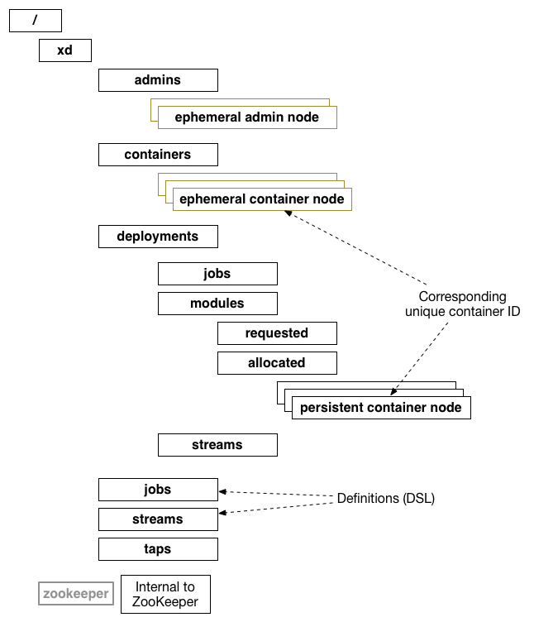
How We Use ZooKeeper
Centralized storage for streams, jobs
Tracking of containers and the modules they are hosting
Notification of arriving and departing containers, stream/job deployments and un-deployments

Slide 22
ZooKeeper/Curator Challenges
Correct handling of connection state
SUSPENDED != LOST
Admin
Both events result in leadership relinquishment
Container
SUSPENDED: container allows modules to continue execution
LOST: container undeploys modules

Slide 23
Distributed Testing Methods
^C (clean shutdown)
^Z (simulates a long GC)
iptables DROP
Kill ZooKeeper servers; disrupt quorum

Slide 24
Developing Custom Modules

Slide 25
Adding A Custom Stream Module
The focus of this section is adding a custom module for building streams. For more information about job modules see:
https://github.com/spring-projects/spring-xd/wiki/Batch-Jobs
This section will cover:
Module Registry
Module Artifacts
Stream Modules: Source, Processor, Sink
Example Source Module

Slide 26
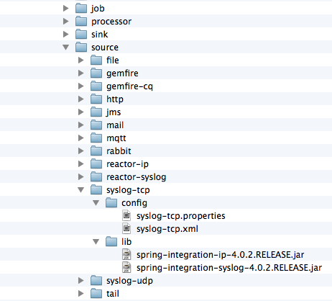
Module Registry
Spring XD 1.0 uses a FileModuleRegistry
Modules installed in the container’s local file system in $XD_HOME/modules
Alternate Module Registry implementations are being considered for future releases

Slide 27
Module Artifacts
Spring XD 1.0 requires:
XML Spring bean definition file <module-name>.xml
(Component scanning configured, at a minimum)
Typically, a jar containing custom code installed in the module’s lib directory
Dependent jars installed in the module’s lib directory
Module classes are first loaded by the ModuleClassLoader (module/lib) and then the System ClassLoader (xd/lib)

Slide 28
Custom Processor Module
A processor module is typically the easiest to implement
Spring XD includes transform and filter processors out of the box, backed by SpEL expressions or Groovy scripts
When this is not enough, you can write your own
---myProcessor.xml---
<beans> …
<int:channel id=”input”/>
<int:channel id=”output”/>
<int:transformer input-channel=”input” output-channel=”output”>
<bean class=”example.MyProcessor”/>
</int:transformer>
</beans>
http | myProcessor | file

Slide 29
Custom Sink Module
A sink is used to capture the the results of a stream
A custom sink is useful for feeding a legacy system
--- mySink.xml ---
<beans> …
<int:channel id=”input”/>
<int:service-activator input-channel=”input”>
<bean class=”example.MyService”/>
</int:service-activator>
</beans>
http |..| mySink

Slide 30
Custom Source Module
A source produces messages continually or in response to events
Most OOTB sources rely on existing Spring Integration (SI) inbound channel adapters, so do not require custom code
If an SI adapter is not available, writing a source requires some advanced knowledge of SI:
Configure an <inbound-channel-adapter> with a simple POJO and a poller
Extend MessageProducerSupport
https://github.com/SpringOne2GX-2014/Spring-XD-Internals/tree/master/spring-xd-source-template

Slide 31
Demo:
Developing a Custom Source Module
ZooKeeper and Spring XD

Slide 32

Questions?

Slide 33
Resources
Project Page
http://projects.spring.io/spring-xd/
Reference Guide
http://docs.spring.io/spring-xd/docs/current/reference/html/
Samples
https://github.com/spring-projects/spring-xd-samples
Demo Code for This Session
https://github.com/SpringOne2GX-2014/Spring-XD-Internals
Spring XD Source Code
https://github.com/spring-projects/spring-xd

