Slide 1
The Quest for the Holy Integration Test
By Rob Winch, Ken Krueger

Slide 2

The Quest for the Holy Integration Test

Slide 3
Contents
Introductions / Sample Application
A review of Unit, Integration, and MVC Test
MVC Test with HtmlUnit
Behavior Driven Development with MVC Test & HtmlUnit

Slide 4
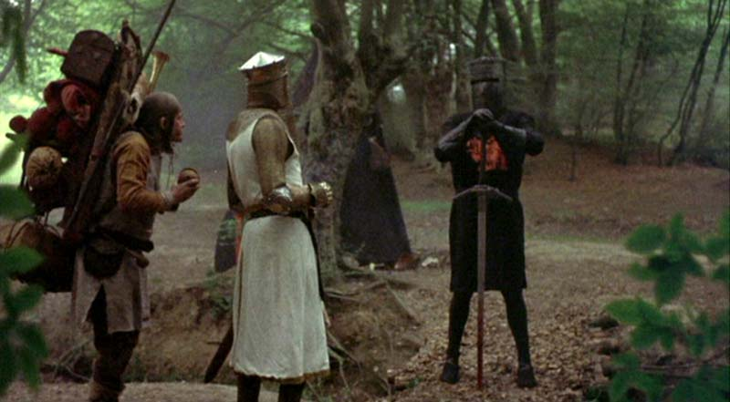
Introductions

Slide 5
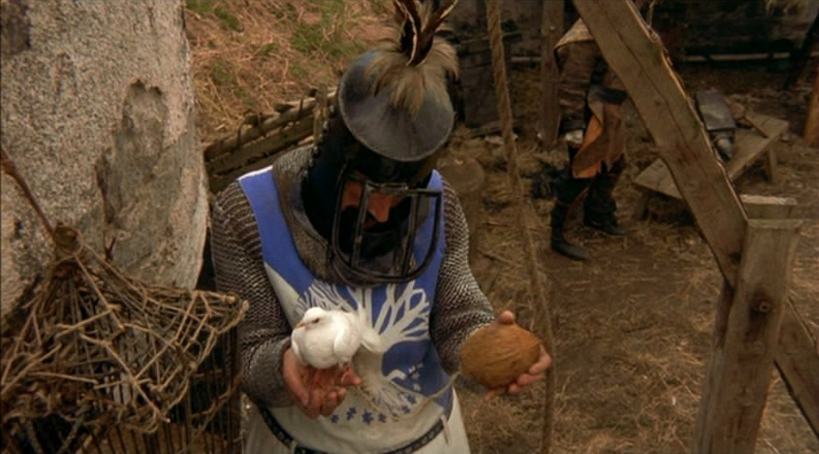
The Experimental Application
http://monty-python-trivia.cfapps.io
https://github.com/SpringOne2GX-2014/monty-python-trivia

Slide 6
Contents
Introductions / Sample Application
A review of Unit, Integration, and MVC Test
MVC Test with HtmlUnit
Behavior Driven Development with MVC Test & HtmlUnit

Slide 7
Recap - Unit Testing
Just your object
Wired with stubs / mocks for dependencies
Spring should not be involved
J
Limitations –
Ignores component interaction L
Junit Test Framework
JUnit
Test Class
Stub
Your
POJO
Mock
Mock

Slide 8
Recap – Integration / System Testing
Multiple Components Together
Includes Spring
Junit + @ContextConfiguration
JJ
Limitations –
Ignores MVC Components L
Junit Test Framework
JUnit
Test Class
Spring Application Context
DAO
Service
In-Memory
DB
Controller
DAO

Slide 9
Recap – Spring MVC Test
Junit Test Framework
Integration Test + Spring MVC testing WITHOUT deploying to a container!
JJJ
Limitations –
Browser Interaction L
JUnit
Test Class
MockMvc
Dispatcher Servlet Context
Spring Root Context

Slide 10
MockMvc
Samples

Slide 11
HtmlUnit + Spring MVC Test
Junit Test Framework
Spring MVC testing + Browser Behavior!
Still no container
No (real) Browser!
No HTTP!
This includes JavaScript
JJJJ
JUnit
Test Class
HtmlUnit + MockMvc
Dispatcher Servlet Context
Spring Root Context

Slide 12
Contents
Introductions / Sample Application
A review of Unit, Integration, and MVC Test
MVC Test with HtmlUnit
Behavior Driven Development with MVC Test & HtmlUnit

Slide 13
HtmlUnit

Slide 14
Why use HtmlUnit
GET /
<form>
POST /
Success

Slide 15
Why use HtmlUnit
mockMvc.perform(get("/"))
.andExpect(xpath("//input[@name='question']").exists());
MockHttpServletRequestBuilder question = post("/")
.param("question", "1");
mockMvc.perform(question)
.andExpect(…);

Slide 16
Dependencies
<dependency>
<groupId>org.springframework</groupId>
<artifactId>spring-test-htmlunit</artifactId>
<version>1.0.0.M2</version>
<scope>test</scope>
</dependency>

Slide 17
Spring Test Setup
@RunWith(SpringJUnit4ClassRunner.class)
@ContextConfiguration(classes = Config.class)
@WebAppConfiguration
public class HtmlUnitTest {
@Autowired
WebApplicationContext context;

Slide 18
MockMvc Setup
MockMvc mockMvc = MockMvcBuilders
.webAppContextSetup(context)
.build();

Slide 19
MockMvc Setup
MockMvc mockMvc = MockMvcBuilders
.webAppContextSetup(context)
.alwaysDo(print()) // Optional
.build();

Slide 20
MockMvc Setup
MockMvc mockMvc = MockMvcBuilders
.webAppContextSetup(context)
.alwaysDo(print()) // Optional
.addFilters(filter)
.build();

Slide 21
MockMvc Setup
MockMvc mockMvc = MockMvcBuilders
.webAppContextSetup(context)
.alwaysDo(print()) // Optional
.addFilters(filter)
.apply(springSecurity())
.build();

Slide 22
HtmlUnit Setup
webClient = new WebClient();
webClient.setWebConnection(
new MockMvcWebConnection(mockMvc));

Slide 23
HtmlUnit Setup
webClient = new WebClient(BrowserVersion.FIREFOX_24);
webClient.setWebConnection(
new MockMvcWebConnection(mockMvc));
webClient.setAjaxController(
new NicelyResynchronizingAjaxController());
Notes:
IE8 is default

Slide 24
Using HtmlUnit
HtmlPage index =
webClient.getPage("http://localhost/mpt/");
assertEquals("Monty Python Trivia", index.getTitleText());

Slide 25
Using HtmlUnit
HtmlForm form =
(HtmlForm) index.getByXPath("//form").get(0);
HtmlSelect movie = form.getSelectByName("movie");
HtmlOption holyGrail =
movie.getOptionByText("Holy Grail");
movie.setSelectedAttribute(holyGrail, true);

Slide 26
Using HtmlUnit
HtmlSelect question = form.getSelectByName("question");
HtmlOption knightsSay = question.getOptionByText(
"What do the Knights of Ni say?");
question.setSelectedAttribute(knightsSay, true);

Slide 27
Using HtmlUnit
HtmlSubmitInput submit = (HtmlSubmitInput)
index.getElementById("submit");
HtmlPage answer = submit.click();
DomElement questionElmt =
answer.getElementById("questionDisplay");
DomElement answerElmt =
answer.getElementById("answerDisplay");
assertEquals("What do the Knights of Ni say?", questionElmt.getTextContent());
assertEquals("Ni!", answerElmt.getTextContent());

Slide 28
WebDriver
Notes:
Part of Selenium project, typically no need to run Selenium server, Selenium injects javascript, WebDriver uses native browser APIs to interact with browser, we use HtmlUnit to emulate headless browsers

Slide 29
WebDriver Setup
MockMvc mockMvc = …
driver = new MockMvcHtmlUnitDriver(mockMvc, javaScriptEnabled);

Slide 30
WebDriver Setup
Capabilities config =
DesiredCapabilities.firefox();
driver = new MockMvcHtmlUnitDriver(mockMvc, config) {
protected WebClient configureWebClient(WebClient client) {
client = super.configureWebClient(client);
client.setAjaxController(new NicelyResynchronizingAjaxController());
return client;
}
};

Slide 31
WebDriver Usage
QuestionPage question = QuestionPage.to(driver);
question.selectMovieOption("Holy Grail");
question.selectQuestionOption("What do the Knights of Ni say?");
question.submit();

Slide 32
WebDriver Usage
AnswerPage answer = AnswerPage.at(driver);
assertTrue(answer.hasQuestion("What do the Knights of Ni say?"));
assertTrue(answer.hasAnswer("Ni!"));

Slide 33
WebDriver Usage
public class QuestionPage {
private WebElement movie;
private WebElement question;
@FindBy(css = "input[type=submit]")
private WebElement submitButton;

Slide 34
WebDriver Usage
public static QuestionPage to(WebDriver driver) {
driver.get("http://localhost/mpt/");
return PageFactory.initElements(driver, QuestionPage.class);
}

Slide 35
WebDriver Usage
public void selectQuestionOption(String movieOption) {
Select select = new Select(movie);
select.selectByVisibleText(movieOption);
}

Slide 36
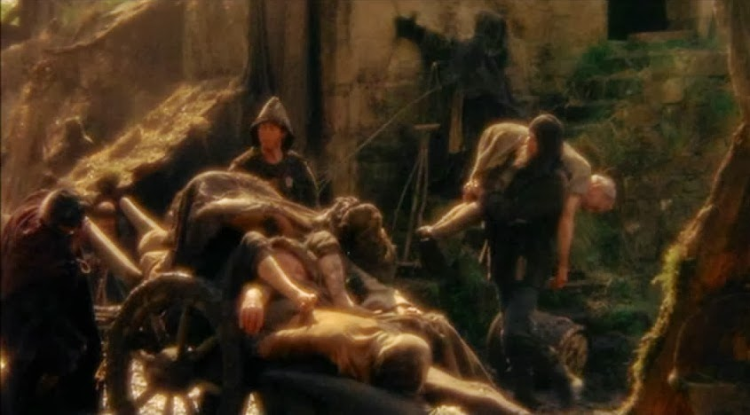
I’m not dead yet…

Slide 37
Geb
Notes:
13 min

Slide 38
Geb Setup
@ContextConfiguration(classes = Config.class)
@WebAppConfiguration
@Stepwise
class GebTest extends GebReportingSpec {
@Autowired
WebApplicationContext context

Slide 39
Geb Setup
MockMvc mockMvc = MockMvcBuilders
.webAppContextSetup(context)
.alwaysDo(print())
.build()

Slide 40
Geb Setup
MockMvc mockMvc = …
browser.driver =
new MockMvcHtmlUnitDriver(mockMvc, javascriptEnabled)

Slide 41
Geb Setup
MockMvc mockMvc = …
browser.driver =
new MockMvcHtmlUnitDriver(mockMvc, capabilities) {
protected WebClient configureWebClient(WebClient client) {
client = super.configureWebClient(client)
client.ajaxController = new NicelyResynchronizingAjaxController()
client
}
}

Slide 42
Geb Usage
def 'I select Holy Grail'() {
when: 'I select Holy Grail'
to QuestionPage
movie = 'Holy Grail'
askQuestion 'What do the Knights of Ni say?'
then: 'The answer is displayed'
at AnswerPage
question == 'What do the Knights of Ni say?'
answer == 'Ni!'
}

Slide 43
Geb Usage
class QuestionPage extends Page {
static url = ''
static at = {
assert title == 'Monty Python Trivia'; true
}
...

Slide 44
Geb Usage
static content = {
movie { ask.movie() }
question { ask.question() }
submitButton { $('input[type=submit]') }
ask { $('form') }
}

Slide 45
Geb Usage
void askQuestion(String toAsk) {
question = toAsk
submitButton.click()
}
Notes:
Observe that the question we are asking is automatically converted to the question input’s value
Demo the test, demo not at with power assert

Slide 46
Contents
Introductions / Sample Application
A review of Unit, Integration, and MVC Test
MVC Test with HtmlUnit
Behavior Driven Development with MVC Test & HtmlUnit

Slide 47
HtmlUnit + Spring MVC Test is Awesome!
Junit Test Framework
Covers from browser through all app layers.
All without a container, browser, or HTTP!
We love it!
So… What’s Missing?
JUnit
Test Class
HtmlUnit + MockMvc
Dispatcher Servlet Context
Spring Root Context

Slide 48
What is Missing
Involvement
We want testers, analysts, product owners, project managers, etc. involved
Not just developers
Process
We want acceptance criteria from our features / stories to drive our tests
Organization
We want testing scenarios to be organized and described in a high-level way

Slide 49
The Next Level…
BDD
Behavior Driven Development
Software Development Process Reminiscent of TDD
But at a higher level (the feature)

Slide 50
BDD – How it Works
BEFORE developing a feature, describe the behavior
Most development processes already do this
Describe the Acceptance Criteria, or Confirmation
Agreement on how we know when the feature is complete
Using a formal “Gherkin” language (Given, When, Then)
Write the Tests
Translate “Gherkin” into “Step Definitions”
Use Software like Cucumber or JBehave to do this
Run the Tests
They will fail
Implement Software until the Tests Pass

Slide 51
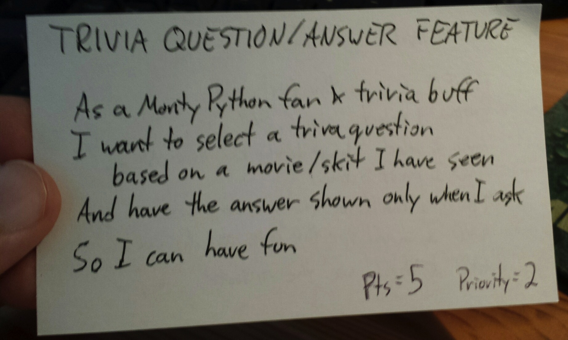
Step 1 – Describe the Behavior
Different methodologies / frameworks for doing this
Scrum / story card illustrated here:

Slide 52
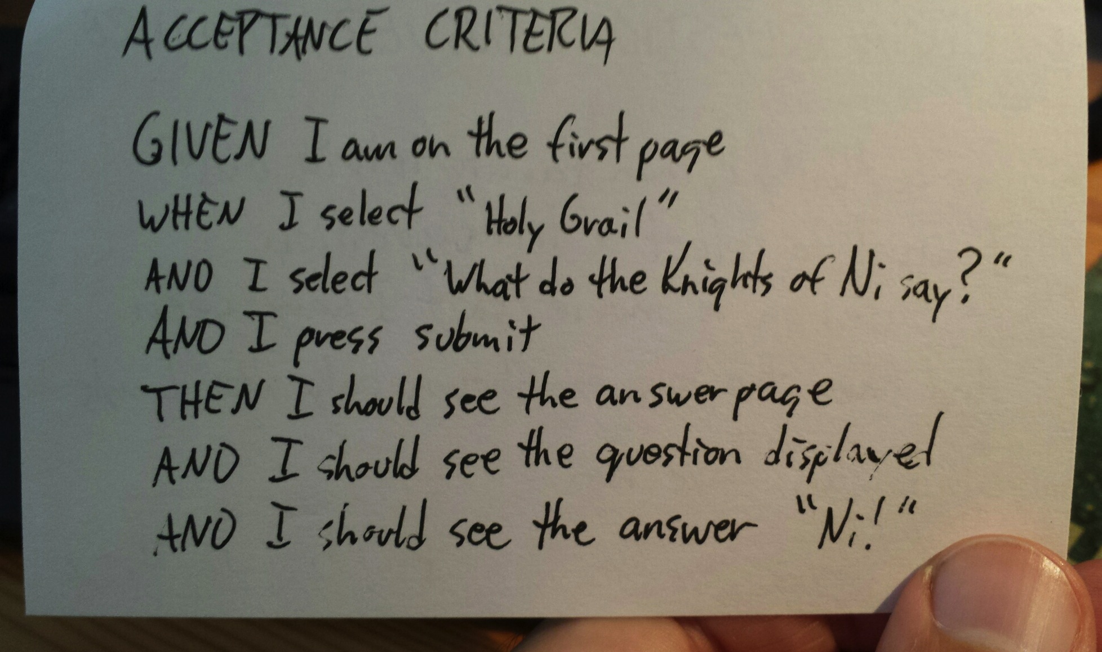
Step 2 – Describe Acceptance Criteria
Use “Gherkin” (Given, When, Then) syntax
Allows for easy automation later

Slide 53
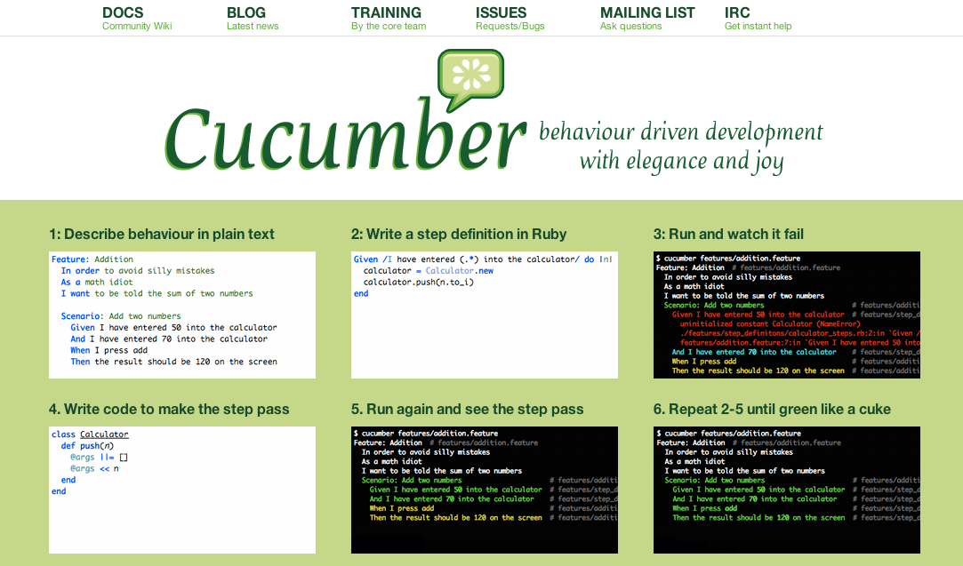
3. Write the Tests
This example uses Cucumber
BDD tool that started in the Ruby/Rails world
Works great with Java, Spring, MVC Test, and HtmlUnit!
Disclaimer:
I am not a Cucumber Expert!
Just thought it would be fun to explore this technology!

Slide 54
How to use Cucumber with Spring MVC Test
Add the maven dependency:
<dependency>
<groupId>info.cukes</groupId>
<artifactId>cucumber-spring</artifactId>
<version>1.1.6</version>
<scope>test</scope>
</dependency>

Slide 55
How to use Cucumber with Spring MVC Test (2)
Add the JUnit test:
org.demo.ApplicationTests.java
Hmm,
A completely empty JUnit test class…
package org.demo;
import org.junit.runner.RunWith;
import cucumber.api.*;
@RunWith(Cucumber.class)
@CucumberOptions(format = "pretty")
public class ApplicationTests {
}

Slide 56
How to use Cucumber with Spring MVC Test (3)
Add a .feature file
In the same folder as the JUnit test
org/demo/questionAndAnswer.feature
Feature: QuestionAndAnswer
Scenario: Trivia Question and Answer Feature
Given I am on the first page
When I select 'Holy Grail'
And I select 'What do the Knights of Ni say'?
And I press submit
Then I should see the answer page
And I should see the question displayed
And I should see the answer 'Ni!'

Slide 57
How to use Cucumber with Spring MVC Test (4)
Make a “Steps Definition” class
This is where Spring MVC Test and HtmlUnit come in:
One method for each Given, When, Then
public class StepDefs {
@Given(“I am on the first page")
public void on_first_page() { fail("not implemented"); }
@When(“I select 'Holy Grail’")
public void i_select_category() { fail("not implemented"); }
@And(“I select 'What do the Knights of Ni say’")
public void i_select_question() { fail("not implemented"); }
@And(“I press submit")
public void submit() { fail("not implemented"); }
// …
}
Steps should initially fail.
We will implement these with HtmlUnit later…

Slide 58
Steps Definition, (continued)
Instantiate Spring MVC, Setup MockMvcHtmlUnitDriver:
@WebAppConfiguration
@ContextConfiguration(classes = Config.class)
public class StepDefs {
@Autowired WebApplicationContext context;
MockMvcHtmlUnitDriver driver;
@Before
public void setup() throws IOException {
MockMvc mockMvc = MockMvcBuilders.webAppContextSetup(context).build();
Capabilities capabilities = DesiredCapabilities.chrome();
driver = new MockMvcHtmlUnitDriver(mockMvc, capabilities);
}
@Given(“I am on the first page")
public void on_first_page() { }
// …
}

Slide 59
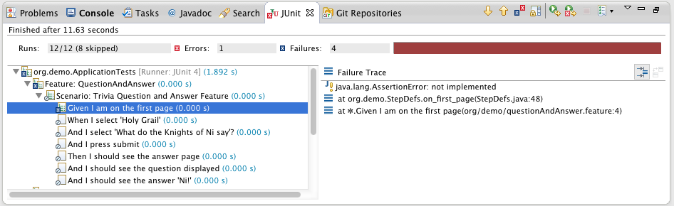
4. Run the test
Expect failure, until we implement the feature

Slide 60
Implement each step
Delegate to WebDriver-based “Page” objects:
private QuestionPage questionPage;
@Given(“I am on the first page")
public void on_first_page() {
questionPage = QuestionPage.to(driver);
}
Have WebDriver position at desired page
public class QuestionPage {
/**
* Have WebDriver go to the index page, and return an
* object that represents this page in future tests.
*/
public static QuestionPage to(WebDriver driver) {
driver.get("http://localhost/mpt/");
return PageFactory.initElements(driver, QuestionPage.class);
}
Initialize this Page object
Notes:
// The driver expects "http" to establish which protocol to use.
// Don't know why it needs localhost.
// Also don't know why it needs the servlet mapping or how it determined 'mpt' since this is only known to maven or eclipse; it is not in any code.

Slide 61
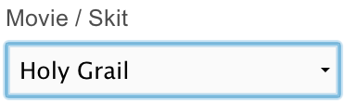
@When – Perform Some Action
Previously initialized in @Given step
Selecting from a select element:
Initialized by WebDriver.
Points to:
QuestionPage questionPage;
@When("I select 'Holy Grail'")
public void i_select_category() {
questionPage.selectMovieOption("Holy Grail");
}
WebDriver class for working with select elements
public class QuestionPage {
private WebElement movie;
/**
* Select the given movie from the list of movies, like "Holy Grail".
*/
public void selectMovieOption(String movieOption) {
Select select = new Select(movie);
select.selectByVisibleText(movieOption);
}

Slide 62
@When – Perform Some Action
Submitting a form:
QuestionPage questionPage;
@And("I press submit")
public void i_press_submit() {
questionPage.submit();
}
public class QuestionPage {
@FindBy(css = "input[type=submit]")
private WebElement submitButton;
// …
public void submit() {
submitButton.click();
}
How easy is that?

Slide 63
@Then – Assert the result
Determine if we are on the correct page:
AnswerPage answerPage;
@Then("I should see the answer page")
public void on_answer_page() {
assertTrue(
”Should be on the Answer page",
AnswerPage.isCurrentPage(driver));
answerPage = AnswerPage.at(driver);
}
public class AnswerPage {
public static boolean isCurrentPage(WebDriver webDriver) {
return webDriver.getTitle().equals("Monty Python Trivia - Answer");
}
Can also check URL, or any identifying information

Slide 64
@Then – Assert the result
Set the target correct page:
AnswerPage answerPage;
@Then("I should see the answer page")
public void on_answer_page() {
assertTrue(
”Should be on the Answer page",
AnswerPage.isCurrentPage(driver));
answerPage = AnswerPage.at(driver);
}
Initialize and return an instance of AnswerPage for later asserts
public class AnswerPage {
public static AnswerPage at(WebDriver driver) {
if (!isCurrentPage(driver)) {
throw new RuntimeException("Web Driver is not on Answer page.");
}
return PageFactory.initElements(driver, AnswerPage.class);
}

Slide 65
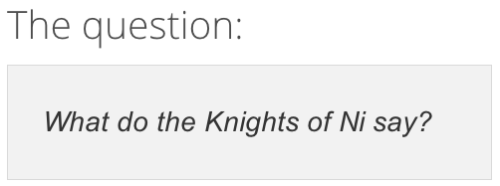
@Then – Assert the result
Check for element contents:
AnswerPage answerPage;
@And("I should see the question displayed")
public void question_displayed() {
assertTrue(
”Was expecting to see the question",
answerPage.hasQuestion(lastQuestionAsked));
}
Initialized by WebDriver.
Points to:
How easy is that?
public class AnswerPage {
private WebElement questionDisplay;
public boolean hasQuestion(String question) {
return questionDisplay.getText().equals(question);
}
Notes:
//

Slide 66
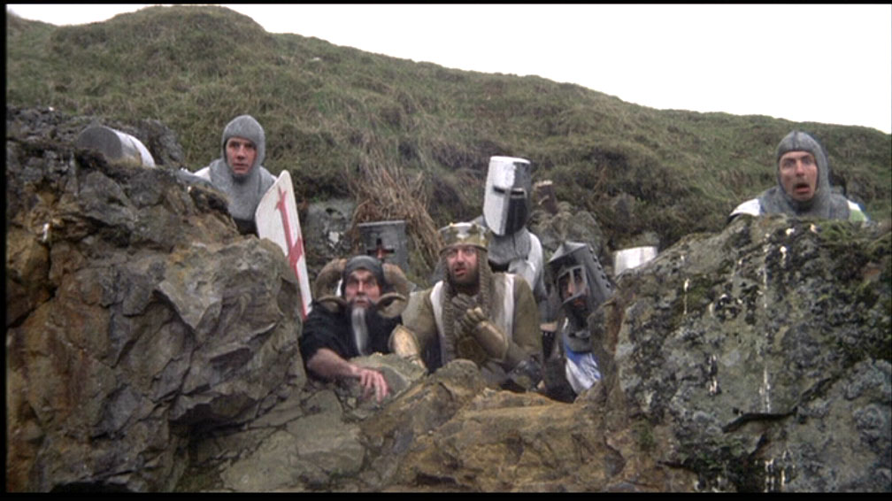
Observations…
…Cucumber and BDD

Slide 67
Cucumber – My Observations
Deceptively Simple!
Basically performs String matching between feature files and code
Bulk of work done by Spring MVC Test, HtmlUnit, and WebDriver
Yet, a game changer
BDD can transform your organization
Cucumber vs. JBehave?
Both great tools, hard to make a wrong choice
Cucumber advantage – not limited to Java (Ruby, .Net, etc.)

Slide 68
BDD – My Observations
Awesome Transformational Effect on Organization
Analysts, Product Owners, Project Managers, Line Managers, and other stakeholders can learn “Given, When, Then”
Even the VP of Marketing!
Things to Watch Out For
The verbiage doesn’t really affect the test
Need code reviews to determine if statement matches code
Keep scenarios simple
Easy to create overly-complicated scenarios

Slide 69

And Yet… …The Quest Continues

Slide 70
The techniques you’ve seen here are impressive
And yet, there are still improvements that can be made…

Slide 71
What is Missing?
Testing with JSPs
Testing with other technologies
More reliable, easier browser simulation
Dealing with page delays
Testing of “Look and Feel” items

Slide 72
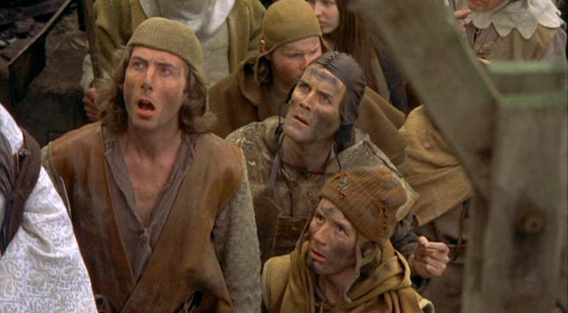
Questions?
Ken (email) kkrueger@pivotal.io
Rob (Twitter) @rob_winch
https://github.com/spring-projects/spring-test-htmlunit
http://monty-python-trivia.cfapps.io
https://github.com/SpringOne2GX-2014/monty-python-trivia

Slide 73

Thanks For Attending!

