Slide 1
Introducing Spring Cloud Task
Michael T Minella, Project Lead, Pivotal
@michaelminella

Slide 2

SPRING CLOUD
TASK

Slide 3

WHY ARE WE
HERE?

Slide 4

EVOLUTION OF DATA
APPLICATIONS

Slide 5

MONOLITHS

Slide 6


EXISTING
INTEGRATION AND BATCH

Slide 7

DATA
MICROSERVICES

Slide 8

CLOUD
NATIVE

Slide 9

DEVELOPED AND TESTED
IN ISOLATION

Slide 10

OPERATIONALLY EASY TO
GOVERN

Slide 11
SPRING CLOUD
STREAM AND TASK

Slide 12
DATA INTEGRATION
AS A SERVICE

Slide 13

COMPOSTION OF
MICROSERVICES

Slide 14
@Bean @StepScope public Partitioner partitioner() throws IOException { MultiResourcePartitioner multiResourcePartitioner = new MultiResourcePartitioner(); ClassLoader cl = this.getClass().getClassLoader(); PathMatchingResourcePatternResolver resourcePatternResolver = new PathMatchingResourcePatternResolver(cl); Resource[] resources = resourcePatternResolver.getResources("file:/tmp/inbound/*.csv"); for (Resource resource : resources) { System.out.println(">> CurResource = " + resource.getFile().getAbsolutePath()); } multiResourcePartitioner.setResources(resources); return multiResourcePartitioner; } @Bean @Profile("worker") public DeployerStepExecutionHandler stepExecutionHandler(JobExplorer jobExplorer) { return new DeployerStepExecutionHandler(this.context, jobExplorer, this.jobRepository); } @Bean @StepScope public Tasklet unzipTasklet(@Value("#{jobParameters['fileName']}") String fileName) { return new Tasklet() { @Override public RepeatStatus execute(StepContribution contribution, ChunkContext chunkContext) throws Exception { final InputStream is = new FileInputStream("/tmp/inbound/customerFeed.zip"); ArchiveInputStream ais = new ArchiveStreamFactory().createArchiveInputStream(ArchiveStreamFactory.ZIP, is); ZipArchiveEntry entry = (ZipArchiveEntry) ais.getNextEntry(); String parent = new File("/tmp/inbound/customerFeed.zip").getParent(); while (entry != null) { if(!entry.getName().startsWith("__")) { File outputFile = new File(parent, entry.getName()); OutputStream os = new FileOutputStream(outputFile); IOUtils.copy(ais, os); os.close(); } entry = (ZipArchiveEntry) ais.getNextEntry(); } ais.close(); is.close(); return RepeatStatus.FINISHED; } }; }
MINIMAL CODING

Slide 15

OPERATIONAL AND
ORCHESTRATION COVERAGE

Slide 16
SPRING CLOUD
DATA FLOW

Slide 17

DEVELOPER
EFFORT

Slide 18

THAT’S WHAT WE’LL
FOCUS ON TODAY

Slide 19

APPLICATIONS THAT
DON’T END

Slide 20
SPRING CLOUD
STREAM

Slide 21

12 FACTOR APPS
DON’T NEED TO END

Slide 22
SPRING CLOUD
TASK

Slide 23

Spring Cloud Task is a framework
for developing microservices that
have an expected end.

Slide 24
1
TASK REPOSITORY

Slide 25
2
TASK LISTENERS

Slide 26
3
SPRING CLOUD STREAM
INTEGRATION

Slide 27
4
SPRING BATCH
INTEGRATION

Slide 28

HELLO, WORLD!

Slide 29


Slide 30

IMPORT
PROCESS

Slide 31
FTP
UNZIP
IMPORT

Slide 32
TRADITIONAL
APPROACH

Slide 33
WHAT’S WRONG
WITH JUST BATCH?

Slide 34

TIGHTLY
COUPLED

Slide 35
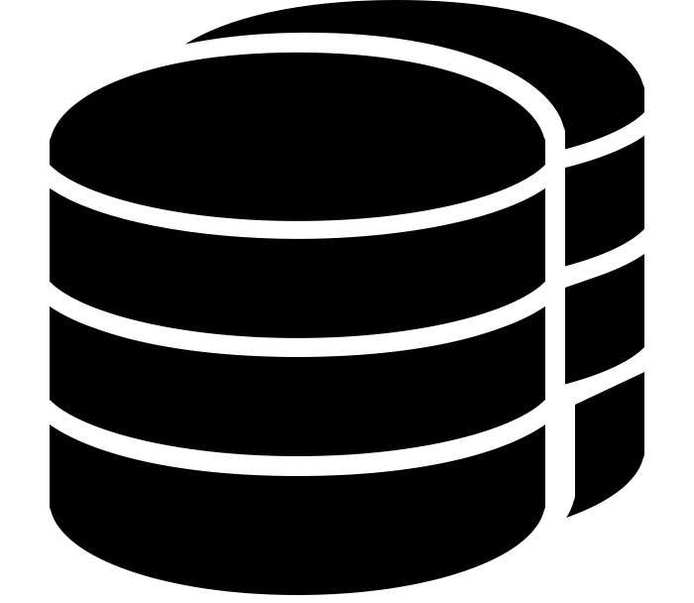
TIES UP
RESOURCES

Slide 36

LIMITS
SCALABILITY OPTIONS

Slide 37

HARD TO
GOVERN

Slide 38
SPRING CLOUD
TASK

Slide 39
FTP
SINK
UNZIP
IMPORT

