Slide 1


NORTH ATLANTIC TREATY ORGANIZATION
SCIENCE & TECHNOLOGY ORGANIZATION
Entanglement-Dynamic Topology for Robust Quantum Sensing
Finding the finite control window where sensitivity, coherence, fidelity and readout remain jointly effective.
Hang Hu · Hsu Kiang Ooi · Anguang Hu
National Research Council Canada · Defence Research and Development Canada
NATO UNCLASSIFIED RELEASABLE TO STEP Nations and Singapore
13/10/2026 | PAGE 1

Slide 2



NORTH ATLANTIC TREATY ORGANIZATION
SCIENCE & TECHNOLOGY ORGANIZATION
Introduction: defence applications
Magnetic and low-frequency RF signatures resist masking and reach where optical sensing fails — exploiting them needs lab sensitivity in a fielded package.
SBQuantum magnetic map
Magnetic anomaly detection
GPS-denied Magnetic navigation
A submerged steel hull distorts Earth’s magnetic field. MAD instruments detect the local anomaly.
Anomaly maps give an unjammable position fix where satellite navigation is denied.
Source: SBQuantum, Magnetic Navigation, sbquantum.com
The hard part is not peak laboratory sensitivity — it is holding a known operating point in the field.
NATO UNCLASSIFIED RELEASABLE TO STEP Nations and Singapore
13/10/2026 | PAGE 2

Slide 3
NORTH ATLANTIC TREATY ORGANIZATION
SCIENCE & TECHNOLOGY ORGANIZATION
Introduction: background information
A nitrogen-vacancy defect in diamond is an optically addressable electron spin: initialise with green light, evolve in the field, read out the fluorescence.
S = 1
φ ∝ B·T
T₂* ≈ µs
Spin triplet
Phase, not amplitude
The limit to beat
Zeeman splitting shifts the m = ±1 levels linearly with the field along the NV axis.
Sensitivity improves with interrogation time, so coherence is the resource that sets it.
Bath-induced dephasing ends free evolution in microseconds, far short of the phase budget.
Every sensitivity gain here comes from extending usable interrogation time without losing the signal.
NATO UNCLASSIFIED RELEASABLE TO STEP Nations and Singapore
13/10/2026 | PAGE 3

Slide 4
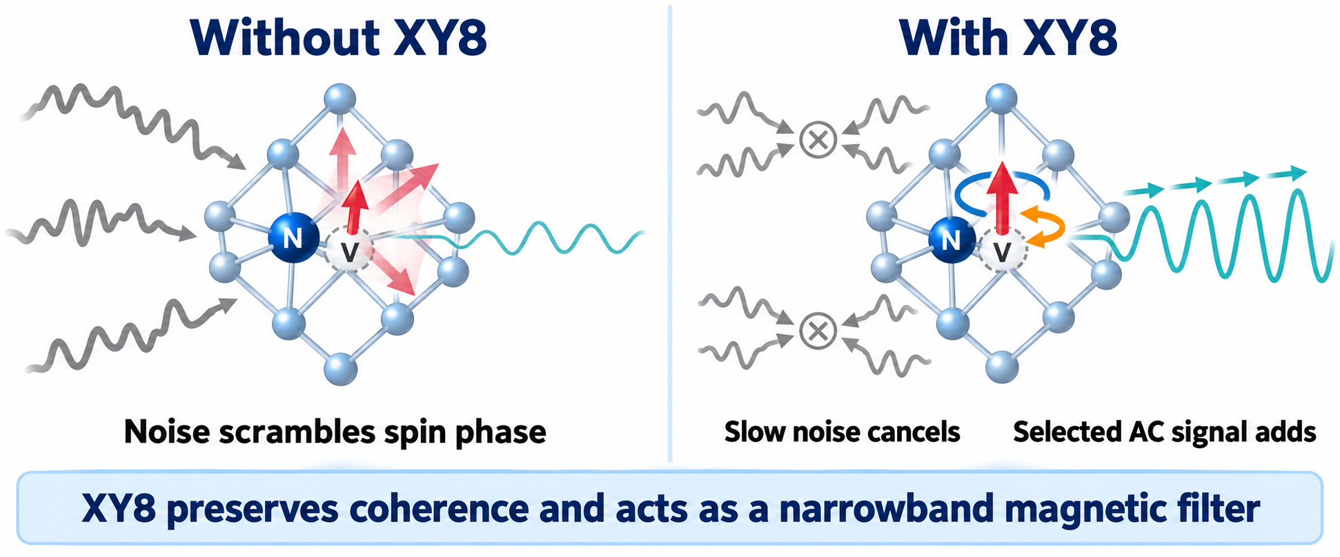
NORTH ATLANTIC TREATY ORGANIZATION
SCIENCE & TECHNOLOGY ORGANIZATION
Introduction: background information
A periodic train of π pulses refocuses slow bath noise and makes the sensor respond only near a chosen frequency — extending coherence and adding selectivity at once.
One XY8 block
X
Y
X
Y
X
Y
X
Y
τ
pulse spacing sets the sensing band
N blocks → 8N π pulses
At resonance: τ = 1 / (4f)
NATO UNCLASSIFIED RELEASABLE TO STEP Nations and Singapore
13/10/2026 | PAGE 4

Slide 5
NORTH ATLANTIC TREATY ORGANIZATION
SCIENCE & TECHNOLOGY ORGANIZATION
Introduction: background information
In weak-field magnetometry and narrowband RF sensing, useful control resources compete with the costs of running them.
↑ signal
↑ selectivity
↑ cost
Phase accumulation
Noise rejection
Errors + time
Deeper XY8 sequences accumulate more target phase and sharpen the filter.
Dynamical decoupling suppresses environmental noise around the sensing band.
Pulse infidelity, decoherence exposure and overhead accumulate with depth.
Design objective: minimize sensitivity penalty η(τ,N) under all resource constraints—not maximize N.
NATO UNCLASSIFIED RELEASABLE TO STEP Nations and Singapore
13/10/2026 | PAGE 5

Slide 6
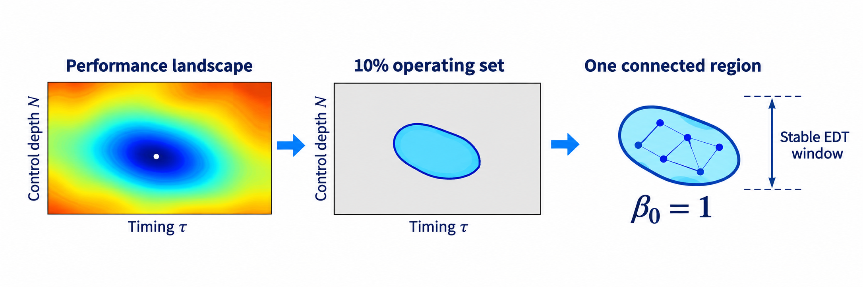
NORTH ATLANTIC TREATY ORGANIZATION
SCIENCE & TECHNOLOGY ORGANIZATION
What EDT Means in This Study
EDT maps where sensing performance and the required quantum resources remain jointly useful.
ENTANGLEMENT
DYNAMICS
TOPOLOGY
Broader framework
Calculated here
Calculated here
Multi-spin entanglement may improve field response, but it also adds preparation and coherence costs.
Current study: one NV spin
Future work: coupled or entangled spins
XY8 reshapes the sensor response during a measurement.
τ selects the sensing frequency
N controls accumulation, selectivity, errors and duration
Near-optimal set:
η(τ,N) ≤ 1.1ηmin
At 200 kHz: one connected resonant region, β₀=1, stable under timing-grid refinement
NATO UNCLASSIFIED RELEASABLE TO STEP Nations and Singapore
13/10/2026 | PAGE 6

Slide 7
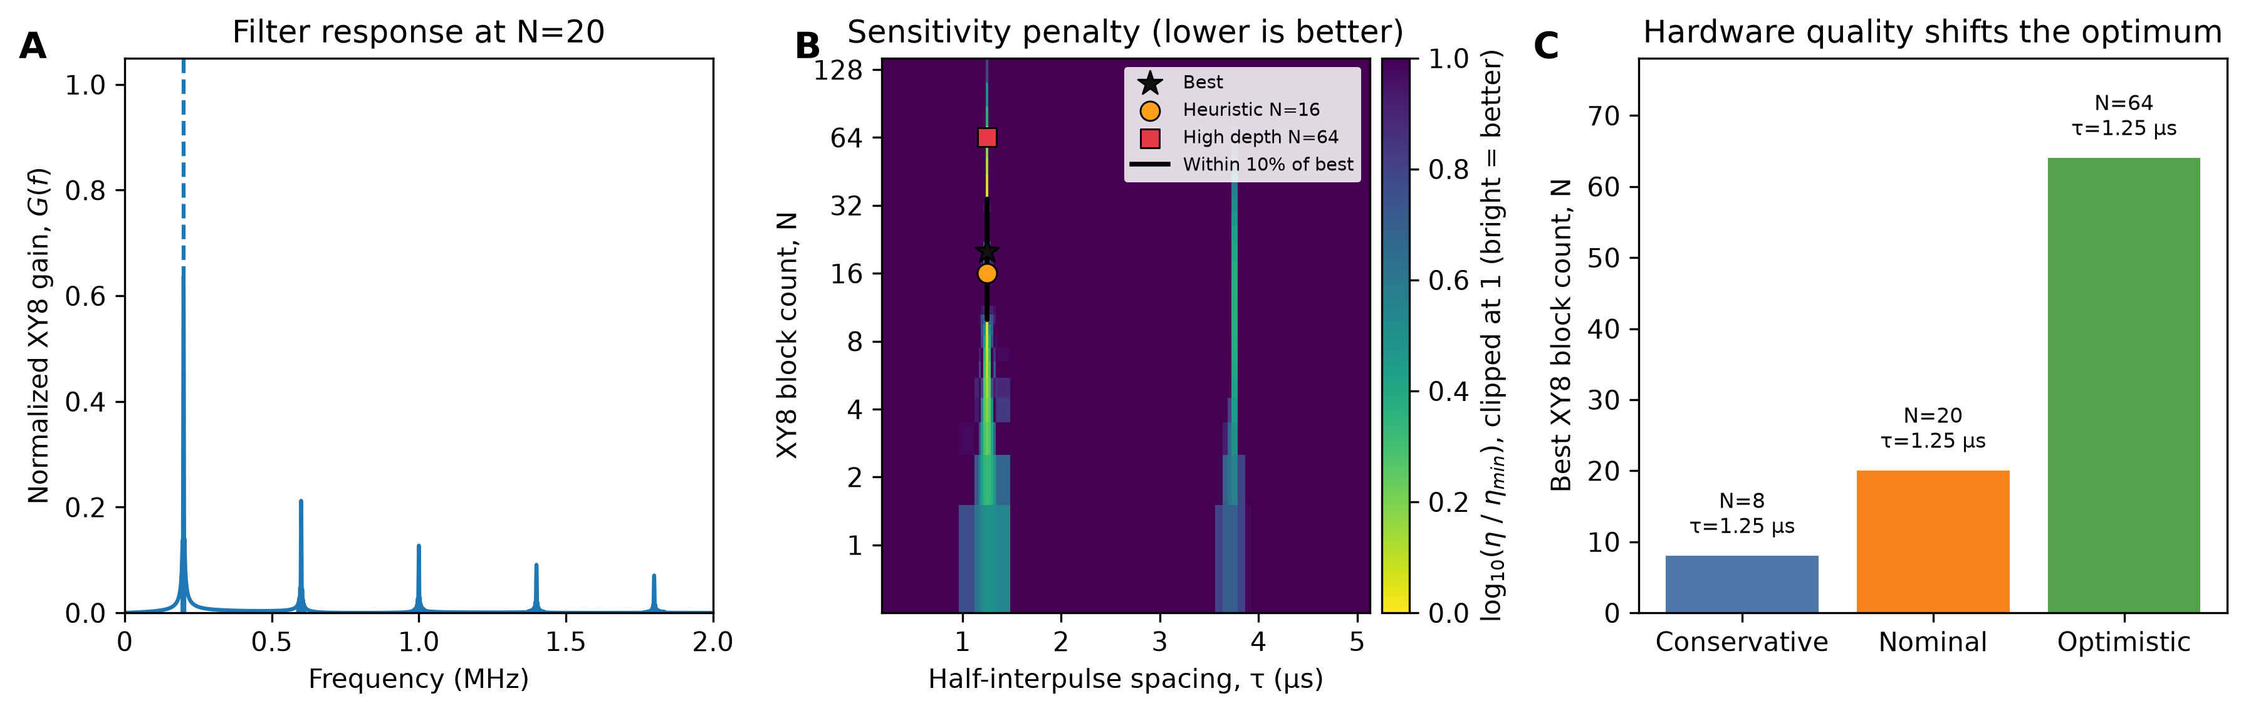
NORTH ATLANTIC TREATY ORGANIZATION
SCIENCE & TECHNOLOGY ORGANIZATION
Refined analysis resolves a finite, hardware-dependent control window
NOMINAL OPTIMUM
N=20, τ=1.25 μs
160 microwave pulses
10% OPERATING WINDOW
N=10–34
Within 10% of the minimum
The early coarse scan suggested N=4–10. Exact resonance sampling and a denser depth sweep resolve N=20 and a broader N=10–34 near-optimal window.
HARDWARE DEPENDENCE
Optimal N: 8–64
Conservative to optimistic hardware
NATO UNCLASSIFIED RELEASABLE TO STEP Nations and Singapore
13/10/2026 | PAGE 7

Slide 8
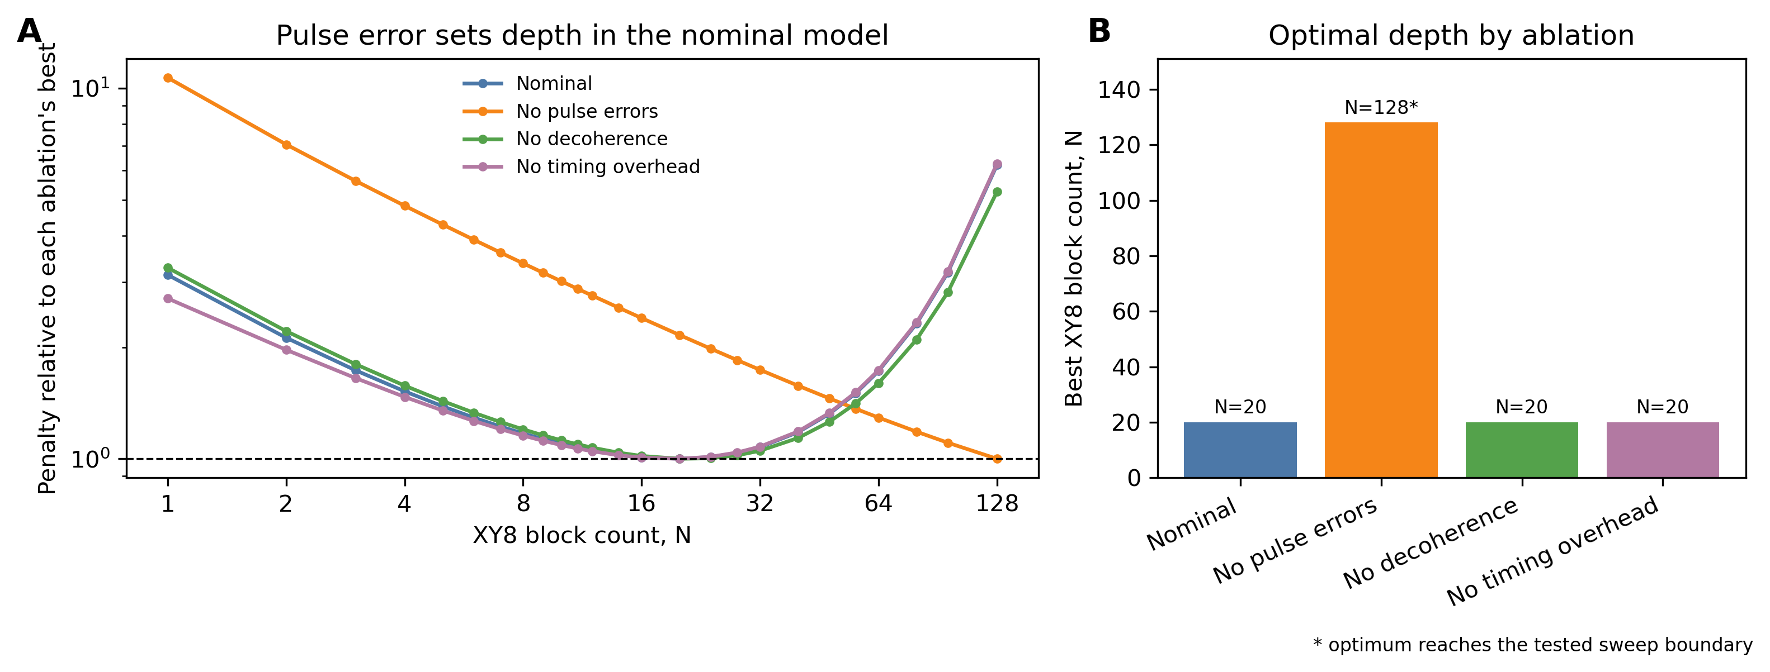
NORTH ATLANTIC TREATY ORGANIZATION
SCIENCE & TECHNOLOGY ORGANIZATION
Pulse Errors Create a Finite Optimal Control Depth
MECHANISM
Remove pulse errors
20 → 128*
~71% lower η
Remove decoherence
N stays 20; η improves ~4.8%
Remove overhead
Pulse-error accumulation creates the interior optimum
N stays 20; <1% change
NATO UNCLASSIFIED RELEASABLE TO STEP Nations and Singapore
13/10/2026 | PAGE 8

Slide 9
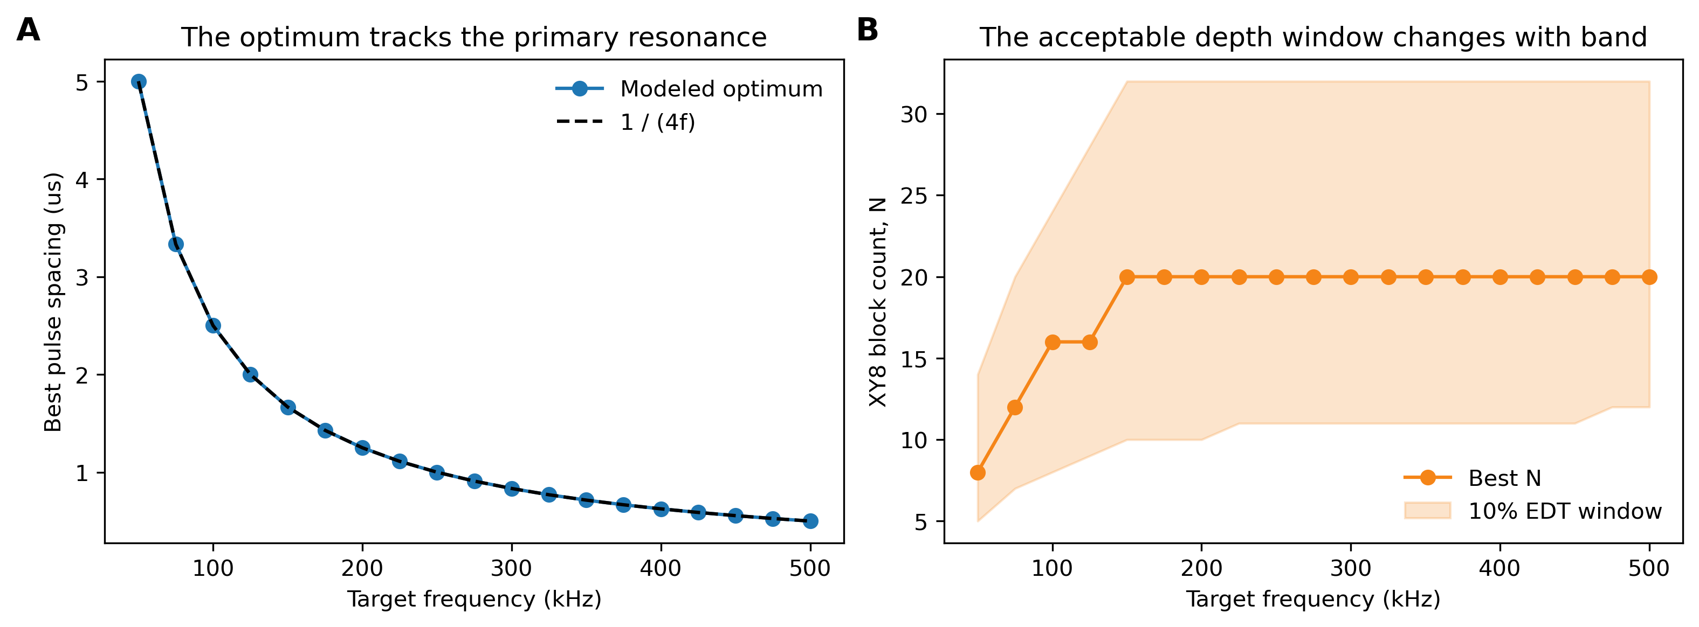
NORTH ATLANTIC TREATY ORGANIZATION
SCIENCE & TECHNOLOGY ORGANIZATION
Results: Pulse Timing Selects the Target Sensing Frequency
DIRECT RULE
τ = 1 / (4f)
50–500 kHz
Modeled τ follows the analytic primary resonance.
Best depth
N = 8 → 20
Timing tracks the sensing band
The 10% window changes with band.
NATO UNCLASSIFIED RELEASABLE TO STEP Nations and Singapore
13/10/2026 | PAGE 9

Slide 10
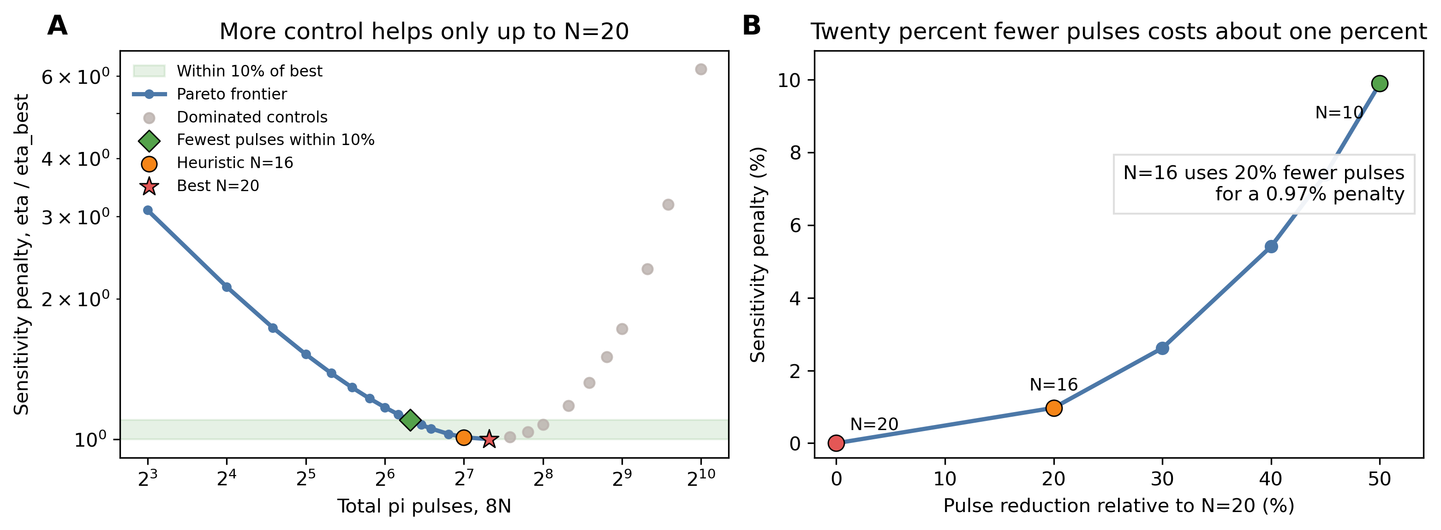
NORTH ATLANTIC TREATY ORGANIZATION
SCIENCE & TECHNOLOGY ORGANIZATION
N = 16 Preserves Performance with Fewer Pulses
PRACTICAL CHOICE
N = 16
128 π pulses
−20%
pulse count
+0.97%
sensitivity penalty
NATO UNCLASSIFIED RELEASABLE TO STEP Nations and Singapore
13/10/2026 | PAGE 10

Slide 11
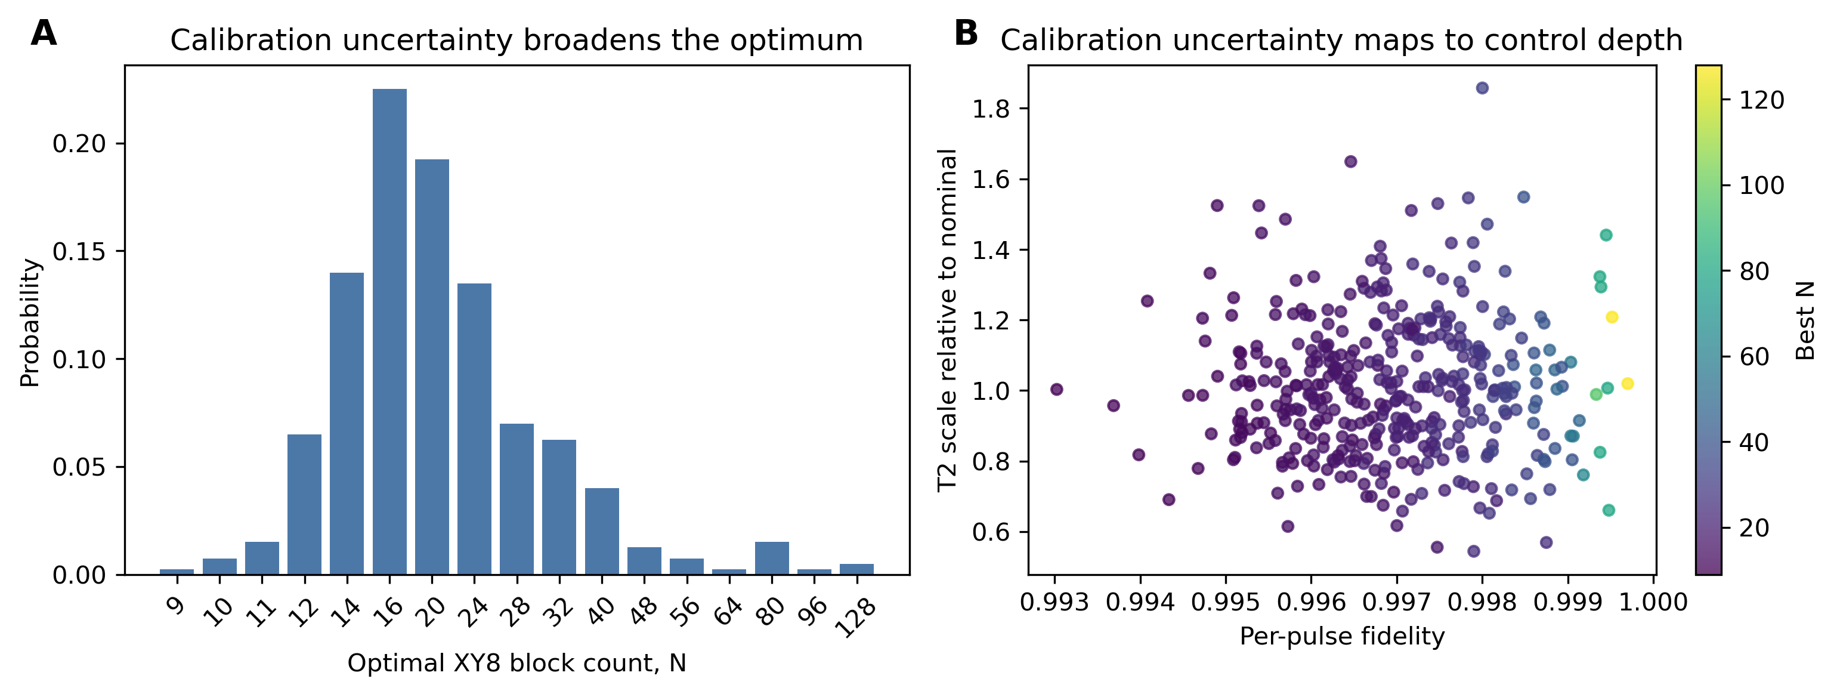
NORTH ATLANTIC TREATY ORGANIZATION
SCIENCE & TECHNOLOGY ORGANIZATION
Hardware Uncertainty Broadens the Preferred Control Depth
400
calibration samples
89%
select N = 12–32
Mode
N=16
Uncertainty broadens the preferred depth
22.5% of samples
NATO UNCLASSIFIED RELEASABLE TO STEP Nations and Singapore
13/10/2026 | PAGE 11

Slide 12
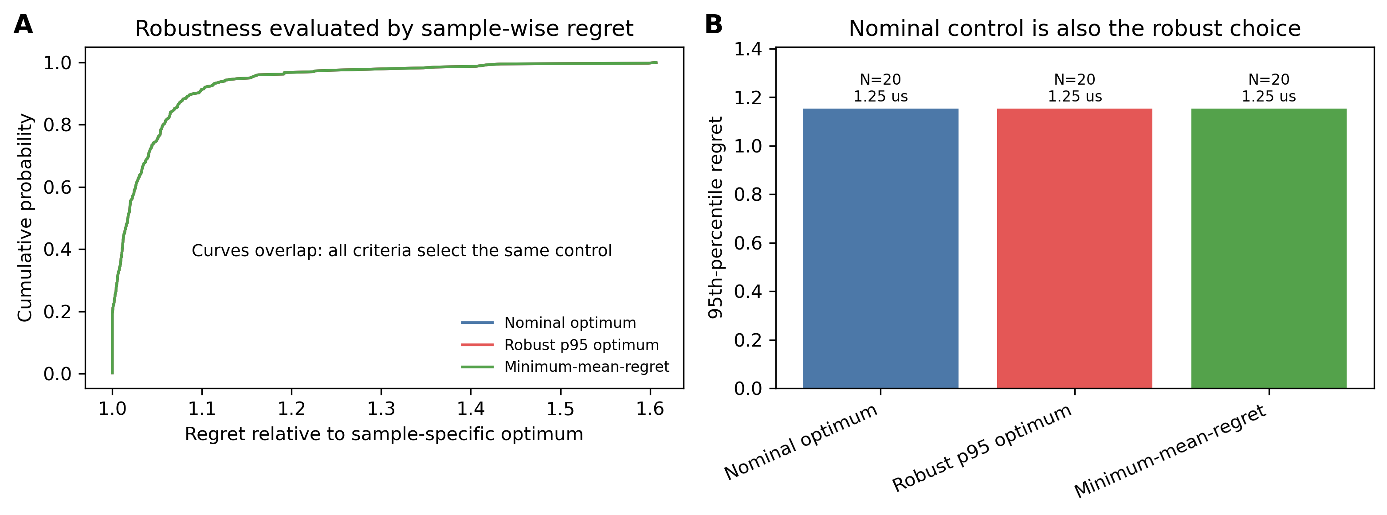
NORTH ATLANTIC TREATY ORGANIZATION
SCIENCE & TECHNOLOGY ORGANIZATION
N = 20 Is the Most Robust Fixed Choice
ALL THREE CRITERIA
N = 20
τ = 1.25 μs
Nominal
95th-percentile regret
Minimum mean regret
p95 regret = 1.154×
NATO UNCLASSIFIED RELEASABLE TO STEP Nations and Singapore
13/10/2026 | PAGE 12

Slide 13
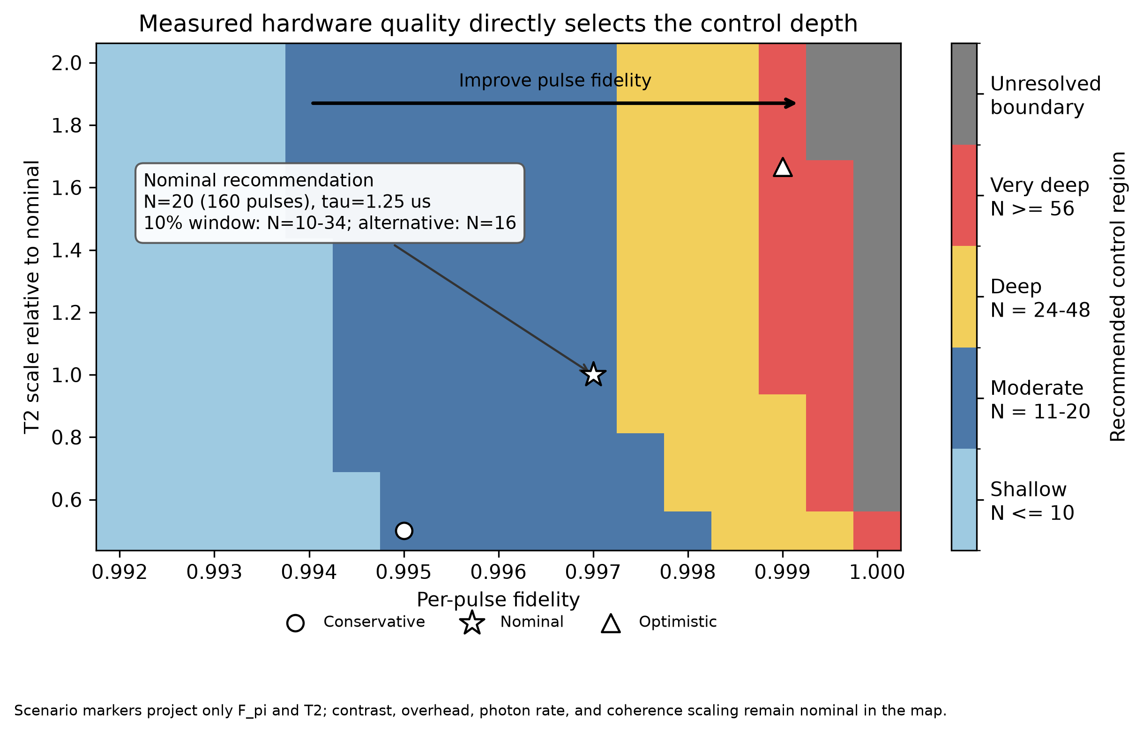
NORTH ATLANTIC TREATY ORGANIZATION
SCIENCE & TECHNOLOGY ORGANIZATION
Measured Hardware Quality Selects the Control Depth
DECISION RULE
(f, Fπ, T₂)
↓
(τ, N, 10% window)
Nominal hardware
τ = 1.25 μs
N = 20 · 160 π pulses
window N = 10–34
Pareto option N = 16
Caveat: contrast, photon rate, overhead and other coherence parameters are held nominal.
NATO UNCLASSIFIED RELEASABLE TO STEP Nations and Singapore
13/10/2026 | PAGE 13

Slide 14
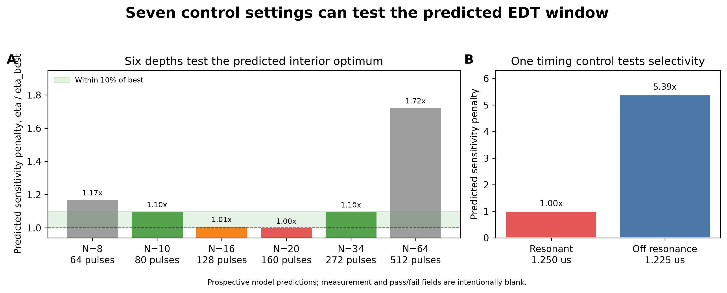
NORTH ATLANTIC TREATY ORGANIZATION
SCIENCE & TECHNOLOGY ORGANIZATION
Seven measurements can test the predicted EDT window
FALSIFIABLE TESTS
1
N=16 and N=20 are tied or ordered as predicted
2
N=8 and N=64 are worse than interior controls
3
Measured optimum lies within N=10–34
4
Off-resonance is worse than resonance
5
Values fall within model intervals
Prediction table generated before measurements are entered.
NATO UNCLASSIFIED RELEASABLE TO STEP Nations and Singapore
13/10/2026 | PAGE 14

Slide 15
NORTH ATLANTIC TREATY ORGANIZATION
SCIENCE & TECHNOLOGY ORGANIZATION
First-principles data connect material physics to control
The diamond host is fixed, but temperature and strain change the NV transition and relaxation rates used by the control model.
Spin–strain
Transition shift
Spin–phonon relaxation
Udvarhelyi et al.
Cambria + Tang
Mondal et al.
Six DFT coefficients map axial, transverse and shear strain into the ground-state spin Hamiltonian.
The analytical D(T) law supplies detuning. Tang’s first-principles slope, −75.99 kHz/K, provides an independent cross-check.
The ab initio T₁(T) curve constrains the temperature-dependent coherence correction without fitting the EDT optimum.
Temperature + strain
Detuning + T₁/T₂
η(τ,N)
10% region + connected components
Inputs were frozen before the environment scan. No parameter was tuned to the EDT result.
NATO UNCLASSIFIED RELEASABLE TO STEP Nations and Singapore
13/10/2026 | PAGE 15

Slide 16
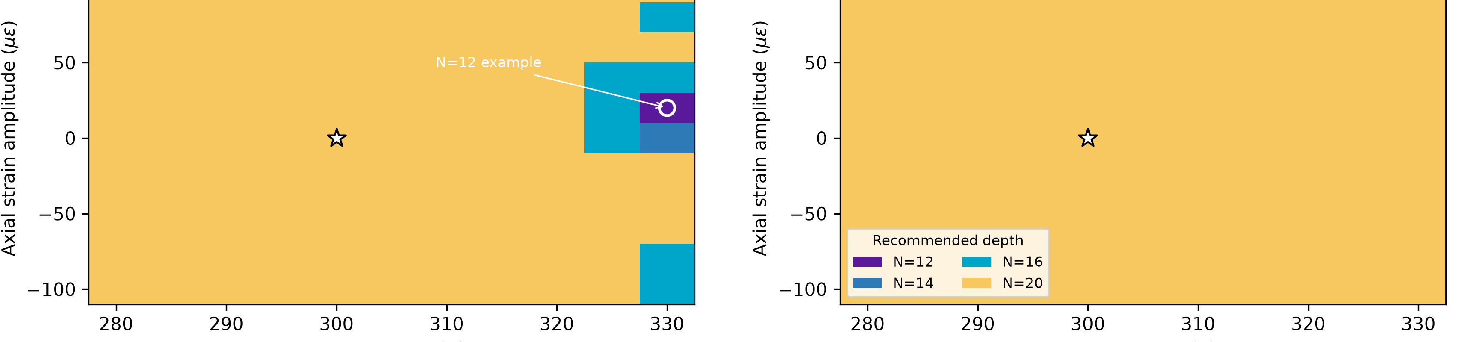
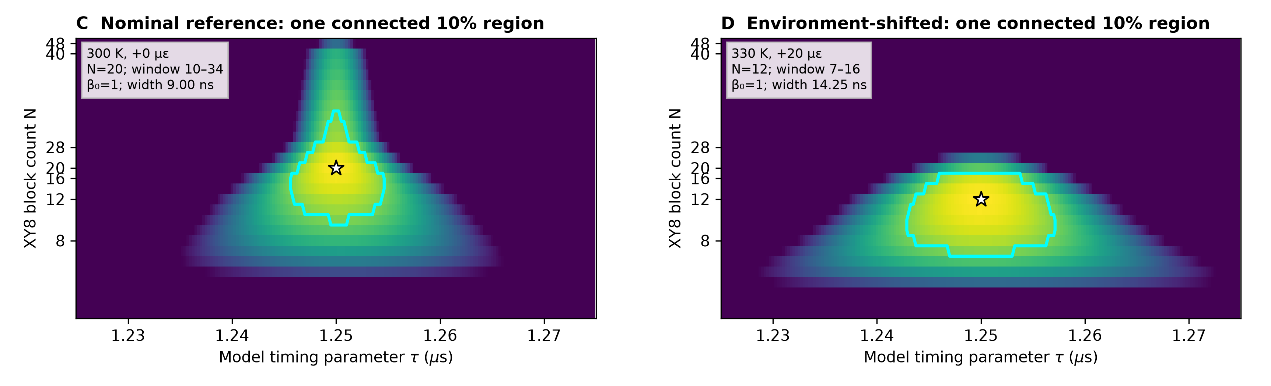
NORTH ATLANTIC TREATY ORGANIZATION
SCIENCE & TECHNOLOGY ORGANIZATION
Environmental detuning moves the optimum without splitting the EDT region
CONFIRMED RESULT
Fixed carrier
N = 12
330 K, +20 µε example
Temperature (K)
Carrier retracked
N = 20
throughout the displayed slice
Topology
β₀ = 1
226 / 226 fine-grid confirmations passed
Environment changes the region’s geometry and recommended depth while its connected-region count stays fixed.
NATO UNCLASSIFIED RELEASABLE TO STEP Nations and Singapore
13/10/2026 | PAGE 16

Slide 17
NORTH ATLANTIC TREATY ORGANIZATION
SCIENCE & TECHNOLOGY ORGANIZATION
EDT makes control depth a testable decision
N=20
Pulse error
7 settings
Resolved optimum
Dominant depth limiter
Prospective validation
At 200 kHz: τ=1.25 μs and a 10% window spanning N=10–34.
Removing pulse errors pushes the optimum to the tested boundary.
A minimal experiment can confirm or falsify the predicted window.
Next step: measure the seven-point protocol, update the hardware calibration, then let the decision rule select control depth.
NATO UNCLASSIFIED RELEASABLE TO STEP Nations and Singapore
13/10/2026 | PAGE 17

