Slide 1
Springfield Challenge
Team 5
Yash Jain
Swapnil Parekh
Harsh Chheda
Aliabbas Merchant

Slide 2
Overview
The aim of the challenge was to:
Develop a software application which has a front-end that allows users to upload documents and define rules for data capture and save rules for future re-use.
Make a back-end processing engine to extract the relevant information from the documents, according to the rules.
Allow the user to execute the conversion engine from front-end which will create the dataset and show captured data on the front-end tool.
Allow multiple processing of several documents

Slide 3
Front-end
The front-end has been made using C#.
It allows the user to create rules for document processing.
The user can upload multiple documents, and specify the location and type of each document and batch process the documents.
The front-end communicates with the back-end, commands it to process the documents, and then finally shows the result to the users.

Slide 4
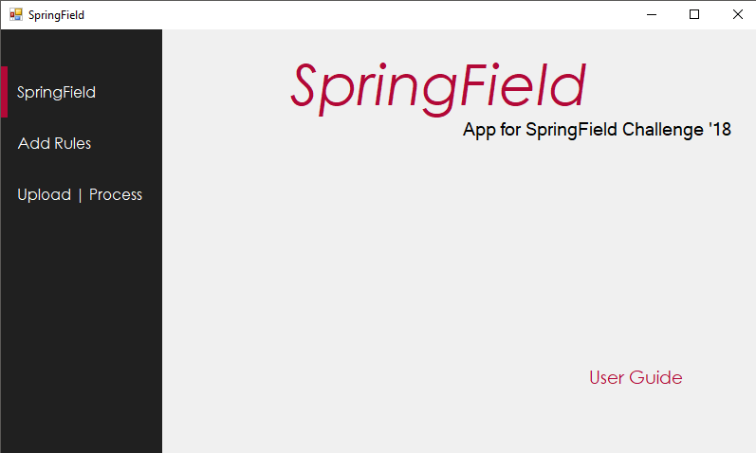

Slide 5
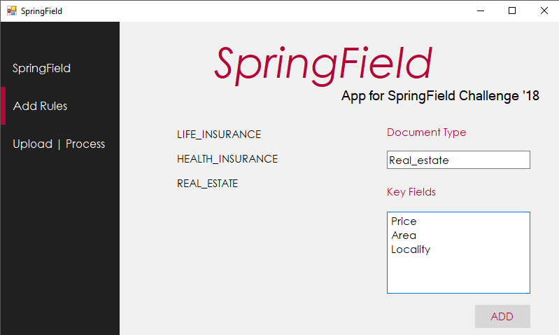

Slide 6
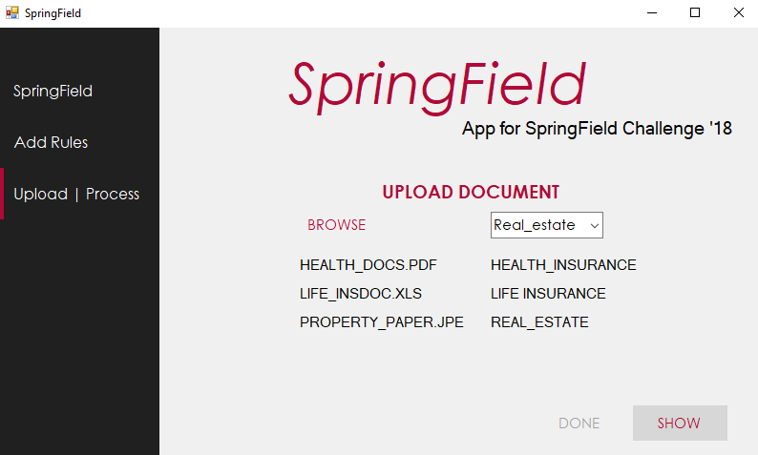

Slide 7
Back-end
The back-end processing engine was made using Python3.
The engine accepts the filename and list of fields(as per the selected rule) from the front-end.
It extracts text from the file and extracts information, as per the list of fields.
The extracted information(key-value pairs) are then stored in a csv file.
The front-end is then notified of the created csv file.

Slide 8
Thank You!

