Slide 1
Support point
X軸
length
dir
r1
a
dr
b
r0
CutRing 面
sin(a+b) = dir.x
sin a = (r1-r0)/length
sin(b) = sin(a+b) √(1-sin²a)
- √(1-sin² (a+b)) sin (a)
start
end

Slide 2
X軸
dir
b
length
r1
-a
dr
r0
CutRing 面
start
end
sin(a+b) = dir.x
sin a = (r1-r0)/length
sin(b) = sin(a+b) √(1-sin²a)
- √(1-sin² (a+b)) sin (a)

Slide 3
length
r0
a
dir
b
r1
dr

Slide 4




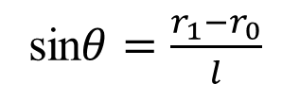










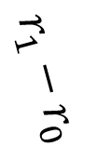
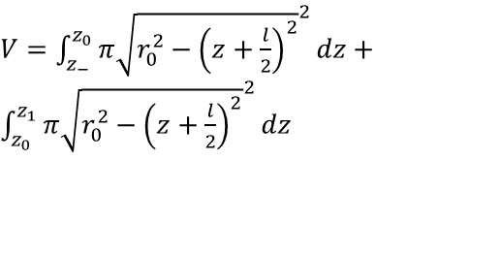

Volume, center of mass, inertia
$$z_{−}$$
$$z_{0}$$
$$x,y$$
$$z_{1}$$
$$z_{+}$$
$s_{0}=r_{0}\sin{θ}$
$s_{1}=r_{1}\sin{θ}$
${z_{−}=−\frac{l}{2}−r}_{0}$
${z_{0}=−\frac{l}{2}−r}_{0}\sin{θ}$
${z_{1}=\frac{l}{2}−r}_{1}\sin{θ}$
${z_{+}=\frac{l}{2}−r}_{0}\sin{θ}$
$$z$$
$$r_{1}$$
$$r_{0}$$
$$r_{1}−r_{0}$$
$$θ$$
$$O$$
$V=\int_{z_{−}}^{z_{0}}{π{\sqrt{r_{0}^{2}−{\left(z+\frac{l}{2}\right)}^{2}}}^{2}dz}+\int_{z_{0}}^{z_{1}}{π{\sqrt{r_{0}^{2}−{\left(z+\frac{l}{2}\right)}^{2}}}^{2}dz}$
$$\frac{l}{2}$$
$$\frac{l}{2}$$
$$s_{0}$$
sin$θ=\frac{r_{1}−r_{0}}{l}$
$$s_{1}$$

