Slide 1
C++基礎題目
寫一個函式 maxValue，接受三個整數作為參數，返回它們中的最大值。

Slide 2
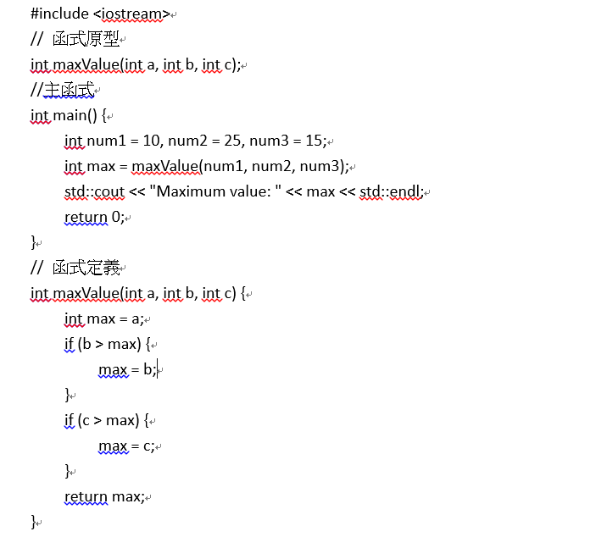

Slide 3
C++
第一堂助教課
Pointers

Slide 4
目錄
Content
01
Basics of pointers
02
Using pointers in functions
03
Dynamic memory allocation
(DMA)
04
Arrays and pointer arithmetic

Slide 5
https://www.ypppt.com/
PART 01
Basics of pointers

Slide 6
Basics of pointers
A pointer is a variable which stores a memory address
To declares a pointer, use *
– type pointed* pointer name; type pointed *pointer name;
Examples:
Int *ptrInt; double* ptrDou;
– These pointers will store address
– These pointers will store of int/double variables
We may point to any type
To point to different types, use different types of pointers
标题内 容
单击此处添加文字阐述，添加简短问题说明文字
标题内 容
单击此处添加文字阐述，添加简短问题说明文字

Slide 7
Basics of pointers
Pointer assignment
We use the address-of operator & to obtain a variable’s address
pointer name = &variable name
The address-of operator & returns the (beginning) address of a variable
Example:
When assigning an address, the two types must match
标题内 容
单击此处添加文字阐述，添加简短问题说明文字
int a = 5;
int* ptr = &a;
标题内 容
int a = 5;
Double* ptr = &a; //error
单击此处添加文字阐述，添加简短问题说明文字

Slide 8
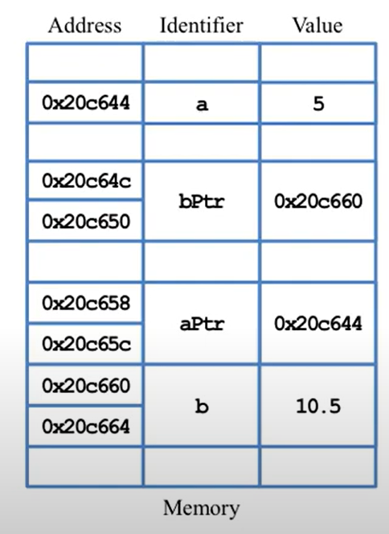
Basics of pointers
Pointer assignment
int a = 5;
int* ptr = &a;
标题内 容
单击此处添加文字阐述，添加简短问题说明文字
double b = 10.5;
double* bptr = &b;
cout << &a = ?
cout << &b = ?
cout << &aPtr = ?
cout << &bPtr = ?
//0x20c644
//0x20c660
//0x20c658
//0x20c64c
标题内 容
单击此处添加文字阐述，添加简短问题说明文字

Slide 9
Basics of pointers
Address operators
& returns a variable‘s address
– We cannot use &100, &(a++)(because a++ returns the value of a)
– We can only perform & on a variable
– We cannot assign a value to &x (&x is a value)
– We can get a usual variable’s or a pointer variable’s address
* returns the pointed variable
– We can perform * on a pointer variable
– We cannot perform * on a usual variable
– We cannot change a variable’s address. NO operation can do this
标题内 容
单击此处添加文字阐述，添加简短问题说明文字
标题内 容
单击此处添加文字阐述，添加简短问题说明文字

Slide 10
Basics of pointers
Null pointers
What will happen?
If we dereference a pointers of unknown value, the outcome is unpredictable
– The pointers points to somewhere. And we do not know where it is !
A pointer pointing to nothing should be assigned nullptr, NULL, or 0
– Dereferencing a null pointer shutdowns the program (a run-time error)
int* ptr;
cout << *ptr; // ?
标题内 容
int* ptr = nullptr;
cout <<“value of ptr = ”ptr; // 0
cout << “address of ptr”<< &ptr; // 0xaaabbb
cout << “the variable pointed by ptr = “ << *ptr // run-time error
标题内 容
单击此处添加文字阐述，添加简短问题说明文字

Slide 11
https://www.ypppt.com/
PART 02
Using pointers in functions

Slide 12
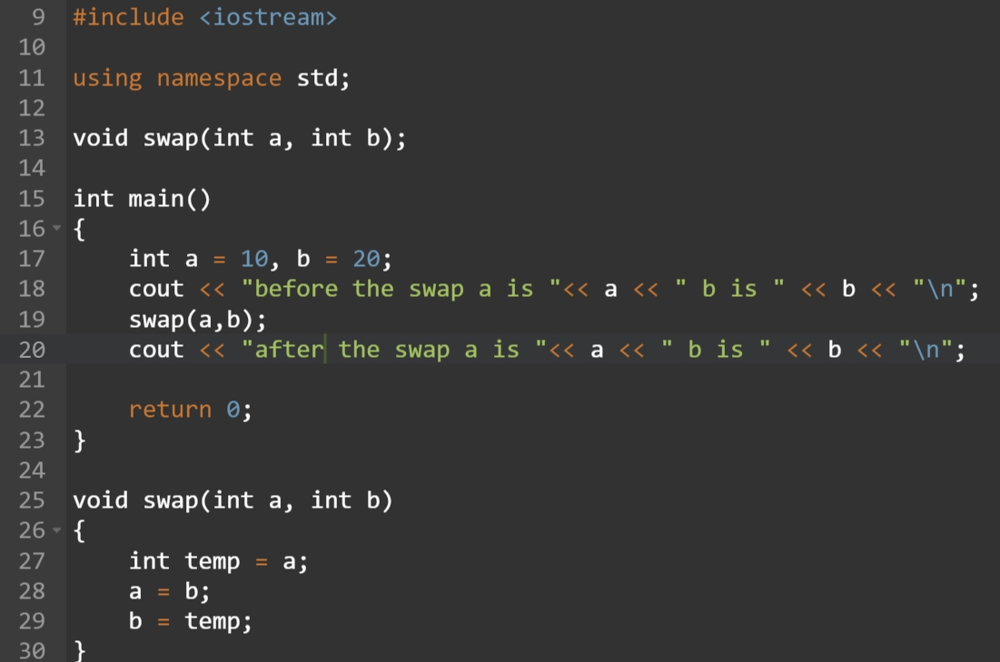

Using pointers in functions
Call-by-value
标题内 容
单击此处添加文字阐述，添加简短问题说明文字
//AP(Actual Parameter)
//FP(Formal Parameter)
标题内 容
单击此处添加文字阐述，添加简短问题说明文字

Slide 13
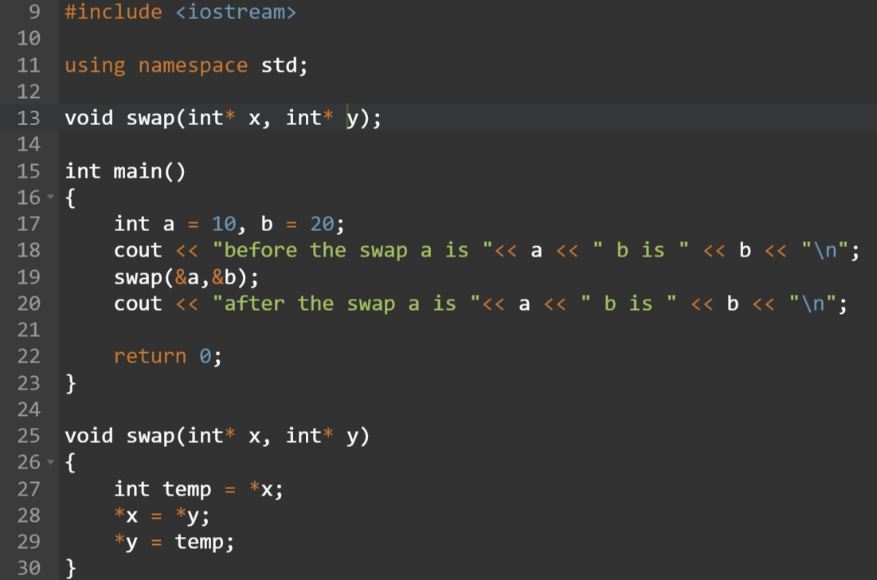

Using pointers in functions
Call-by-pointers
int* x = &a;
int* y = &b;
标题内 容
单击此处添加文字阐述，添加简短问题说明文字
标题内 容
单击此处添加文字阐述，添加简短问题说明文字

Slide 14
Using pointers in functions
Call-by-pointers
Address Identifier value
Address Identifier value
0x20c644 | x | 0x20c660
0x20c64c | y | 0x20c664
0x20c654
0x20c658 | temp | 10
0x20c65c
0x20c660 | a | 10
0x20c664 | b | 20
0x20c644 | x | 0x20c660
0x20c64c | y | 0x20c664
0x20c654
0x20c658 | temp | 10
0x20c65c
0x20c660 | a | 20
0x20c664 | b | 10
标题内 容
单击此处添加文字阐述，添加简短问题说明文字
标题内 容
单击此处添加文字阐述，添加简短问题说明文字

Slide 15
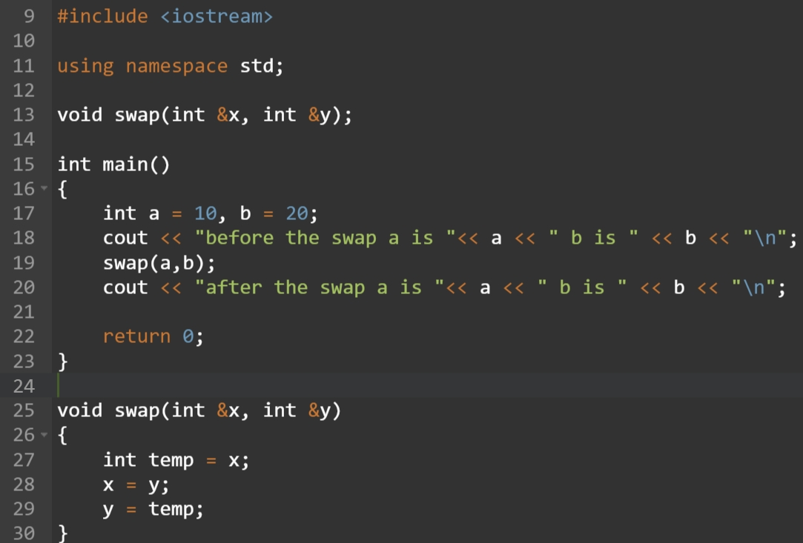

Using pointers in functions
Call-by-reference
标题内 容
Int a =20;
Int& x = a;
x = 30;
cout << a <<“\n” //30
单击此处添加文字阐述，添加简短问题说明文字
标题内 容
单击此处添加文字阐述，添加简短问题说明文字

Slide 16
C++基礎題目
使用call by reference 的方式,透過函式將數值轉換並回傳

Slide 17
Using pointers in functions
Conclusion
The principle behind calling by reference and by pointers is the same
You can view calling by reference as a special tool made by using pointers
Do not mix references and pointers
- Ex . We cannot pass a pointer variable or an address to a reference
You can call by reference in most situations, and it is clearer and more convenient than to call by pointer
标题内 容
单击此处添加文字阐述，添加简短问题说明文字
标题内 容
单击此处添加文字阐述，添加简短问题说明文字

Slide 18
https://www.ypppt.com/
PART 03
Dynamic memory allocation

Slide 19
Dynamic memory allocation
We may decide the length of an array dynamically
- That is, during the run time
The operator new allocates a memory space and returns the address
new int allocates 4 bytes, and the returned address is not recorded
int* a = new int makes a store the address of the 4-byte space
int* a = new int (5) makes the space contain 5 as the value
int* a = new int [5] allocates 20 bytes(for 5 integers)
- a points to the first integer
- a can be viewed as an array. It is a dynamic array
Dynamically allocated arrays cannot be initialized with a single statement
- A loop, for example, is needed
标题内 容
单击此处添加文字阐述，添加简短问题说明文字
标题内 容
单击此处添加文字阐述，添加简短问题说明文字

Slide 20
Dynamic memory allocation
Address Identifier value
Memory allocation (the size and location of the space) is determined during the run time
Space allocated during the run time has no name!
- On the other hand, every space allocated during the compilation time has a name
To access a dynamically-allocated space, we use a pointer to store its address
0x20c644 | No name | 1
0x20c648 |  | 2
0x20c64c |  | 3
0x20c650
0x20c654
0x20c658 | len | 3
0x20c65c
0x20c660 | a | 0x20c644
0x20c664
标题内 容
单击此处添加文字阐述，添加简短问题说明文字
int len = 0;
cin >> len; //3
int* a = new int [len];
for(int I = 0; I < len; i++)
a[i] = I + 1;
标题内 容
单击此处添加文字阐述，添加简短问题说明文字

Slide 21
Dynamic memory allocation
Releasing space manually
int* a = new int;
delete a; // release 4 bytes
int* b = new int[5];
delete b; // release only 4 byte!
// unpredictable results may happen
delete [] b; //release all 20 bytes
The delete operator will release
a dynamically-allocated space
标题内 容
单击此处添加文字阐述，添加简短问题说明文字
int* a = new int;
delete a; // a is still pointing to the address
a = nullptr; // now a points to nothing
int* b = new int[5];
delete [] b; // b is still pointing to the address
b = nullptr; // now b points to nothing
The delete operator will do
nothing to the pointer To avoid reusing the released space, set the pointer to nullptr
标题内 容
单击此处添加文字阐述，添加简短问题说明文字

Slide 22
https://www.ypppt.com/
PART 04
Arrays and pointer arithmetic

Slide 23
Pointer arithmetic
++ and --
++ : Increment the pointer variable′s value by the number of bytes occupied by a variable in this type(point to the next variable)
-Ex. For integer pointers, the value (an address) increase by 4 bytes
-- : Decrement the pointer variable′s value by the number of bytes a variable in this type occupies(point to the previous variable)
标题内 容
单击此处添加文字阐述，添加简短问题说明文字
double a [3] = {10.5, 11.5, 12.5};
double* b = &a[0];
cout << *b << “ ”<< b << “\n”; // 10.5
b = b+2; // b++ and then b++
cout << *b << “ ”<< b << “\n”; // 12.5
b--;
cout << *b << “ ”<< b << “\n”; // 11.5
标题内 容
单击此处添加文字阐述，添加简短问题说明文字
Notes:
陣列是目前唯一會讓我們知道是連著存的變數。所以我們可以用array 來看看++或—的變化。

Slide 24
Pointer arithmetic
Pointer arithmetic : -
We cannot add two address
However, we can find the difference of two addresses
标题内 容
单击此处添加文字阐述，添加简短问题说明文字
double a [3] = {10.5, 11.5, 12.5};
double* b = &a[0];
double* c = &a[2];
cout << c – b; // 2, not 16!
标题内 容
单击此处添加文字阐述，添加简短问题说明文字

Slide 25
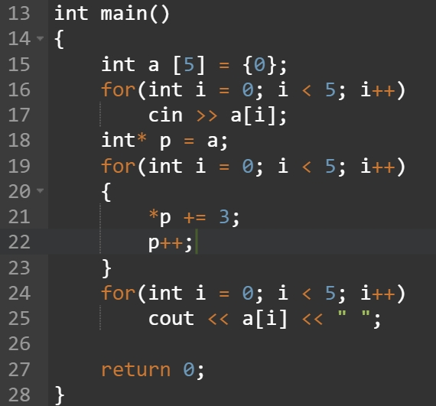

Pointer arithmetic
Example 1. incrementing array elements
a
1 | 2 | 3 | 4 | 5
标题内 容
p
单击此处添加文字阐述，添加简短问题说明文字
a
4 | 5 | 6 | 7 | 8
p
标题内 容
单击此处添加文字阐述，添加简短问题说明文字

Slide 26
Reference
台大孔令傑老師YT線上影片:
https://www.youtube.com/watch?v=91AyfUVy2Ik&list=PLMHSr8fseBzUvwjKtR6pX0Vv9Q9H-V3lY&index=66
标题内 容
单击此处添加文字阐述，添加简短问题说明文字
单击此处添加文字阐述，添加简短问题说明文字

