Slide 1
C++ 第二次助教課
Array(vector)

Slide 2
Vector介紹: ●動態陣列 ●不需要提前宣告長度 ●支持陣列尾部新增、刪除 ●其他功能…. https://www.geeksforgeeks.org/vector-in-cpp-stl/

Slide 3
課堂練習: vector宣告 + push_back新元素 + print

Slide 4
#include <iostream> #include <vector> using namespace std; int main() { vector<int> vec; // 宣告一個儲存int的vector vec.push_back(1); vec.push_back(2); vec.push_back(3); for(auto x : vec){ cout << x << " "; } return 0; }

Slide 5
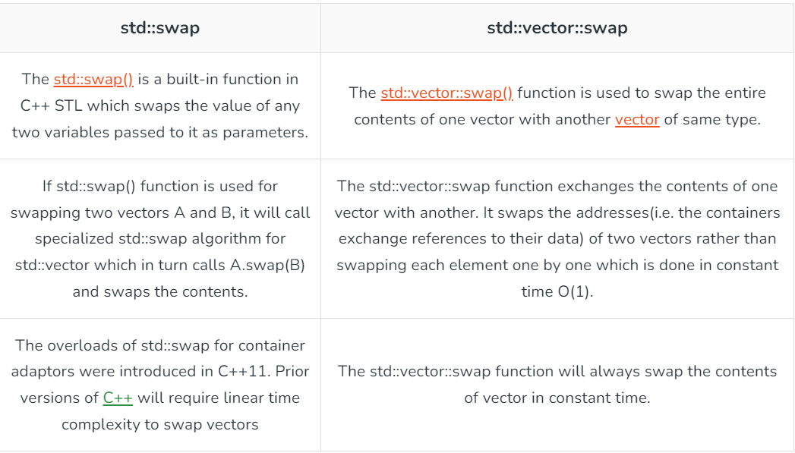
Vector : swap (from geekforgeeks)

Slide 6
#include <iostream> #include <vector> using namespace std; int main() { vector<int> v1 = {1,2,3}; // 宣告一個儲存int的vector vector<int> v2 = {4,5,6}; int n = v1.size(); //將v1的長度assign給n for(int i = 0 ; i < n ; i++){ swap(v1[i], v2[i]); } return 0; }

Slide 7
課堂練習: 給2個vector v1&v2 對於vector的每個index i v1&v2須符合以下要求 v1[i] = max(v1[i], v2[i]) v2[i] = min(v1[i], v2[i]) 使用swap實作

Slide 8
測試資料: vector<int> v1 = {3,7,1}; vector<int> v2 = {1,4,8}; vector<int> v1 = {12, 4, 37, 56, 999}; vector<int> v2 = {13, 4, 8, 81,9999};

Slide 9
#include <iostream> #include <vector> using namespace std; int main() { vector<int> v1 = { 12, 4, 37, 56, 999 }; vector<int> v2 = { 13, 4, 8, 81,9999}; for (int i = 0; i < v1.size(); i++) { if(v2[i] > v1[i]) swap(v1[i], v2[i]); } for(auto x : v1){ cout << x << " "; } for(auto x : v2){ cout << x << " "; } return 0; }

Slide 10
Vector: sort
#include <iostream> #include <vector> include <algorithm> //這行要打不然會Error using namespace std; int main() { vector<int> vec = {1, 5, 8, 9, 6, 7, 3, 4, 2, 0} ; // 宣告一個儲存int的vector sort(vec.begin(), vec.end());呼叫sort function來排序vec
// sort(vec.begin(), vec.begin() + 看你想排序前幾個元素); for(auto x : vec){ cout << x << " "; } return 0; }

Slide 11
課堂練習: 給一個數列，請找出這個數列的眾數(一定有且只有一個) vector<int> vec = {1,2,3,1,1}; ans:1 vector<int> vec = {1,2,5,5,4,2,2,1,2}; ans:2 不會出現如1,1,1,2,2,2 hint : sort

Slide 12
#include <iostream> #include <vector> #include <algorithm> using namespace std; int main() { vector<int> vec = {1,2,5,5,4,2,2,1,2}; sort(vec.begin(), vec.end()); int maxLen = 0; int ans; int curLen = 1; int curNum = vec[0]; for(int i = 1 ; i < vec.size() ; i++){ if(vec[i] == curNum){ curLen++; } else{ curLen = 1; curNum = vec[i]; } if(curLen > maxLen){ ans = curNum; maxLen = curLen; } } cout << ans; return 0; }

