Slide 1

Computer Building- Video Editing
H34121020-張勇泰

Slide 2
Introduction:
I.Talk through the main factor about computer building
II.Introduce some common video editing software
lll.Talk about how different you choose can affect
VI.Talk about my own choice

Slide 3
When talking about Computer Building.We talk about personal computer(which is known as PC).Which is a kind of Microcomputer.To build up a PC,we need to have a understanding that computer is like a kind of calculator.We need something to count,something to store the inform,something to do the input and output.We call the part which calculate as CPU(Central Processing Unit).RAM(Random-access memory)as the place to store information temporarily for CPU.M.2 SSD(Solid-state drive) or HDD(Hard Disk Drive) for storing purpose.And MB(Mother Board)to combine all of the stuff above.

Slide 4
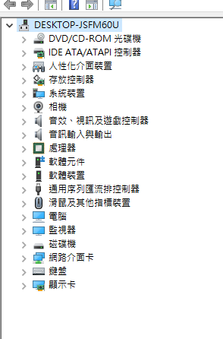



Take my own computer as an example.
There are many parts in a computer.And base on your own budget and the use of the computer,it can have many different fuctions.
I got this computer from my father,and it’s usually used in a gaming purpose.

Slide 5
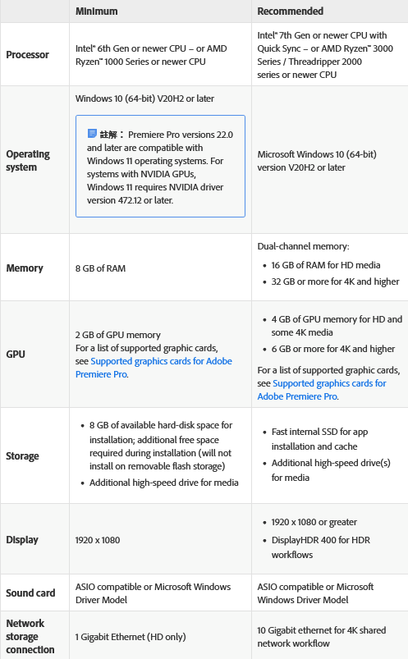

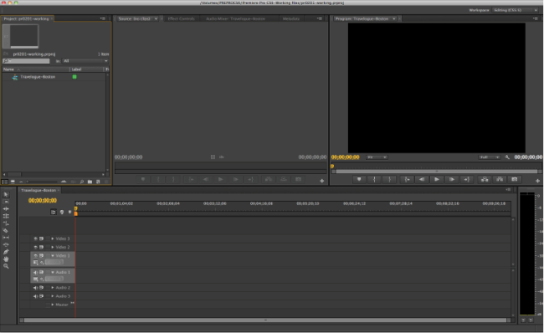
Adobe Premiere Pro
Cost:
Feature:Premiere Pro supports high resolution video editing at up to 10,240 × 8,192resolution, at up to 32 bits per channel color, in both RGB and YUV.
672 per month
user interface:
System requirements for Premiere Pro→

Slide 6

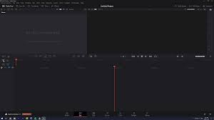
DaVinci Resolve
Cost:free
Feature:video editing, color correction, audio mixing/effects (including Fairlight), and visual effects (including Fusion).
DaVinci Resolve minimum requirements
For those using macOS devices, you should have:
macOS 11 Big Sur or later
8 GB of system memory (16 GB for intense graphics work)
M1 Apple Silicon CPU (or intel core i7 on older macs)
Integrated GPU or discrete GPU with at least 2GB of VRAM and supports Metal or OpenCL 1.2
A fast Solid State Hard Drive (SSD)
For those running Windows devices you should have:
Windows 10 or later
16 GB of system memory (32 GB for intense graphics work)
intel core i7 or AMD Ryzen 7 CPU
Integrated or discrete GPU with at least 2GB of VRAM and supports OpenCL 1.2 or CUDA 11 and the Latest driver Blackmagic Design Desktop Video 10.4.1 or later
A fast Solid State Hard Drive (SSD)
Those running Linux will want:
CentOS 7.3
32 GB of system memory
Intel core i7 or AMD Ryzen 7 CPU
Discrete GPU with at least 2GB of VRAM that supports OpenCL 1.2 or CUDA 11 as well as the latest driver Blackmagic Design Desktop Video 10.4.1 or later
A fast Solid State Hard Drive (SSD)
user interface:
System requirements for DaVinci Resolve→

Slide 7
The main factor:How the software is written
The main difference between CPU and GPU is that GPU can’t do float-pointoperation.
Which is also the reason why the cuda(core)number is usually a lot higher than CPU.
And take Premiere Pro for example,it is written to run in CPU.
The traditional ones are usually wrote to run in CPU.
DaVinci is different it’s wrote to run in GPU.
Importance:
GPU=CPU(depend on the softwere)>
Ram(but still need a decent one)>
SSD/HDD>(screen)>
MB,power, ….

Slide 8
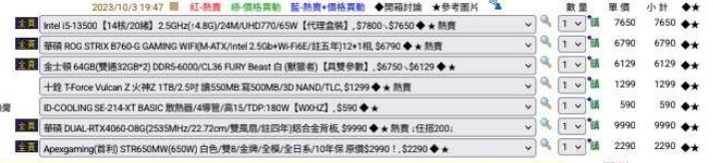
My own pick:
Budget:35000

Slide 9
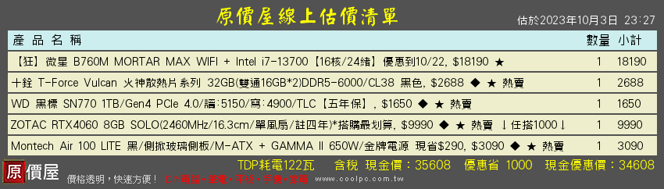
My friend suggest the one which has most high CP rated

Slide 10
Reference:
https://www.freepik.com/vectors/ppt-background
https://jacksonlin.net/20180709-installing-pc-for-video-editing/
https://linux.vbird.org/linux_basic/centos7/0105computers.php
https://zh.wikipedia.org/zh-tw/Adobe_Premiere_Pro
https://zh.wikipedia.org/zh-tw/DaVinci_Resolve
https://helpx.adobe.com/tw/premiere-pro/system-requirements.html
https://www.simonsaysai.com/blog/davinci-resolve-system-requirements

