Slide 2
Classification Results
模型架构图
Linear
TES/BIA Results
N×
Add & Norm
Flatten + Linear Head
Feed Forward
Transformer Encoder
Add & Norm
Muti-Head Attention
Position Embedding
Norm + Patching
Input Signal Series

Slide 3
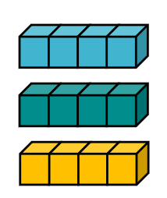

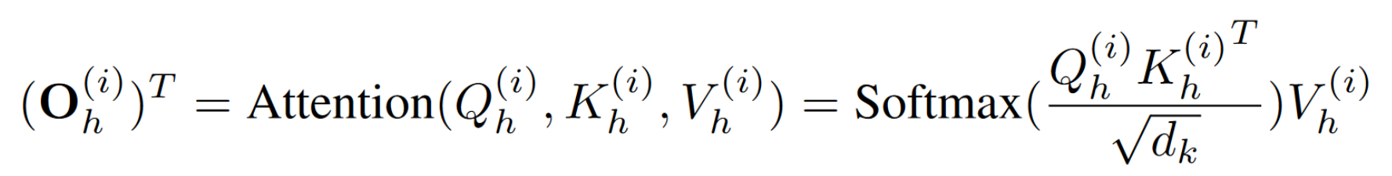


Classification model
PatchTST
Physiological Signals
Signal Collection
Bow
Chew
Cough
TES
Results
TES
Swallow
Belch
Signal Processing
Combine
Pronunciation
Transformer
Encoder
a
e
i
o
u
BIA
BIA
Results
Eating
Drink
Bread
Porridge
Q
Projection + Position Embedding
K
MLP
Linear Head
Output
Embedding
Patching
Patch-Product Attention
V

Slide 4
Transformer Encoder
...
...
...
...

Slide 5
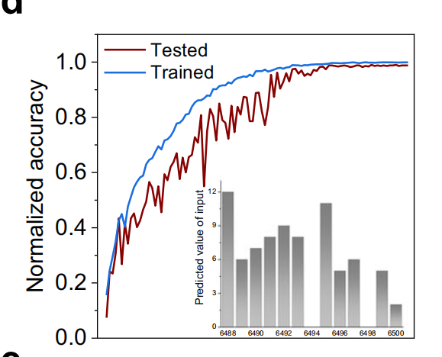
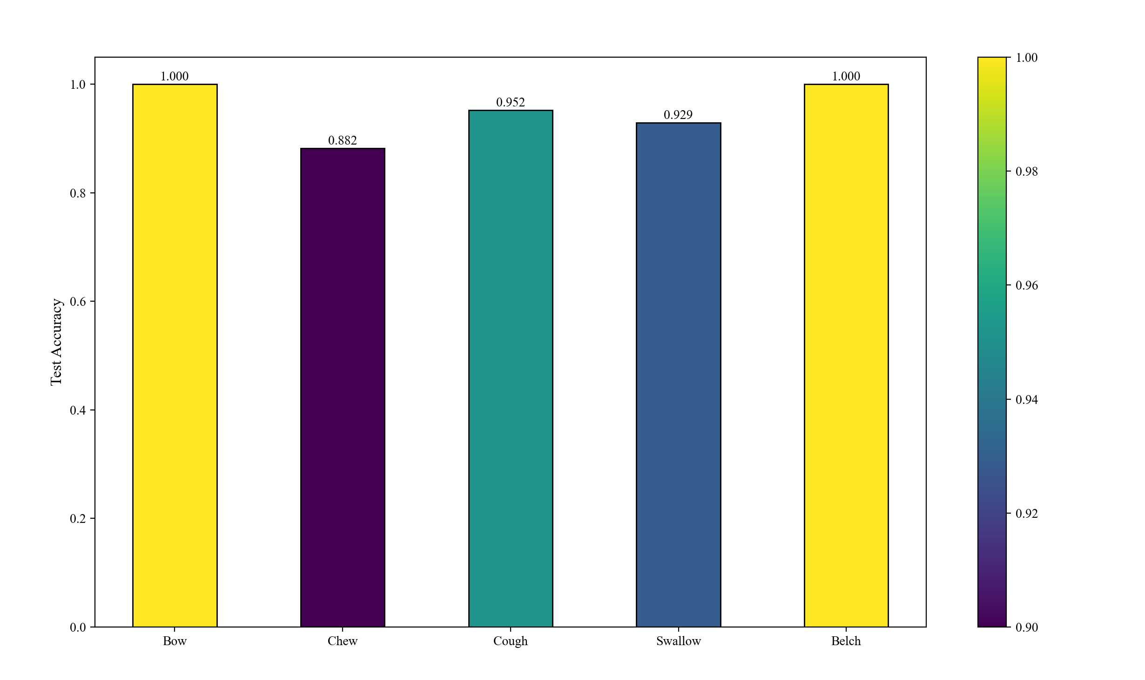
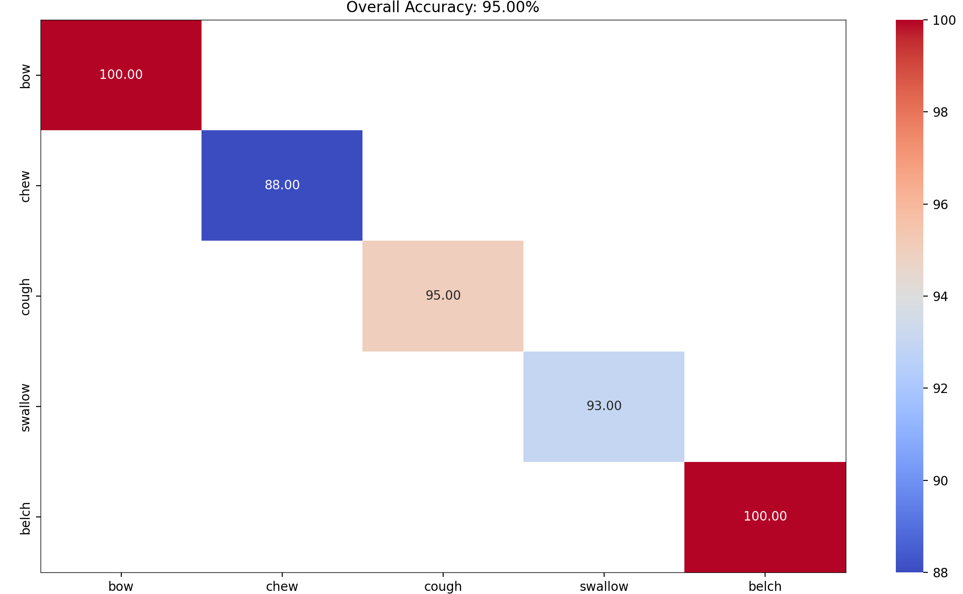
生理4类结果图，不知道需不需要规定字体，NC论文里面画的是accuracy（右边），但是一般训练的时候只有loss是可以算的，不知道它咋画的accuracy，然后它论文里面没有画loss，我想要不要咱们画loss（下边）

Slide 6
accuracy - training sample1个生理信号的图
mse，mae图挑一个数据集画
发音，吃东西最后结果*2
列表格

Slide 7
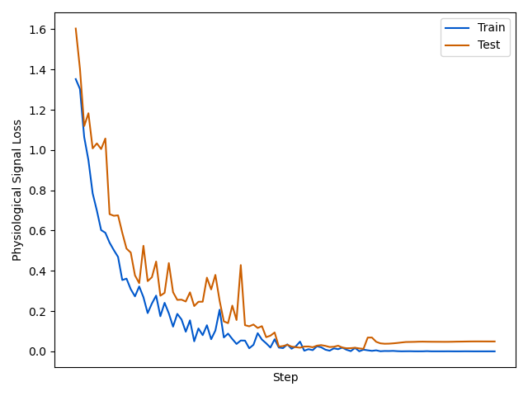
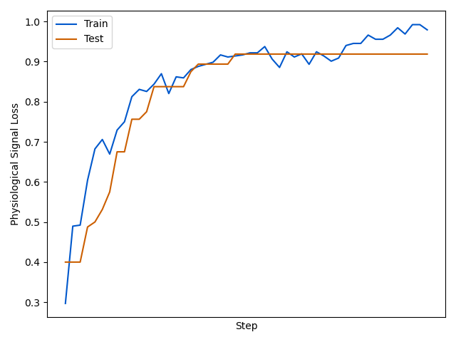
train，test的loss和acc

Slide 8
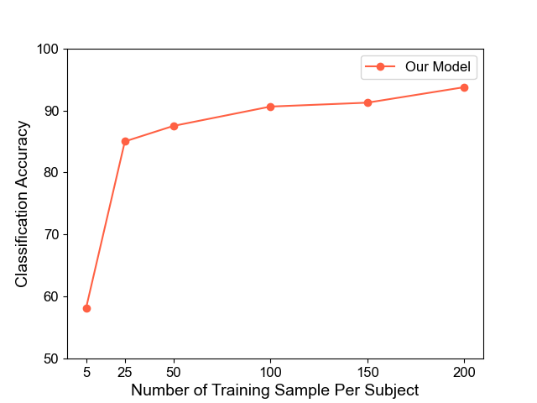
不同样本量的acc

Slide 9
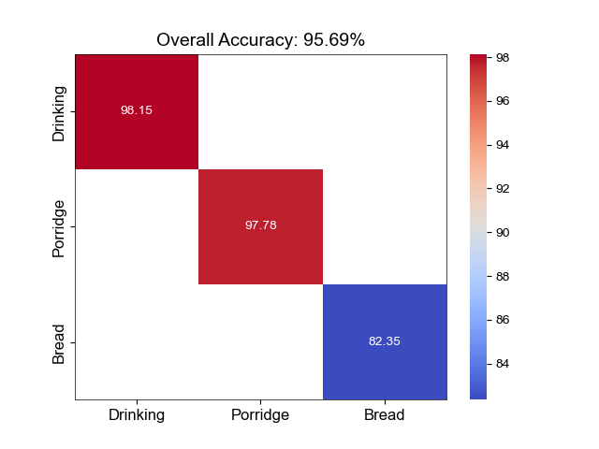
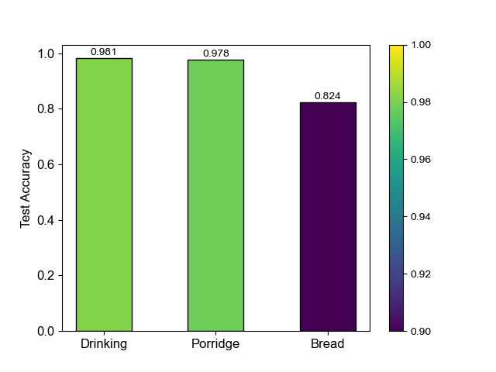
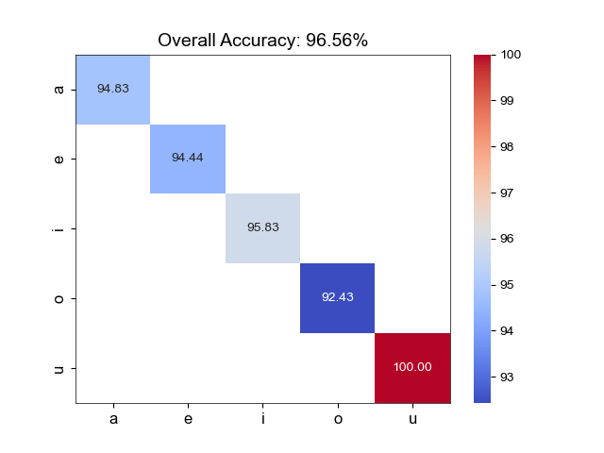
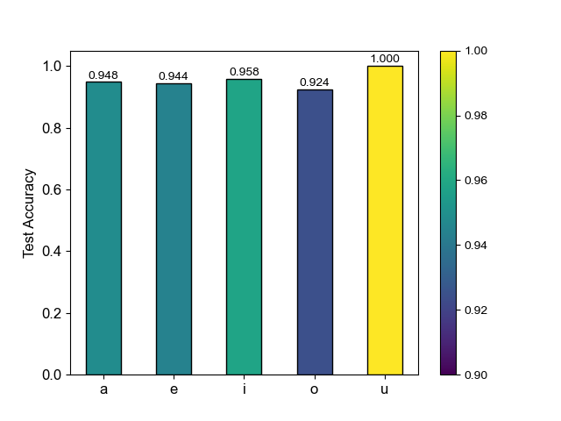
eating
发音整体的

Slide 10
改了分类
 | 生理信号 |  |  |  |  |  | 发音 |  |  |  |  |  | 吃东西
 | All | Bow | Chew | Cough | Swallow | Belch | All | a | e | i | o | u | All | Drink | Poritage | Bread
Dicision Tree | 0.83 | 0.58 | 0.78 | 0.86 | 0.81 | 0.99 | 0.85 | 0.78 | 0.80 | 0.94 | 0.84 | 0.76 | 0.95 | 1.00 | 0.92 | 0.88
KNN | 0.88 | 0.66 | 0.82 | 0.89 | 0.92 | 1.00 | 0.87 | 0.79 | 0.82 | 0.96 | 0.81 | 0.90 | 0.93 | 0.96 | 0.94 | 0.81
Logistic | 0.68 | 0.46 | 0.47 | 0.67 | 0.56 | 0.87 | 0.84 | 0.71 | 0.88 | 0.98 | 0.83 | 0.77 | 0.71 | 0.83 | 0.62 | 0.50
Random Forest | 0.90 | 0.60 | 0.86 | 0.92 | 0.85 | 0.99 | 0.91 | 0.81 | 0.89 | 0.99 | 0.88 | 0.93 | 0.95 | 0.98 | 0.90 | 1.00
SVM | 0.75 | 0.46 | 0.52 | 0.64 | 0.77 | 1.00 | 0.84 | 0.74 | 0.87 | 0.96 | 0.78 | 0.84 | 0.76 | 0.88 | 0.66 | 0.83
Our PatchTST | 0.92 | 0.85 | 0.83 | 0.92 | 0.90 | 0.98 | 0.97 | 0.96 | 0.95 | 0.98 | 0.90 | 0.98 | 0.96 | 0.98 | 0.98 | 0.82

Slide 11
9个数据集的对比表，加粗是最高的，横线第二高
Model | Zxy | Lyh | Yzt-1 | Yzt-2 | TENG-1 | TENG-2 | IM-1 | IM-2 | Eating
Decision Tree | 95.6 | 77.8 | 75.6 | 82.1 | 75.3 | 85.4 | 93.7 | 83.8 | 94.8
KNN | 95.6 | 84.3 | 84.6 | 87.2 | 79.8 | 85.4 | 86.5 | 94.6 | 93.1
Logistic | 65.6 | 71.3 | 65.4 | 67.9 | 75.3 | 83.1 | 87.4 | 90.1 | 70.7
Random Forest | 97.5 | 88.0 | 85.9 | 88.5 | 85.4 | 88.8 | 94.6 | 94.6 | 94.8
SVM | 81.9 | 67.6 | 73.1 | 75.6 | 71.9 | 83.1 | 91.9 | 90.1 | 75.9
Our PatchTST | 95.0 | 89.8 | 87.2 | 88.5 | 91.0 | 94.4 | 96.4 | 97.3 | 95.7

Slide 12
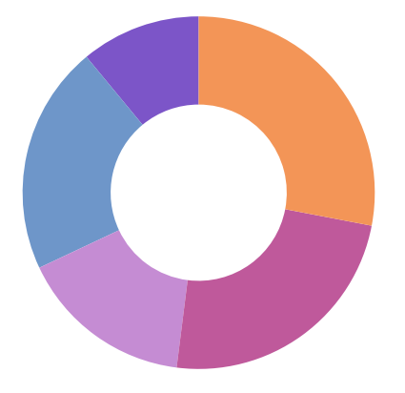
213, 0.85
Bow
528, 0.98
Chew
381, 0.83
Cough
Swallow
295, 0.91
443, 0.90
Belch

Slide 13
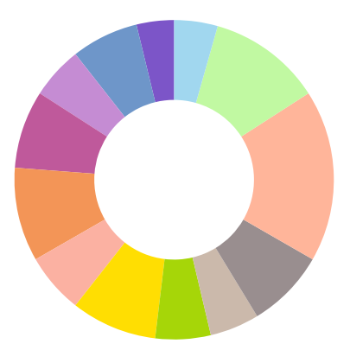
213
0.96
86
0.82
381
0.92
222
0.98
295
0.91
443
0.93
338
0.98
528
0.98
410
0.95
540
1.00
585
0.94
380
0.96
335
0.92
Bow
Chew
Cough
Swallow
Belch
A
E
I
O
U
Water
Porridge
Bread

Slide 14
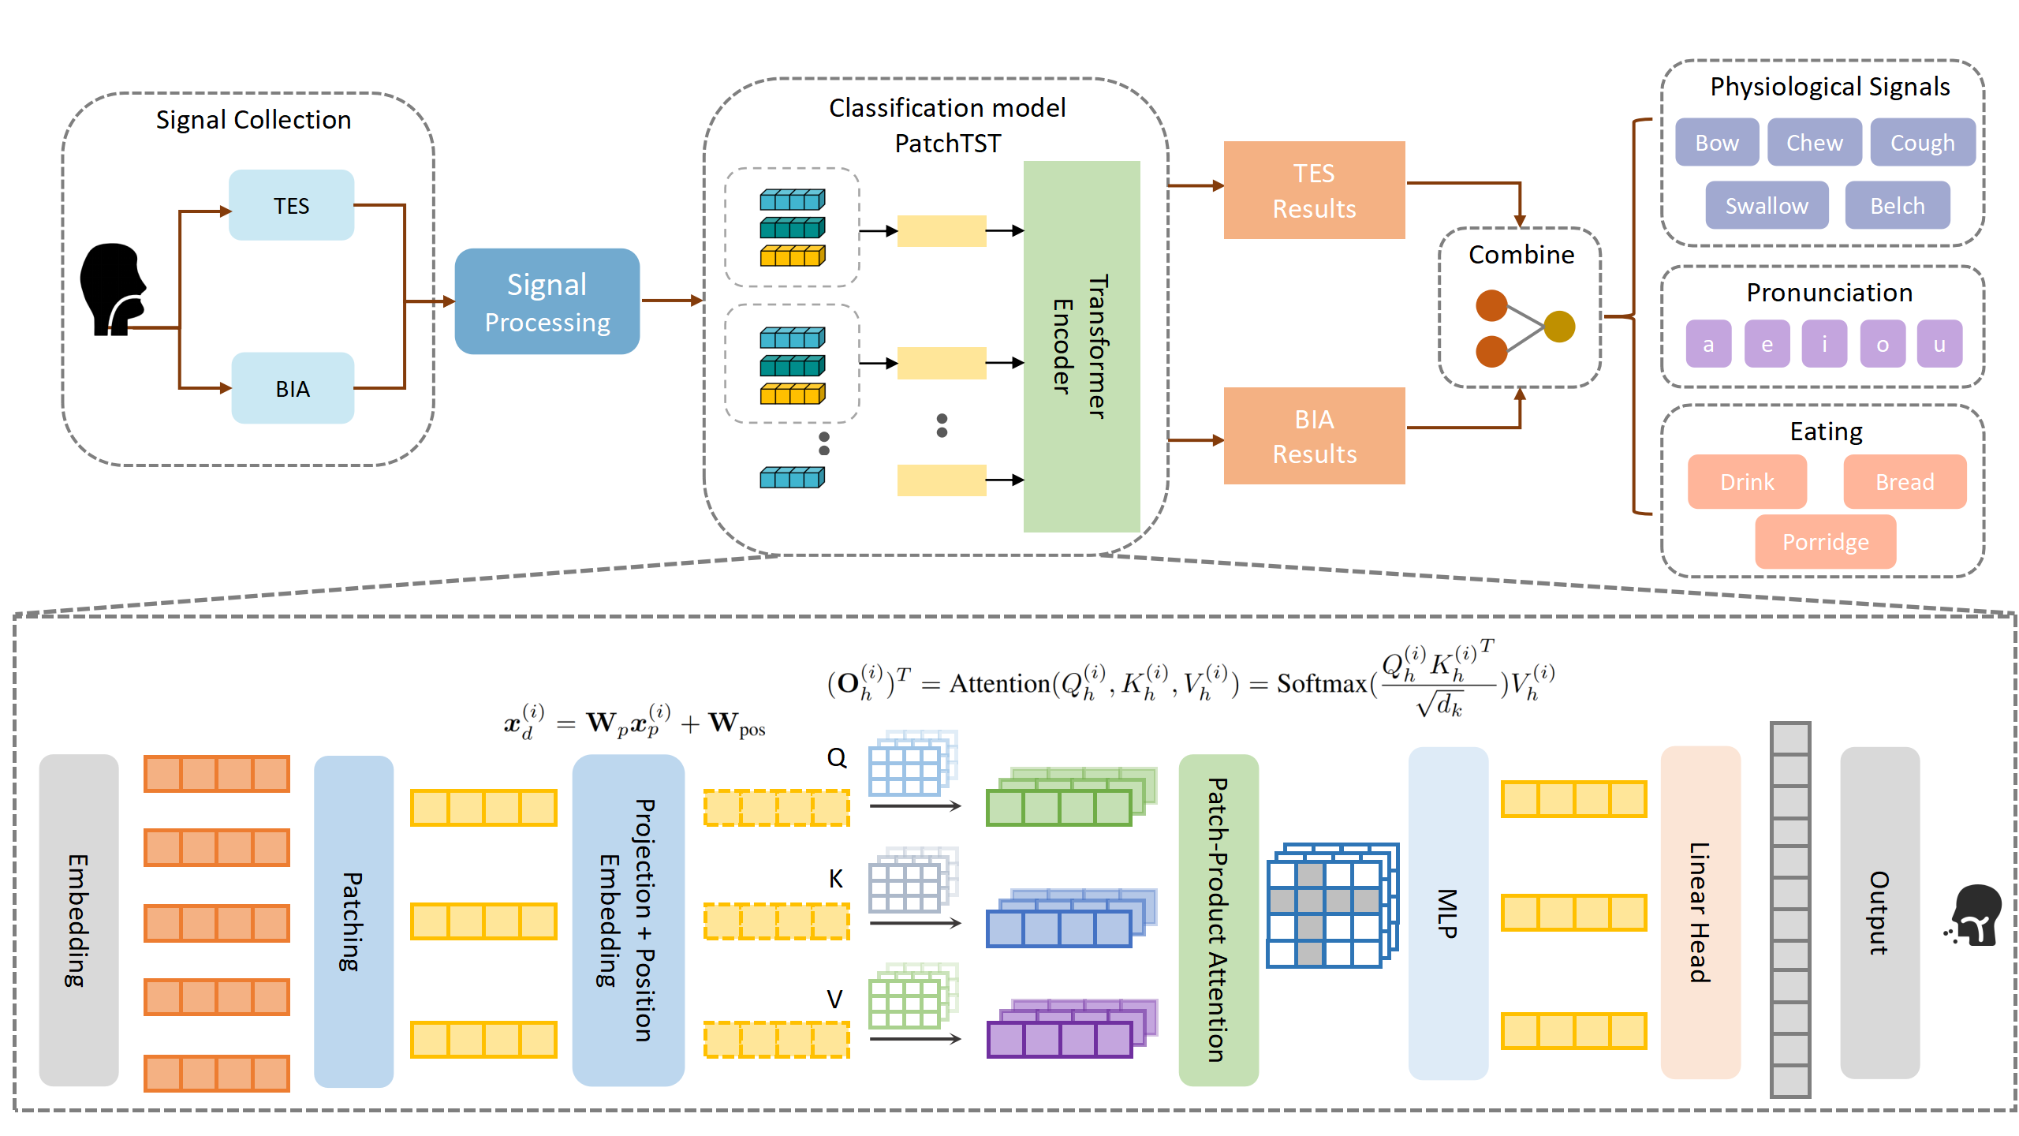
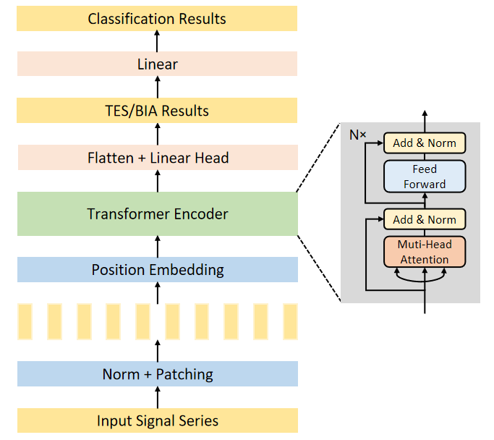
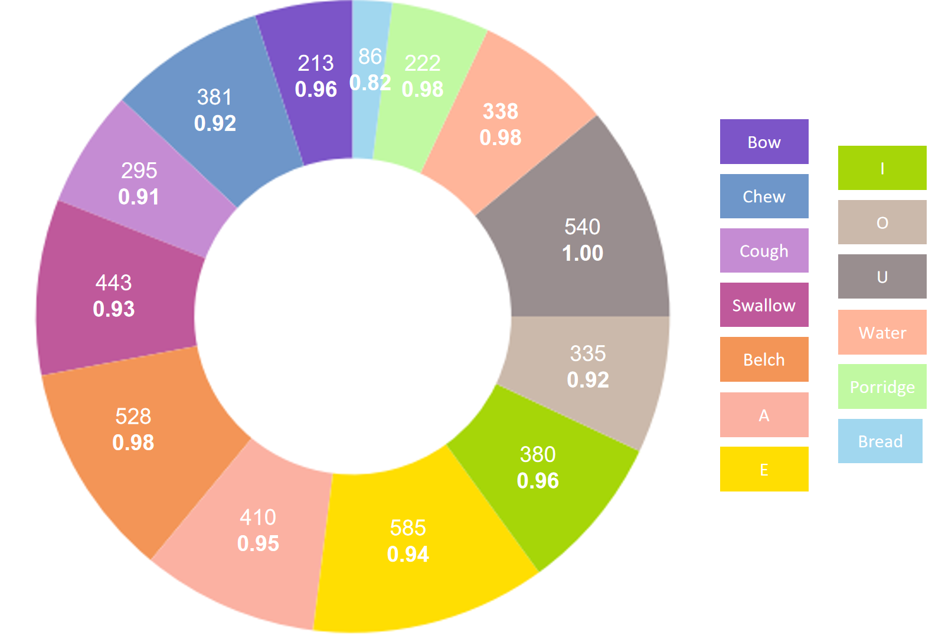
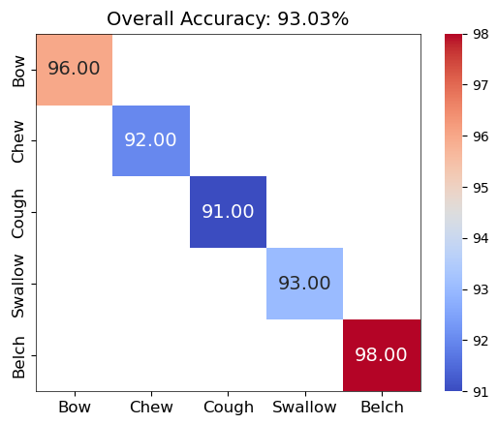

Slide 15
调一下图排版的顺序
热力图的数字放大
loss图线加粗，图表名字放大
环图分成3份，每份里面划分类别

Slide 16
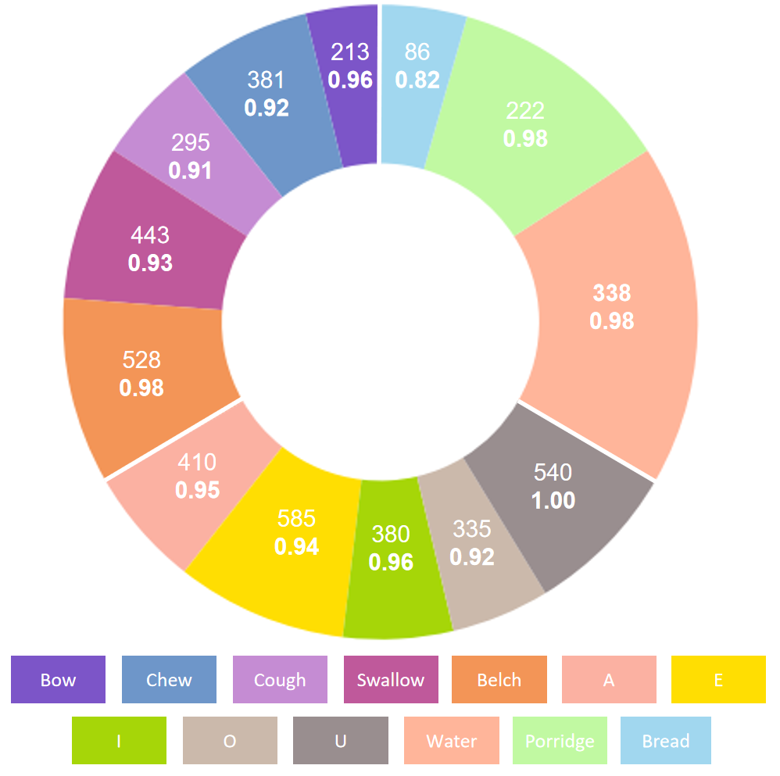
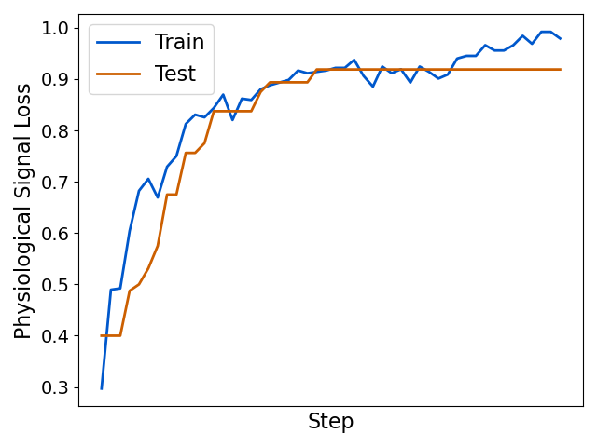
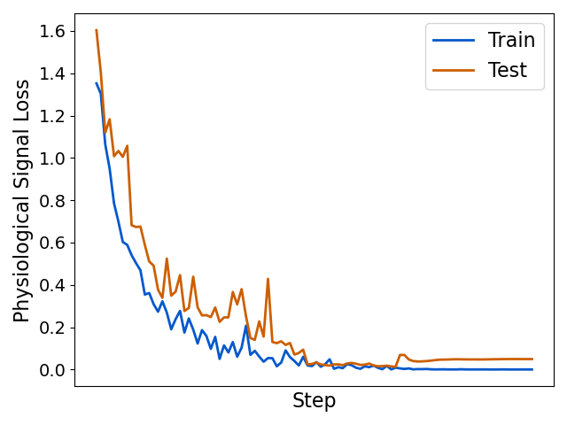

Slide 17
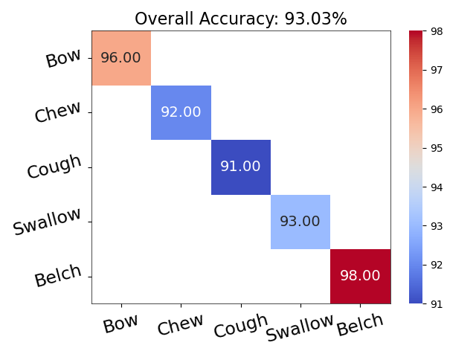
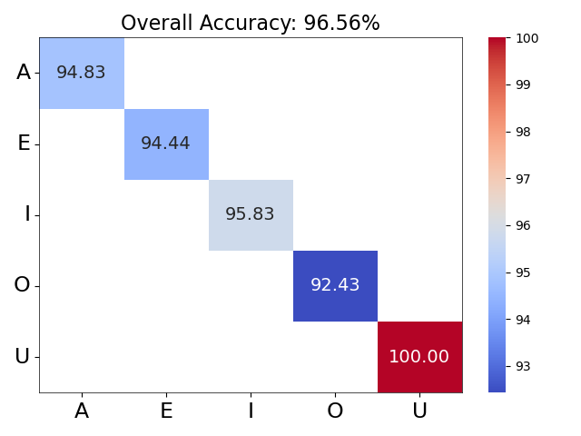
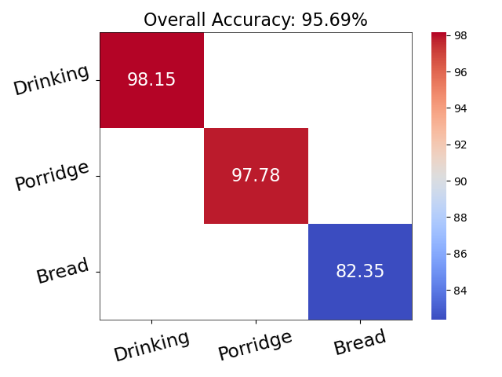
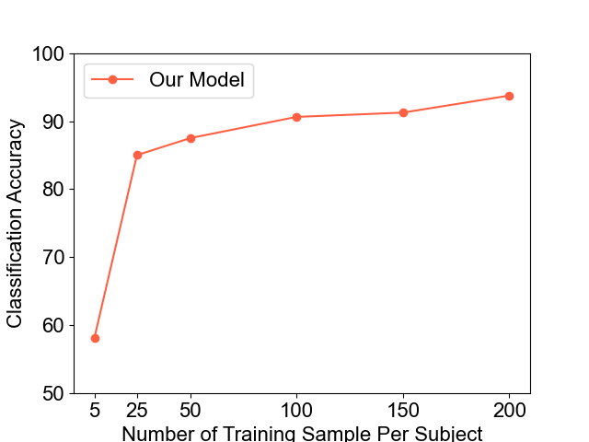

Slide 18
标题
生理动作
发音
信号
结果

