Slide 1
Weekly Report
程文胜 2020.9.21-9.27

Slide 2
Weekly Report
Abstract
Content
End

Slide 3
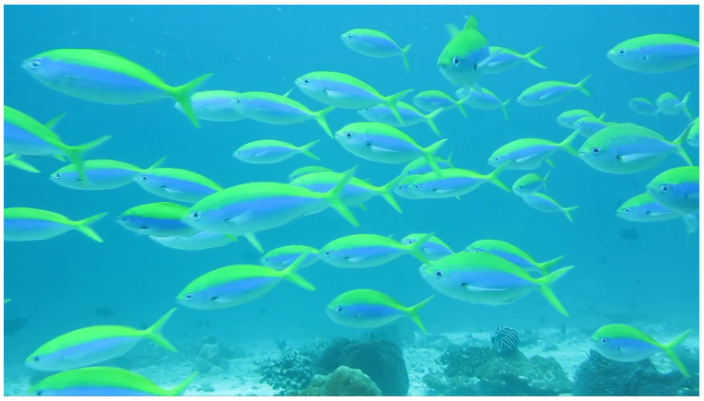
Abstract
In this week, I also put my effort on labeling the MOT images. I finished labeling the fish-2 sequence. This sequence is difficult even for human.

Slide 4
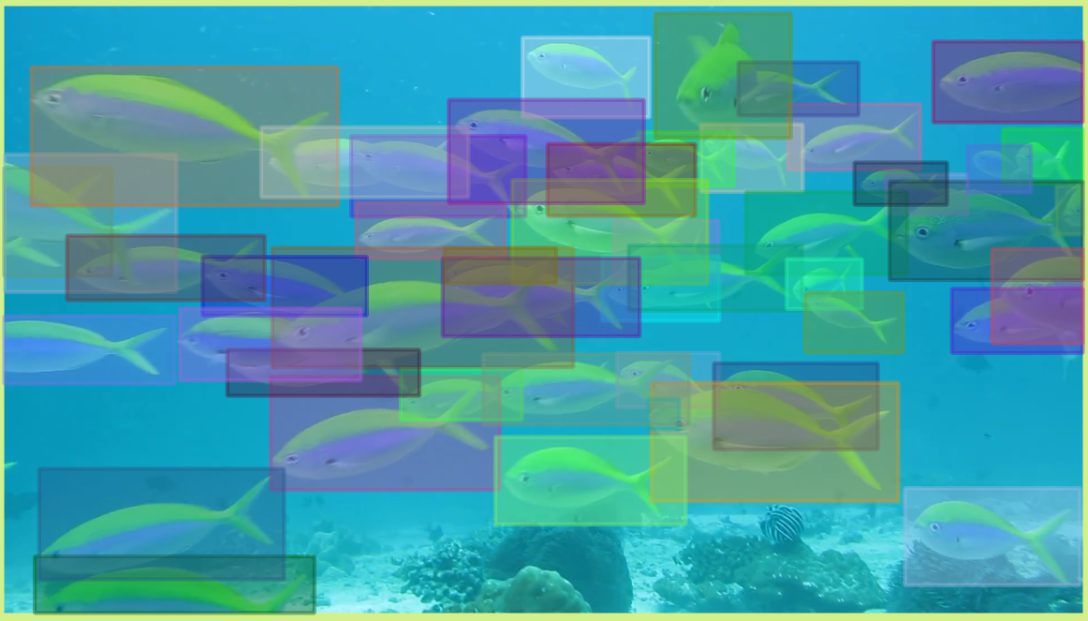
Content
Occlusion is the main issue for this sequence. Due to the view angle, many fishes would be occluded by the fish closer to the camera, and then we can only see part of its body.

Slide 5
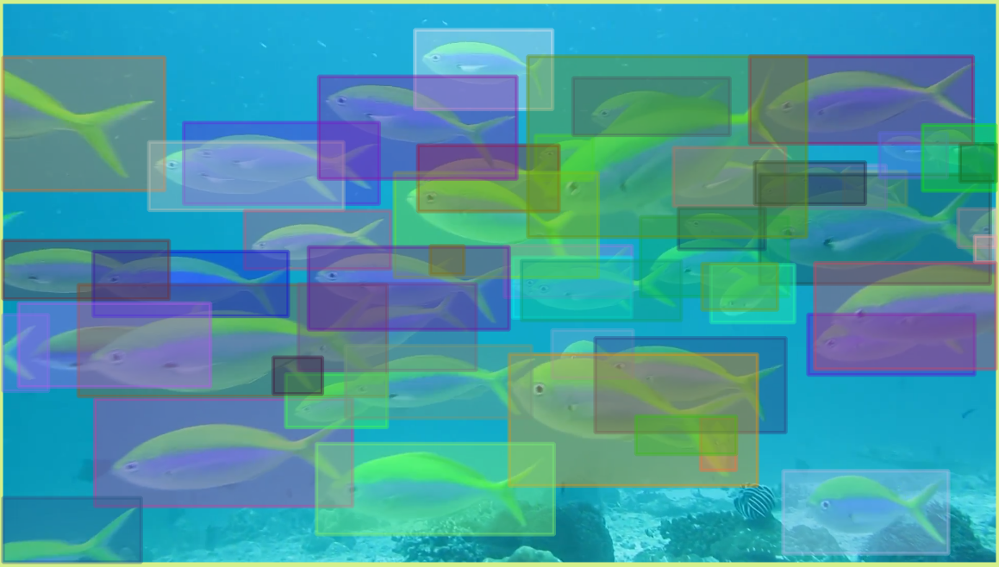
Content
Another reason is the size of fishes varies largely. Unlike goat sequence, whose occlusion are most partial due to their similar size, the fish sequence have many full occlusion, i.e., small fishes would frequently fully occluded by bigger fish. This requires methods to reconnect tracklets.

Slide 6
Report End
程文胜 9.27

