Slide 1
Weekly Report
程文胜 2020.3.14-3.20

Slide 2
Weekly Report
Abstract
Content
End

Slide 3
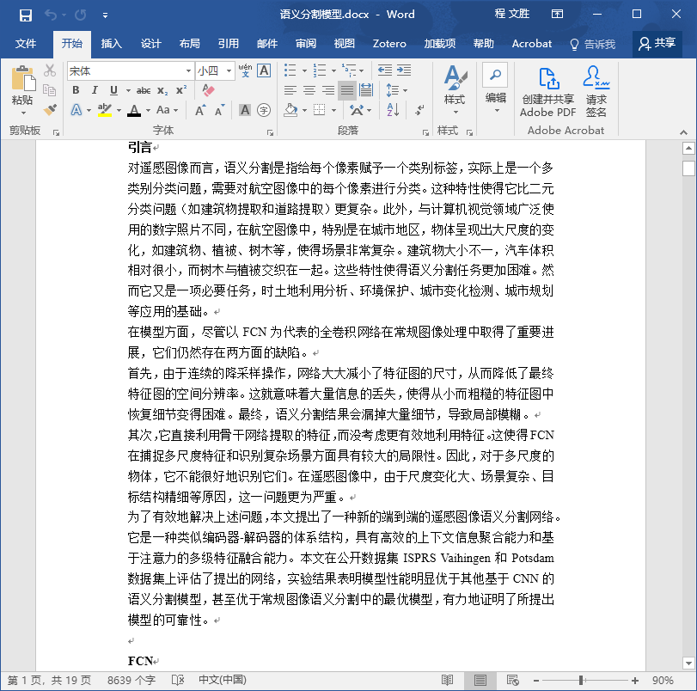
Abstract
This week I mainly put my effort on writing thesis, and adjusting Lei Xu’s paper for journal.

Slide 4
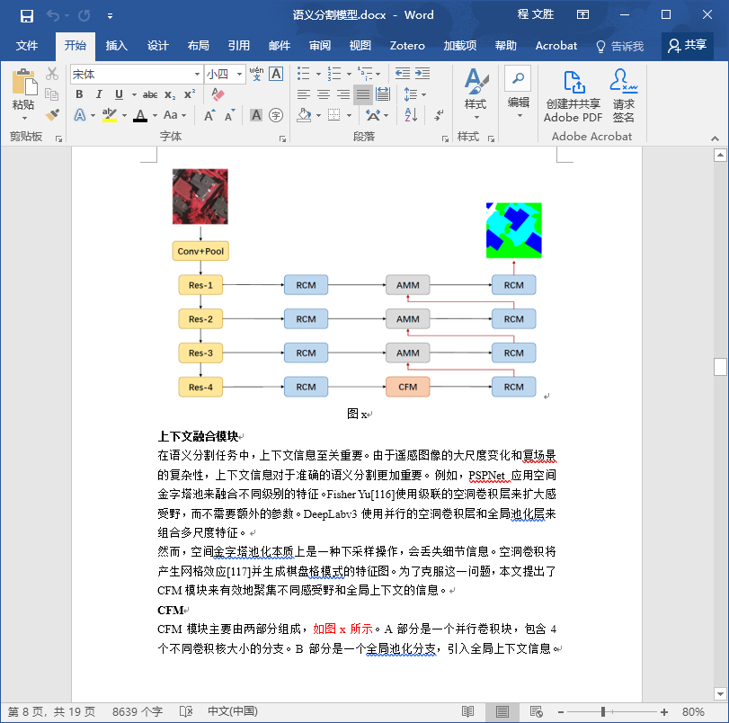
Content
I mainly pay attention to the semantic segmentation part of my thesis this week. Next week I would work on the change detection part.

Slide 5
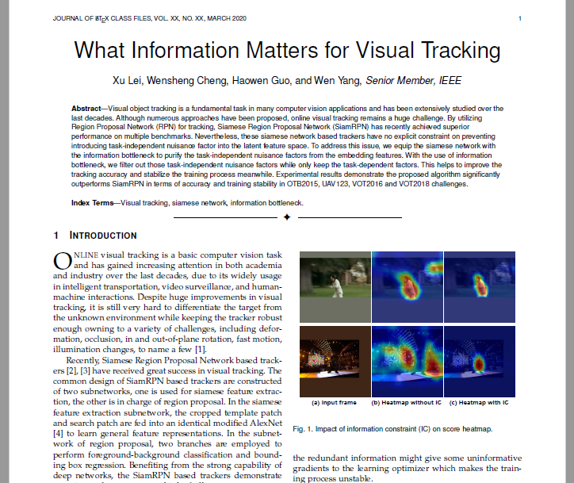
Content
I also work on Lei Xu’s paper to transform it to the journal version. I think we may need to find somebody else to help us to further revise the paper. Also, a IEEE Fellow’s name night be helpful.

Slide 6
Report End
程文胜 VIPG

