Slide 1
Weekly Report
程文胜 2021.2.1-2.7

Slide 2
Weekly Report
Abstract
Content
End

Slide 3
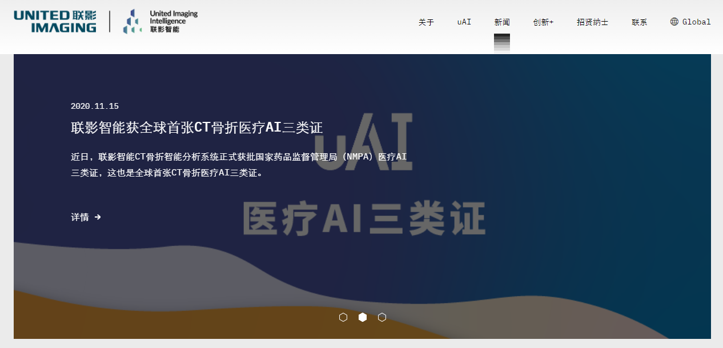
Abstract
Last week I mainly spent time on getting familiar with company rules and devices, and checking MOT metrics in detail.

Slide 4

Content
I started my internship on this Monday. I spent some time on getting familiar with company rules, like intranet and extranet. We have 10 GPUs with Docker in total for our team, which seems enough.

Slide 5
Content
I also checked MOT challenge datasets in detail, as well as CLEAR metric, IDF1 metric, and HOTA metric. MOT16/17 has visibility annotation, which is used to decide occlusion situation. This is not included in our GMOT dataset. But I feel it’s ok, since current metrics, including the latest HOTA, don’t actually use the information. I also found a numeric bug of HOTA when testing its code and reported it to its author.

Slide 6
Report End
程文胜 2.7

