Slide 1
Weekly Report
程文胜 2019.11.18-11.22

Slide 2
Weekly Report
Abstract
Content
End

Slide 3
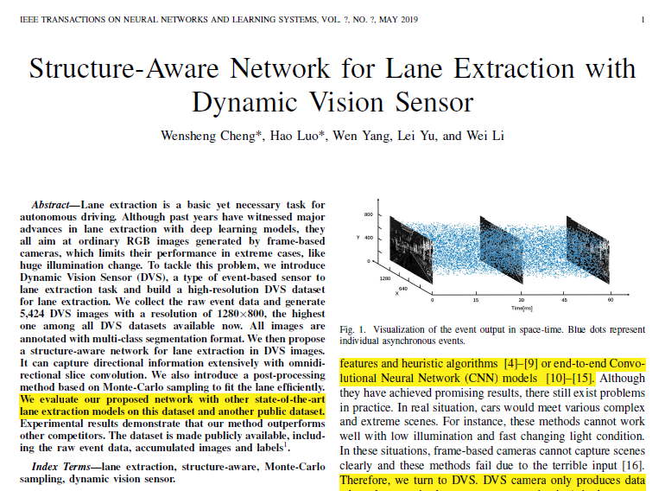
Abstract
This week I mainly put my effort on revising TNNLS journal paper.

Slide 4
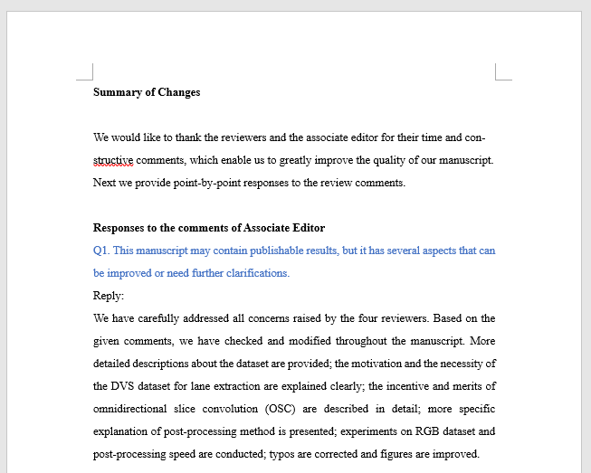
Content
We first wrote text responses to associate editor and reviewers. Then we revised the text to make the language less aggressive.

Slide 5
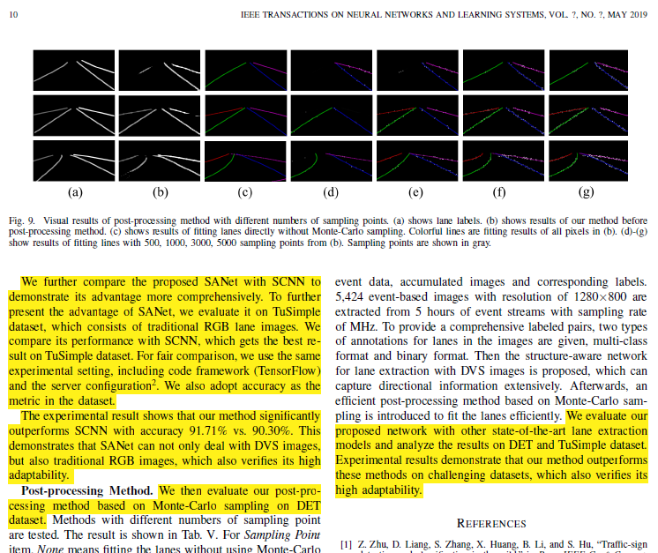
Content
About experiments, we have conducted two experiments required by reviewers. The experiment on RGB image dataset was done as expected, while the experiment of post-processing accuracy didn’t work. Because the post-processing method didn’t fit the lanes well in some situations.

Slide 6
Report End
程文胜 VIPG

