Slide 1
Weekly Report
程文胜 2021.6.27-7.6

Slide 2
Weekly Report
Abstract
Content
End

Slide 3
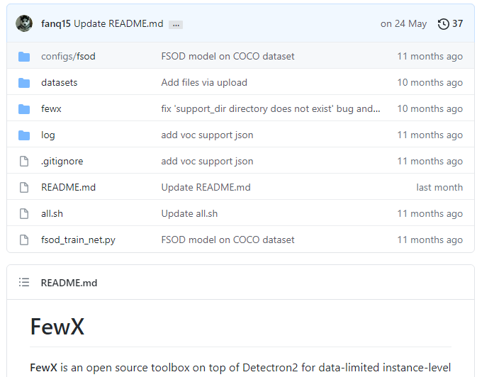
Abstract
Last week I mainly spent time on running few shot object detection method on our dataset and doing corresponding evaluation.

Slide 4
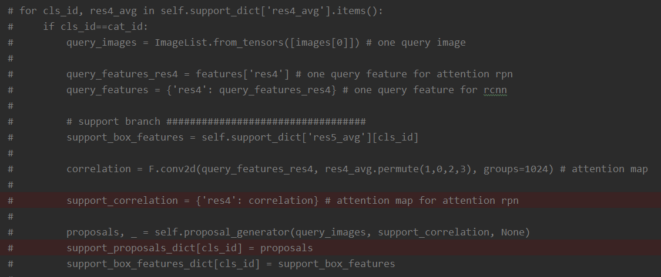
Content
Different with general few shot object detection task, we only need to detect one class for one given sequence, since the template comes from the sequence.

Slide 5
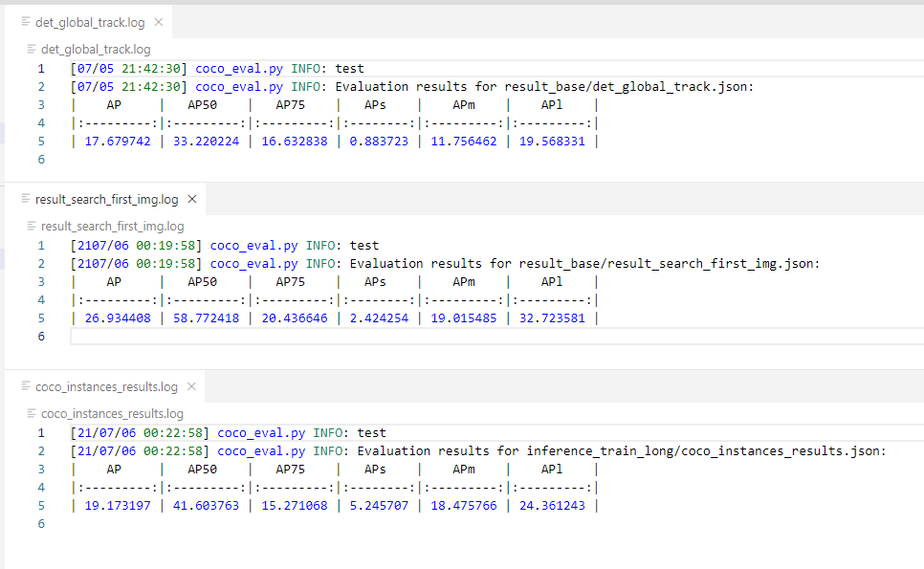
Content

Slide 6
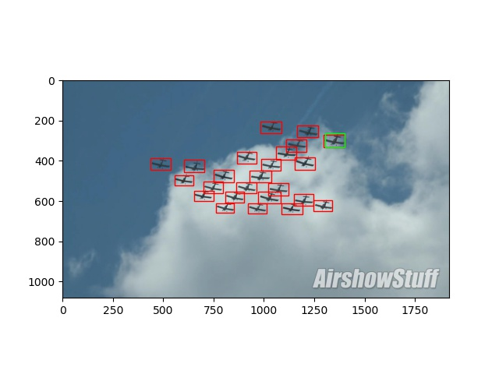
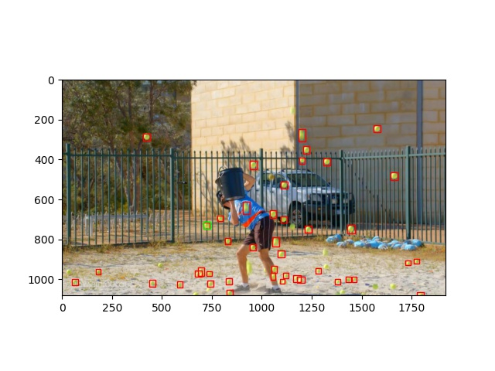
Content

Slide 7
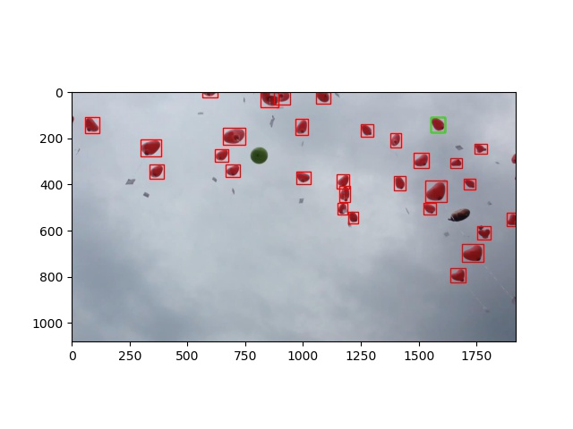
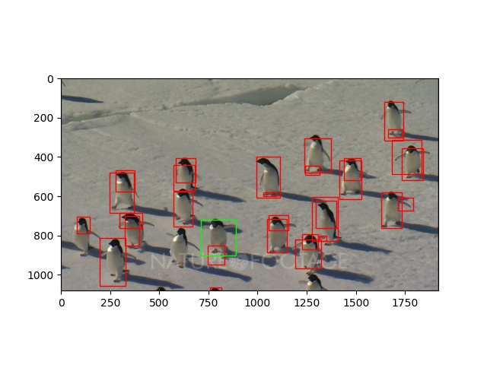
Content

Slide 8
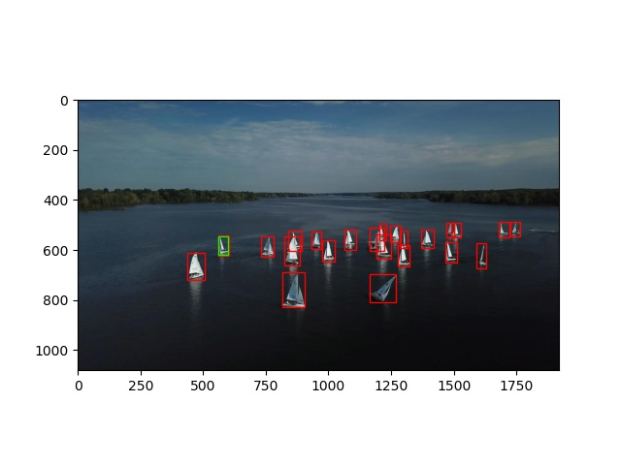
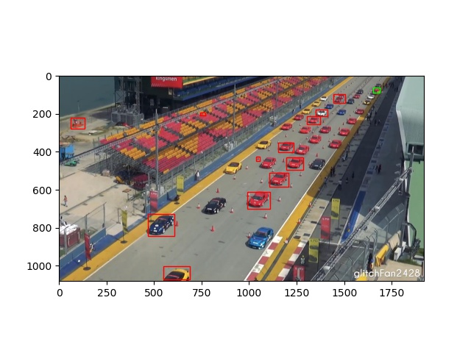
Content

Slide 9
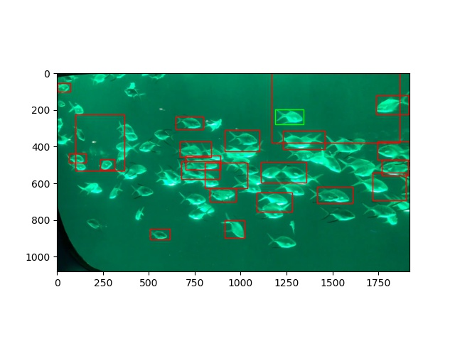
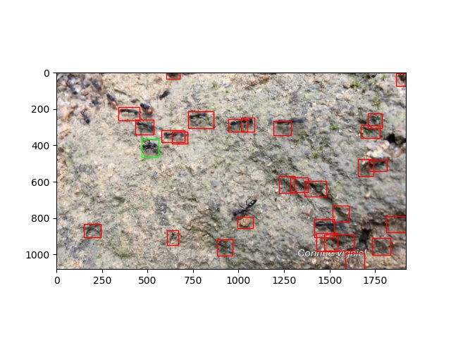
Content

Slide 10
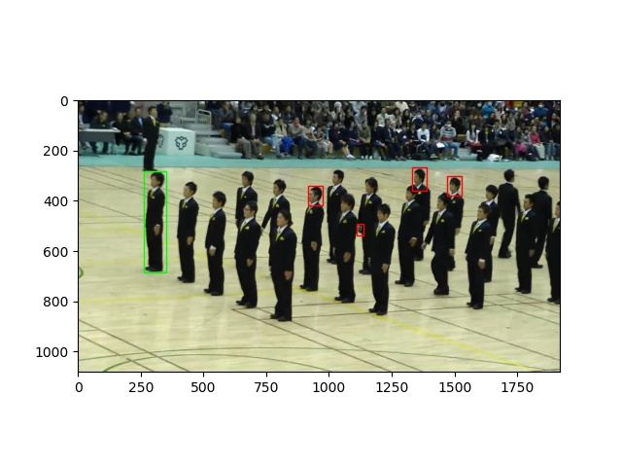
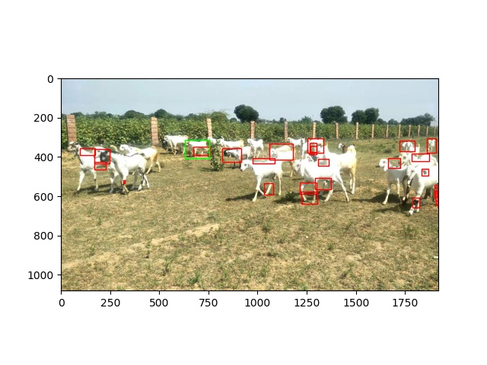
Content

Slide 11
Report End
程文胜 7.6

