Slide 1
Weekly Report
程文胜 2021.7.13-7.19

Slide 2
Weekly Report
Abstract
Content
End

Slide 3
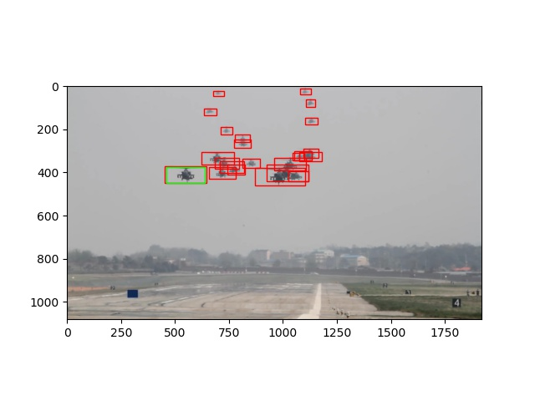
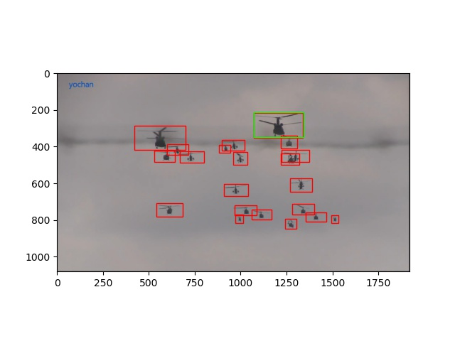
Abstract
Last week I mainly spent time on writing problem definition and running experiments of non-class-overlap setting.

Slide 4
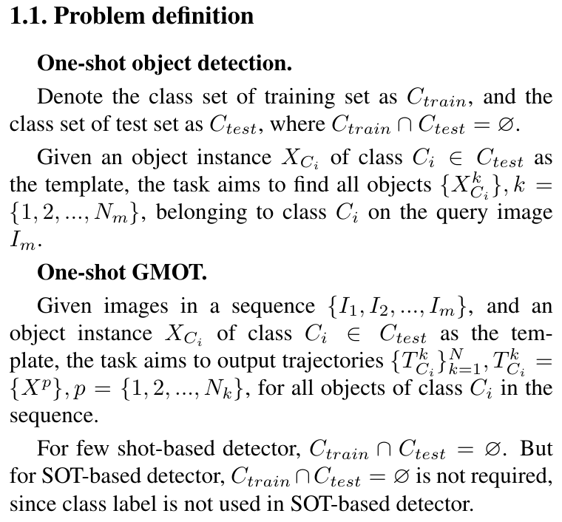
Problem Definition
The problem definition is shown below.

Slide 5
Result on training sequences(go to folder)
Go to local file folder

Slide 6
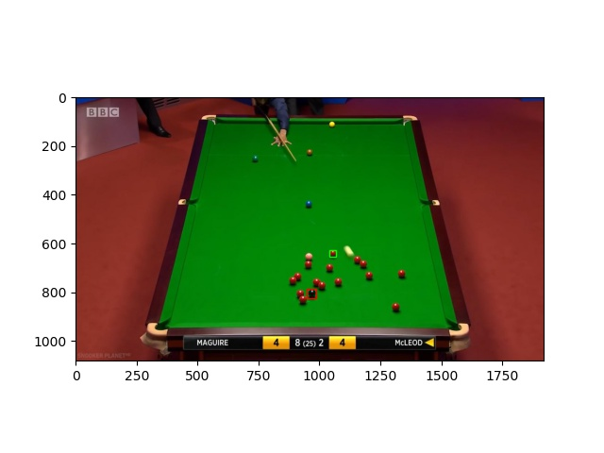
Result on test sequences
Go local file folder

Slide 7
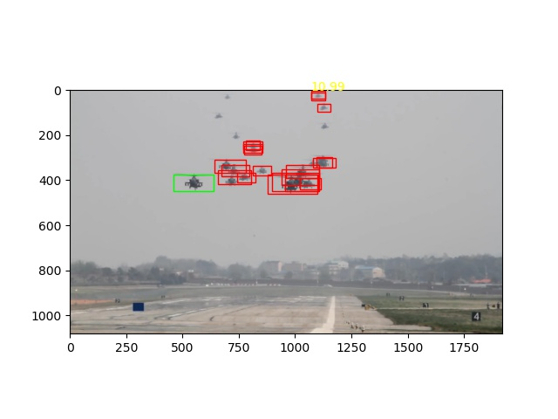
RPN on training sequences
Go to local file folder

Slide 8

RPN on test sequences
Go to local file folder

Slide 9
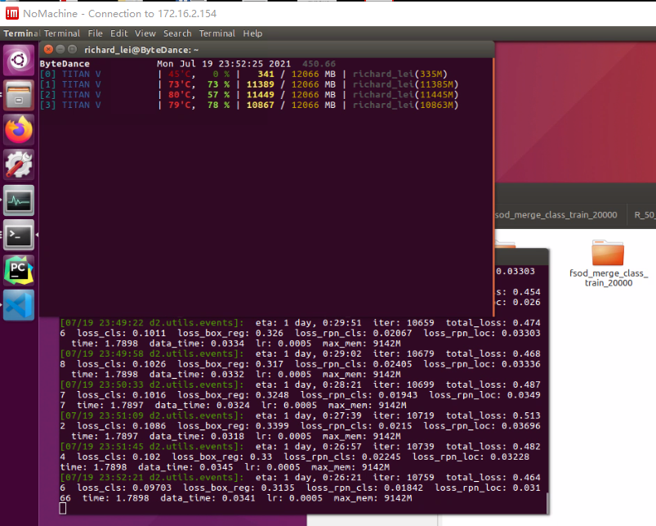
Training with merge class

Slide 10
Report End
程文胜 7.19

