Slide 1
Weekly Report
程文胜 2019.4.21-2019.5.4

Slide 2
Weekly Report
Abstract
Content
Discussion

Slide 3
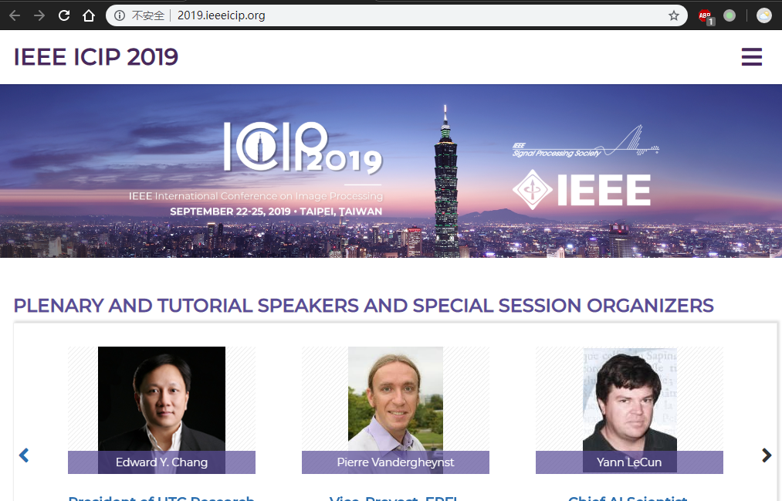
Abstract
This week I mainly put my effort on expanding the workshop paper and applying for ICIP travel grant.

Slide 4
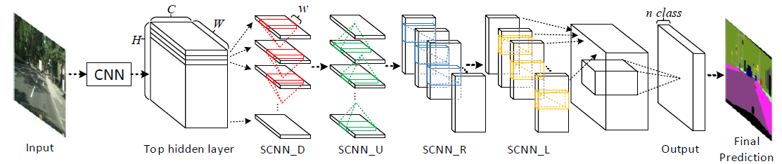
Content
About workshop paper, we consider to do more work of lane segmentation algorithm itself. We plan to adjust the best lane detection model-SCNN directly. We have tried attention mechanism and RNN along diagonal direction. The lane accuracy did arise, however, we then found that this metric is biased and we should use mIoU as a balanced metric.
SCNN model overview

Slide 5
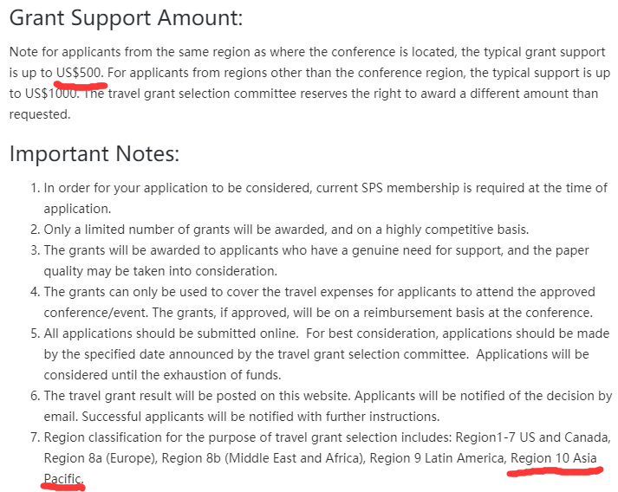
Content
About the travel grant, I have consulted Heng Zhang and submit required materials, including application form, resume, and reference letter. Since Wuhan and Taiwan are in the same region defined by SPS committee, the travel grant amount would be up to $500. The decision would be made by 14, May.

Slide 6
Discussion
The metric matters, especially when the problem isn’t defined well. The metric can guide the way of model improvement. The lane accuracy we used before only cares about precision and forces the model predict pixel as lane. This lowers the accuracy of background prediction. So the overall performance dropped down.
I plan to revise ICIP paper following comments of reviewers. It has to be uploaded by 15, May. The system further requires a response to reviwers’ comments one by one. I would also keep an eye on the registration, since authors need to register by 15, May.

Slide 7
Report End
程文胜 VIPG

