Slide 1
Weekly Report
Wensheng Cheng
2022.4.24-5.1

Slide 2
Last discussion
Rethink our GMOT task.
Problem formulation.
Method pipeline.
Key points/challenges.

Slide 3
This week
Evaluate previous models on more specific metrics to decide on which model should be used as the detection results for graph input
Graph construction discussion: node/edge
Problem formulation correction
Problem’s unique property

Slide 4
Evaluation
Mainly evaluate previous modes on TP, FP, FN, Pre, Rec.
 | search_iterative_all_frame iter_2 | train_l_test_40_iter_2 no_post_process | train_l_test_40_iter_2 instance_nms_th_05
AP | 22.23 | 29.11 | 27.13
AP50 | 46.73 | 64.33 | 60.05
AP75 | 18.38 | 22.71 | 21.98
TP | 123930 | 201251 | 168560
FP | 34075 | 715686 | 142737
FN | 132411 | 55090 | 87781
Rec | 53.47 | 81.51 | 67.91
Pre | 79.10 | 24.89 | 56.69

Slide 5
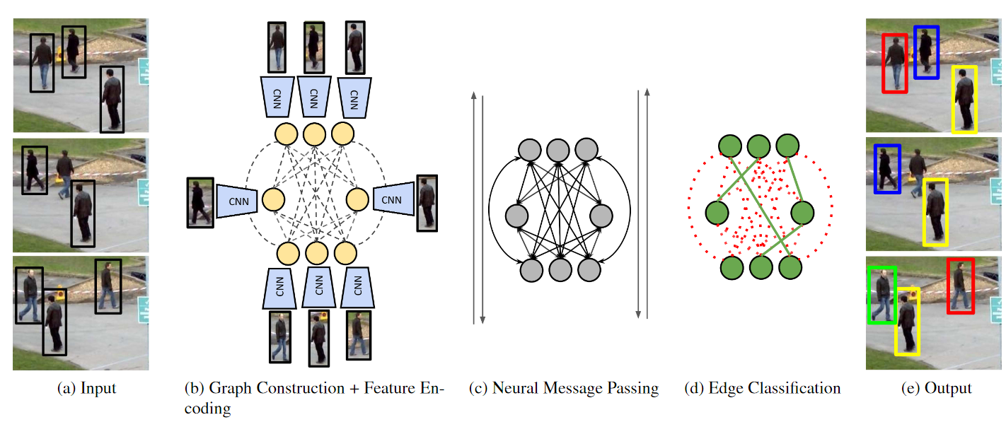
Graph Construction-A
Build a bipartite graph, node is object, edge is association.
Model association as a edge classification task.
Learning a Neural Solver for Multiple Object Tracking. CVPR 2020.

Slide 6
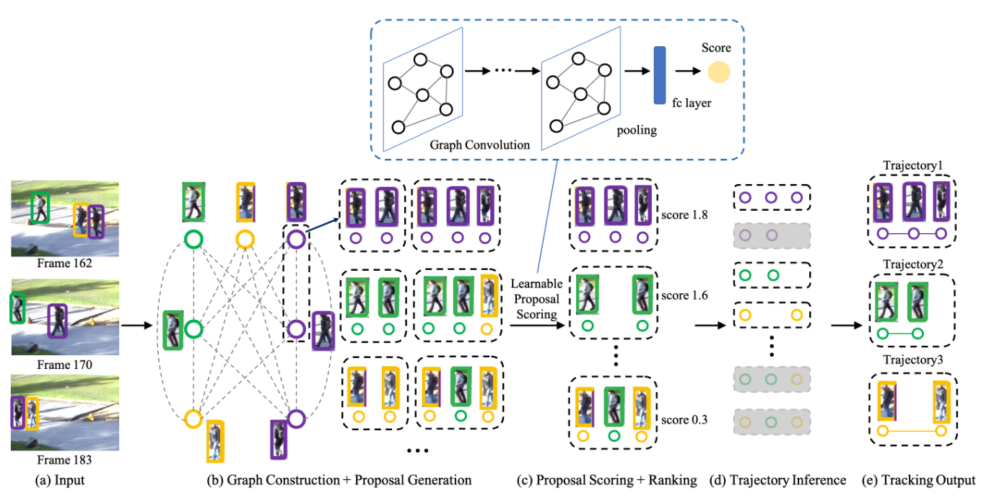
Graph Construction-B
Build a bipartite graph, node is object, edge is association.
Model association as a edge classification task.
Extra GCN model to get trajectory score.
Learning a Proposal Classifier for Multiple Object Tracking. CVPR 2021.

Slide 7
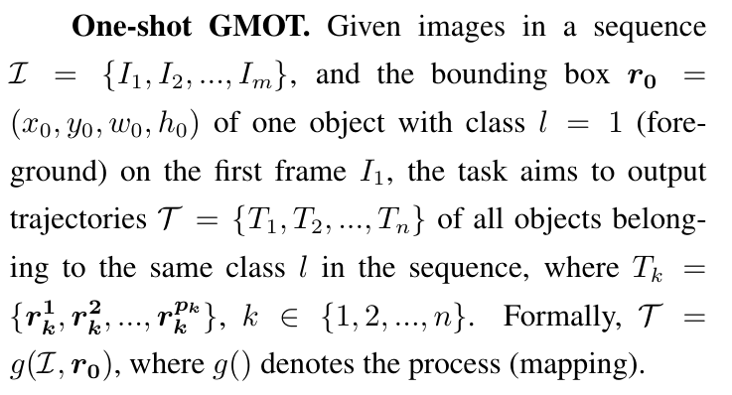
Problem Formulation
Below is the corrected problem formulation for the GMOT task.

Slide 8
Unique Property
Below shows properties different from normal MOT task.
One shot detection process: we may not pay much attention on this, since it’s too general. But we could add some constraints specific for our task.
Crowd condition: we need to take use of this condition to make improvements on data association, like removing FP on single image, removing FP based on tracklet similarity, build models in unsupervised way, etc.
Challenge/Goal: how to fully take use of the crowd condition, especially build unsupervised models based on the crowd condition.

Slide 9
End
End and Thanks!

