Slide 1
Weekly Report
Wensheng Cheng
2022.5.1-5.9

Slide 2
Last discussion
Evaluate previous models on more specific metrics to decide on which model should be used as the detection results for graph input
Graph construction discussion: node/edge
Problem formulation correction
Problem’s unique property

Slide 3
This week
Extract box features from the trained detector, and take them as the node features.
All nodes are connected to others to form fully connected graph. Two consecutive frames are taken as inputs for now. Edge weights are the cos similarity between features of two nodes.
Loss A: for nodes with same labels of the template, make them also have similar graph embeddings with the template.
Result: didn’t work in principle, since the last classification layer would not be supervised in this way.
Loss B: for nodes with similar graph embeddings, make them have similar classification probability.
Result: could supervise the classification layer, but the graph embeddings of all nodes are already similar in the start.

Slide 4
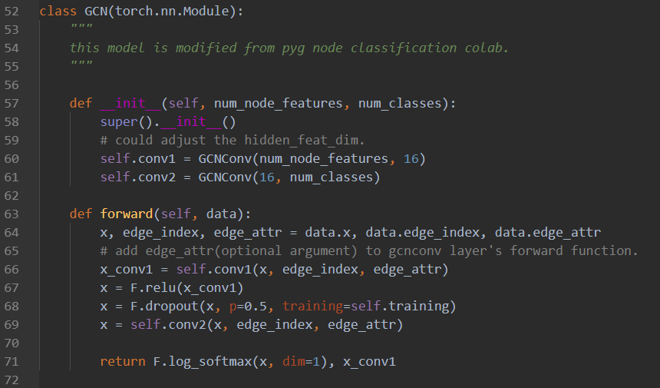
Graph Definition
The GNN is based on GCN layer, and the task is node classification. I use the PyG framework.

Slide 5
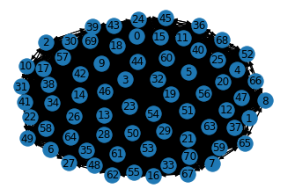
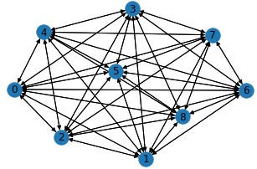
Graph Definition
Each node is connected to all other nodes. The edge weight is the cos similarity of node input features. The graph is undirected and is shown below.
Node=9
Node=71

Slide 6
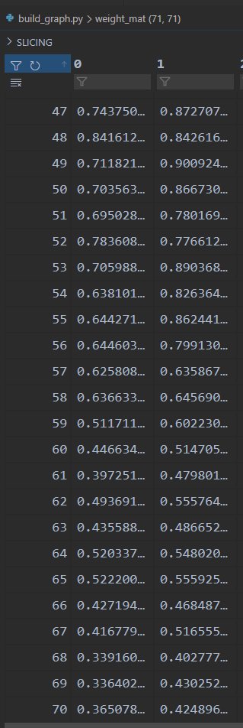
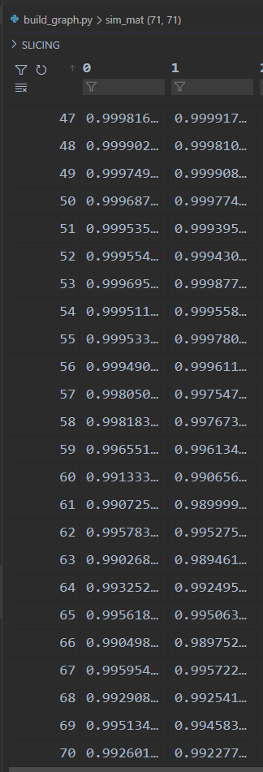
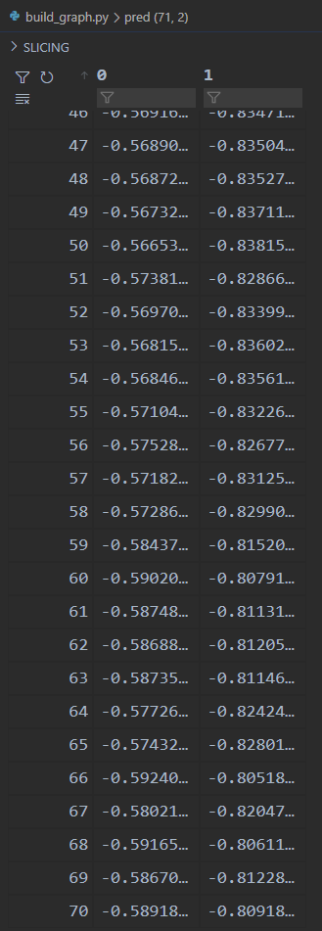
Loss B
For nodes with different features, the intermediate graph embeddings are similar, and the final prediction probabilities are also similar.
Input feat
Graph feat
Classification Prob

Slide 7
Thoughts
Maybe caused by fully connected way, try to use KNN to only connect one node to is neighbors.
If we relax the assumption, i.e, assume pseudo labels with top confidence are good enough, we may deal the problem with label propagation methods, since we now have several labels available.

Slide 8
End
End and Thanks!

