Slide 1
Weekly Report
程文胜 2019.12.21-12.27

Slide 2
Weekly Report
Abstract
Content
End

Slide 3
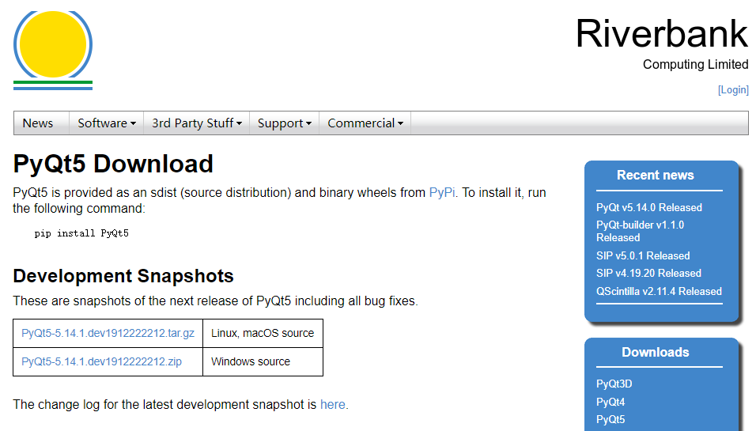
Abstract
This week I continued to work on the pyqt5 GUI software.

Slide 4
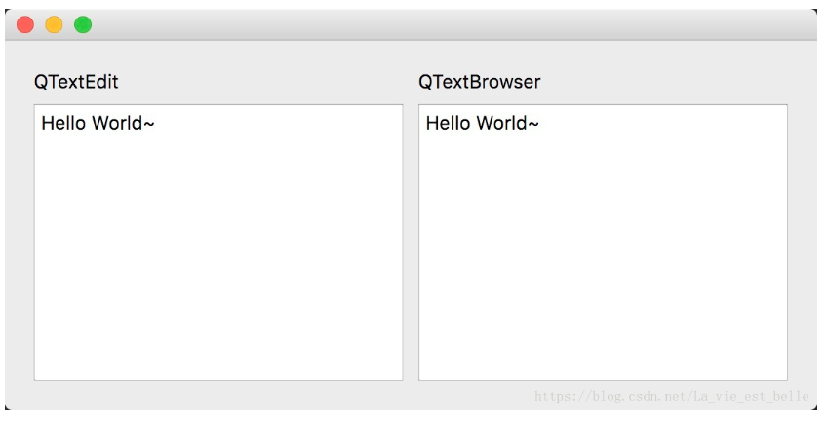
Content
To view the software logs, I plan to add a Qtextbrowser widget to show the history of operations. Contents on the right side can not be changed, while the left one could be modified.

Slide 5
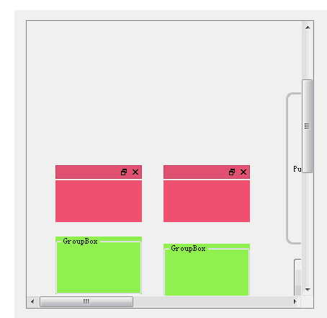
Content
I also plan to add a central widget to the Qmainwindow, which is used to display images. Since these remote sensing images are large, I also need to put them into a small window, and I found Qscrollarea class could be used for this function. When the image is too large, it would create scroll bars for us to slide and view the whole image.

Slide 6
Report End
程文胜 VIPG

