Slide 1
Weekly Report
程文胜 2021.4.5-4.13

Slide 2
Weekly Report
Abstract
Content
End

Slide 3
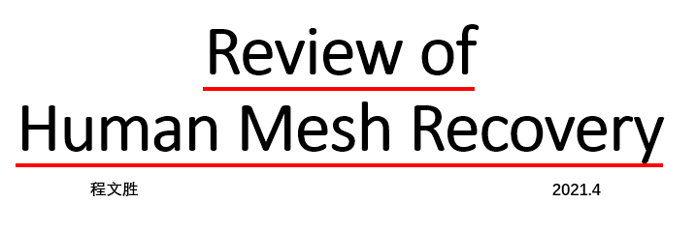
Abstract
Last week I mainly spent time on preparing the literature review of human mesh recovery, and discussing new topic with senior Fan Yang.

Slide 4
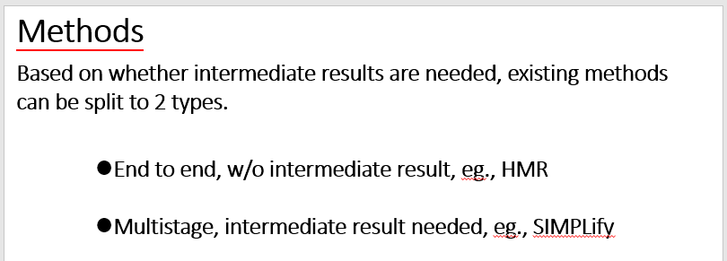
Content
Following our old plan, I made a literature review of human mesh recovery in our team, and discussed related content with audience.

Slide 5
Content
I discussed with Fan Yang about the idea we thought about in previous weeks, which is use 2D person segmentation to refine mesh, with the hypothesis that the 2D person segmentation is noisy, and our focus is how to refine the 2D person segmentation result.
Then after some experiments, we found that the idea is not solid, i.e., the hypothesis is not true. We found that existing part segmentation methods can do well on nesh dataset (human 3.6M), and even fat people.

Slide 6
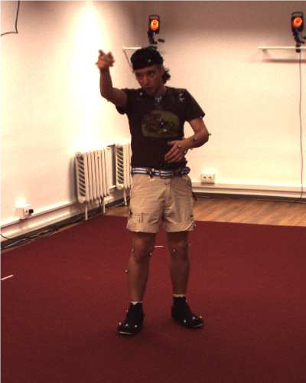
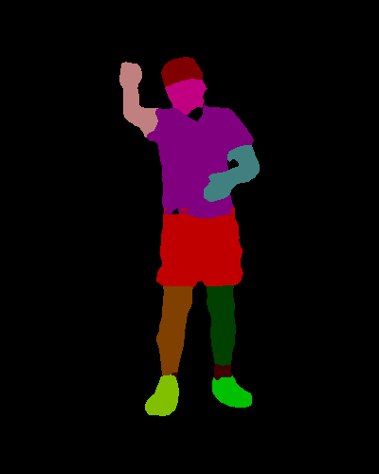
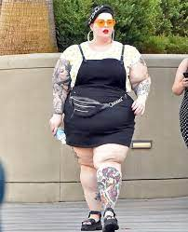
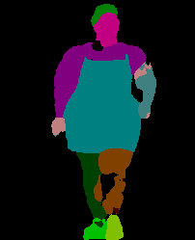
Content
Part segmentation result

Slide 7
Content
After in-depth discussion with Fan Yang, we think that it seems there are not many low-hanging fruits in this area. Based on our experience, we plan to turn to a more familiar topic, one-shot GMOT task. This seems more practical and many methods could be tried in this new field. We plan to work on it in following weeks.
My main opinion for one-shot GMOT task is that the detector matters, as demonstrated in our paper. My current thought is, the main problem for our current baseline one-shot detector is missing. I think this is due to the feature variance of different instances, since those missing objects are very different from the initial target in feature space. So if we iteratively update the target bank by search result, and search objects with different targets, I think we can reduce the missing situation.

Slide 8
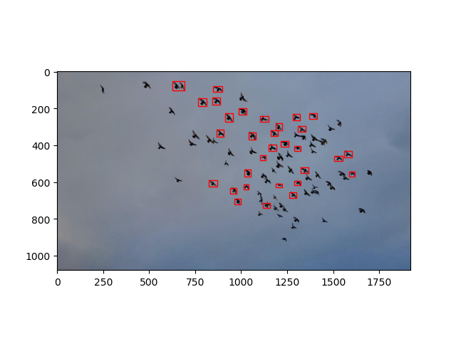
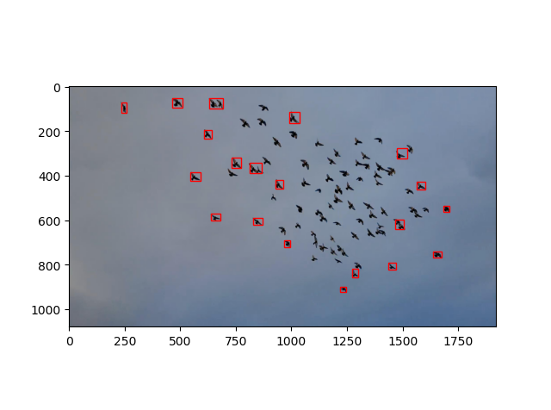
Content
Search results with different initialization boxes

Slide 9
Report End
程文胜 4.13

